Slide 1
Unified Language Model Pre-training for Natural Language Understanding and Generation
Microsoft Research
NeurIPS2019
78 Google Scholar citation
Deli Chen 2020-5-14

Slide 2
UNILM: Key Words
Pre-trained model for both text Understanding and Generation
Three types of masks: unidirectional, bidirectional, and sequence-to-sequence prediction
Employing a shared Transformer network and utilizing specific self-attention masks
Nice performance on both understanding and generation
GLUE, SQuAD 2.0, CoQA answering
CNN/Daily Mail, Gigaword, CoQA generation

Slide 3
Outline
Motivation
Method
Experiment

Slide 4
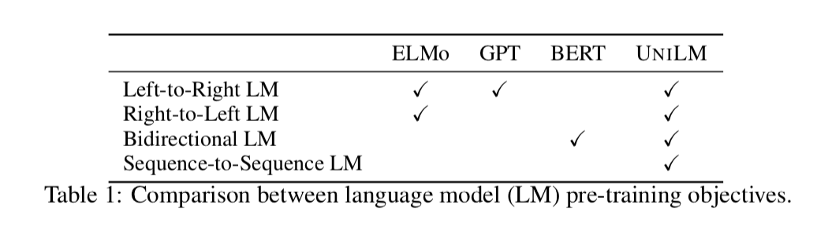
Language Model used in different work
Understanding： BERT, XLNET, ALBERT…
Generation：GPT，GPT2…

Slide 5
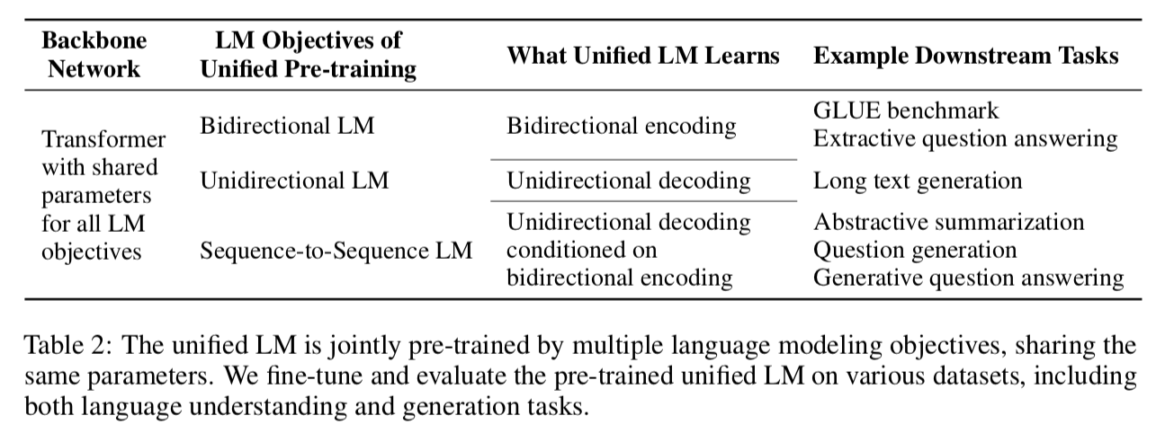
The LM objectives of UNILM

Slide 6
Advantages
A single Transformer LM that uses the shared parameters and architecture for different types of LMs;
Parameter sharing makes the learned text representations more general because they are jointly optimized for different language modeling objectives
The seq2seq mask make the model a natural choice for NLG

Slide 7
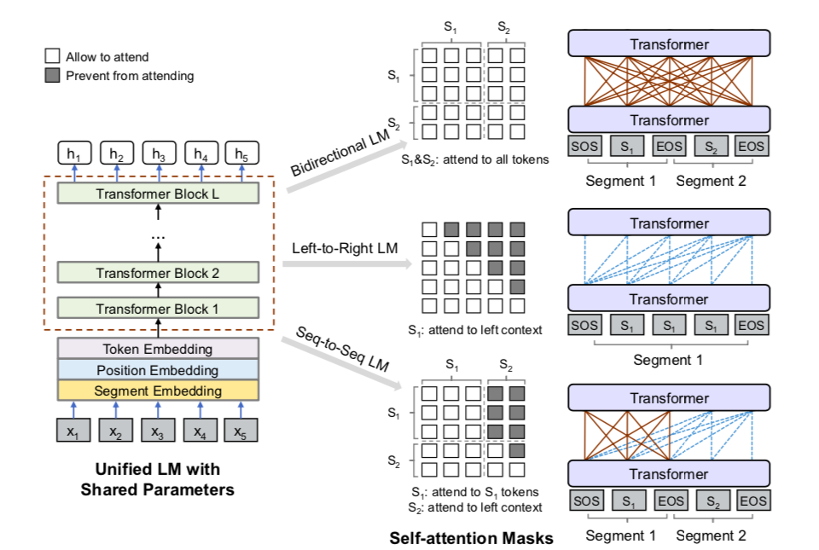
Overview of unified LM pre-training

Slide 8
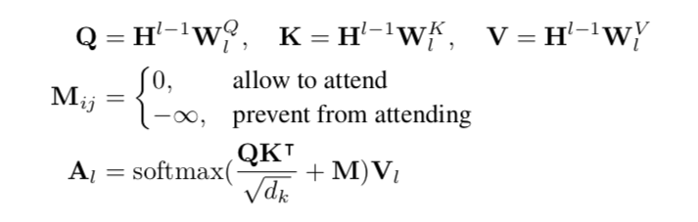
Backbone Network: Multi-Layer Transformer
We use different mask matrices M to control what context a token can attend to when computing its contextualized representation, as illustrated in Figure 1. Take bidirectional LM as an example. The elements of the mask matrix are all 0s, indicating that all the tokens have access to each other.

Slide 9
Pre-training Objectives
Unidirectional LM
left-to-right and right-to-left LM objectives are used
x1x2 [MASK] x4”, only tokens x1, x2 and itself can be used
Bidirectional LM
allows all tokens to attend to each other in prediction
encodes contextual information from both directions
Sequence-to-Sequence LM
tokens in the first (source) segment can attend to each other from both directions within the segment
tokens of the second (target) segment can only attend to the leftward context in the target segment and itself

Slide 10
Pre-training Setup1
randomly mask word with [MASK], then the model try to recover the masked token
the pair of source and target texts are packed as a contiguous input text sequence in training
within one training batch, 1/3 of the time we use the bidirectional LM objective, 1/3 of the time we employ the sequence-to-sequence LM objective, and both left-to-right and right-to-left LM objectives are sampled with rate of 1/6

Slide 11
Pre-training Setup2
UNILM is initialized by BERTLARGE, and then pre-trained using English Wikipedia2 and BookCorpus
The vocabulary size is 28, 996. The maximum length of input sequence is 512. The token masking probability is 15%.
80% of the time we replace the token with [MASK], 10% of the time with a random token, and keeping the original token for the rest
It takes about 7 hours for 10, 000 steps using 8 Nvidia Telsa V100 32GB GPU cards with mixed precision training

Slide 12
Fine-tune Setup
NLU task
we fine-tune UNILM as a bidirectional Transformer encoder
we use the encoding vector of [SOS] as the representation of input, denoted as hL1 , and feed it to a randomly initialized softmax classifier
we maximize the likelihood of the labeled training data by updating the parameters of the pre-trained LM and the added softmax classifier
NLG task
[SOS] S1 [EOS] S2 [EOS]
model is fine-tuned by masking some percentage of tokens in the target sequence at random, and learning to recover the masked words

Slide 13
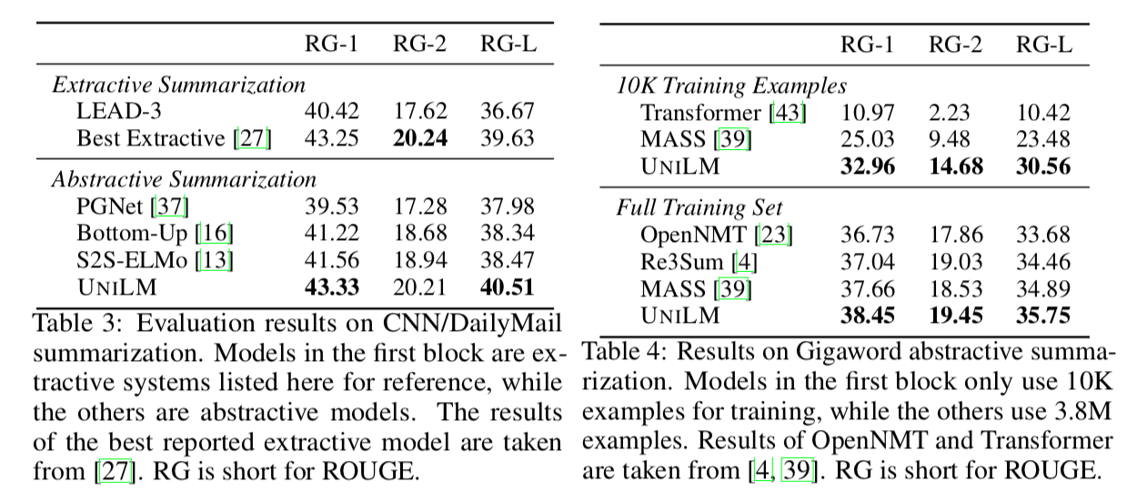
Abstractive Summarization

Slide 14
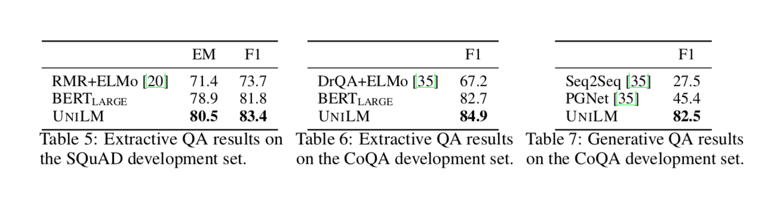
Question Answering

Slide 15
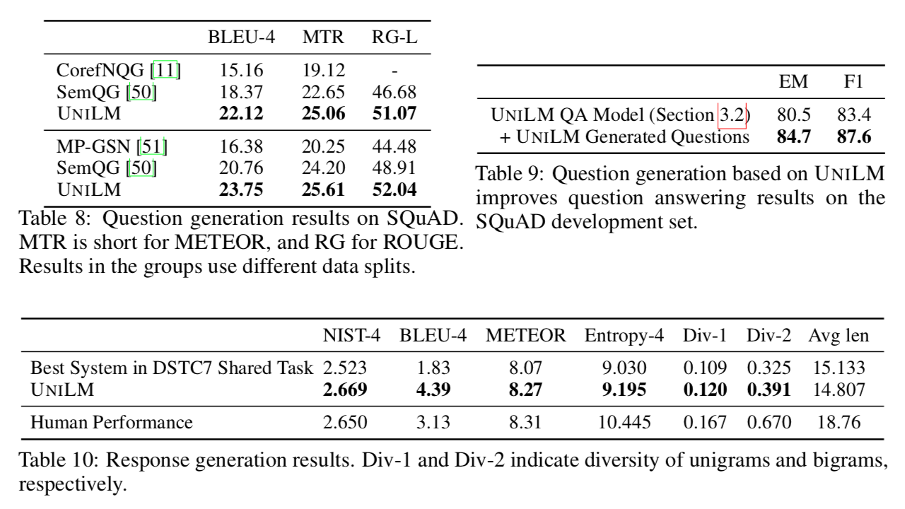
Question/Response Generation

Slide 16
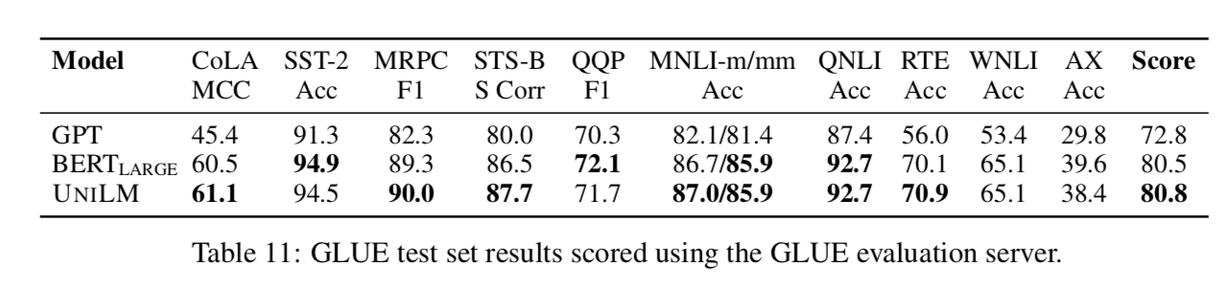
GLUE Benchmark

