Slide 1
Loss Landscapes Part 2
Edge of Stability
10/15
Make sure to go to your tutorial!

Slide 2
How to carry out assignments
It is extremely tempting to go “Chat, do this report for me”. Unfortunately, you will likely get suboptimal experiments and retain less content. Instead, plan out the experiments of interest in natural language, specifying hyperparameters as well as what relationships you’d like to see plotted. Then, you can leave implementation and job monitoring to models
Always pre-register an experiment outcome. Hypothesis generation is one of the most important parts of the scientific process, and you won’t learn anything from your experiment if you don’t have a perspective coming. Plus, every experiment you run is now free practice!

Slide 3
Overview
Today, we will study sharpness
Edge of Stability: How does the sharpness evolve over training?
  Full batch plain GD followed by modern optimizer components
  We will be closely following the tutorial at https://centralflows.github.io by Jeremy Cohen and Alex Damian
How does sharpness influence model performance when limited by data?
  Note that this will touch on concepts from the Generalization unit
Optimizing Sharpness

Slide 4
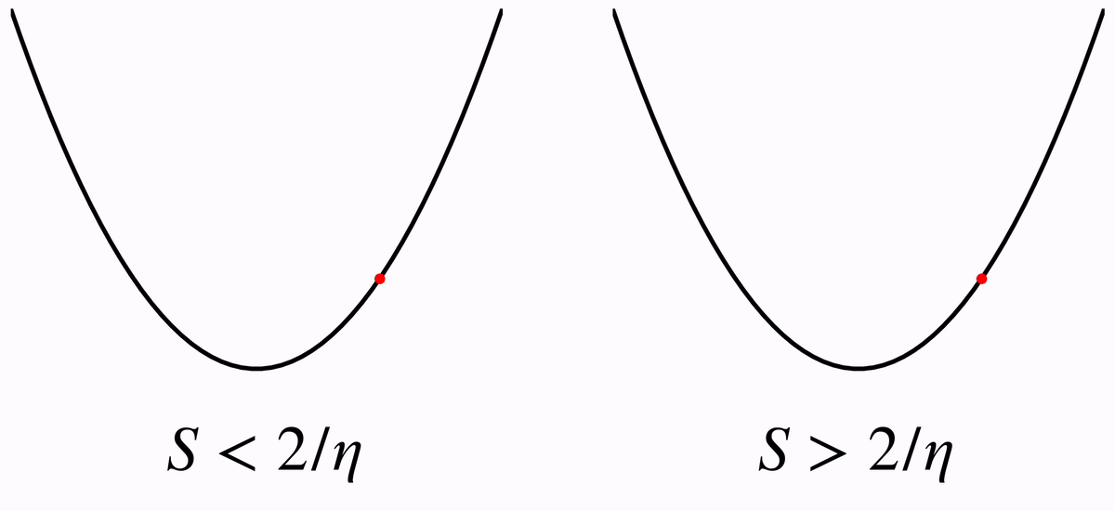
Traditional quadratic intuition
Suppose we were performing SGD on a quadratic (1/2)Sx². In this case, we must set the learning rate so that S < 2/η. Otherwise, training will diverge
Gradient Descent on Neural Networks Typically Occurs at the Edge of Stability

Slide 5
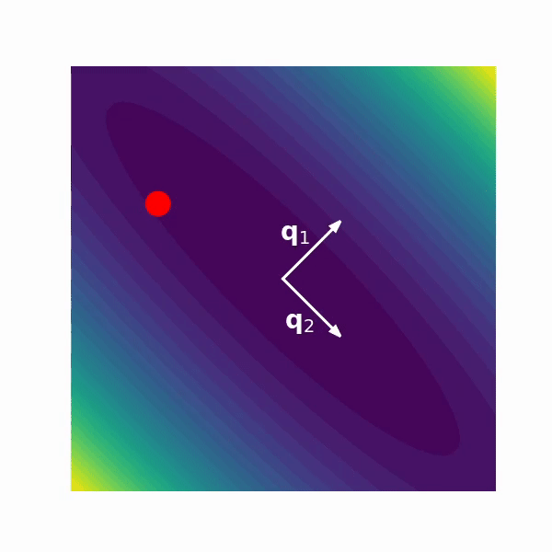
Traditional quadratic intuition
In multiple dimensions, this condition is equivalent to all the eigenvalues of the Hessian staying under 2/η. If not, one of the directions will oscillate. Recall that we had the same conditions for learning rate in the NQM with h_{i}.
Gradient Descent on Neural Networks Typically Occurs at the Edge of Stability

Slide 6
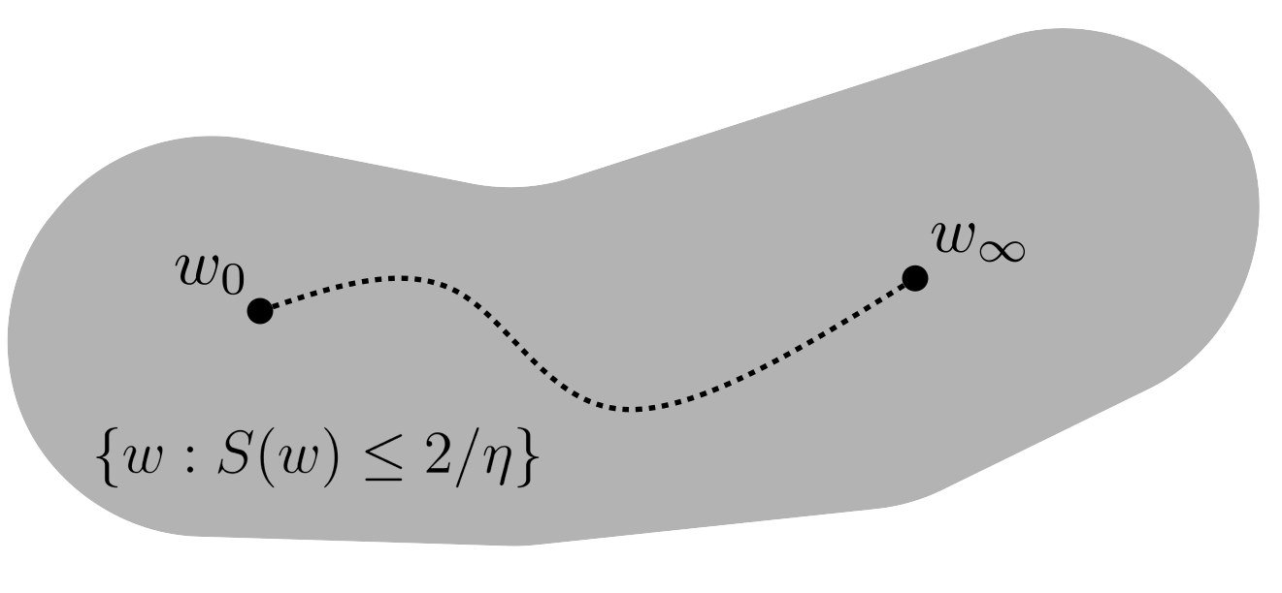
Sharpness in deep networks
Under this perspective, perhaps gradient descent for deep learning also requires this stability and always maintains sharpness under 2/η
Gradient Descent on Neural Networks Typically Occurs at the Edge of Stability

Slide 7
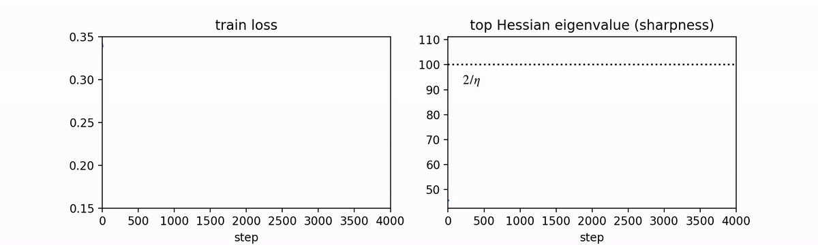
Sharpness in deep networks
This mental model would predict that if the sharpness ever exceeds 2/η, training would diverge
Gradient Descent on Neural Networks Typically Occurs at the Edge of Stability

Slide 8
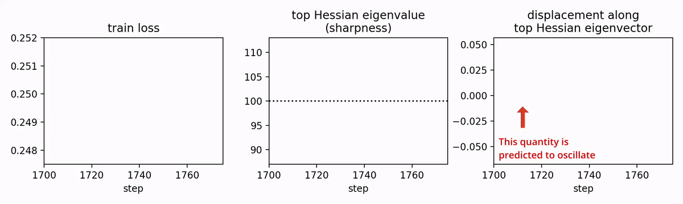
Sharpness in deep networks
Similar to quadratics, the the loss starts to blow up and the model starts to oscillate around the top eigenvalue of the Hessian
Gradient Descent on Neural Networks Typically Occurs at the Edge of Stability

Slide 9
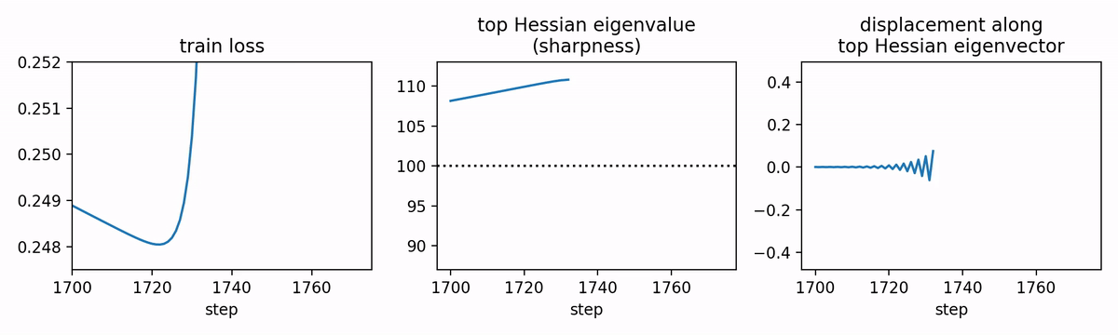
Sharpness in deep networks
Interestingly, with enough oscillation the sharpness drops back down! This deviates from quadratics
Gradient Descent on Neural Networks Typically Occurs at the Edge of Stability

Slide 10
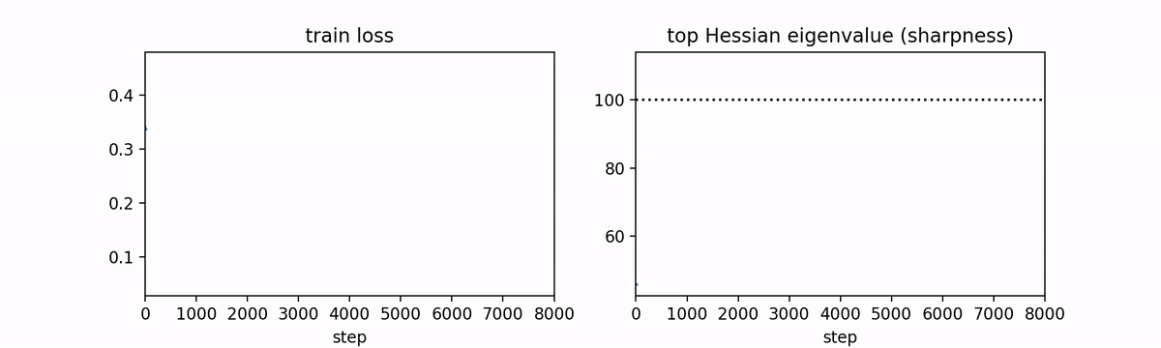
Sharpness in deep networks
We can now look at the full run to see how loss (inconsistently) goes down while the sharpness equilibrates around 2/η
Gradient Descent on Neural Networks Typically Occurs at the Edge of Stability

Slide 11
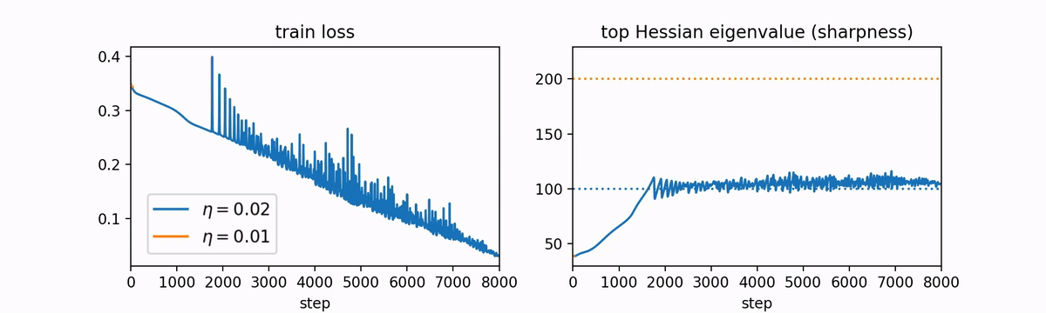
Sharpness in deep networks
The same phenomenon occurs at a different learning rate with the sharpness equilibrating at a correspondingly different threshold
Gradient Descent on Neural Networks Typically Occurs at the Edge of Stability

Slide 12
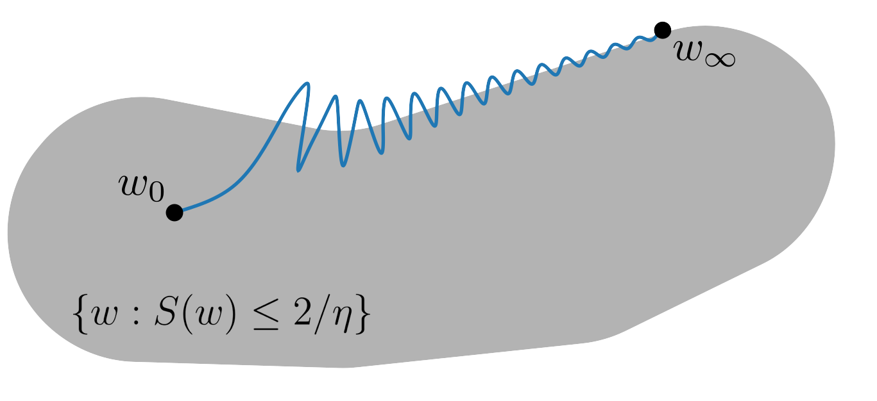
Sharpness in deep networks
Therefore, the traditional picture is somewhat flawed and gradient descent hovers around the “Edge of Stability”
Gradient Descent on Neural Networks Typically Occurs at the Edge of Stability

Slide 13
GD vs SGD
The loss curves in the preceding plot have unusually exaggerated loss spikes due to the use of full-batch GD. Nonetheless, similar behavior also exists for SGD with a different threshold [Jastrzebski et al, 2018]
In your assignment, you will spend the majority of Problem 3 exploring the Edge of Stability in the typical minibatch regime
On the Relation Between the Sharpest Directions of DNN Loss and the SGD Step Length

Slide 14
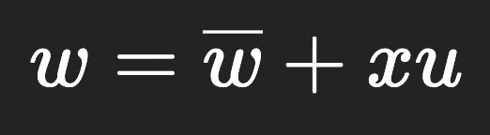
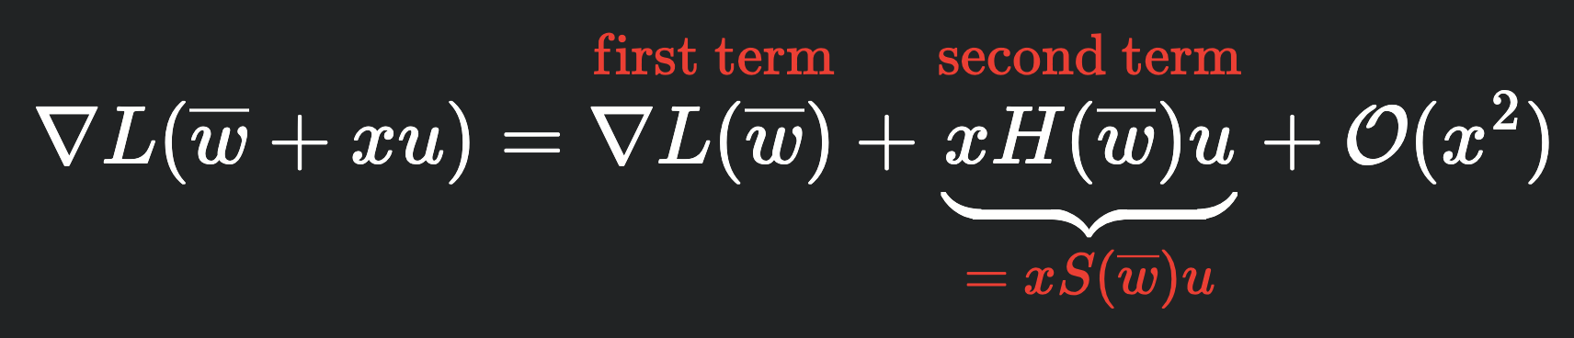
Self-stabilization (informal)
Oscillation around the top eigenvector can be written as
Take a Taylor expansion of the loss around this weight. Keeping the first and second term yields a quadratic approximation
This approximation behaves like a quadratic model where we will move in the opposite direction of u, causing oscillation for large sharpness
Self-Stabilization: The Implicit Bias of Gradient Descent at the Edge of Stability

Slide 15
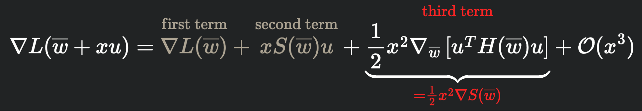
Self-stabilization (informal)
The magic comes from a third-order Taylor expansion
The inner quantity is the curvature in the u direction, equivalent to the eigenvalue in the u direction. Therefore, this expression takes the gradient of the sharpness and minimizes it with effective step size (1/2)ηx²
Self-Stabilization: The Implicit Bias of Gradient Descent at the Edge of Stability

Slide 16
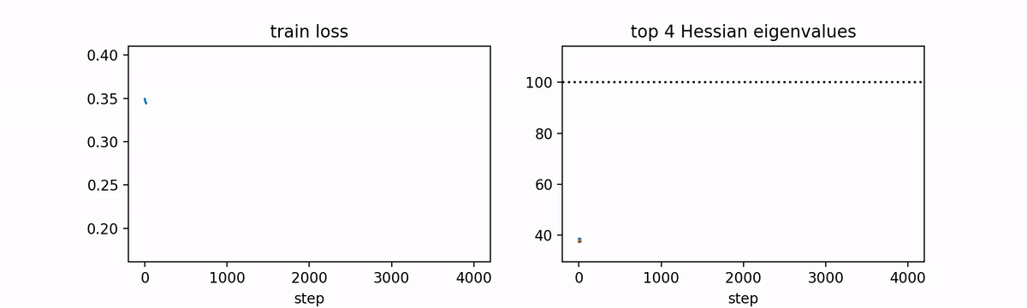
Multiple eigenvalues
We’ve analyzed only the top eigenvalue. When there are multiple eigenvalues, it can be observed that multiple of them eventually reach the edge of stability and oscillate at this threshold
Gradient Descent on Neural Networks Typically Occurs at the Edge of Stability

Slide 17
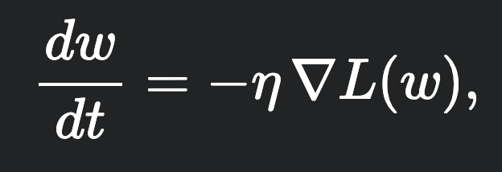
Gradient Flow
Though the exact dynamics are difficult to analyze, is there a theoretical construct that can capture the macroscopic properties of training?
The typical approach is to consider the continuous-time approximation to gradient descent, a differential equation called gradient flow
Understanding Optimization in Deep Learning with Central Flows

Slide 18
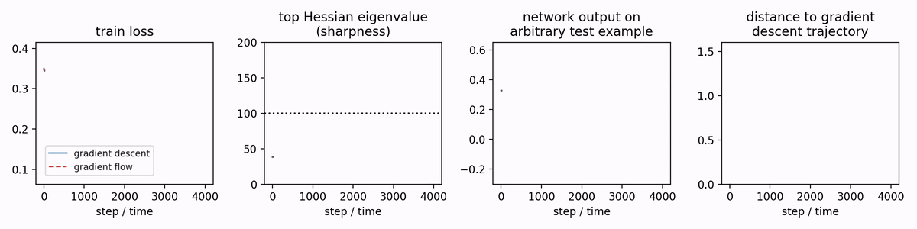
Gradient Flow
Gradient flow is actually pretty good at capturing training before sharpness exceeds the edge of stability. However, past this regime, gradient flow continues to increase sharpness, diverging from empirics
Understanding Optimization in Deep Learning with Central Flows

Slide 19
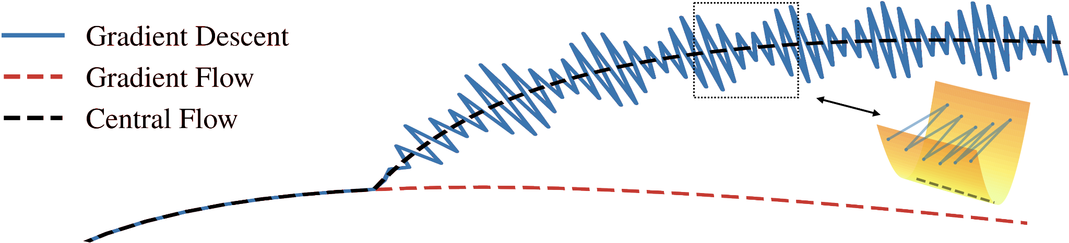
Central Flow
The central flow models gradient descent via its time-averaged trajectory
Informal proof sketch: assume time-averaged trajectory follows a differential equation, show that only one makes sense, and show that it agrees with empirics
Understanding Optimization in Deep Learning with Central Flows

Slide 20
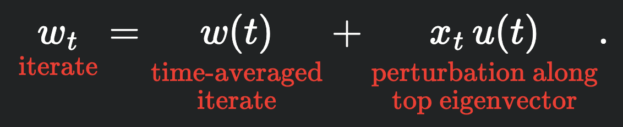
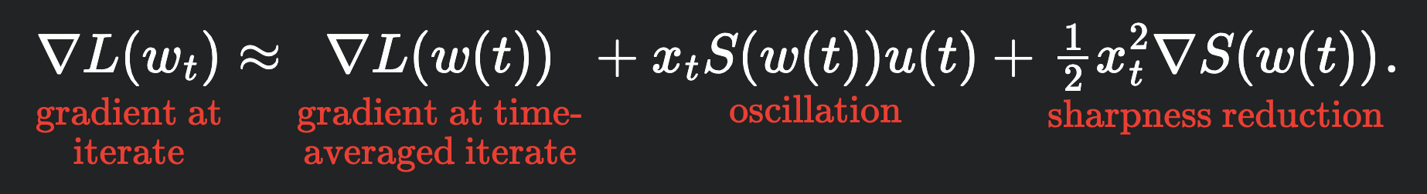
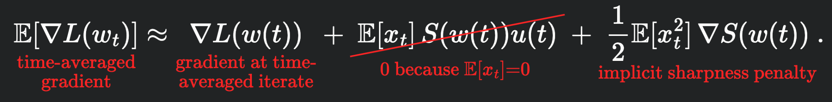
Central Flow
When only one eigenvalue is at edge of stability, we can write each iterate as
with Taylor expansion
By abusing notation, we can cancel out the oscillation
Understanding Optimization in Deep Learning with Central Flows

Slide 21
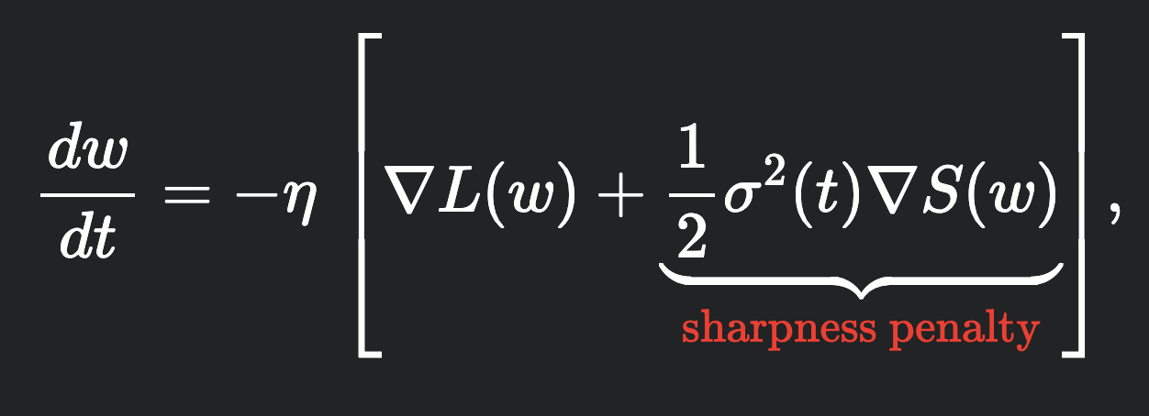
Central Flow
This corresponds to a differential equation
with unknown sharpness penalty that
depends on the oscillations
We know that when we enter the edge of stability, the time-averaged sharpness stops changing. Therefore, we will enforce that the time derivative of the sharpness along the central flow is zero
Understanding Optimization in Deep Learning with Central Flows

Slide 22
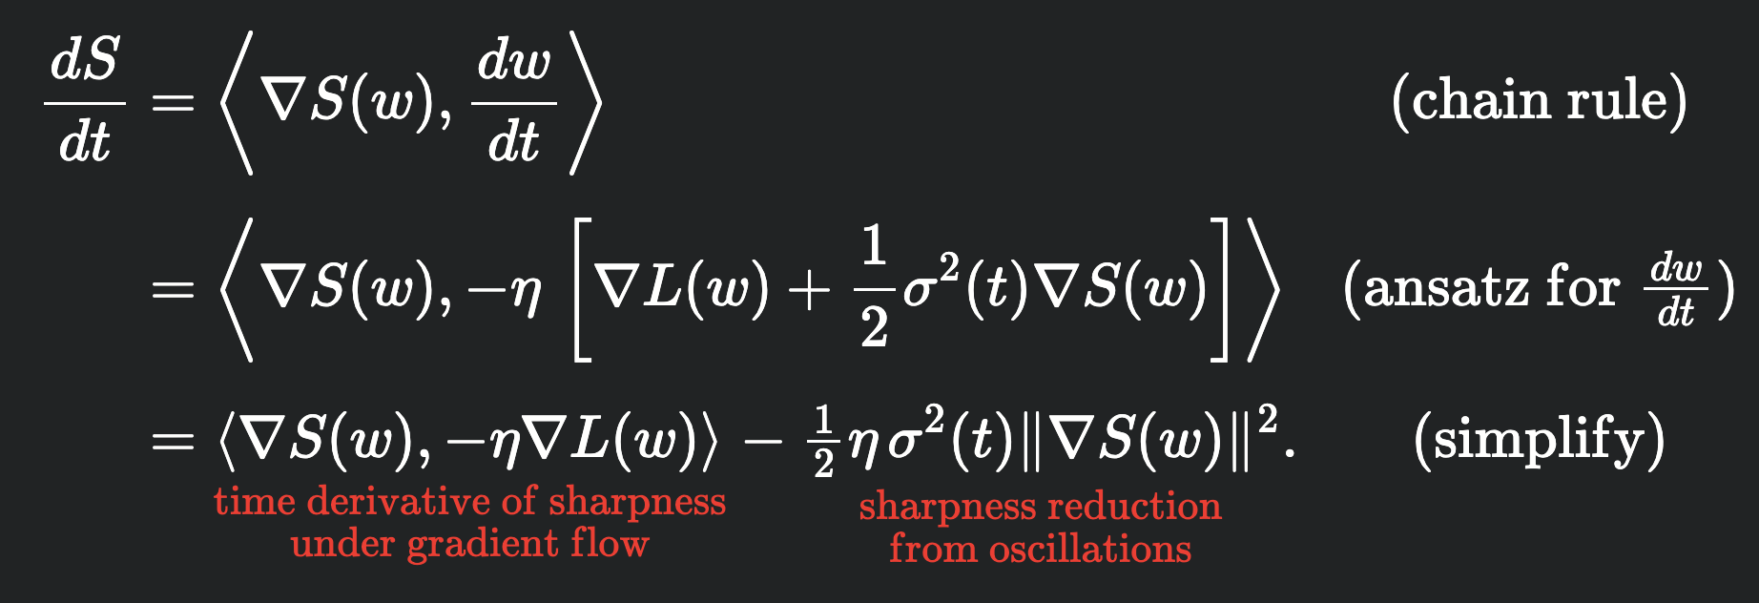
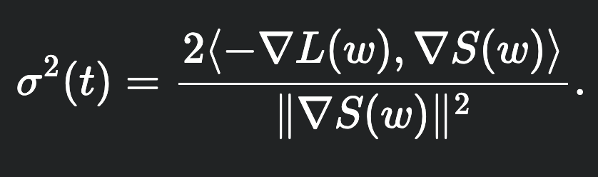
Central Flow
Interestingly, there is only one such choice that meets this property
This gives us the unique solution
Understanding Optimization in Deep Learning with Central Flows

Slide 23
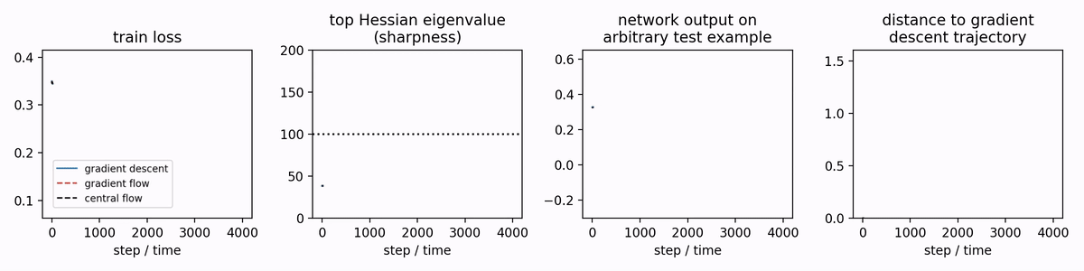
Central Flow
Now we can assess its empirical predictions. We find that it tracks the empirical predictions quite well
Understanding Optimization in Deep Learning with Central Flows

Slide 24
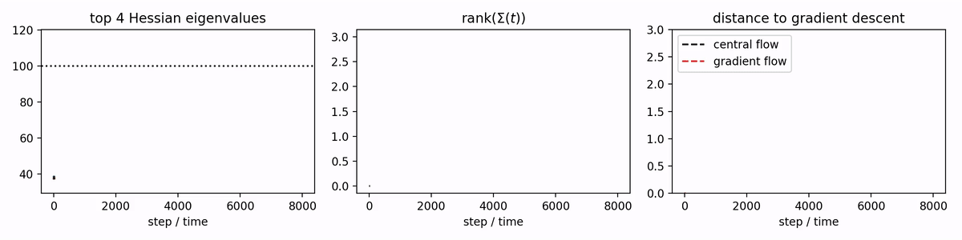
Central Flow
You can also generalize it to multiple eigenvectors and track each separately
Understanding Optimization in Deep Learning with Central Flows

Slide 25
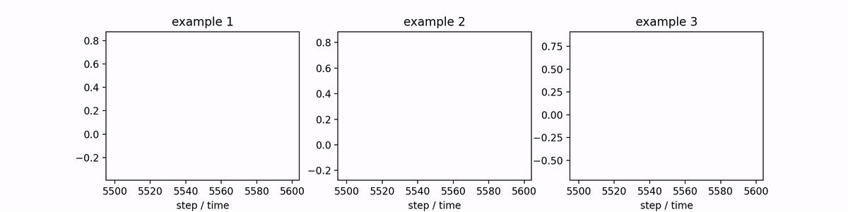
Central Flow
The central flow can further be used to track the variations in individual predictions
Understanding Optimization in Deep Learning with Central Flows

Slide 26
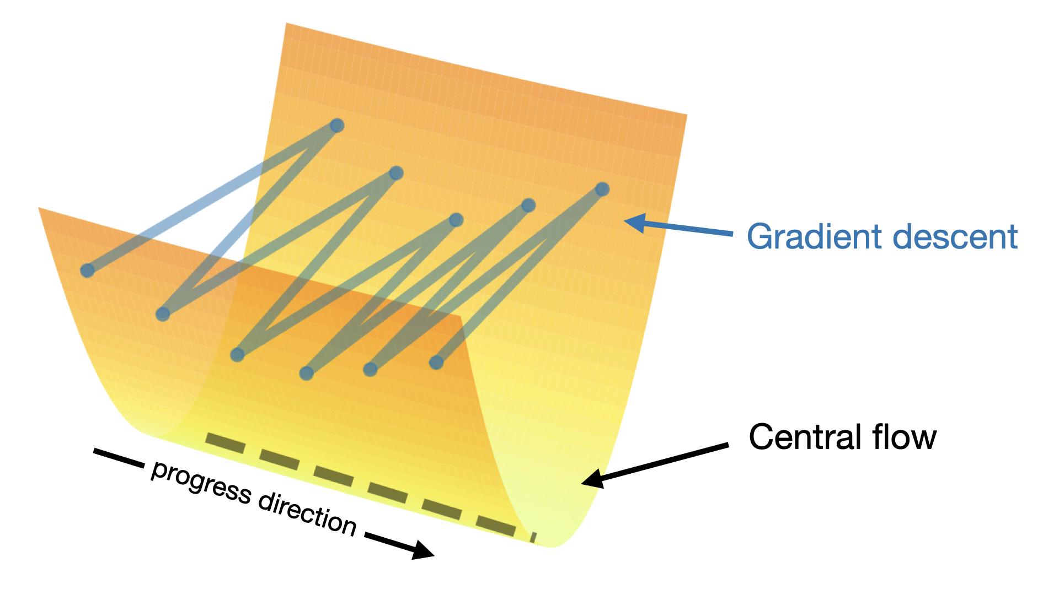
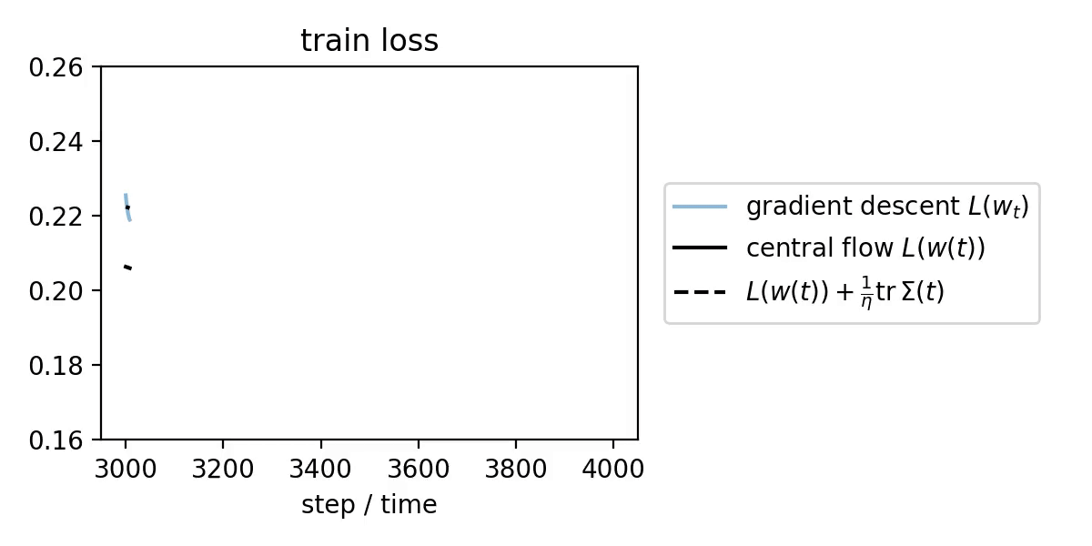
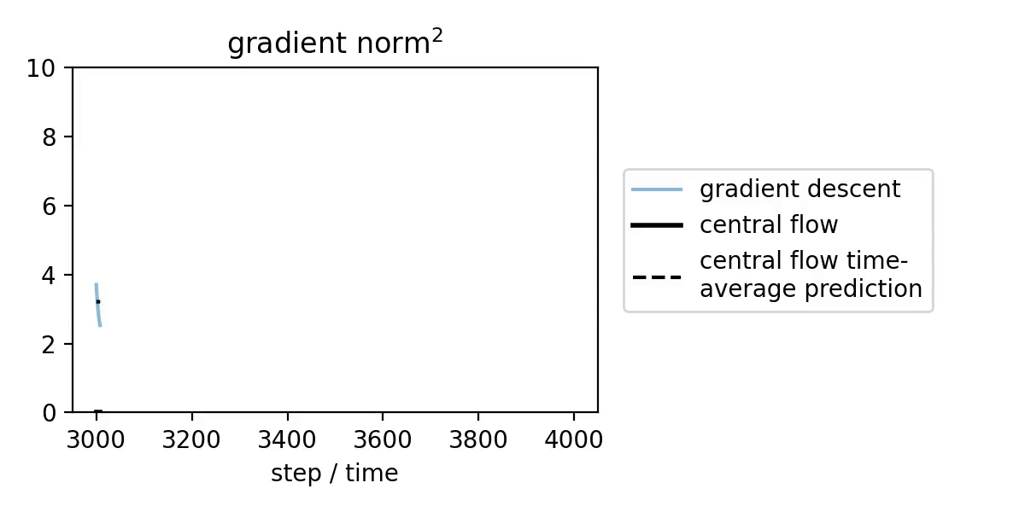
River valley predictions
Since the central flow captures the time-averaged dynamics, it intuitively corresponds to the river direction in the river valley mental model, revealing hidden progress made without annealing (and even the loss without annealing)
Understanding Optimization in Deep Learning with Central Flows

Slide 27
River valley predictions
There are two layers of movement at once
Oscillations from wall to wall
Moving vertically from varying sharpness
The first source of movement comes from high sharpness, the second source comes from oscillating sharpness
Understanding Optimization in Deep Learning with Central Flows

Slide 28
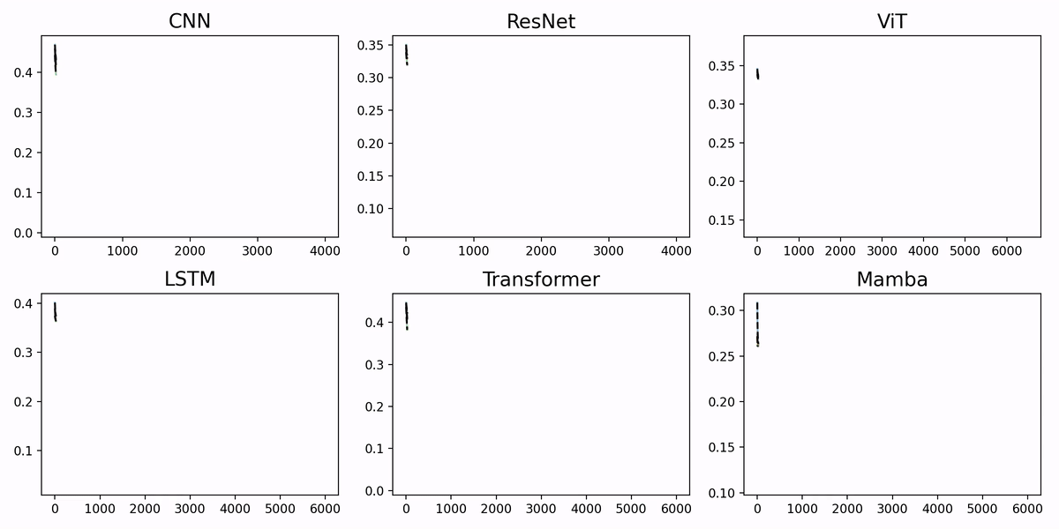
Summary
Quadratics predict that optimization diverges when sharpness exceeds a critical threshold
Modern NNs empirically reduce the sharpness. GD implicitly regularizes sharpness to prevent this from happening
By tracking time-averaged parameters, we can build the Central Flow which makes the correct empirical predictions

Slide 29
Extending EoS to cover modern optimizer modifications
There are three main missing components from EoS
Momentum
Minibatch SGD
Adaptive optimizers

Slide 30
Interaction with momentum
For momentum, we accumulate the gradient over iterations
v_{t+1} = 𝛽v_{t} + g_{t} w_{t} = w_{t} - ηv_{t+1}
To reason about the sharpness, we need to reason about the maximum stable LR
A Walk with SGD
Gradient Descent on Neural Networks Typically Occurs at the Edge of Stability

Slide 31
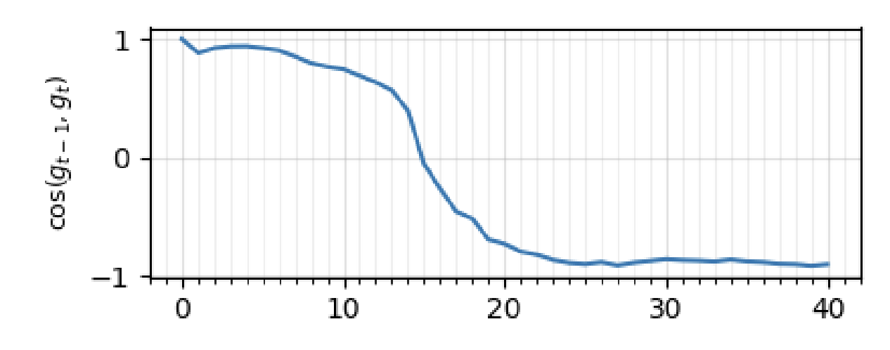
Interaction with momentum
For quadratics, if we have full batch, the gradients take us from wall to wall. In this regime gradients accumulate like
g_{t} + 𝛽g_{t-1} + 𝛽²g_{t-2} + 𝛽³g_{t-3} + … ≈ g - 𝛽g + 𝛽²g - 𝛽³g + … = g / (1 + 𝛽)
Therefore, for the same learning rate, sharpness increases by a factor of 1 + 𝛽
A Walk with SGD
Gradient Descent on Neural Networks Typically Occurs at the Edge of Stability

Slide 32
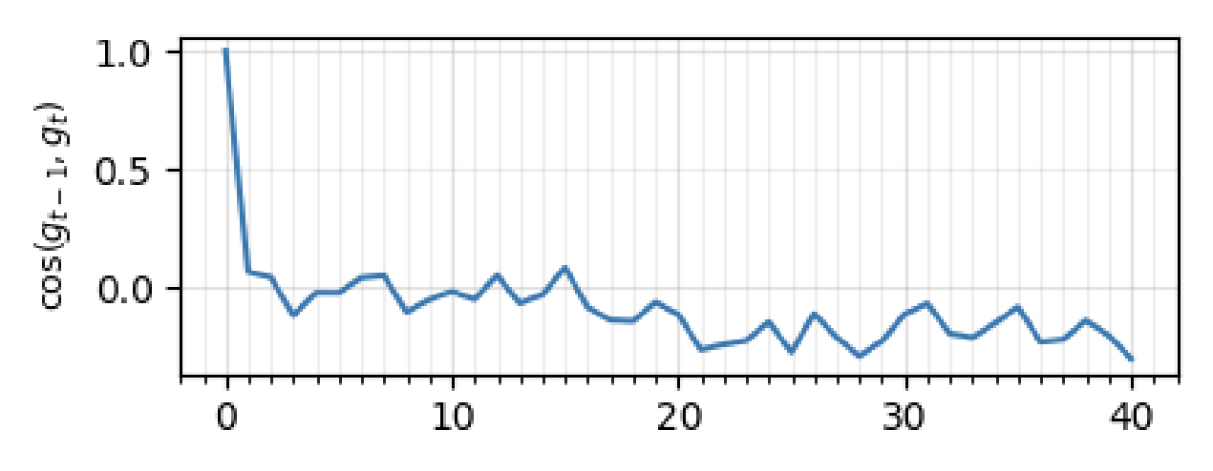
Interaction with batch size
For minibatch, recall from River Valley that the minibatch regime is noise dominated, with gradient directions being close to independent. This results in the gradients accumulating differently
Var(g) = Var(g_{t} + 𝛽g_{t-1} + 𝛽²g_{t-2} + 𝛽³g_{t-3} + …)
≈ Var(g_{t}) + Var(𝛽g_{t-1}) + Var(𝛽²g_{t-2}) + Var(𝛽³g_{t-3}) + …
= Var(g) / (1 - 𝛽)
Momentum Further Constrains Sharpness at the Edge of Stochastic Stability

Slide 33
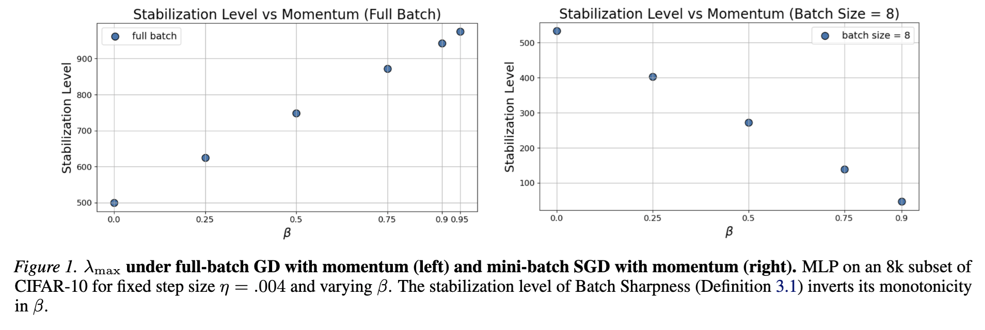
Interaction with momentum
Therefore, we have two regimes: large batch where momentum increases sharpness and small batch where momentum decreases sharpness
Refer to Andreyev et al, 2026 for an analysis of momentum and Song et al, 2026 for an analysis of EoS with noise from zeroth order optimization
Momentum Further Constrains Sharpness at the Edge of Stochastic Stability

Slide 34
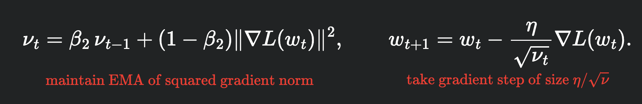
Scalar RMSProp
Finally, we would like our analysis to extend past SGD
We’ll start by studying a simple adaptive optimizer Scalar RMSProp
This is Adam without momentum and without per-parameter adaptivity. We will see how this update adapts to the loss curvature
Understanding Optimization in Deep Learning with Central Flows

Slide 35
Scalar RMSProp
Under Scalar RMSProp, the step size should instead be thought of as η / √𝜈_{t}
Therefore, we expect oscillation whenever sharpness S exceeds 2√𝜈_{t} / η
This motivates an effective sharpness, ηS / √𝜈_{t}, which should stabilize around 2
Understanding Optimization in Deep Learning with Central Flows

Slide 36
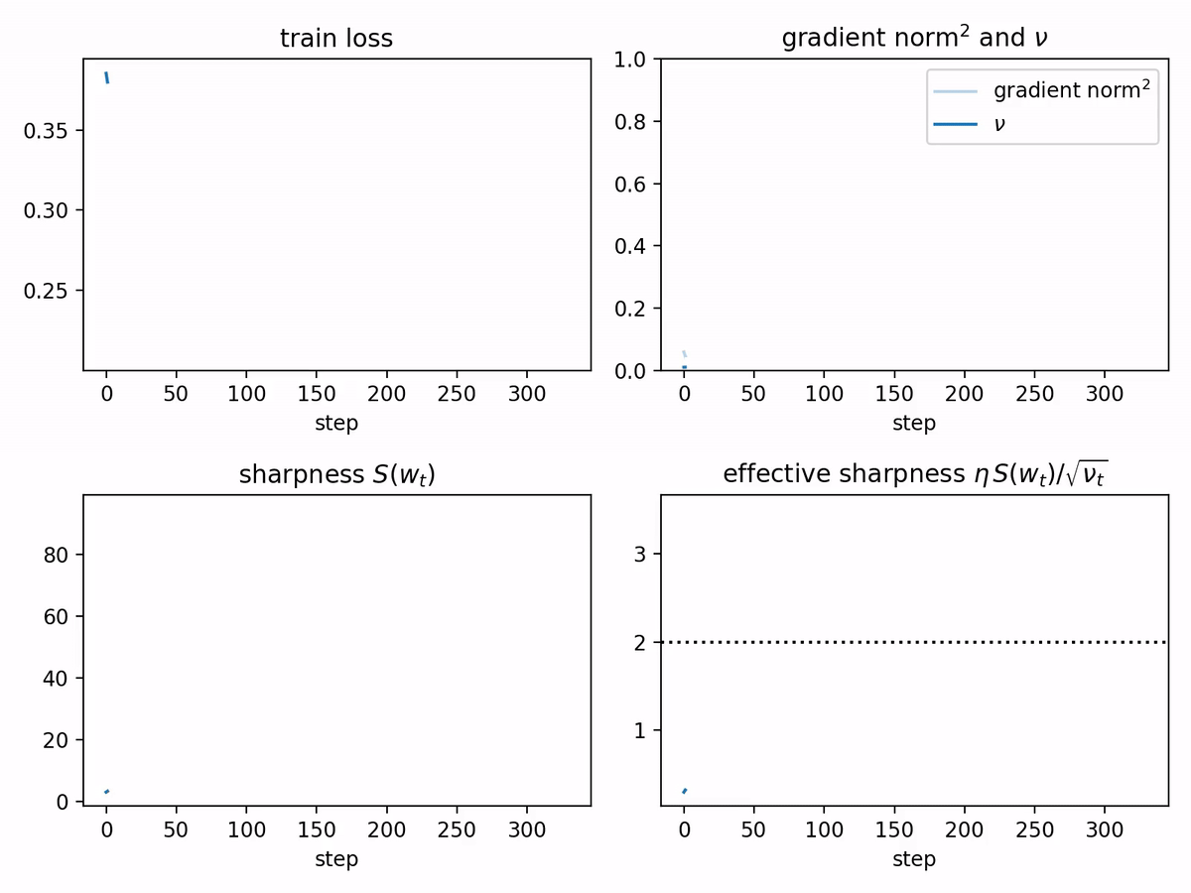
Scalar RMSProp
Indeed, the effective
sharpness does display the
Edge of Stability empirically
Understanding Optimization in Deep Learning with Central Flows

Slide 37
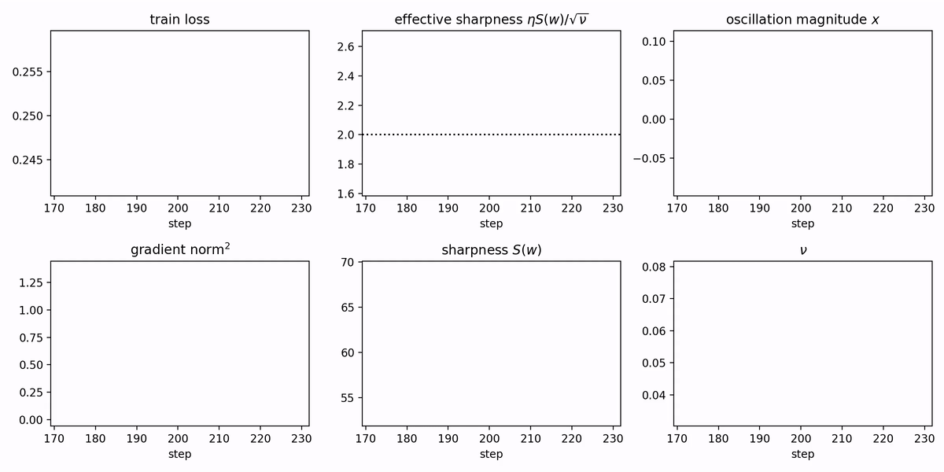
Scalar RMSProp
Self-stabilization of effective sharpness in RMSProp happens for two reasons
Similar to gradient descent, oscillations automatically reduce sharpness
In addition, oscillations increase the gradient norm, causing 𝜈_{t} to grow, reducing the effective sharpness η / √𝜈_{t} via the denominator (not the numerator)
Understanding Optimization in Deep Learning with Central Flows

Slide 38
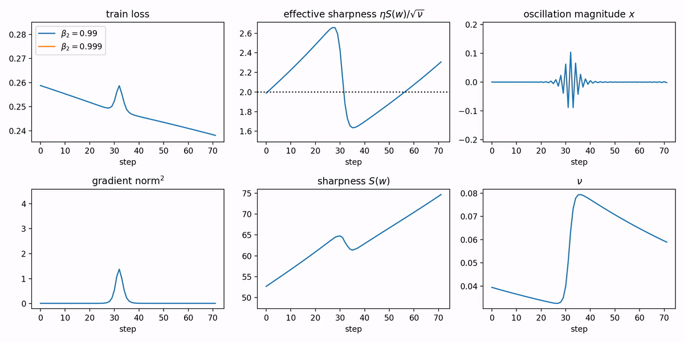
Scalar RMSProp
High 𝛽₂ implies that 𝜈_{t} will update slower, self-stabilization will happen slower, and the effective sharpness will come more from sharpness reduction, not 𝜈_{t} growth
Understanding Optimization in Deep Learning with Central Flows

Slide 39
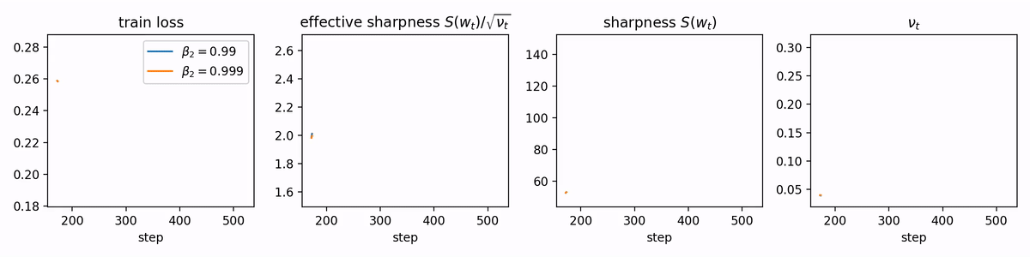
Scalar RMSProp
In the long run, high 𝛽₂ in the long term will result in lower sharpness and lower 𝜈_{t} for the same effective sharpness
Understanding Optimization in Deep Learning with Central Flows

Slide 40
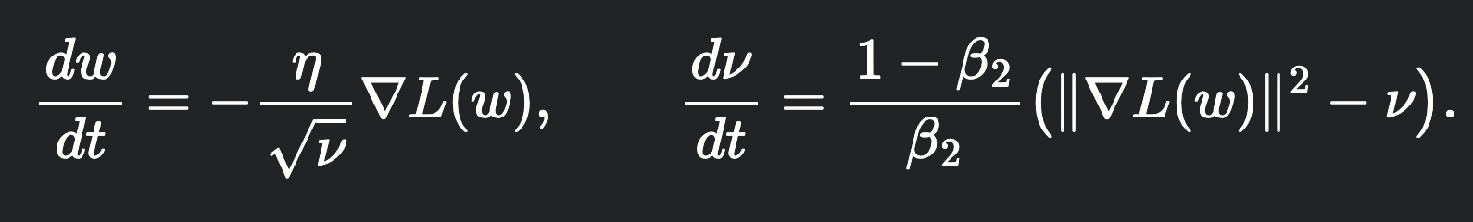
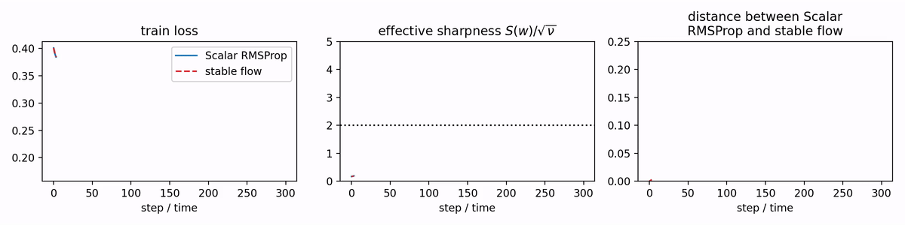
Scalar RMSProp
Similar to gradient flow, we can write down the stable flow for Scalar RMSProp
Understanding Optimization in Deep Learning with Central Flows

Slide 41
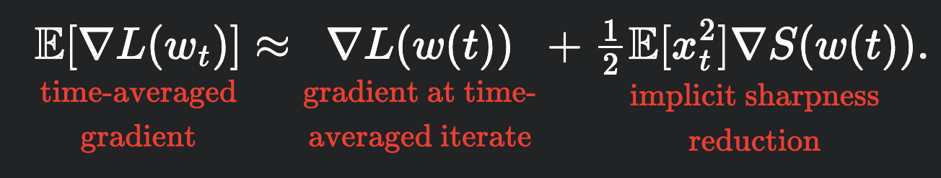
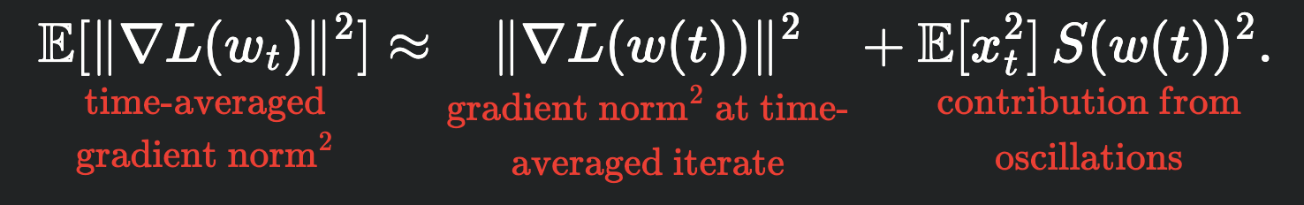
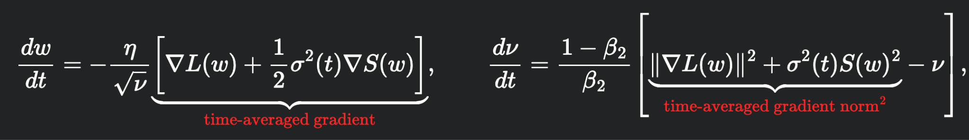
Scalar RMSProp
To derive a central flow for Scalar RMSProp, we can repeat the GD derivation
Time-averaged gradient
Approximate gradient norm
Final prediction
for central flow
Understanding Optimization in Deep Learning with Central Flows

Slide 42
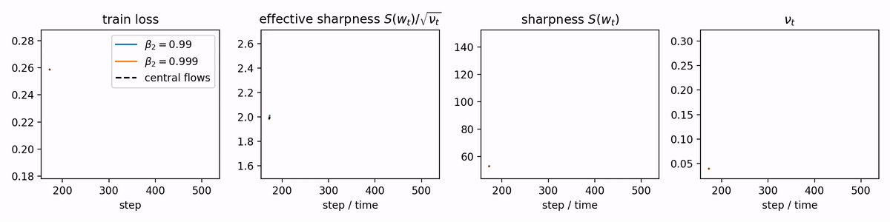
Scalar RMSProp
Similar to GD, there is a unique choice of variance schedule that works. It makes excellent empirical predictions!
Understanding Optimization in Deep Learning with Central Flows

Slide 43
Scalar RMSProp
Over the course of training for Scalar RMSProp, the effective sharpness stays stable at 2, the sharpness grows, and the effective step size decreases
Therefore, scalar RMSProp manages to keep the effective step size automatically balanced at 2 / S without explicitly computing the sharpness
This is one precise sense in which RMSProp adapts to the loss landscape
Understanding Optimization in Deep Learning with Central Flows

Slide 44
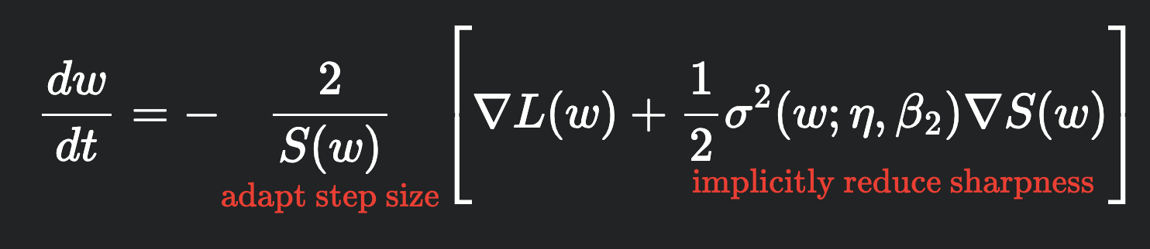
Scalar RMSProp
Is this the only benefit of an adaptive optimizer? No, there is an additional effect from sharpness reduction that happens every oscillation
At EoS, 𝜈_{t} stabilizes so we can analyze only how the parameter evolves
In addition to adapting the step size, we also reduce sharpness. With larger learning rates, we face more oscillation, and result in reduced sharpness
Understanding Optimization in Deep Learning with Central Flows

Slide 45
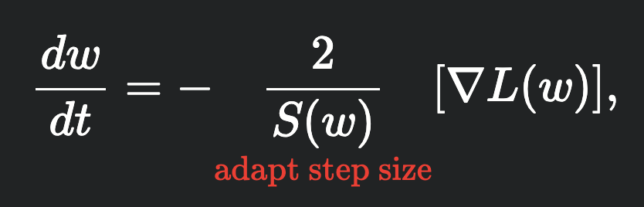
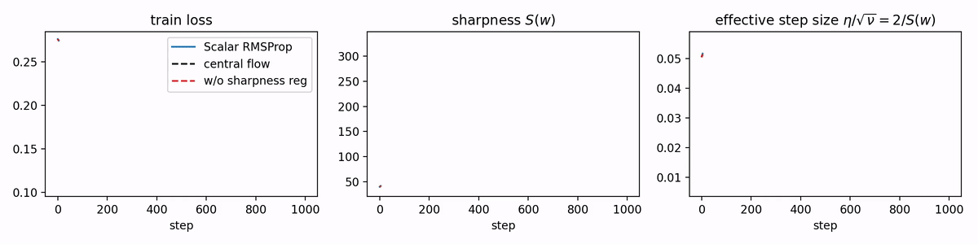
Scalar RMSProp
We can ablate the effects of the sharpness regularization by simulating a flow that’s missing the sharpness regularization term. Note how Scalar RMSProp reduces the sharpness, increases effective step size, and accelerates convergence
Understanding Optimization in Deep Learning with Central Flows

Slide 46
Scalar RMSProp
One common confusion is why the learning rate in an adaptive optimizer is meaningful since it gets rescaled (for example, at EoS, the effective step size is fixed at 2 / S)
We now see that larger learning rate results in higher sharpness regularization, increasing effective step size. Therefore, increasing learning rate does increase step size, but quite indirectly
Understanding Optimization in Deep Learning with Central Flows

Slide 47
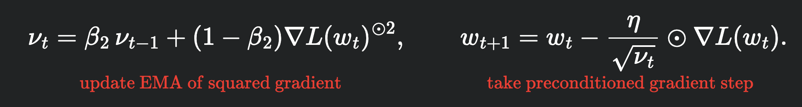
RMSProp
Now that we understand Scalar RMSProp, we can extend our analysis to RMSProp which maintains a coordinate-wise squared gradient EMA. This is equivalent to Adam without the momentum
This is equivalent to diagonal preconditioning of diag(√𝜈_{t} / η)
Though people have an intuition that Adam/RMSProp helps similar to Newton’s method, it’s worth noting that they are purely first-order methods
Understanding Optimization in Deep Learning with Central Flows

Slide 48
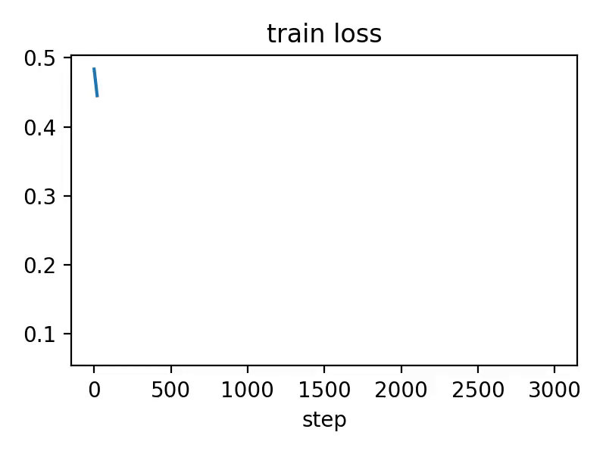
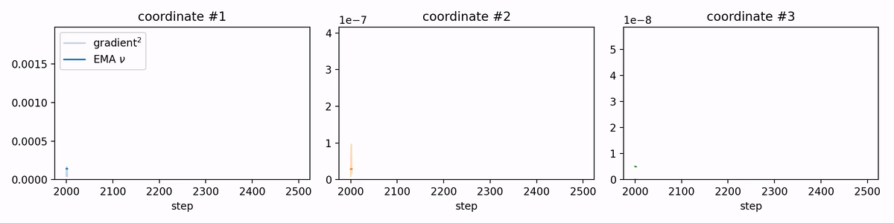
RMSProp
RMSProp has a smooth loss curve. However, its coordinates oscillate quite a bit
Understanding Optimization in Deep Learning with Central Flows

Slide 49
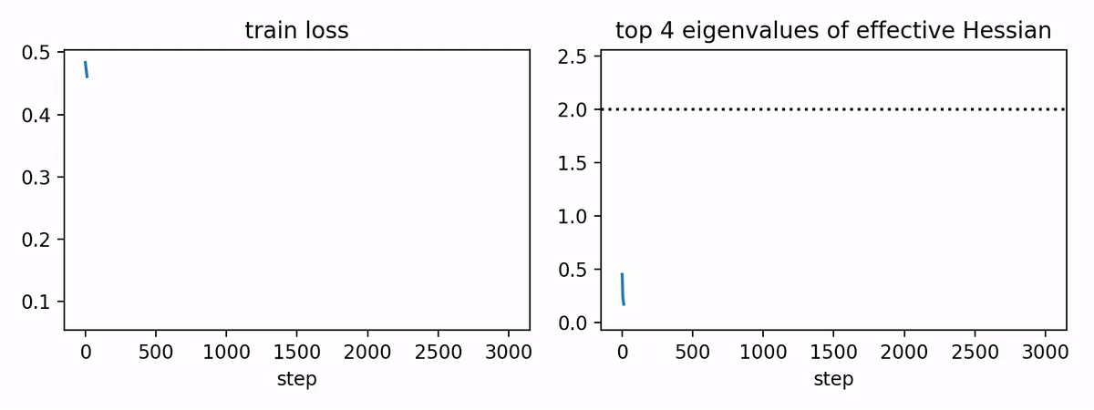
RMSProp
Since we are reasoning about preconditioned gradient descent, it’s most helpful to think about the effective Hessian P⁻¹H = diag(η / √𝜈_{t})H and whether its eigenvalues exceed 2. We see the familiar EoS
Understanding Optimization in Deep Learning with Central Flows

Slide 50

RMSProp
For RMSProp, you can also derive a similar-looking central flow for all the eigenvalues. It unfortunately does not have a simple closed form, we’ll skip the math. As expected, it makes the right predictions and such
Understanding Optimization in Deep Learning with Central Flows

Slide 51


RMSProp
So, what is RMSProp’s preconditioner actually computing? We can reason about the stationary preconditioner, equivalent to
This is equivalent to solving the following convex program
Understanding Optimization in Deep Learning with Central Flows

Slide 52

RMSProp
The constraint enforces the stable effective step size. trace(P) corresponds to minimizing the sum of the inverse effective learning rates (i.e. increasing step size subject to stability). Speeds up training
Understanding Optimization in Deep Learning with Central Flows

Slide 53

RMSProp
Interestingly, only optimizing the first term without the diagonal constraint is equivalent to preconditioning via the Hessian
Understanding Optimization in Deep Learning with Central Flows

Slide 54

RMSProp
On the other hand, the second term exists to directly slow down training. When introducing this second term into the central flow, training proceeds more slowly
This might be a suboptimal aspect of RMSProp, even though it is what it does
Understanding Optimization in Deep Learning with Central Flows

Slide 55
Summary
When normalizing the gradient (i.e. via RMSProp), we change the effective step size and the effective sharpness
Training via (Scalar) RMSProp both adapts to the curvature of the loss landscape while also reducing the sharpness. (Scalar) RMSProp accelerates training because of the adaptive component and its effective sharpness reduction
The stationary preconditioner of RMSProp reveals the similarities and differences between second-order methods

Slide 56
Failures of Edge of Stability / Central Flows
Generally less reliable phenomenology for
Cross-entropy loss
Stochastic setting
Modern optimizers such as AdamW
Extremely high learning rates
Furthermore, it is mostly unknown why progressive sharpening happens

Slide 57
Your assignment
In your assignment, you will be analyzing where sharpness and effective sharpness stabilize as a function of different hyperparameters (learning rate, batch size, momentum, etc.).
It will be most helpful to first process EoS/Central Flows and what predictions they make. Then, you can run your experiments and see where the models made correct and incorrect predictions.
Understanding Optimization in Deep Learning with Central Flows

Slide 58
Why do we care about sharpness?
We’ve now reasoned about how decreasing sharpness can accelerate training from the perspective of increasing step size
Is there any other reason we should care about sharpness?

Slide 59


Generalization
So far in this class, we’ve considered model performance in the context of unlimited data for a fixed number of steps. However, we may be constrained by the number of samples rather than the number of steps
In this setting, train loss and validation loss
are not correlated. Even though we can
minimize train loss quite aggressively by
memorizing samples, what we care about
is loss on the validation set.
Scaling Repeated-Data Pretraining: Batch Size, Regularization, and GPU-Time Tradeoffs

Slide 60

Generalization
There is a folklore intuition that flatter minima will display better generalization [Hochreiter and Schmidhuber, 1997, Dziugaite and Roy, 2017]
On Large-Batch Training for Deep Learning: Generalization Gap and Sharp Minima

Slide 61
Fantastic Generalization
Jiang et al, 2019 studies how well various generalization measures correlate with model performance over a sweep of 2187 models. Overall, they find that most measures correlate poorly, with sharpness being a promising contender
1/α′ sharpness mag | 0.516
sum-of-fro/margin | 0.381
pacbayes-orig | 0.360
path-norm/margin | 0.305
grad-noise-final | 0.292
fro/spec | 0.243
cross-entropy | 0.147
# params | −0.15
Fantastic Generalization Measures and Where to Find Them

Slide 62

Fantastic Generalization?
However, later studies find that this correlation is actually quite weak and often negative as well [Andriushchenko et al, 2023], Furthermore, you can construct examples where the global minima are extremely sharp [Dinh et al, 2017]
A Modern Look at the Relationship between Sharpness and Generalization

Slide 63

Fantastic Generalization?
You can construct examples where the global minima are extremely sharp [Dinh et al, 2017]. One general failure of sharpness is that is not invariant to your parameterization.
Sharp Minima Can Generalize For Deep Nets

Slide 64

Sharpness Aware Minimization
Suppose believed sharpness was good for training speed and generalization. Can we optimize for it?
We know of a few indirect knobs: high learning rate, low batch size
Foret et al, 2020 proposed
Sharpness-Aware Minimization
(SAM) to directly optimize
sharpness
Sharpness-Aware Minimization for Efficiently Improving Generalization

Slide 65
Sharpness Aware Minimization
Core intuition: instead of seeking weights that have low loss, seek out minima where the entire region surrounding the weights also have low loss
Operationalized as minimize the loss under a bounded adversarial update around the weights
In practice, the adversary is estimated via a gradient
Sharpness-Aware Minimization for Efficiently Improving Generalization

Slide 66


Sharpness Aware Minimization
Original paper reports improvements in generalization over standard SGD (at the cost of some extra compute)
Empirically, it is known to work best under label
noise (analyzed in Baek et al, 2024)
Sharpness-Aware Minimization for Efficiently Improving Generalization

Slide 67


Sharpness Aware Minimization
Original SAM paper found that SAM works better with a smaller batch size (denoted by m on the right)
Later it is theoretically proved that the sharpness SAM optimize for depends on batch size. At batch size 1, SAM actually minimizes a different version of sharpness, called the average case sharpness.
Sharpness-Aware Minimization for Efficiently Improving Generalization

Slide 68


Application: Sharpness Aware Pretraining
One intuition is that flatter minima provide better initializations for fine-tuning. Therefore, seeking flatter minima (either via SAM or higher learning rates) can lead to pre-trained initializations that are more amenable to fine-tuning
Sharpness-Aware Pretraining Mitigates Catastrophic Forgetting

Slide 69
Sharpness Testimonials
“I feel like I should’ve been nerd sniped by this for at most 6 months of first year of grad school 😂 not 2 years”
“I feel like I should have been nerd sniped for my whole PhD. Sharpness is the only interesting problem in ML”
“I realize sharpness is not the solution to generalization before I enter my PhD and stop working on it, I am still glad that I make this choice”
“Sharpness is super interesting. It’s just that at some point, I realized it’s not useful.“

Slide 70
Summary
Sharpness, in addition to accelerating convergence, may or may not improve generalization when limited by samples
We can try to directly optimize for sharpness, though it’s unclear what we are actually optimizing
Sharpness can serve as a helpful mental model for algorithm design in components such as fine-tuning

