Slide 1
Neural Networks. Backprop. Modular Design
Radu Ionescu, Prof. PhD.
raducu.ionescu@gmail.com
Faculty of Mathematics and Computer Science
University of Bucharest

Slide 2
Plan for Today
Notation + Setup
Neural Networks
Chain Rule + Backprop

Slide 3
Supervised Learning
Input: x (images, text, emails…)
Output: y (spam or non-spam…)
(Unknown) Target Function
f: X → Y (the “true” mapping / reality)
Data
(x₁,y₁), (x₂,y₂), …, (x_{N},y_{N})
Model / Hypothesis Class
g: X → Y
y = g(x) = sign(w^{T}x)
Learning = Search in hypothesis space
Find best g in model class

Slide 4
Basic Steps of Supervised Learning
Set up a supervised learning problem
Data collection
Start with training data for which we know the correct outcome provided by a teacher or oracle.
Representation
Choose how to represent the data.
Modeling
Choose a hypothesis class: H = {g: X → Y}
Learning/Estimation
Find best hypothesis you can in the chosen class.
Model Selection
Try different models. Picks the best one. (More on this later)
If happy, stop
Else refine one or more of the above

Slide 5
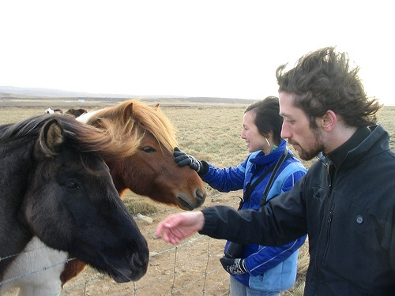
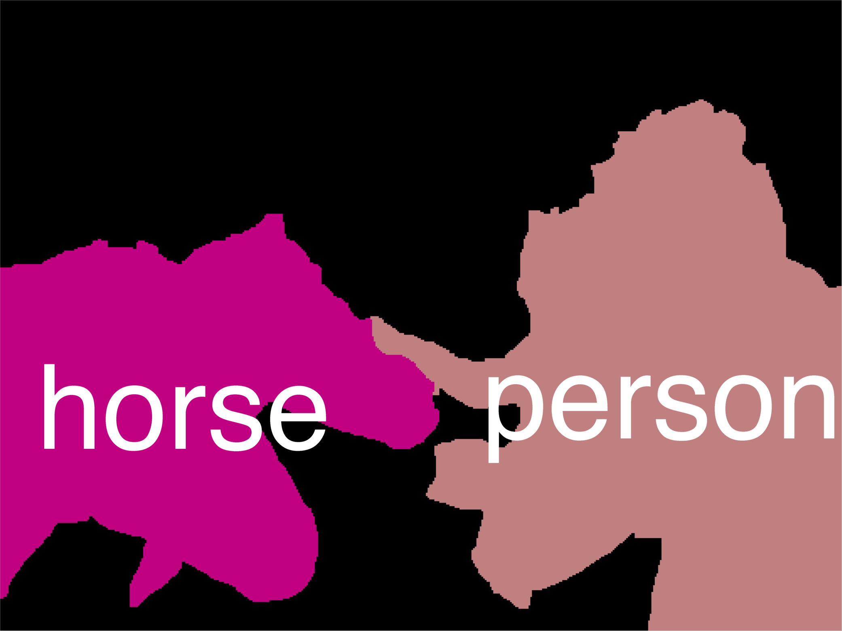
Error Decomposition
Reality
Modeling Error
model class
Estimation Error
Optimization Error

Slide 6
Error Decomposition
Reality
Modeling Error
Estimation Error
Optimization Error
model class

Slide 7
Error Decomposition
Modeling Error
Reality
model class
Higher-Order Potentials
Estimation Error
Optimization Error

Slide 8
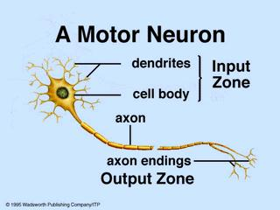
Biological Neuron

Slide 9
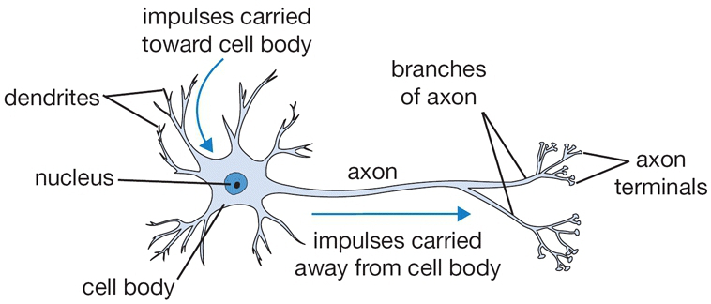
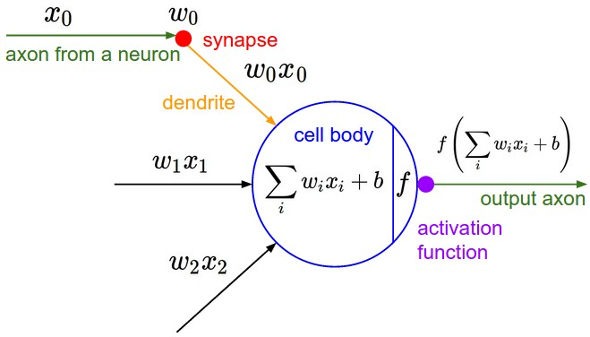
The Neuron Metaphor
Neurons
accept information from multiple inputs
transmit information to other neurons
Artificial neuron
multiply inputs by weights along edges
apply some function to the set of inputs at each node

Slide 10
Types of Neurons
Linear Neuron
Logistic Neuron
Potentially more. Require a convex
loss function for gradient descent training.
Perceptron

Slide 11
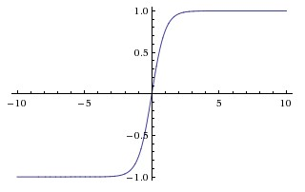
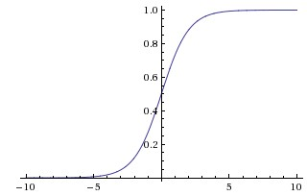
Activation Functions
sigmoid vs tanh
saturated gradients towards +/- infinity
sigmoid has non-zero mean

Slide 12
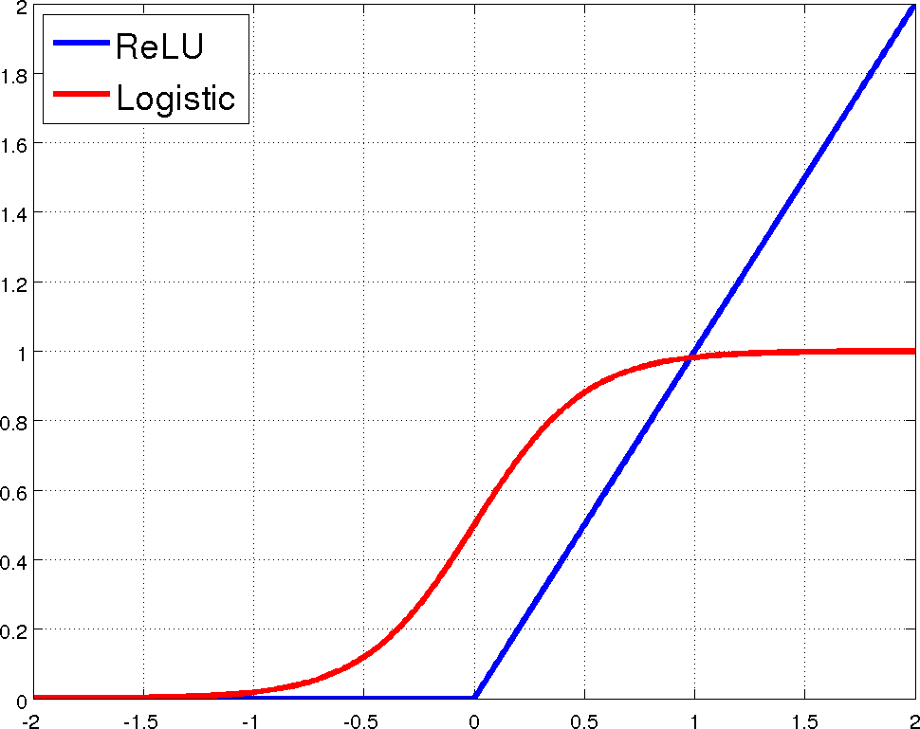
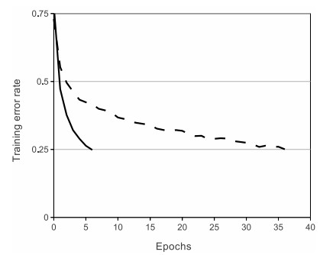
Rectified Linear Units (ReLU)
[Krizhevsky et al., NIPS12]

Slide 13
Limitation
A single “neuron” is still a linear decision boundary
What to do?
Idea: Stack a bunch of them together!

Slide 14
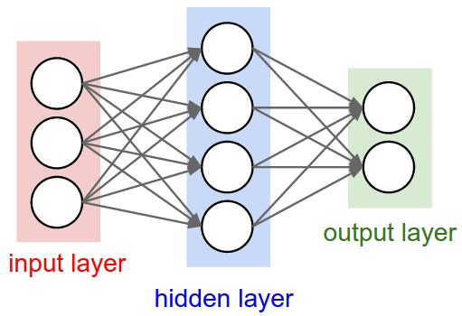
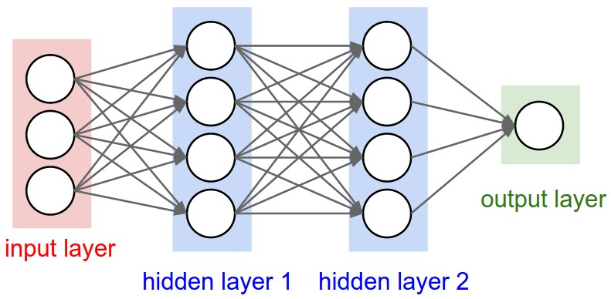
Multilayer Networks
Cascade neurons together
The output from one layer is the input to the next
Each layer has its own sets of weights

Slide 15

Multilayer Networks
A 2-layer neural network:
A 3-layer neural network:

Slide 16



Detailed architecture of a neural network
w_{1,1}
$$Σ$$
w_{2,1}
w_{1,1}
x_{i,1}
w_{3,1}
b_{1,1}=0
$$Σ$$
w_{2,1}
x_{i,2}
$$Σ$$
y
b_{1,1}=0
w_{3,1}
$$Σ$$
x_{i,3}
w_{2,4}
w_{1,4}
w_{4,1}
b_{1,1}=0
w_{3,4}
$$Σ$$
w_{1,1}
w_{2,1}
w_{3,1}
w_{4,1}
w_{1,1} w_{1,2} w_{1,3} w_{1,4}
w_{2,1} w_{2,2} w_{2,3} w_{2,4}
w_{3,1} w_{3,2} w_{3,3} w_{3,4}
W₀ =
W₁ =
b_{1,1}=0

Slide 17
Limitation
A single “neuron” is still a linear decision boundary
What to do?
Idea: Stack a bunch of them together!
Non-linearities are mandatory (see proof)

Slide 18
Universal Function Approximators
Theorem:
A two-layer network with linear outputs can uniformly approximate any continuous function on a finite subset to arbitrary accuracy, given enough hidden units [Funahashi ’89]

Slide 19
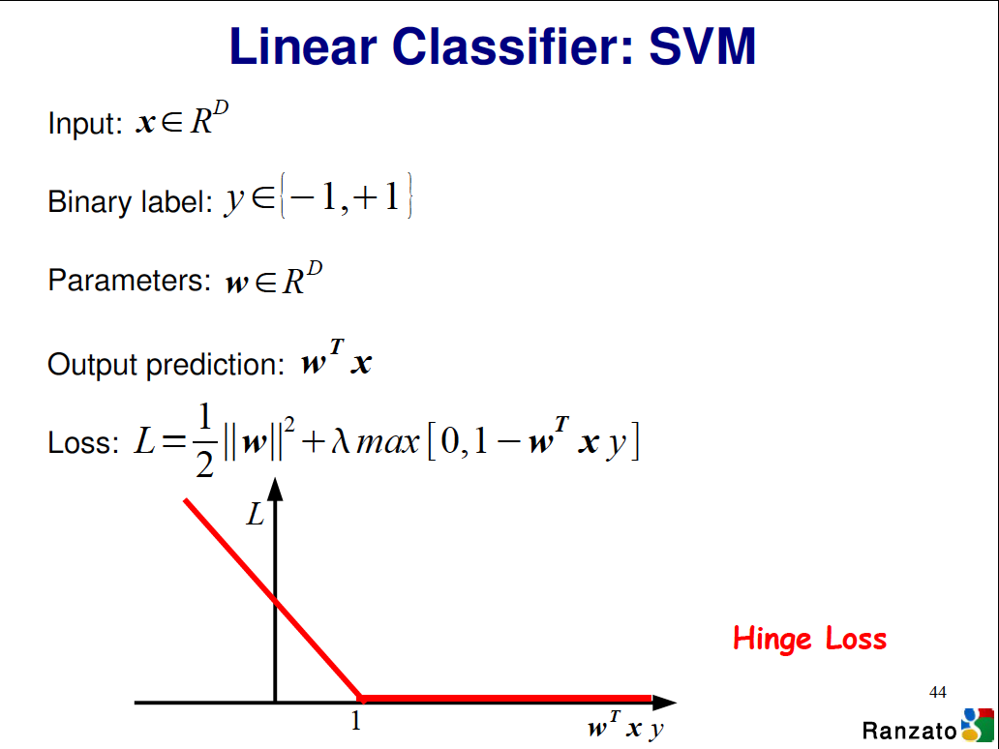

Slide 20
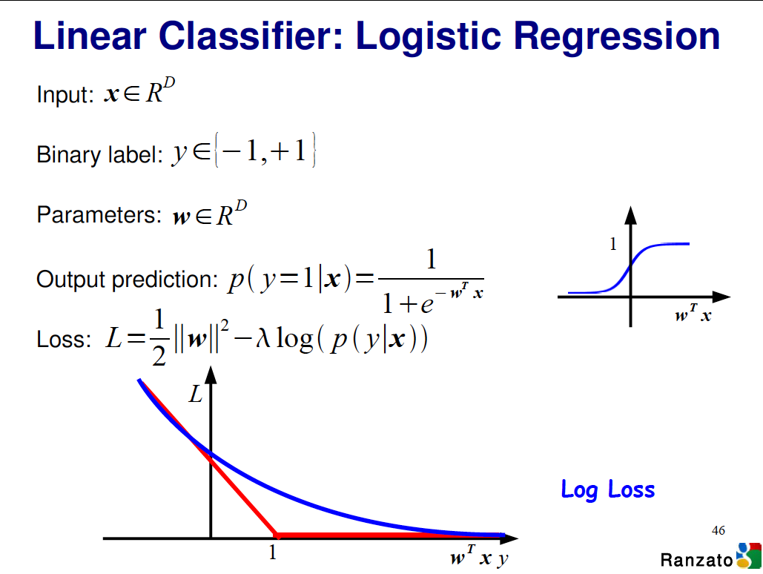

Slide 21
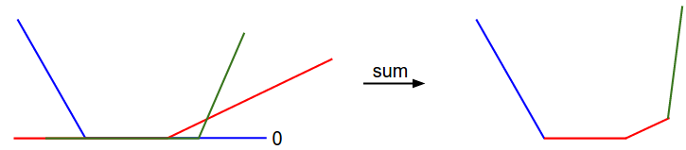
Visualizing Loss Functions
Sum of individual losses

Slide 22
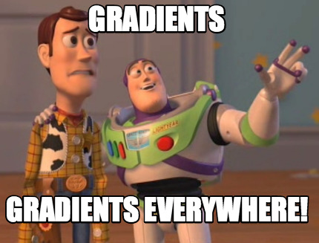
Detour

Slide 23


Gradient Descent Algorithm

Slide 24

Gradient Descent Algorithm
In 1-dimension, the derivative of a function:
In multiple dimensions, the gradient is the vector of partial derivatives.

Slide 25
current W:
[0.34,
-1.11,
0.78,
0.12,
0.55,
2.81,
-3.1,
-1.5,
0.33,…]
loss 1.25347
gradient dW:
[?,
?,
?,
?,
?,
?,
?,
?,
?,…]

Slide 26
current W:
[0.34,
-1.11,
0.78,
0.12,
0.55,
2.81,
-3.1,
-1.5,
0.33,…]
loss 1.25347
W + h (first dim):
[0.34 + 0.0001,
-1.11,
0.78,
0.12,
0.55,
2.81,
-3.1,
-1.5,
0.33,…]
loss 1.25322
gradient dW:
[?,
?,
?,
?,
?,
?,
?,
?,
?,…]

Slide 27
current W:
[0.34,
-1.11,
0.78,
0.12,
0.55,
2.81,
-3.1,
-1.5,
0.33,…]
loss 1.25347
W + h (first dim):
[0.34 + 0.0001,
-1.11,
0.78,
0.12,
0.55,
2.81,
-3.1,
-1.5,
0.33,…]
loss 1.25322
gradient dW:
[-2.5,
?,
?,
?,
?,
?,
?,
?,
?,…]
(1.25322 - 1.25347)/0.0001
= -2.5

Slide 28
current W:
[0.34,
-1.11,
0.78,
0.12,
0.55,
2.81,
-3.1,
-1.5,
0.33,…]
loss 1.25347
W + h (second dim):
[0.34,
-1.11 + 0.0001,
0.78,
0.12,
0.55,
2.81,
-3.1,
-1.5,
0.33,…]
loss 1.25353
gradient dW:
[-2.5,
?,
?,
?,
?,
?,
?,
?,
?,…]

Slide 29
current W:
[0.34,
-1.11,
0.78,
0.12,
0.55,
2.81,
-3.1,
-1.5,
0.33,…]
loss 1.25347
W + h (second dim):
[0.34,
-1.11 + 0.0001,
0.78,
0.12,
0.55,
2.81,
-3.1,
-1.5,
0.33,…]
loss 1.25353
gradient dW:
[-2.5,
0.6,
?,
?,
?,
?,
?,
?,
?,…]
(1.25353 - 1.25347)/0.0001
= 0.6

Slide 30
current W:
[0.34,
-1.11,
0.78,
0.12,
0.55,
2.81,
-3.1,
-1.5,
0.33,…]
loss 1.25347
W + h (third dim):
[0.34,
-1.11,
0.78 + 0.0001,
0.12,
0.55,
2.81,
-3.1,
-1.5,
0.33,…]
loss 1.25347
gradient dW:
[-2.5,
0.6,
?,
?,
?,
?,
?,
?,
?,…]

Slide 31
current W:
[0.34,
-1.11,
0.78,
0.12,
0.55,
2.81,
-3.1,
-1.5,
0.33,…]
loss 1.25347
W + h (third dim):
[0.34,
-1.11,
0.78 + 0.0001,
0.12,
0.55,
2.81,
-3.1,
-1.5,
0.33,…]
loss 1.25347
gradient dW:
[-2.5,
0.6,
0,
?,
?,
?,
?,
?,
?,…]
(1.25347 - 1.25347)/0.0001
= 0

Slide 32
Gradient Evaluation
1) Numerical approach
We choose a small positive h and apply the formula:
We obtain an approximate value
Very slow to compute
2) Analytic approach
We use calculus to determine the gradient’s formula as a function of X and W

Slide 33
current W:
[0.34,
-1.11,
0.78,
0.12,
0.55,
2.81,
-3.1,
-1.5,
0.33,…]
loss 1.25347
gradient dW:
[-2.5,
0.6,
0,
0.2,
0.7,
-0.5,
1.1,
1.3,
-2.1,…]
dW = ...
(some function of x and W)

Slide 34
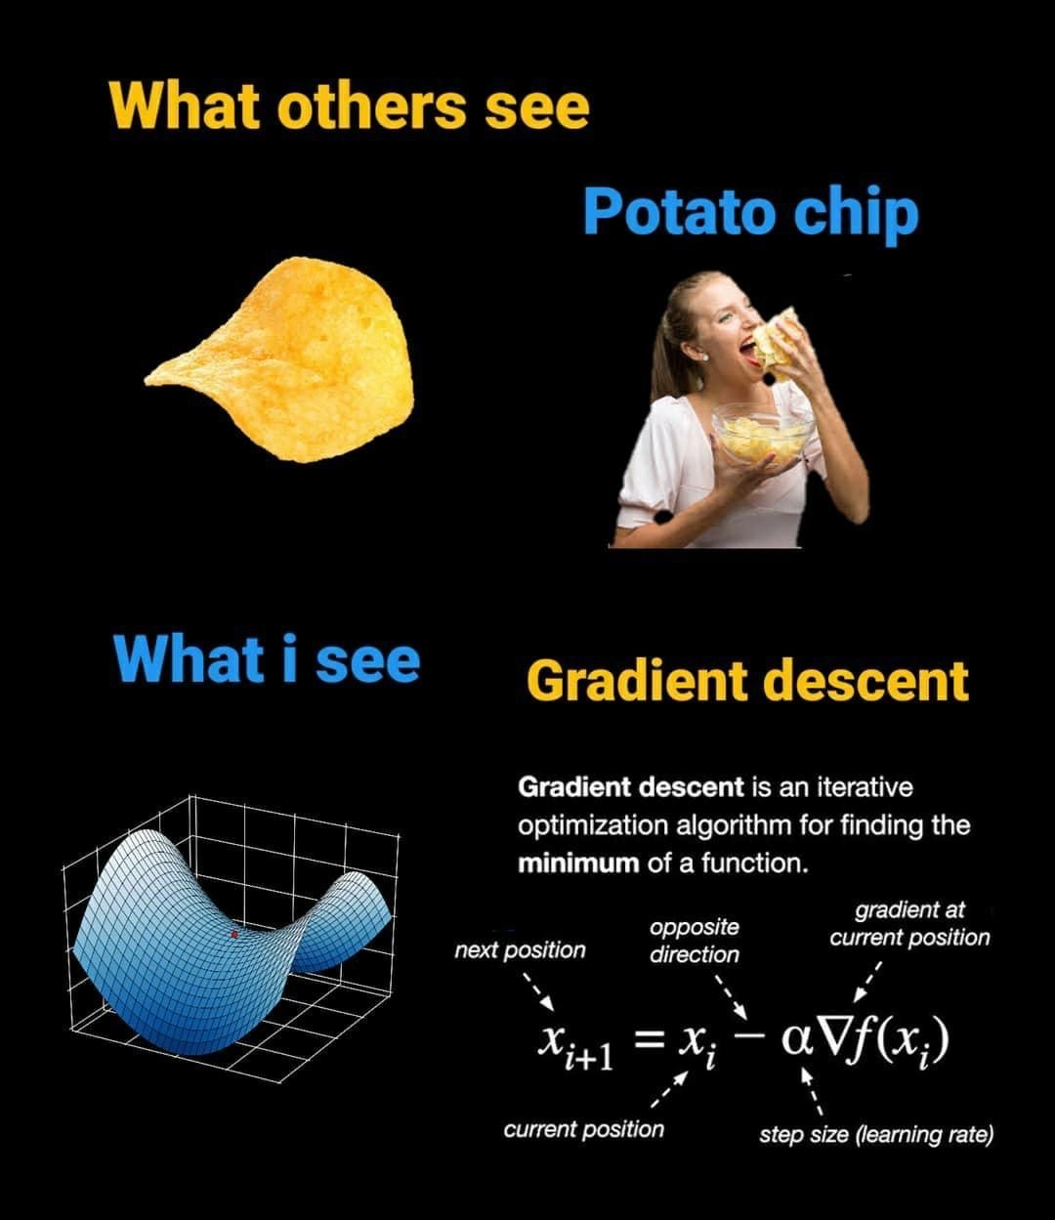

Slide 35
Gradient Evaluation (Python)
def f(x):
y = 0.5 * (x**4) - 2 * (x**2) + x + 5
return y
# 1) Numerical Method
h = 0.001
gradient = (f(x + h) - f(x)) / h
# 2) Analythic Method
def f_prime(x):
y_prime = 2 * (x**3) - 4 * x + 1
return y_prime
gradient = f_prime(x)

Slide 36
Gradient Descent (Python)
def GD(W0, X, goal, learningRate):
perfGoalNotMet = true
W = W0
while perfGoalNotMet:
gradient = eval_gradient(X, W)
W_old = W
W = W – learningRate * gradient
perfGoalNotMet = sum(abs(W - W_old)) > goal

Slide 37
Mini-batch Gradient Descent
Also known as Stochastic Gradient Descent (SGD)
Only use a small portion of the training set to compute the gradient:
. . .
while perfGoalNotMet:
X_batch = select_random_subsample(X)
gradient = eval_gradient(@loss, X_batch, W)
. . .
Common mini-batch sizes are 32/64/128 examples, e.g. Krizhevsky’s ILSVRC ConvNet used 256 examples

Slide 38
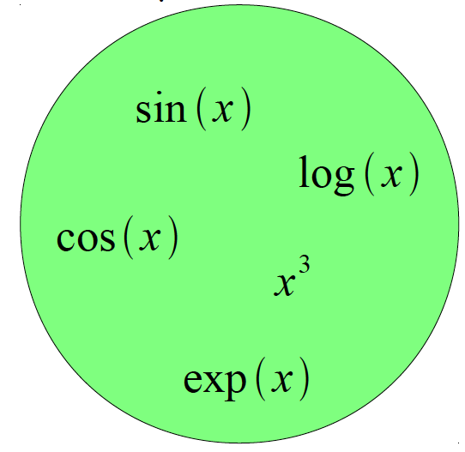
Logistic Regression as a Cascade
Given a library of simple functions
Compose into a
complicate function

Slide 39
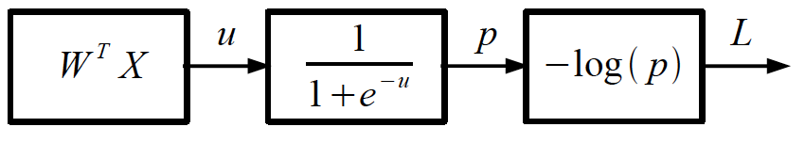
Logistic Regression as a Cascade
Given a library of simple functions
Compose into a
complicate function

Slide 40
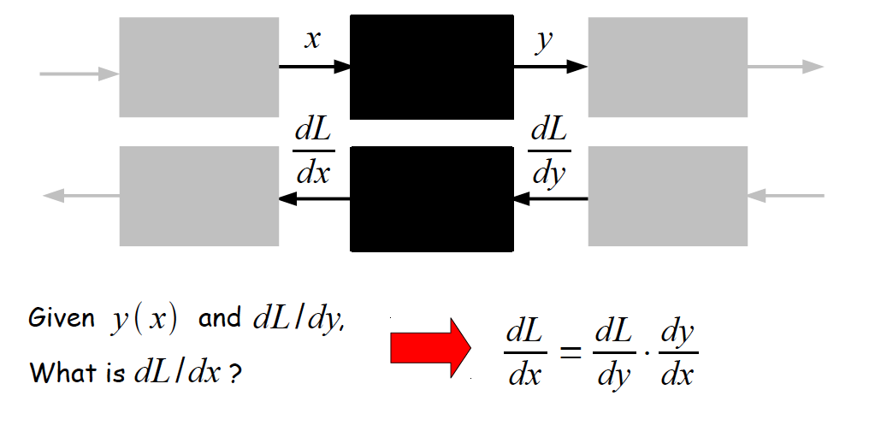
Chain Rule

Slide 41
Chain Rule

Slide 42
Chain Rule: All local

Slide 43
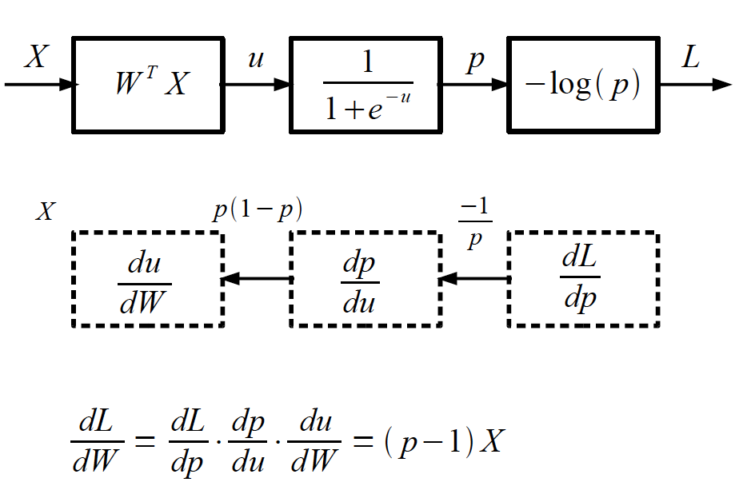
Logistic Regression as a Cascade

Slide 44
Logistic Regression as a Cascade

Slide 45
Logistic Regression as a Cascade

Slide 46
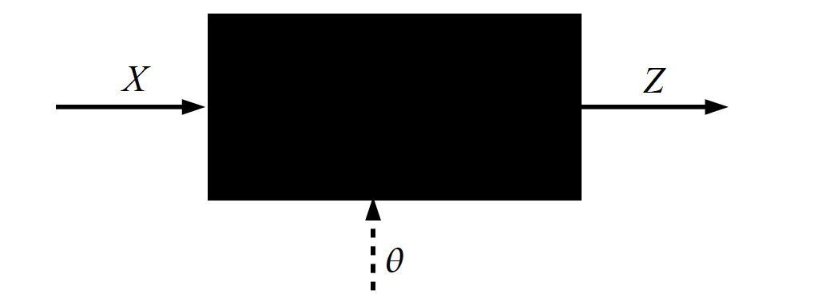
Key Computation: Forward-Prop

Slide 47
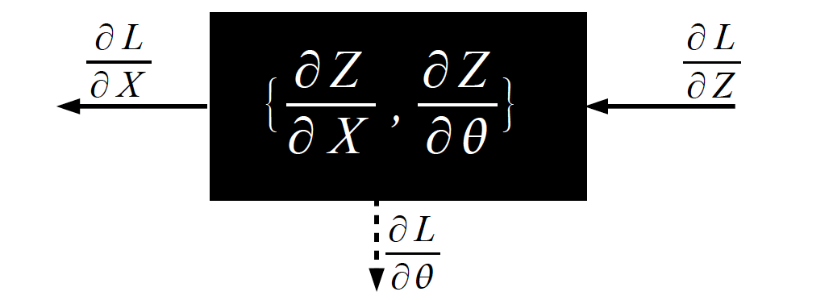
Key Computation: Back-Prop

Slide 48
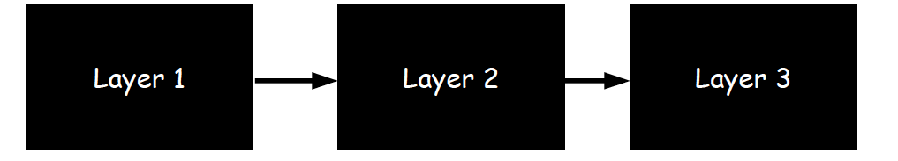
Neural Network Training
Step 1: Compute Loss on mini-batch [F-Pass]

Slide 49
Neural Network Training
Step 1: Compute Loss on mini-batch [F-Pass]

Slide 50
Neural Network Training
Step 1: Compute Loss on mini-batch [F-Pass]

Slide 51
Neural Network Training
Step 1: Compute Loss on mini-batch [F-Pass]
Step 2: Compute gradients w.r.t. parameters [B-Pass]

Slide 52
Neural Network Training
Step 1: Compute Loss on mini-batch [F-Pass]
Step 2: Compute gradients w.r.t. parameters [B-Pass]

Slide 53
Neural Network Training
Step 1: Compute Loss on mini-batch [F-Pass]
Step 2: Compute gradients w.r.t. parameters [B-Pass]

Slide 54

Neural Network Training
Step 1: Compute Loss on mini-batch [F-Pass]
Step 2: Compute gradients w.r.t. parameters [B-Pass]
Step 3: Use gradient to update parameters

Slide 55
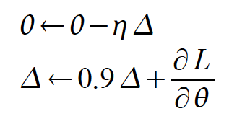
Neural Network Training
Step 1: Compute Loss on mini-batch [F-Pass]
Step 2: Compute gradients w.r.t. parameters [B-Pass]
Step 3: Use gradient to update parameters
- with momentum

Slide 56
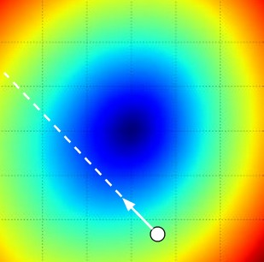
W₂
W^{(current)}
W₁
Negative direction of the gradient

Slide 57
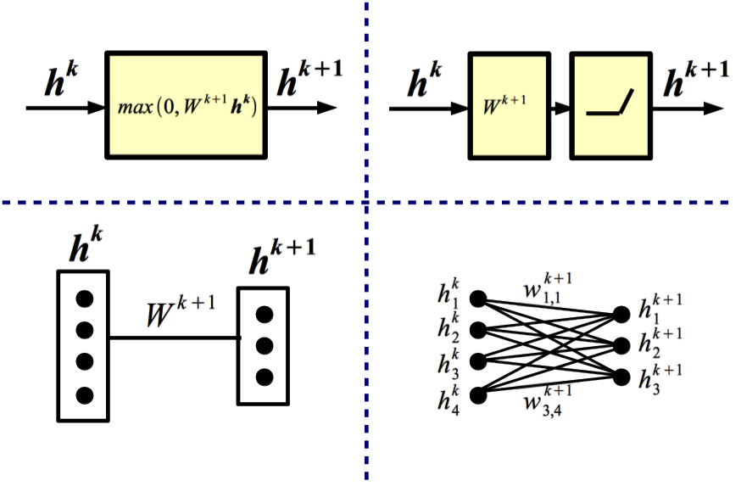
Equivalent Representations

Slide 58
Backward Propagation
Question: Does BPROP work with sigmoid activations only?
Answer: Nope, any almost everywhere differentiable transformation works.
Question: What is the computational cost of BPROP?
Answer: About twice FPROP (need to compute gradients w.r.t. input and parameters at every layer).
Note: FPROP and BPROP are dual of each other. E.g.:
FPROP
BPROP
SUM
+
COPY
+

