Slide 1
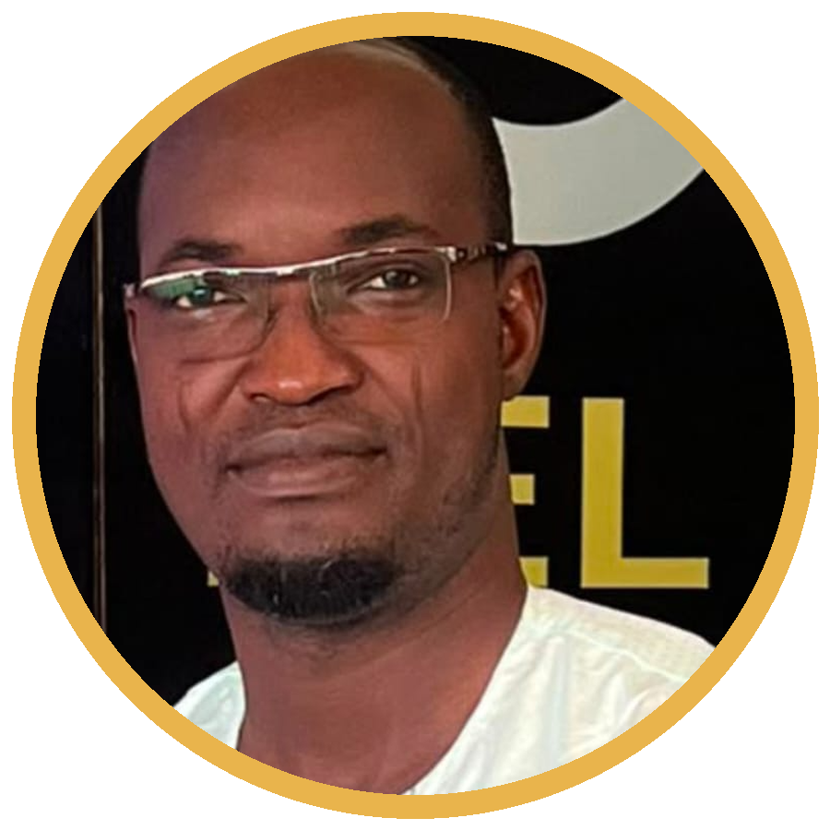
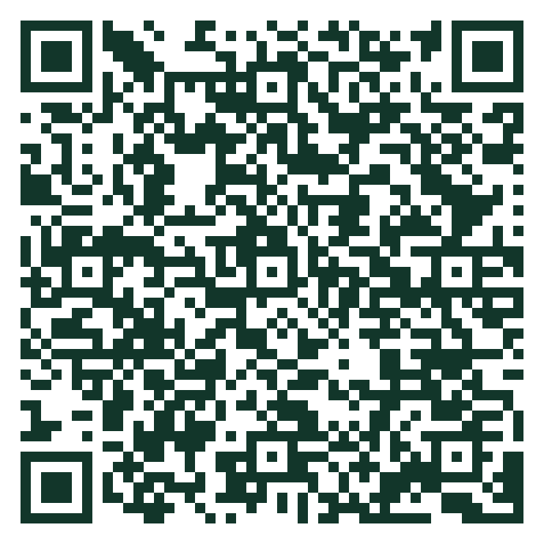

SKILL SESSION · 90 MIN · HANDS-ON
Mastering the Scientific Narrative
A Practical Guide to Reading and Writing High-Impact AI Research Papers
Dr. Ing. Castro G. Hounmenou
Castro Gbêmêmali Hounmenou
University of Labé (UL) · CERFIG, Guinea
castro.hounmenou@univ-labe.edu.gn
RESOURCE KIT
Scan now — templates, checklist & reading list are live from this first slide.
Theme: Sovereign Intelligence
Notes:
⏱ 00:00–00:01 | RÉGIE : Souriez, regardez la salle, attendez le silence. Diapo affichée pendant l'installation.
SAY: "Good morning everyone! My name is Castro Hounmenou, from the University of Labé and CERFIG in Guinea. I work on AI applications and I review papers — which means I've seen hundreds of brilliant African ideas fail in writing, and I've seen average ideas succeed because they were written well. In the next 90 minutes, I will give you the two skills that separate those outcomes: reading papers like an expert, and writing papers that get accepted. This is a workshop — you WILL write today. Ready? Let's go."
TRANSITION : cliquez vers le sondage.

Slide 2



YOUR FACILITATOR
Who is standing in front of you?
★
PhD, Statistics–Probability
★
50+ indexed publications
Machine Learning & Data Mining. 15+ years leading data-collection and statistical analysis projects across West Africa.
Machine learning, epidemiology and agro-climatology — including work shown at NeurIPS workshops.
★
World Top Scientist 2024
★
Guinea's AI Strategy
In Biostatistics. Best Researcher Award 2025 in Infectious Disease Modeling.
Member of the national Scientific Committee — and a reviewer who has read hundreds of submissions.
Dr. Ing. Castro G. Hounmenou
Assistant Professor of AI, Université de Labé · Post-doc, CERFIG
Why this matters: I sit on both sides of the review process — today you get what I look for when I read your paper.
Mastering the Scientific Narrative · C. G. Hounmenou · Skill Session
Resource Kit →
2
Notes:
⏱ 00:01–00:02 | RÉGIE : slide de crédibilité. Ne le lisez PAS ligne par ligne — 45 secondes max.
SAY: "Thirty seconds on why you should listen to me. I am an Assistant Professor of AI at the University of Labé and a post-doctoral researcher at CERFIG. My PhD is in Statistics and Probability — machine learning and data mining. Over fifty indexed publications, and fifteen years running data-collection projects across West Africa."
POINT CLÉ — SAY: "But here is the part that matters for you today: I am also a reviewer. I have read hundreds of submissions. So everything I show you in the next ninety minutes is what I actually look for when I read your paper."
RÉGIE : montrez le QR en bas à droite — "the kit is already live, scan it now, you will need the template in forty minutes."

Slide 3


OPENING · BLOCK 1
OPENING · ICEBREAKER
2 min
Let's be honest for a second…
Let's be honest for a second…
Poll 1
Poll 2
Who has ever opened a research paper…
and closed it after two minutes?
Who has already submitted to a
conference or a journal?
Raise your hand — no judgement!
Keep it up — you are our witnesses today.
Why this matters: both hands tell the same story — reading and writing papers are learnable skills, not talents. Today you leave with a method for each.
Mastering the Scientific Narrative · C. G. Hounmenou · Skill Session
Resource Kit →
3
Notes:
⏱ 00:01–00:03 | RÉGIE : Levez vous-même la main pour modéliser le geste. Comptez à voix haute ("wow, almost everyone!").
SAY: "Quick poll, be honest. Poll 1: who has ever opened a research paper... and closed it after two minutes? [main levée] Look around — you are not alone! Poll 2: who has already submitted to a conference or journal? [quelques mains] Keep those hands up — you are our witnesses today."
POINT CLÉ — SAY: "Notice the gap between the two polls. Many of us struggle to read; few of us have submitted. That gap is not talent — it's method. Reading and writing papers are LEARNABLE skills, and today you get both methods."
PIÈGE À ÉVITER : ne commentez jamais négativement le faible nombre de mains au Poll 2.

Slide 4
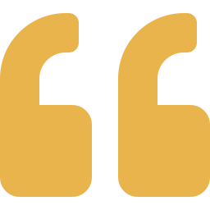
Research that is not written does not exist.
Research that is not published does not travel.
AI research is not only about writing code. It is about establishing African scientific agency — documenting and publishing local innovations where the global community reads them.
NeurIPS
ICLR
CVPR
Nature MI
AfricaNLP
Indaba
Sovereign Intelligence → Sovereign Narrative. Owning our stories is how African-led solutions get peer-reviewed, cited, and built upon.
Resource Kit →
Notes:
⏱ 00:03–00:04 | RÉGIE : Ralentissez le débit. C'est le slide "pourquoi" — le lien avec le thème Sovereign Intelligence.
SAY: "Here is the premise of this session. Research that is not written does not exist. Research that is not published does not travel. You can build the best crop-disease model in West Africa — if it lives only on your laptop, the world will cite someone else's inferior version. AI research is not only about writing code; it is about establishing African scientific agency: documenting and publishing OUR innovations in the venues the world reads — NeurIPS, ICLR, CVPR, Nature Machine Intelligence, and our own growing venues like AfricaNLP and the Deep Learning Indaba."
SAY (plus lentement): "Sovereign Intelligence requires a Sovereign Narrative. Owning our stories is how African-led solutions get peer-reviewed, cited, and built upon."

Slide 5



OPENING · ROADMAP
Our 90 minutes together
1
2
3
4
5
6
Opening & context
Anatomy of an AI paper
3-Pass reading method
The Writing Blueprint
Resource Kit + Q&A
Write your abstract in Overleaf
5'
8'
14'
18'
7'
23'
Superpower 1 — Read efficiently
Superpower 2 — Write with impact
Deconstruct any dense AI paper with the systematic 3-Pass method.
Build a scientific story that meets NeurIPS / ICLR reviewer standards.
+ 15 extra minutes of open discussion at the end — and the Resource Kit is already live on the QR code, from slide 1.
Mastering the Scientific Narrative · C. G. Hounmenou · Skill Session
Resource Kit →
5
Notes:
⏱ 00:04–00:05 | RÉGIE : 60 secondes max. Balayez la timeline de gauche à droite avec la main.
SAY: "Here's our hour together. Five minutes of context — almost done. Eight minutes on the anatomy of an AI paper. Fourteen minutes on the 3-Pass reading method, with a live demo. Eighteen minutes on the Writing Blueprint — four steps. Then the golden block [pointez la carte dorée]: nine minutes where YOU write a real abstract. And we close with Q&A and your Resource Kit."
SAY: "Two superpowers, one kit, sixty minutes. Let's open the paper."
TRANSITION : enchaînez immédiatement — pas de questions ici, le Q&A vient à la fin.

Slide 6


PART 1 · THE ANATOMY OF AN AI PAPER
8 min
The structural DNA of a modern AI paper
Classic science (IMRAD)
Modern ML style (NeurIPS / ICLR / CVPR)
Introduction
Title + Abstract the paper in 200 words — 80% of readers stop here
Methods
Introduction problem, gap, contributions (often as a bullet list)
Related Work position yourself in the conversation
Results
Methodology your model / approach, with clear notation
And
Experiments & Results datasets, baselines, metrics, ablations
Discussion
Discussion · Limitations · Broader Impact honesty builds trust
Same skeleton, new muscles: ML papers add Related Work, ablations and Broader Impact.
Mastering the Scientific Narrative · C. G. Hounmenou · Skill Session
Resource Kit →
6
Notes:
⏱ 00:05–00:07 | RÉGIE : Début de la Partie 1 (8 min au total). Pointez d'abord la colonne IMRAD, puis l'écran de droite ligne par ligne.
SAY: "Good news: every scientific paper you have ever feared has the same skeleton. Classic science calls it IMRAD: Introduction, Methods, Results And Discussion. Modern machine-learning venues — NeurIPS, ICLR, CVPR — use an extended version of exactly the same skeleton."
SAY (en pointant la ligne dorée): "Look at the first row: Title plus Abstract. Here is the number that should change how you write: roughly 80% of readers never go past the abstract. The abstract is not a summary you write at the end — it IS the paper for most of humanity."
SAY: "The additions are Related Work — positioning yourself in the conversation — ablations inside Experiments, and a Broader Impact statement. Same skeleton, new muscles."

Slide 7

PART 1 · THE ANATOMY OF AN AI PAPER
The hidden logic — every section answers one question
Abstract
Introduction
“Why should I spend 10 minutes on this paper?”
“What problem, what gap, what is new here?”
Related Work
Methodology
“How is this different from what already exists?”
“Could I re-implement this myself?”
Results
Limitations
“What is the evidence — and is it fair?”
“Where does this honestly stop working?”
Reading tip: before reading a section, say its question out loud. Writing tip: if your section does not answer its question, rewrite it.
Mastering the Scientific Narrative · C. G. Hounmenou · Skill Session
Resource Kit →
7
Notes:
⏱ 00:07–00:08 | RÉGIE : Lisez 3 des 6 questions à voix haute avec énergie, comme si un reviewer les posait.
SAY: "Now the secret that changes everything: every section is the answer to ONE question a busy reader is silently asking. The Abstract answers: 'Why should I spend ten minutes on this paper?' The Introduction: 'What problem, what gap, what is new?' The Methodology: 'Could I re-implement this myself?' Limitations: 'Where does this honestly stop working?'"
SAY: "This gives you two tools. Reading tip: before reading a section, say its question out loud — you'll instantly know what to look for. Writing tip: if your section does not answer its question, rewrite it. Simple, brutal, effective."

Slide 8

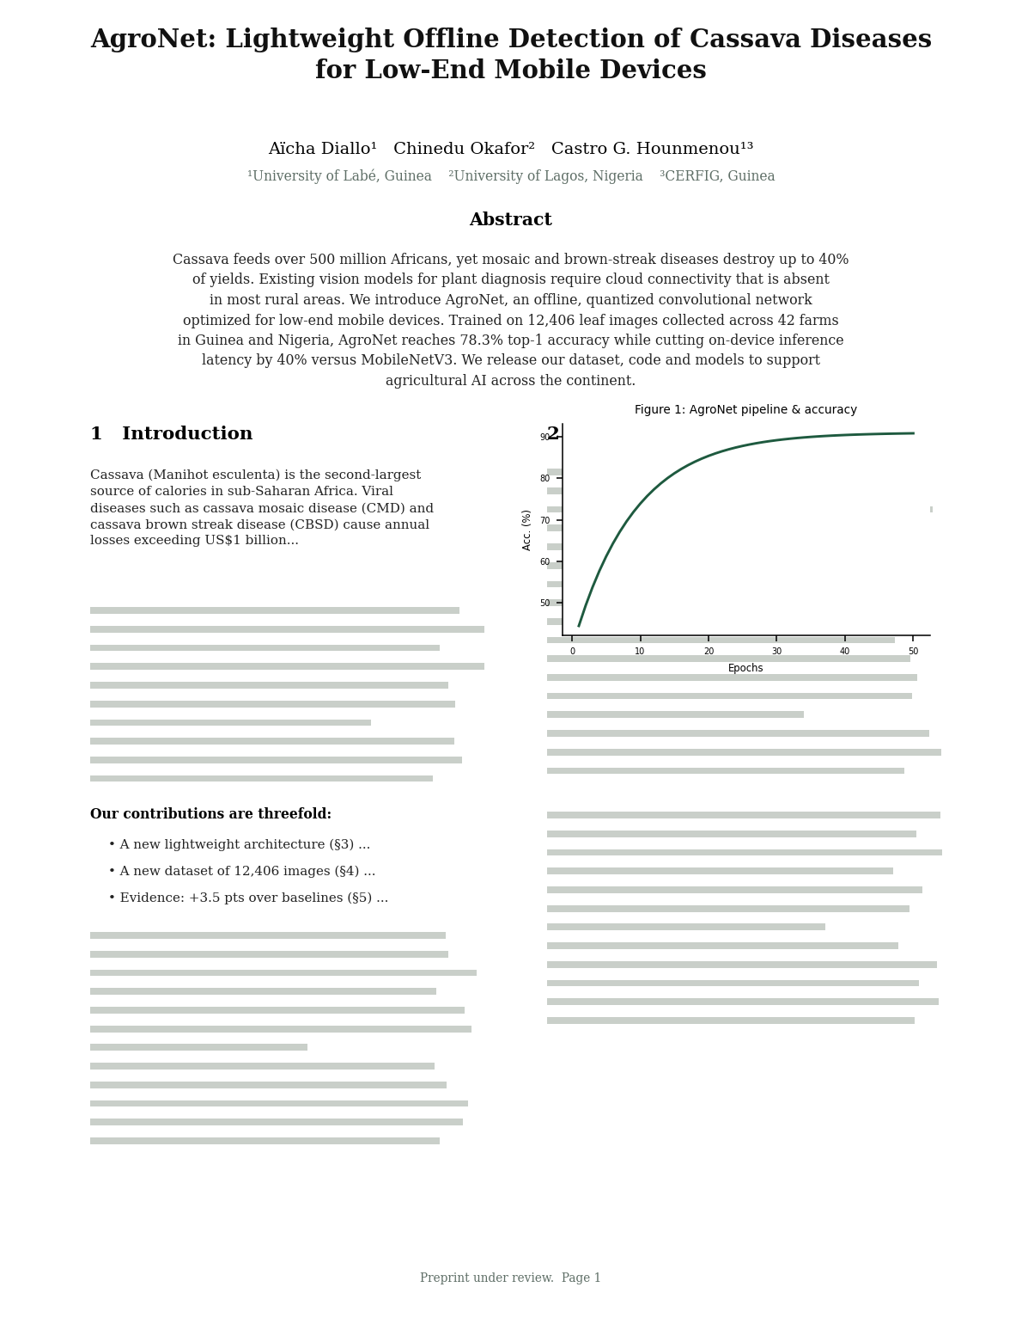
PART 1 · THE ANATOMY OF AN AI PAPER
Visual map — page 1 of a NeurIPS paper
1
1
Title — a promise in ≤ 15 words
2
Authors & affiliations — your African lab on the map
2
3
3
Abstract — the paper in miniature (our exercise later!)
4
Figure 1 — often summarizes the whole idea; readers jump here
4
5
Contributions list — reviewers hunt for this bullet list
5
Live demo: we open a real annotated paper (African AI example) and locate 1→5 together.
Mastering the Scientific Narrative · C. G. Hounmenou · Skill Session
Resource Kit →
8
Notes:
⏱ 00:08–00:10 | RÉGIE : Slide clé de la Partie 1. La page affichée est la page 1 de "AgroNet" — notre exemple fil rouge (fictif mais réaliste). Ayez la version imprimée en main et brandissez-la.
SAY: "Here is page one of a real-style paper — AgroNet, cassava disease detection on cheap phones. This exact paper will follow us through the whole session. Let's locate the five vital organs."
SAY (pointez chaque pastille): "One — the title: a promise in fifteen words or less. Two — authors and affiliations: this is your African lab entering the world map; never undersell it. Three — the abstract: the paper in miniature; you will write one in thirty minutes. Four — Figure 1: experienced readers jump here FIRST, before reading a single sentence; if Figure 1 tells your story, you have already won. Five — the contributions list: reviewers hunt for these bullets."
RÉGIE : distribuez ou faites circuler l'extrait imprimé maintenant — il servira pour la démo du 3-Pass.

Slide 9


PART 1 · THE ANATOMY OF AN AI PAPER
The beating heart: the contributions list
At the end of every strong Introduction, reviewers expect an explicit list:
“Our contributions are threefold:”
Reviewer's lens
A new method — we propose X, the first … for low-resource settings;
A new resource — we release a dataset of N samples collected in …;
New evidence — X outperforms strong baselines by Y% on Z benchmarks.
Each claimed contribution must be verifiable in the Results section. Claim 3 things, prove 3 things.
Types of contribution: method · dataset/resource · benchmark · analysis/theory · open-source tool.
Mastering the Scientific Narrative · C. G. Hounmenou · Skill Session
Resource Kit →
9
Notes:
⏱ 00:10–00:11 | RÉGIE : Restez sur l'exemple AgroNet ; le cadre de droite est le point de vue reviewer.
SAY: "Zoom on organ number five: the contributions list. At the end of every strong introduction, reviewers expect the explicit sentence: 'Our contributions are threefold.' A method. A resource. Evidence."
SAY (pointez le cadre doré): "And here is the reviewer's iron law: contributions are PROMISES; results are PROOFS. Claim three things, prove three things. Claim four and prove three? Rejected."
SAY: "Note the second bullet carefully: releasing an African dataset is a first-class scientific contribution — remember that; we come back to it with FAIR data."

Slide 10

PART 1 · THE ANATOMY OF AN AI PAPER
A real abstract, dissected
The 5 moves of a great abstract
AgroNet — Abstract (the paper you just saw)
Cassava feeds over 500 million Africans, yet mosaic and brown-streak diseases destroy up to 40% of yields. Existing vision models for plant diagnosis require cloud connectivity that is absent in most rural areas. We introduce AgroNet, an offline, quantized convolutional network optimized for low-end mobile devices. Trained on 12,406 leaf images collected across 42 farms in Guinea and Nigeria, AgroNet reaches 78.3% top-1 accuracy while cutting inference latency by 40% versus MobileNetV3. We release our dataset, code and models to support agricultural AI across the continent.
CONTEXT — stakes & numbers
GAP — what blocks the world
METHOD — your one-line answer
RESULTS — data + hard numbers
IMPACT — the door you open
Our 3-sentence exercise compresses these 5 moves into 3: Context+Gap → Method → Results+Impact.
Mastering the Scientific Narrative · C. G. Hounmenou · Skill Session
Resource Kit →
10
Notes:
⏱ 00:11–00:12 | RÉGIE : Nouveau slide "abstract disséqué". Lisez l'abstract EN ENTIER à voix haute, en changeant légèrement de ton à chaque couleur.
SAY: "Before we leave anatomy, let's dissect the AgroNet abstract, move by move — because great abstracts are engineered, not inspired. [Lisez.] Green: CONTEXT — 500 million people, 40% losses; stakes with numbers. Red: the GAP — cloud connectivity absent in rural areas; the wall the world hits. Dark: METHOD — one sentence, one system, its key property: offline, quantized, low-end devices. Gold: RESULTS — 12,406 images, 42 farms, 78.3%, minus 40% latency; numbers, not adjectives. Blue: IMPACT — we release everything; the door we open."
SAY: "Five moves. In our exercise you will compress them into three sentences: context-plus-gap, method, results-plus-impact. Keep this structure in your head."

Slide 11



PART 1 · THE ANATOMY OF AN AI PAPER
Inside the mind of a reviewer
What gets scored
Common desk-rejection causes
Clarity of the core contribution
can I state it in one sentence?
Missing or weak baselines
Novelty
what is genuinely new vs. related work?
Unclear notation, undefined symbols
Rigor & reproducibility
protocol, baselines, code, seeds
Overclaiming (“solves”, “first ever”)
Quality of evidence
fair comparisons, honest error bars
Unreadable figures, no axis labels
Mini-quiz (show of hands): I read two abstracts aloud — A (vague, overclaiming) vs B (precise, evidence-based). Which one would YOU accept?
Mastering the Scientific Narrative · C. G. Hounmenou · Skill Session
Resource Kit →
11
Notes:
⏱ 00:12–00:13 | RÉGIE : Mini-quiz oral. Préparez mentalement les 2 abstracts parlés (A vague / B précis).
SAY: "So who are we writing for? A tired, skeptical volunteer reading 8 papers this weekend. On the left, what reviewers score: can I state the contribution in ONE sentence? Is it genuinely new? Can I reproduce it? Is the evidence fair? On the right, the desk-rejection classics: missing baselines, undefined symbols, overclaiming — the words 'we solve' are a red flag — and unreadable figures."
QUIZ — SAY: "Mini-quiz. Abstract A: 'We use AI to improve agriculture in Africa. Our results are very good and promising.' Abstract B: 'We introduce AgroNet, evaluated on 12,406 images from 42 farms, reaching 78.3% accuracy, +3.5 points over MobileNetV3.' Hands up for A? [silence amusé] For B? [toutes les mains] Exactly. Precision wins. Always."
TRANSITION : "You now know what a paper IS. Next: how experts READ one — fast."

Slide 12
CASE STUDY · A REAL AFRICAN PAPER
From a field in Benin to a NeurIPS poster
A real African paper, told properly — this is narrative sovereignty in practice.
1
2
3
4
The local question
The African dataset
The honest result
The global venue
Climate change is cutting maize yields in Benin, and farmers cannot control the weather. Which climatic parameters actually drive a high yield?
26 years (1995–2020) of climate and maize-yield data, 5 districts with synoptic stations, across two agro-climatic zones — Sudanian and Sudano-Guinean.
A decision tree fits almost perfectly (R² = 0.998) but nobody can read it — so the team mined frequent patterns to produce rules a farmer can act on.
Presented at a NeurIPS 2022 workshop, then published in IJ-AI (2024). Local problem → global conversation.
Read the paper: Tahi, Houndji, Hounmenou & Glèlè Kakaï — IJ-AI 13(4):3930–3941, 2024. Full reference in your kit.
Mastering the Scientific Narrative · C. G. Hounmenou · Skill Session
Resource Kit →
12
Notes:
⏱ 00:11–00:12 | RÉGIE : c'est LE slide qui rend la souveraineté narrative concrète. Ralentissez.
SAY: "Let me show you a real paper. Not an American paper — a Beninese one. The question was local: climate change is cutting maize yields, and farmers cannot control the weather. Which climatic parameters actually drive a high yield?"
SAY: "The dataset is African: twenty-six years of climate and yield data, five districts with synoptic stations, two agro-climatic zones. And look at step three — this is my favourite part. The decision tree fitted almost perfectly, R-squared 0.998. A weaker team would have stopped there and claimed victory. But nobody can READ a decision tree. So the team mined frequent patterns to produce rules a farmer can actually act on. That honesty IS the contribution."
PUNCH — SAY: "And where did it go? A NeurIPS workshop, then a journal. Local question, African data, global venue. That is narrative sovereignty. That is what we are learning to do today."
NOTE : Castro est co-auteur — dites-le simplement, sans vantardise : "I am one of the co-authors, so I can tell you exactly what the reviewers asked."

Slide 13
CASE STUDY · THE ABSTRACT THAT WORKS
A published African abstract, move by move
Odounfa, Hounmenou et al. — Discover Artificial Intelligence, 2025
1
CONTEXT
the crop, the region, the stakes
Chili pepper is a major crop in West Africa, but anthracnose and TYLCV severely cut its yields and farmers' income. Visual inspection is slow, labour-intensive and depends on individual expertise. We built a dataset of 534 leaf images collected in Benin under varied lighting, angles and backgrounds, and compared 13 deep-learning models. YOLOv8 reaches mAP@0.5 = 0.995 while MobileNetV2 and DenseNet121 reach 96.25% accuracy; YOLOv8 runs in 1.2 ms per image with only 3.1M parameters. Deep learning can therefore support real-time, automated disease detection for smallholder farmers.
2
GAP
why today's practice fails
3
METHOD
the dataset + what was compared
4
RESULTS
named metrics, exact numbers
5
IMPACT
the door it opens
Notice: no adjective does any work. Every claim is a number a reviewer can check, against a named baseline.
Mastering the Scientific Narrative · C. G. Hounmenou · Skill Session
Resource Kit →
13
Notes:
⏱ 00:12–00:13 | RÉGIE : laissez 15 secondes de lecture silencieuse avant de parler.
SAY: "Here is a published abstract from a paper I co-authored last year — chili pepper disease detection in Benin. Read it for fifteen seconds. [silence] Now watch the five moves on the right."
SAY: "Context: the crop, the region, the stakes. Gap: visual inspection is slow and depends on individual expertise. Method: 534 images collected in Benin, thirteen models compared. Results: YOLOv8 at mAP 0.995, MobileNetV2 and DenseNet121 at 96.25%, 1.2 milliseconds per image, 3.1 million parameters. Impact: real-time detection for smallholder farmers."
POINT CLÉ — SAY: "Now count the adjectives doing real work in that abstract. Zero. No 'revolutionary', no 'very accurate'. Every single claim is a number a reviewer can check, against a baseline we name. THAT is what gets accepted."
TRANSITION : "Keep these five moves in your head — in forty minutes you will compress them into three sentences of your own."

Slide 14

PART 2 · READING WITH PURPOSE · 14 MIN
Why we read badly
The linear, page-by-page approach fails on math-heavy ML papers with 30-page appendices. You run out of time and confidence before reaching the point.
Page 1 → page N
reading like a novel
Every equation
decoding all proofs on first contact
No decision point
never asking “is this worth my time?”
The fix: S. Keshav's “3-Pass” method (2007) — read a paper in up to three deliberate passes, each with a goal, a duration, and an exit door.
Resource Kit →
Notes:
⏱ 00:13–00:15 | RÉGIE : Slide sombre = respiration. Début Partie 2 (14 min). Ton complice sur les 3 cartes.
SAY: "Let's diagnose why we read badly. Habit one: page 1 to page N, like a novel — but a NeurIPS paper is not a novel, it's a legal document with appendices. Habit two: decoding every equation on first contact — you drown on page 3. Habit three, the worst: no decision point; we never ask 'is this paper worth my time?'"
SAY: "The fix comes from S. Keshav at the University of Waterloo — a two-page classic from 2007 called 'How to Read a Paper', which is in your Resource Kit. His idea: read in up to three deliberate passes. Each pass has a goal, a time budget, and an exit door. Pass one..."

Slide 15
PART 2 · THE 3-PASS METHOD
5–10'
Pass 1 — The quick scan
Read ONLY: title · abstract · introduction · section headings · figures · conclusions.
Then answer the 5 C's:
C1
C2
C3
C4
C5
Category
Context
Correctness
Contributions
Clarity
What type of paper is it? (method, benchmark, survey…)
Which prior work does it build on?
Do the assumptions look valid?
What are the claimed novelties?
Is it well written?
Exit door: after Pass 1 you DECIDE — discard, keep for reference, or go deeper. Most papers legitimately stop here. This is also how reviewers and busy PIs will read YOUR paper.
Mastering the Scientific Narrative · C. G. Hounmenou · Skill Session
Resource Kit →
15
Notes:
⏱ 00:15–00:17 | RÉGIE : Slide central de la méthode. Insistez physiquement sur "ONLY".
SAY: "Pass 1, the quick scan: five to ten minutes, and you read ONLY six things — title, abstract, introduction, section headings, figures, conclusions. You are FORBIDDEN from reading the method section. Yes, forbidden — it feels wrong, do it anyway."
SAY: "Then you answer Keshav's five C's. Category: what type of paper — method, benchmark, survey? Context: what does it build on? Correctness: do the assumptions look sane? Contributions: what's claimed as new? Clarity: is it well written?"
SAY (pointez le bandeau doré): "And here is the exit door: after Pass 1, you DECIDE — discard, keep for reference, or go deeper. Most papers legitimately stop here, and that is a victory, not a failure. Now flip it: this is also how reviewers will read YOUR paper. Your title, figures and headings must carry the story alone."

Slide 16

PART 2 · THE 3-PASS METHOD
≤ 1 h
Pass 2 — Grasping the content
1
Read with care, skip the proofs — note key theorems, ignore heavy derivations for now
Success test
2
Interrogate every figure & table — axes, units, error bars — is the evidence convincing?
You pass Pass 2 when you can summarize the paper's main idea, evidence and limits to a colleague — without opening it.
3
Trace the experimental setup — datasets, baselines, metrics, hyperparameters
4
Take structured notes in the margin — your future self is your first reader
5
Mark the references you must read next — this grows your literature map
It is normal not to understand everything — jot questions; some resolve in Pass 3, some become YOUR research ideas.
Mastering the Scientific Narrative · C. G. Hounmenou · Skill Session
Resource Kit →
16
Notes:
⏱ 00:17–00:19 | RÉGIE : Rythme soutenu ; la carte de droite "Success test" est le point d'ancrage.
SAY: "Pass 2 — you decided the paper deserves an hour. Read with care but SKIP the proofs — note the theorems, ignore the heavy derivations for now. Interrogate every figure and table: axes, units, error bars — is this evidence actually convincing? Trace the experimental setup: which datasets, which baselines, which metrics. Take structured notes in the margin — your future self is your first reader. And mark the references you must read next: that's how a literature map grows."
SAY (carte de droite): "The success test is simple: you pass Pass 2 when you can summarize the paper's main idea, evidence and limits to a colleague — without opening it. And listen: it is NORMAL not to understand everything. Write your questions down. Some resolve in Pass 3. Some become your next paper."

Slide 17



PART 2 · THE 3-PASS METHOD
1–5 h
Pass 3 — Critical reconstruction
Virtually re-implement the paper: re-derive the approach with the same assumptions, then compare your reconstruction with the authors' choices.
Rebuild
Expose
Project
Re-derive the method step by step; challenge every design choice — “why a transformer here and not a CNN?”
Identify hidden assumptions, missing baselines, weak statistics, and failure cases the authors did not test.
Ask: “What would I have done differently? What experiment is missing?” — this is where new papers are born.
When to invest in Pass 3: papers central to your own research, literature reviews, and when you serve as a peer reviewer.
Mastering the Scientific Narrative · C. G. Hounmenou · Skill Session
Resource Kit →
17
Notes:
⏱ 00:19–00:21 | RÉGIE : Dernier étage de la fusée. Vendez l'angle "carrière" (peer review).
SAY: "Pass 3 — critical reconstruction. One to five hours, reserved for maybe one paper in twenty. The exercise: virtually RE-IMPLEMENT the paper. Rebuild: re-derive the method step by step and challenge every choice — why a transformer here and not a CNN? Expose: find the hidden assumptions, the missing baselines, the failure cases the authors did not test. Project: ask 'what would I have done differently? what experiment is missing?' — that question is where new papers are born."
SAY: "Career note: Pass-3 reading IS the skill of a peer reviewer. Workshops like AfricaNLP welcome young reviewers — it's the single fastest way to enter the community and to learn what acceptance looks like from the other side."

Slide 18
LIVE DEMO · 4 MIN
Watch my eyes: Pass 1 on a real paper
Demo paper (African AI context — printed excerpt in your hands):
e.g., a Masakhane NLP paper, or an AI-for-drought-prediction / crop-disease-detection paper
1
2
3
4
Title + abstract
~60 sec
Headings + Figure 1
~90 sec
Conclusions
~60 sec
Verdict: the 5 C's out loud
~60 sec
A visible timer runs on screen. Follow along on your printed copy — you'll do this yourselves in a moment.
Resource Kit →
Notes:
⏱ 00:21–00:22 (puis démo 22:00–25:00) | RÉGIE : Slide de lancement. Vérifiez que chacun a l'extrait imprimé. Lancez un minuteur VISIBLE (téléphone sur la caméra ou minuteur à l'écran).
SAY: "Enough theory. I will now do Pass 1 in front of you, on a real paper, in four minutes, thinking ALOUD — you follow on your printed excerpt. Watch where my eyes go: sixty seconds on title and abstract. Ninety seconds on headings and Figure 1 — notice I skip every equation. Sixty seconds on the conclusions. Then sixty seconds for the verdict: the five C's, out loud."
RÉGIE PENDANT LA DÉMO : verbalisez TOUT ("my eyes jump to Figure 1... I see the word 'offline', that's the gap... I skip this proof entirely..."). Le but est de rendre visible le processus invisible de l'expert. Tenez STRICTEMENT les 4 minutes — le respect du minuteur fait partie du message.

Slide 19

PART 2 · LIVE DEMO DEBRIEF
What just happened in 4 minutes?
We answered the 5 C's
category, context, correctness, contributions, clarity — from ~10% of the text
Your weekly practice
3 papers / week in Pass 1
1 paper / week in Pass 2
1 paper / month in Pass 3
We made a decision
keep / discard / go deeper — reading time is a budget you allocate
We never read the method
and yet we can already discuss the paper intelligently
≈ 90 min per week, total.
Reading is a budgeted skill: minutes in, decisions out.
Mastering the Scientific Narrative · C. G. Hounmenou · Skill Session
Resource Kit →
19
Notes:
⏱ 00:25–00:26 | RÉGIE : Débriefing énergique post-démo. La carte de droite (routine hebdo) est le cadeau pratique.
SAY: "What just happened? In four minutes we answered the five C's from about ten percent of the text. We made a DECISION — reading time is a budget you allocate, not a debt you owe. And notice: we never read the method — yet we can already discuss this paper intelligently in a lab meeting."
SAY (carte de droite): "Your sustainable routine, starting this week: three papers per week in Pass 1, one per week in Pass 2, one per MONTH in Pass 3. Total: about ninety minutes a week. That's one football match. In six months you will have triaged over seventy papers and deeply own a dozen — that is a literature review."

Slide 20

PART 2 · RECAP
The 3-Pass method at a glance
Pass | Goal | Time / paper | Output
1 · Scan | Triage — get the bird's-eye view (5 C's) | 5–10 min | Decision: discard / keep / deepen
2 · Grasp | Understand content, evidence, figures | up to 1 h | Summary you can tell a colleague
3 · Reconstruct | Virtually re-implement; critique deeply | 1–5 h | Strengths, weaknesses, new ideas
Tools that multiply the method
Zotero / Mendeley
reference managers
Notion / Obsidian
structured reading notes
Elicit · Scite.ai
AI-assisted discovery — verify, never outsource judgement
Mastering the Scientific Narrative · C. G. Hounmenou · Skill Session
Resource Kit →
20
Notes:
⏱ 00:26–00:27 | RÉGIE : Slide de synthèse — lisez le tableau ligne par ligne, c'est le take-home de la Partie 2. Prenez 1-2 questions éclair MAX.
SAY: "The whole method on one slide — also in your kit. Pass 1, scan: five to ten minutes, output a decision. Pass 2, grasp: up to an hour, output a summary you can tell a colleague. Pass 3, reconstruct: one to five hours, output strengths, weaknesses, and your own new ideas."
SAY: "Tools that multiply this: Zotero or Mendeley to manage references — non-negotiable, set it up this week. Notion or Obsidian for structured notes. Elicit and Scite for AI-assisted discovery — useful servants, terrible masters: they help you FIND papers, but Pass-2 and Pass-3 judgement cannot be delegated, especially not to a language model."
TRANSITION (pivot de la session) — SAY: "You now read like a reviewer. Time to write FOR one."

Slide 21



PART 3 · THE WRITING BLUEPRINT · 18 MIN
Building your story in four steps
A paper is not a diary of what you did — it is a story engineered for a busy, skeptical reader.
1 · Frame
2 · Core
3 · Impact
4 · Honesty
Title & Introduction that demand attention
Methodology, notation & FAIR data
Results & publication-quality figures
Discussion, limitations, conclusion
Each step maps to a section of the Scientific Writing Checklist you take home.
Resource Kit →
Notes:
⏱ 00:27–00:28 | RÉGIE : 30-40 secondes chrono. Annoncez l'architecture, ne développez rien ici.
SAY: "Part 3 — the Writing Blueprint, four steps, eighteen minutes. Hold this mindset: a paper is NOT a diary of what you did. It is a story engineered for a busy, skeptical reader. Step 1, Frame: a title and introduction that demand attention. Step 2, the Core: methodology, notation, FAIR data. Step 3, Impact: results and figures of publication quality. Step 4, Honesty: discussion, limitations, conclusion. Each step maps to one section of the checklist you take home. Step one — titles."

Slide 22
PART 3 · STEP 1 — FRAMING
Titles: your 15-word promise
Formulas that work
Traps to avoid
[Method]: [What it does] for [Problem]
“AgroNet: Lightweight Crop-Disease Detection for Offline Mobile Use”
Vague & grand
“A Novel Approach to Artificial Intelligence in Africa”
[Question or claim as hook]
“Do Multilingual Models Understand West African Languages?”
Keyword-free
reviewers & search engines can't find or classify it
[Resource] + [scale/context]
“NaijaVoices: a 500-Hour Speech Corpus for Nigerian Languages”
Overclaiming
“Solving Healthcare with Deep Learning” — no.
Test: could a stranger guess your method, problem AND context from the title alone?
Mastering the Scientific Narrative · C. G. Hounmenou · Skill Session
Resource Kit →
22
Notes:
⏱ 00:28–00:30 | RÉGIE : Lisez un bon titre et un piège à voix haute. Les exemples sont volontairement africains — les participants doivent s'y projeter.
SAY: "Your title is a fifteen-word promise, and it's also your SEO. Three formulas that work. Formula one — Method colon what-it-does for problem: 'AgroNet: Lightweight Crop-Disease Detection for Offline Mobile Use'. Formula two — the question hook: 'Do Multilingual Models Understand West African Languages?'. Formula three — resource plus scale: 'NaijaVoices: a 500-Hour Speech Corpus for Nigerian Languages'."
SAY: "Three traps. Vague and grand: 'A Novel Approach to Artificial Intelligence in Africa' — approach to WHAT? Keyword-free titles that search engines cannot classify. And overclaiming: 'Solving Healthcare with Deep Learning' — no, you are not."
SAY: "The test: could a stranger guess your method, your problem AND your context from the title alone?"

Slide 23

PART 3 · STEP 1 — FRAMING
The Introduction funnel
CONTEXT — the world
Crop diseases threaten food security across West Africa…
Heilmeier Catechism (extract)
What are you trying to do? (no jargon)
How is it done today, and what are the limits?
What is new in your approach?
Who cares — locally and globally?
GAP — what's missing
…but existing vision models need cloud compute unavailable to rural farmers.
CONTRIBUTION — you
We introduce AgroNet, an offline, quantized detector for low-end phones.
Answer these 4 → your Introduction writes itself.
General → specific → YOU. End with the contributions list (slide 8).
Mastering the Scientific Narrative · C. G. Hounmenou · Skill Session
Resource Kit →
23
Notes:
⏱ 00:30–00:32 | RÉGIE : Descendez l'entonnoir avec la main (large → étroit). L'exemple AgroNet revient — continuité voulue.
SAY: "The introduction is a funnel: general, then specific, then YOU. Level one, CONTEXT: crop diseases threaten food security across West Africa — the world's problem. Level two, the GAP: existing vision models need cloud compute unavailable to rural farmers — the wall. Level three, CONTRIBUTION: we introduce AgroNet, offline, quantized, for low-end phones — your answer. And you end with the contributions list from earlier."
SAY (carte de droite): "If you're stuck, use the Heilmeier Catechism — the questions DARPA uses to vet millions of dollars: What are you trying to do, with zero jargon? How is it done today and what are the limits? What is new in YOUR approach? And who cares — locally and globally? Answer these four honestly, and your introduction writes itself."
POINT SOUVERAINETÉ — SAY: "Note 'who cares locally AND globally': your African context is not a limitation to hide, it's a relevance argument to claim."

Slide 24



PART 3 · STEP 1 — FRAMING
Before / after: the same research, two stories
BEFORE — activity report
AFTER — scientific story
“In this work we used a CNN to classify images of cassava leaves. We collected data and trained the model with Keras. Deep learning is a powerful technique that has many applications. Our results are presented below.”
“Cassava feeds 500M Africans, yet mosaic disease destroys up to 40% of yields [context]. Existing detectors require cloud connectivity absent in rural areas [gap]. We introduce an offline detector that reaches 91% accuracy on-device, enabling diagnosis where it matters [contribution].”
No stakes, no gap, no claim — the reader has no reason to continue.
Stakes → gap → measurable claim. Same project, publishable frame.
Notice: the 'after' version is also the skeleton of a perfect abstract — keep it in mind for the exercise.
Mastering the Scientific Narrative · C. G. Hounmenou · Skill Session
Resource Kit →
24
Notes:
⏱ 00:32–00:33 | RÉGIE : Lisez les deux versions avec des tons opposés (plat vs engagé). Demandez à main levée laquelle ils citeraient.
SAY: "Same research project, two stories. Before — the activity report: 'we used a CNN to classify cassava leaves, we collected data, we trained with Keras, deep learning is powerful, results below.' No stakes, no gap, no claim. The reader has zero reason to continue."
SAY: "After — the scientific story: 'Cassava feeds 500 million Africans, yet mosaic disease destroys up to 40% of yields — context. Existing detectors require cloud connectivity absent in rural areas — gap. We introduce an offline detector reaching 91% accuracy on-device — contribution.' Stakes, gap, measurable claim."
SAY: "Which paper would you cite? [mains] Exactly. And notice: the 'after' version is secretly a perfect abstract skeleton. Keep it — you will need it in twelve minutes."

Slide 25
PART 3 · STEP 2 — THE CORE
Methodology: write for re-implementation
The gold standard: a competent reader could rebuild your system from your text alone.
1
Consistent notation
2
Architecture & training
3
Evaluation protocol
scalars x, vectors x (bold), matrices X (bold caps); define EVERY symbol at first use — one notation table saves reviewers.
layers, losses, optimizer, learning-rate schedule, hardware; hyperparameters in a table, search space stated.
metrics with formulas, train/val/test splits, number of seeds, and the baselines you compare against — chosen fairly.
Reviewer heuristic: a Methodology I cannot re-implement is a Methodology I cannot trust — and cannot accept.
Mastering the Scientific Narrative · C. G. Hounmenou · Skill Session
Resource Kit →
25
Notes:
⏱ 00:33–00:35 | RÉGIE : Étape 2 (Core). Les 3 cartes = la checklist méthodo. Mentionnez que tout est dans le kit.
SAY: "Step 2, the core. The gold standard for a Methodology is brutal: a competent reader could REBUILD your system from your text alone. Three pillars. One — consistent notation: scalars lowercase, vectors bold, matrices bold capitals; define EVERY symbol at first use; one notation table saves your reviewers' sanity. Two — architecture and training: layers, losses, optimizer, schedule, hardware, and all hyperparameters in a table with the search space stated. Three — the evaluation protocol: metrics with formulas, exact splits, number of seeds, and FAIRLY chosen baselines."
SAY (bandeau): "The reviewer heuristic is simple: a methodology I cannot re-implement is a methodology I cannot trust — and cannot accept."

Slide 26

PART 3 · STEP 2 — THE CORE
Your dataset deserves a full biography
African datasets are scientific treasures — describe them like one:
Provenance
where, when, by whom, with what consent and ethics approval
Size & composition
N samples, class balance, languages/regions covered
Preprocessing
cleaning, filtering, augmentation — every transformation stated
Splits & leakage control
how train/val/test were separated (by farm, by speaker…)
Known biases
urban vs rural coverage, device quality, seasonal effects
Access & license
where others can find it and under which terms
Best practice: publish a “dataset card / datasheet” alongside the paper — template included in your kit.
Mastering the Scientific Narrative · C. G. Hounmenou · Skill Session
Resource Kit →
26
Notes:
⏱ 00:35–00:36 | RÉGIE : Passez vite sur les 6 cartes mais RALENTISSEZ sur "Known biases" et l'éthique.
SAY: "Your dataset deserves a full biography — six chapters. Provenance: where, when, by whom, and with what consent and ethics approval — critical when collecting health data, voices, or community photos in our contexts. Size and composition. Preprocessing: every transformation stated. Splits and leakage control — split by FARM or by SPEAKER, not by image, or you leak. Known biases: urban versus rural coverage, device quality, seasons — and hear this: DECLARING bias is scientific strength, not weakness. Finally, access and license."
SAY: "Best practice: publish a dataset card — a datasheet — alongside the paper. Template in your kit. Which brings us to the international standard for valuable data..."

Slide 27




PART 3 · STEP 2 — THE CORE
FAIR data — turning local data into global assets
F · Findable
A · Accessible
I · Interoperable
R · Reusable
DOI + rich metadata; indexed on Zenodo, HuggingFace Hub, or an institutional repository.
clear retrieval protocol — open where possible, controlled where ethics requires (e.g., health data).
standard formats (CSV, JSON, HF datasets), documented schemas, standard vocabularies.
explicit license (CC-BY, CC-BY-NC…), dataset card, provenance — so others can build on it, citing YOU.
Sovereignty in practice: a FAIR African dataset gets cited, benchmarked, and becomes infrastructure the global community depends on — with African authors on every citation.
Mastering the Scientific Narrative · C. G. Hounmenou · Skill Session
Resource Kit →
27
Notes:
⏱ 00:36–00:38 | RÉGIE : Slide-thème. Le bandeau sombre final est LE message souveraineté — dites-le lentement.
SAY: "FAIR: Findable, Accessible, Interoperable, Reusable — Wilkinson and colleagues, 2016, reference in your kit. Findable: get a DOI — Zenodo gives them for free — plus rich metadata, indexed on HuggingFace Hub or an institutional repository. Accessible: a clear retrieval protocol — open where possible, controlled where ethics requires, like health data. Interoperable: standard formats, documented schemas. Reusable: an explicit license — CC-BY for example — a dataset card, provenance."
SAY (lentement, bandeau sombre): "Here is sovereignty in practice: a FAIR African dataset gets cited, benchmarked, and becomes infrastructure the global community DEPENDS on — with African authors on every citation. That is what owning the narrative looks like in data."

Slide 28

PART 3 · STEP 2 — THE CORE
Reproducibility: your repo is part of the paper
Pin everything
library versions, random seeds, hardware noted in the paper
agronet/
├── README.md ← start here
├── requirements.txt ← exact versions
├── data/ ← or download script
├── src/ ← clean, commented
├── configs/ ← all hyperparams
├── scripts/run.sh ← one-command repro
└── results/ ← logs & figures
One command to reproduce
if a reviewer can run run.sh, you've won their trust
Link it
anonymized repo for review; public + archived (Zenodo DOI) at camera-ready
Reproducibility is doubly strategic for African labs: it neutralizes skepticism and showcases engineering quality.
Mastering the Scientific Narrative · C. G. Hounmenou · Skill Session
Resource Kit →
28
Notes:
⏱ 00:38–00:39 | RÉGIE : Pointez l'arbre du repo à l'écran ; annoncez le squelette dans le kit.
SAY: "Your repository is part of the paper. The tree on screen is in your kit: a README that says how to start, requirements with EXACT versions, data or a download script, clean source, all hyperparameters in configs, and the magic file: scripts slash run dot sh — ONE command that reproduces your main result. If a reviewer can run run.sh, you have won their trust."
SAY: "Pin everything — versions, random seeds, hardware. Link an anonymized repo during review; make it public and archive it with a Zenodo DOI at camera-ready. NeurIPS and ICLR now attach reproducibility checklists to every submission."
SAY: "And a strategic note for our labs: reproducibility neutralizes skepticism and showcases African engineering quality. It's armor."

Slide 29
PART 3 · STEP 3 — IMPACT
Choose the chart that carries your claim
Line curves
Bar charts
Confusion matrix
evolution & convergence
training loss, accuracy vs. epochs, scaling laws
comparing methods
your model vs. baselines on each benchmark
where the model fails
per-class errors — vital in health applications
Scatter / Pareto
Box plots
Qualitative panels
trade-offs
accuracy vs. latency on low-end devices
variance across seeds
honest reporting: mean ± std over ≥3 runs
showing, not telling
example predictions, attention maps, error cases
One figure = one message. If you must explain a figure for 2 minutes, it is the wrong figure.
Mastering the Scientific Narrative · C. G. Hounmenou · Skill Session
Resource Kit →
29
Notes:
⏱ 00:39–00:40 | RÉGIE : Survolez la grille (30 sec) puis atterrissez sur "Box plots".
SAY: "Step 3 — impact. Evidence must be SEEN. Choose the chart that carries your claim: line curves for convergence; bar charts to compare methods; a confusion matrix to show WHERE you fail — vital in health; scatter or Pareto plots for trade-offs like accuracy versus latency; box plots for variance across seeds; and qualitative panels — show real predictions, including failures."
SAY (sur box plots): "Circle this one mentally: reporting mean plus-minus standard deviation over at least three seeds is a maturity marker reviewers notice instantly. One run is an anecdote; ten seeds is evidence."
SAY: "Golden rule: one figure, one message. If you need two minutes to explain a figure, it is the wrong figure."

Slide 30
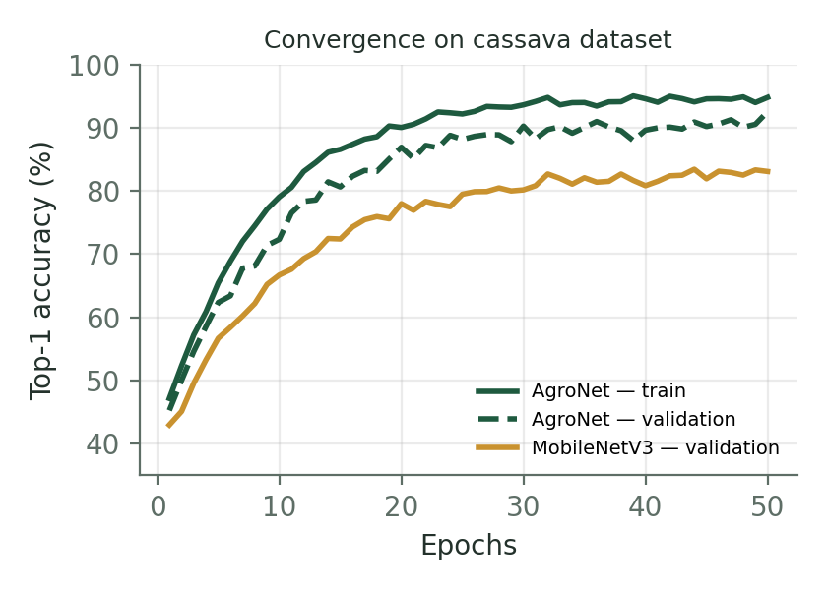
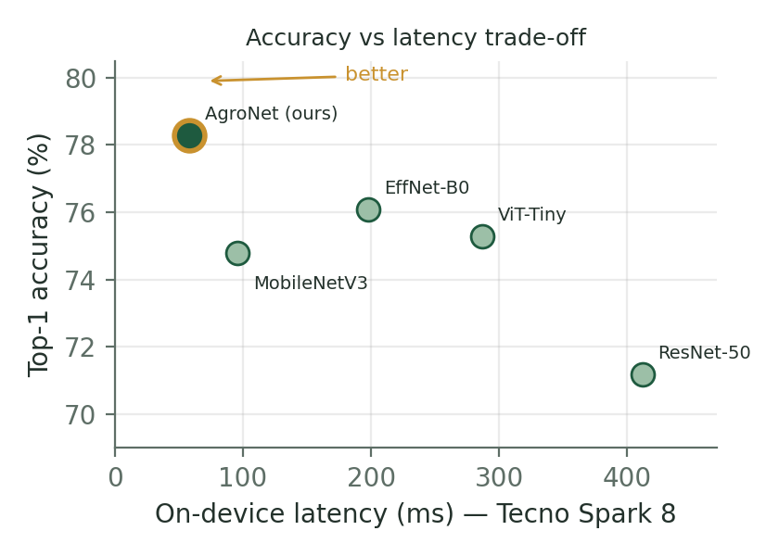
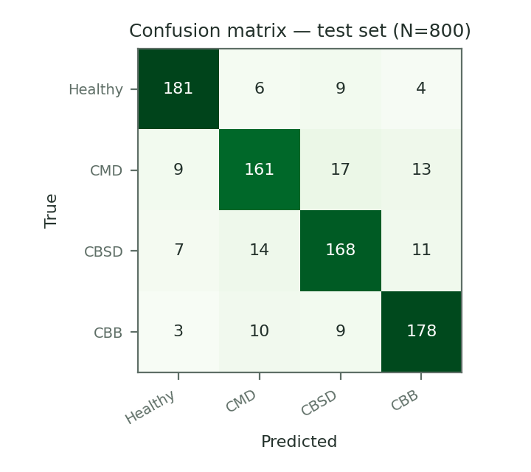
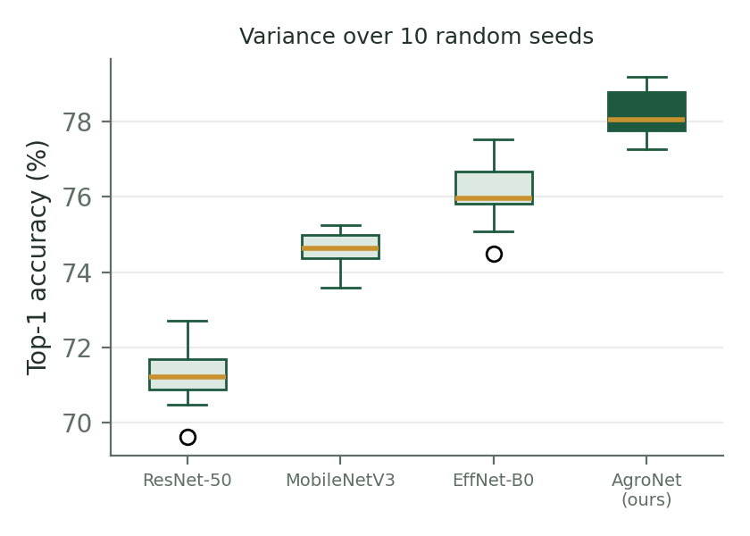
PART 3 · STEP 3 — IMPACT
The four figures of a strong Results section
① Convergence — trains stably, beats the baseline
② Trade-off — best accuracy at lowest latency: the low-resource argument in one image
③ Confusion matrix — “here is exactly where we fail” (vital in health & agri)
④ Seed variance — the gain is not luck: 10 seeds, honest spread
Mastering the Scientific Narrative · C. G. Hounmenou · Skill Session
Resource Kit →
30
Notes:
⏱ 00:40–00:41 | RÉGIE : Nouveau slide "galerie" — quatre vraies figures du papier AgroNet. Balayez-les dans l'ordre ①→④.
SAY: "Here they are in real life — the four figures of a strong Results section, from our AgroNet paper. One: the convergence curves — 'we train stably and we beat the baseline'. Two: the trade-off plot — best accuracy at LOWEST latency; for low-resource deployment, this is your sovereignty argument in a single image. Three: the confusion matrix — 'here is exactly where we fail': healthy versus CMD versus CBSD; honesty made visible. Four: the box plot over ten seeds — 'our gain is not luck'."
SAY: "Every figure here has labeled axes, units, and a self-contained message. Your paper needs its version of these four."

Slide 31
PART 3 · STEP 3 — IMPACT · MINI-QUIZ
Spot the errors — vote A or B!
Figure A
Figure B
Truncated axis exaggerates gains · cryptic labels · no units · no error bars
Full axis · named baselines · units & protocol in caption · honest comparison
Same numbers — different credibility. Reviewers see hundreds of Figure A's.
Mastering the Scientific Narrative · C. G. Hounmenou · Skill Session
Resource Kit →
31
Notes:
⏱ 00:41–00:43 | RÉGIE : Slide quiz — VOTE avant de laisser lire les légendes rouges/vertes. Cachez-les avec le corps si besoin.
SAY: "Quiz time. Same numbers, two figures. Which one belongs in a NeurIPS paper — A or B? Vote! [vote] Now, tell me what's wrong with A. [laissez répondre]"
CORRIGÉ — SAY: "Figure A's y-axis starts at 70 — the truncated axis makes a 7-point gap look like a 3x difference; that's how you lie with charts. Labels m1, m2, m3 are cryptic. 'Results' as a title says nothing. No units, no error bars, and that magenta... Figure B: full axis from zero, named baselines, units and protocol in the caption, values on bars. Same numbers — different credibility."
SAY: "Reviewers see hundreds of Figure A's. Be a Figure B. And export vector graphics from matplotlib or TikZ — never a blurry Excel screenshot."

Slide 32

PART 3 · STEP 3 — IMPACT
Publication-quality checklist for every figure
Self-contained caption
a reader should understand the figure without the body text — state what, where, and the takeaway.
Labeled axes with units
“Accuracy (%)”, “Latency (ms)”, “Epochs” — never bare numbers.
Readable at print size
fonts ≥ 8 pt after scaling; test by zooming to 100% on one column.
Honest scales & colors
no truncated axes without a break mark; colorblind-safe palettes; consistent colors across figures.
Vector graphics
export PDF/SVG from matplotlib or TikZ — never blurry screenshots.
Compare against baselines
your bar never stands alone; context creates credibility.
Tables: same rules — booktabs style, bold your best result, report mean ± std.
Mastering the Scientific Narrative · C. G. Hounmenou · Skill Session
Resource Kit →
32
Notes:
⏱ 00:43 (30 sec) | RÉGIE : Slide-référence, à survoler — tout est dans le kit. Ne lisez pas les 6 items.
SAY: "The full polish checklist is in your kit — six rules, from self-contained captions to colorblind-safe palettes and comparing against baselines. One habit to start today: zoom your figure to its final printed size; if you squint, your reviewer squints. Same rules for tables: booktabs style, bold your best result, mean plus-minus std."
TRANSITION : "Last writing step — the one that builds trust: honesty."

Slide 33
PART 3 · STEP 3 — IMPACT
“Better” is not a result — it is a hypothesis
Two accuracies differ. So what? Reviewers ask whether the gap survives a statistical test.
1
Report a distribution, not a point
2
Test before you claim
Run k-fold cross-validation or ≥3 seeds and report mean ± std. A single lucky run is not evidence.
Check normality (Shapiro–Wilk). If it fails — as it usually does with small African field datasets — use Kruskal–Wallis, not ANOVA.
3
Then say which pair differs
4
Report the trade-off, not just the score
A significant omnibus test says “somebody differs”. A post-hoc test (Nemenyi, Dunn) says who. Report the critical difference.
Accuracy, parameters, GFLOPs, inference time. On a $50 phone, 1.2 ms at 3.1M parameters IS the contribution.
This is exactly what the chili-pepper paper does — and it is the single cheapest way to look like a serious lab.
Resource Kit →
Notes:
⏱ 00:43–00:45 | RÉGIE : slide sombre = moment d'autorité. C'est votre domaine d'expertise (biostatistique).
SAY: "One more thing about results, and this is where I put my biostatistician hat on. Your model gets 96.2%. The baseline gets 94.8%. Is your model better? You do not know yet. You have a hypothesis, not a result."
SAY: "Four rules. One: report a distribution, not a point — k-fold or at least three seeds, mean plus or minus standard deviation. Two: test before you claim. Check normality with Shapiro-Wilk; with small African field datasets it usually fails, so use Kruskal-Wallis, not ANOVA. Three: an omnibus test only says somebody differs — a post-hoc test like Nemenyi says WHO, and you report the critical difference. Four: report the trade-off. On a fifty-dollar phone, 1.2 milliseconds at 3.1 million parameters IS the contribution."
PUNCH — SAY: "This is the single cheapest way to look like a serious lab. It costs you one afternoon of statistics and it removes the reviewer's easiest objection."

Slide 34
PART 3 · STEP 4 — HONESTY
Discussion, Limitations & Conclusion
Discuss — don't repeat
Interpret: WHY does your method win? When does it not? What does it mean for the field and for deployment?
Limitations — the trust section
Honest, specific, self-critical. E.g.: “AgroNet was validated on 3 cassava varieties; performance under extreme low-light and on 2G-only devices remains untested.” Reviewers respect this — hiding limits is how papers die in review.
Conclusion — land the story
One paragraph: restate contribution + strongest number + future work that follows naturally from your limitations.
Mastering the Scientific Narrative · C. G. Hounmenou · Skill Session
Resource Kit →
34
African-context limitations (connectivity, device constraints, data coverage) are scientifically valuable observations — own them.
Notes:
⏱ 00:43–00:45 | RÉGIE : Ralentissez sur la carte "Limitations" (dorée). L'exemple bas-débit rural est le pont contexte-africain → science rigoureuse.
SAY: "Step 4. Discussion: interpret, don't repeat — WHY does your method win, when does it lose, what does it mean for deployment? Limitations — listen carefully, this is the trust section: honest, specific, self-critical. Example: 'AgroNet was validated on three cassava varieties; performance under extreme low-light and on 2G-only devices remains untested.' Reviewers RESPECT this. Hiding limits is how papers die in review — someone always finds them."
SAY: "And notice something beautiful: African-context limitations — connectivity, device constraints, data coverage — are scientifically VALUABLE observations. Own them; they are future work, which feeds your conclusion: contribution, strongest number, and the future work your limitations just wrote for you."
SAY: "Frame. Core. Impact. Honesty. Now — YOU write."

Slide 35


PART 4 · RESOURCE KIT HANDOVER
Your Resource Kit — everything on one QR code
1
Scientific Writing Checklist
step-by-step pre-submission guide covering all four blueprint steps
2
LaTeX / Overleaf templates
pre-configured for NeurIPS, ICLR and major venues — start writing today
3
Curated annotated reading list
Keshav's 3-Pass paper, FAIR principles, writing guides, African AI venues
4
Tools & templates
Zotero/Mendeley guides, dataset-card template, reproducible-repo skeleton
Scan → GitHub repo
github.com/Castro2026/ DeepLearningIndaba2026-Scientific-Narrative-Academy
Open the Overleaf template NOW — you will write your abstract straight into it. Printed backups and a short URL on the board for anyone without a smartphone.
Mastering the Scientific Narrative · C. G. Hounmenou · Skill Session
Resource Kit →
35
Notes:
⏱ 00:54–00:58 | RÉGIE : Q&A d'abord (~2-3 min), puis le kit. Faites scanner le QR AVANT de parler (les téléphones sortent, c'est le moment).
SAY (Q&A): "Questions — anything: choosing venues, submission process, handling reviewer rebuttals, finding co-authors or mentors." [Si silence, amorcez : "A question I always get: 'is a workshop paper worth it?' — YES: workshops like AfricaNLP or Indaba are the ideal first submission: real reviews, real deadline, kinder stakes."]
SAY (kit): "Scan now. Your Resource Kit, on GitHub: one — the Scientific Writing Checklist, the four blueprint steps as a pre-submission tick-list. Two — LaTeX Overleaf templates pre-configured for NeurIPS, ICLR and major venues: start writing TODAY. Three — a curated annotated reading list: Keshav's 3-Pass paper, the FAIR principles, the best writing guides, African AI venues and their deadlines. Four — tools: Zotero guides, the dataset-card template, the reproducible-repo skeleton."
SAY: "Share it with the colleagues who are not in this room — multiplication is the strategy."

Slide 36
PART 5 · WARM-UP
Abstract makeover — 60 seconds before you write
BEFORE
AFTER — 3 sentences
“Malaria is a big problem in Africa. In this project we used machine learning and deep learning to detect malaria. We tested our model and the results were very good and promising. This shows AI can help healthcare.”
“Rural clinics in West Africa diagnose malaria by manual microscopy, taking 30+ minutes per slide with scarce experts. We introduce PaluNet, a compact detector that runs on a $50 smartphone attached to any microscope. On 8,500 field slides from 6 clinics, PaluNet reaches 94% sensitivity in under 20 seconds, matching expert microscopists.”
No numbers · no gap · “very good” is not evidence · could describe 10,000 projects
Context+gap → method → numbers. 3 sentences, fundable.
Your turn now — same transformation, your scenario.
Mastering the Scientific Narrative · C. G. Hounmenou · Skill Session
Resource Kit →
36
Notes:
⏱ 00:45–00:46 | RÉGIE : Warm-up de l'exercice (60 sec). Lisez le AVANT d'une voix plate, le APRÈS avec conviction.
SAY: "Sixty seconds before you write — one last makeover, in the health scenario this time. Before: 'Malaria is a big problem in Africa. We used machine learning to detect malaria. Results were very good and promising.' This could describe ten thousand projects. 'Very good' is not evidence."
SAY: "After, three sentences: 'Rural clinics diagnose malaria by manual microscopy — 30 minutes per slide, scarce experts. We introduce PaluNet, a compact detector running on a 50-dollar smartphone attached to any microscope. On 8,500 field slides from six clinics: 94% sensitivity in under 20 seconds, matching expert microscopists.' Context-gap, method, numbers. Three sentences — fundable."
SAY: "Your turn. Same transformation, your scenario."

Slide 37




PART 5 · HANDS-ON · 23 MIN · YOUR TURN
Write your 3-sentence abstract
S1 · CONTEXT / PROBLEM
“In African agricultural zones, crop disease X causes major yield losses, but existing vision models require high-compute resources.”
Pick ONE scenario card:
Climate — flood forecasting
S2 · METHOD
“We introduce [Model], an offline, quantized network optimized for low-end mobile devices.”
Agriculture — pest detection
Health — malaria diagnosis
S3 · IMPACT / RESULTS
“Our approach reaches X% accuracy on local data while cutting inference time by Y% versus baselines.”
NLP — local languages
Solo or in pairs · write straight into your Overleaf copy · take the time you need · volunteers read theirs aloud for live feedback.
Judge yourself with one question: could a stranger fund this project after 3 sentences?
Resource Kit →
Notes:
⏱ 00:46–00:54 | RÉGIE : GARDEZ CE SLIDE AFFICHÉ pendant tout l'exercice. Chrono : 1 min consignes, 4 min rédaction, 3 min partage. CIRCULEZ dans la salle.
SAY (consignes, 1 min): "Here is your template — three sentences. Sentence one, context and problem. Sentence two, your method — 'We introduce...'. Sentence three, impact with NUMBERS — invent plausible ones, that's allowed today. Pick ONE scenario card: climate and flood forecasting, agriculture and pest detection, health and malaria diagnosis, or NLP for local languages. Solo or in pairs. Paper or phone. Four minutes — go!"
RÉGIE (pendant les 4 min) : penchez-vous vers 4-5 groupes ; questions de coaching : "Where is your number in sentence 3?" / "What exactly is the gap?" / "Can you name the region?"
PARTAGE (3 min) — SAY: "Two or three volunteers — read yours aloud!" Feedback : commencez TOUJOURS par un point fort précis, puis UNE amélioration ("I love the named region; now give me a number in sentence 3"). Valorisez explicitement l'ancrage africain.
CRITÈRE — SAY: "Judge yourselves with one question: could a stranger fund this project after three sentences?"

Slide 38
EXTENDED DISCUSSION · 15 MIN
Now the floor is yours
30 extra minutes beyond the core hour: keep writing in Overleaf, or bring me your hardest question.
?
?
?
?
Submitting
Collaborating
Data & ethics
Your abstract
Which venue for my first paper? What does a rebuttal look like? How do I answer Reviewer 2?
How do I find co-authors and mentors? How do authorship orders work? Who pays the APC?
Community consent, anonymisation, and who owns an African dataset once it is on Hugging Face.
Bring me the three sentences you just wrote. I will tell you what a reviewer would say.
No question is too basic. The questions you are afraid to ask are the ones the whole room needs answered.
Resource Kit →
Notes:
⏱ 01:15–01:26 | RÉGIE : c'est le temps supplémentaire demandé par les organisateurs. Ne le remplissez PAS de contenu — laissez la salle parler.
SAY: "We have half an hour more than a normal session, and I want to use it the way you need it. Two options: keep writing in your Overleaf copy — I will come round and read over your shoulder — or ask me anything."
RÉGIE : si personne ne parle en premier, amorcez avec UNE question de la grille ("Let me start with the one I get most often: which venue for a first paper?"). Puis rendez la parole.
RÉGIE : circulez. Les meilleures questions arrivent en tête-à-tête, pas au micro.
PIÈGE À ÉVITER : ne laissez pas 2 personnes monopoliser. "Let me take three more, then I'll be here after the session for anyone individually."

Slide 39
TAKE-HOME
The papers behind this session
§
The reading method
S. Keshav (2007). “How to Read a Paper.” ACM SIGCOMM Computer Communication Review, 37(3):83–84. — the 3-Pass method, 2 pages, read it tonight.
§
The paper we scanned live
Vaswani et al. (2017). “Attention Is All You Need.” NeurIPS 2017. — proceedings.neurips.cc/paper_files/paper/2017
§
An African AI paper, published
Odounfa, Hounmenou et al. (2025). “Deep learning enables precision agriculture for sustainable chili pepper disease detection in Benin.” Discover Artificial Intelligence 5:315 — open access.
§
An African AI paper, at NeurIPS
Tahi, Houndji, Hounmenou & Glèlè Kakaï (2024). “Using pattern mining to determine fine climatic parameters for maize yield in Benin.” IJ-AI 13(4):3930–3941 — first shown at a NeurIPS 2022 workshop.
All of these — plus the checklist, Overleaf templates and dataset-card template — are in your Resource Kit.
Resource Kit →
Notes:
⏱ 01:26–01:28 | RÉGIE : slide de référence — 30 secondes, tout est dans le kit.
SAY: "Four papers. Keshav's 'How to Read a Paper' is two pages — read it tonight, it is the method we used this morning. Attention Is All You Need is the paper we scanned live. And the last two are African papers: the chili-pepper paper in Discover AI, open access, and the maize paper that went to a NeurIPS workshop."
POINT CLÉ — SAY: "I put the African ones on this slide deliberately. When you write your related work, cite African research. If we do not cite each other, nobody else will."

Slide 40



Master the scientific narrative —
so Africa tells its own research stories.
Read 3-Pass method — triage, grasp, reconstruct
Write Frame · Core · Impact · Honesty
The challenge
Your first submitted paper within 6 months.
Thank you — stay in touch for mentoring & follow-up
castro.hounmenou@univ-labe.edu.gn
+224 627 812 787 · +229 01 95 30 66 12
Resource Kit →
Notes:
⏱ 00:58–01:00 | RÉGIE : Message final debout, lentement, en regardant la salle. Terminez À L'HEURE — c'est une démonstration de professionnalisme.
SAY: "Let's close the loop. You leave with two skills. Read: the 3-Pass method — triage, grasp, reconstruct; ninety minutes a week. Write: Frame, Core, Impact, Honesty — and a three-sentence abstract already in your pocket."
SAY (le défi): "And a challenge, with a smile but seriously: your first submitted paper within six months. A workshop counts. AfricaNLP counts. Indaba counts. Email me your abstract draft — the address is on screen — and I will answer."
SAY (final, lentement): "Master the scientific narrative — so Africa tells its own research stories. The models we build become sovereign the day the papers that describe them carry our names. Thank you."
RÉGIE : restez disponible 10 min après pour les questions individuelles ; notez les emails des volontaires pour le suivi mentoring.

