Slide 1
Graphs + Knowledge Tables + LLMs
Suncorp Group | GraphRAG Implementation — September 2025

Slide 2
1. Motivation
🗄️ Massive structured data (SQL: policies, claims, payments)
📑 Massive unstructured data (emails, PDFs, reports)
🔍 Traditional RAG misses relationships between entities
🕸️ GraphRAG = entity + relationship reasoning + LLM
Suncorp Group | GraphRAG Implementation — September 2025

Slide 3
2. What is GraphRAG?
🧩 Retrieval Augmented Generation with a knowledge graph backbone
🗂️ Entities become nodes, relationships become edges
🔎 Query → extract entities → retrieve subgraph → combine with vectors
💡 Example: 'Show all claims linked to Provider X before Policy Y started'
Suncorp Group | GraphRAG Implementation — September 2025

Slide 4
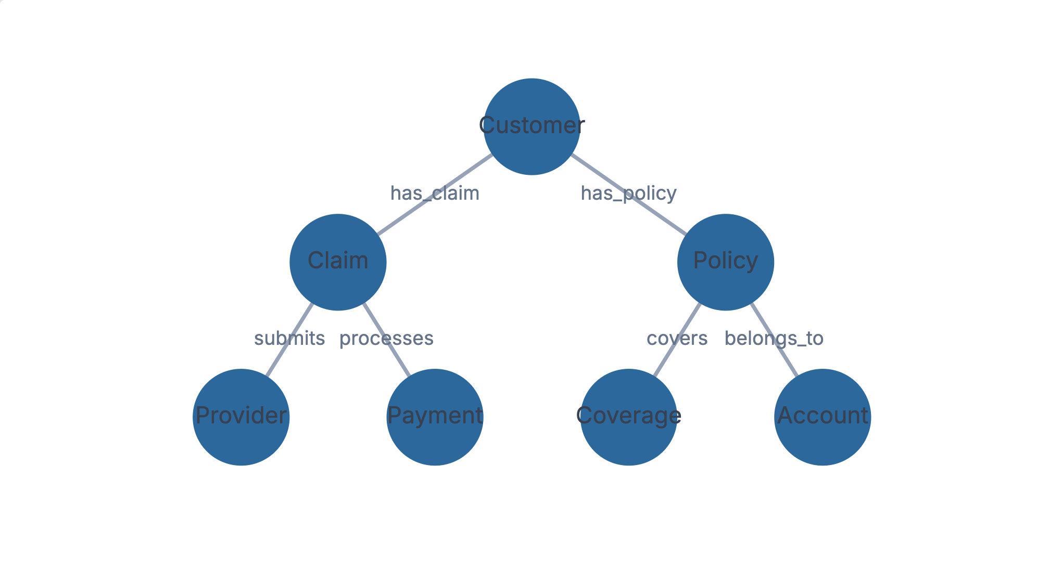
3. Structured RAG + Graph
🗄️ Structured DB → Graph nodes (Policy, Claim, Customer, Provider)
📄 Unstructured docs → Graph edges & attributes (emails, PDFs, notes)
⚡ Potential: Faster retrieval, SQL joins, provenance tracking
✅ Auditability: Every answer can be traced to source
Suncorp Group | GraphRAG Implementation — September 2025

Slide 5
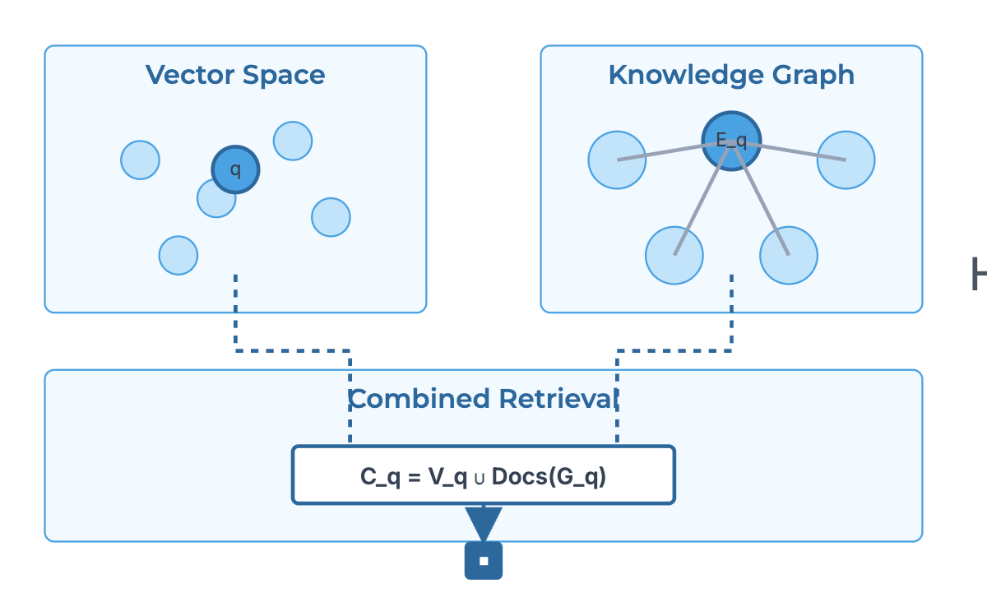
4. Math from HybridRAG (Sarmah et al., 2024)
Vector retrieval
V_q = top_k(sim(f_emb(q), f_emb(c)))
Graph retrieval
G_q = hop(E_q, h) → subgraph
Combined context
C_q = V_q ∪ Docs(G_q)
LLM generation
ŷ = LLM(q, C_q)
Suncorp Group | GraphRAG Implementation — September 2025

Slide 6
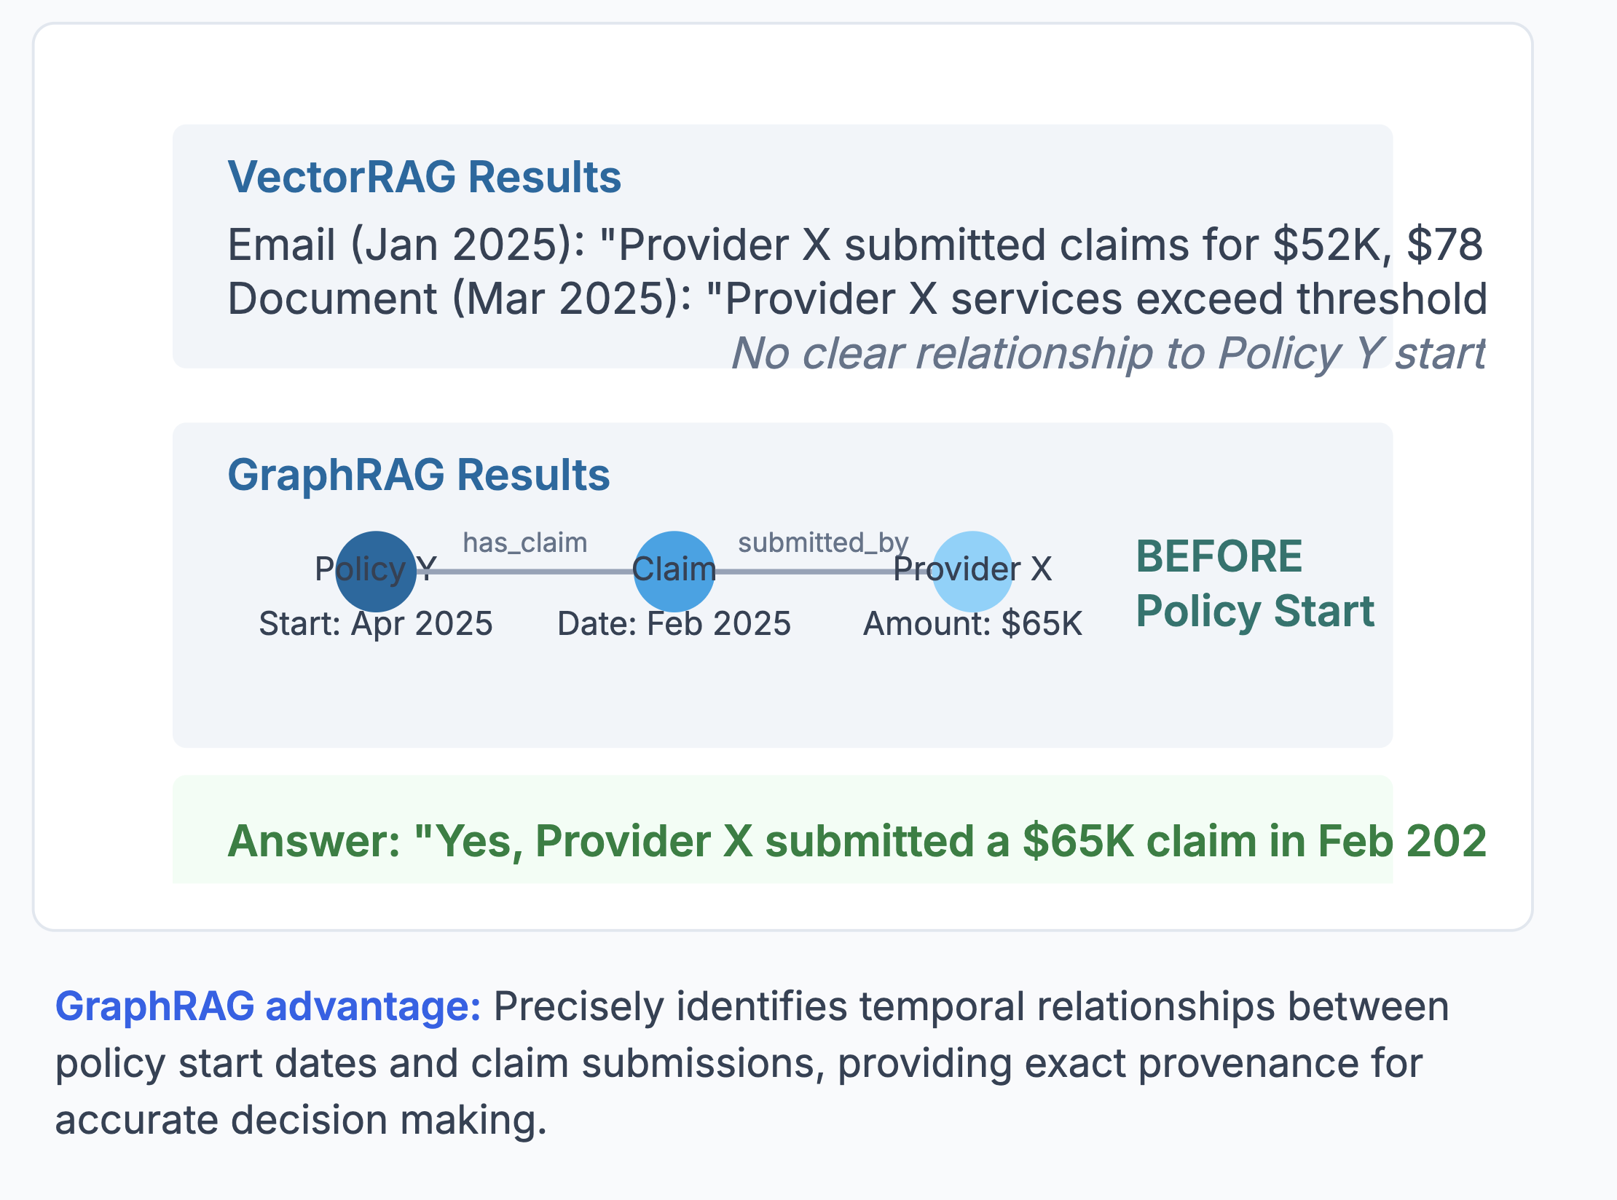
5. Toy Example (Suncorp Claim)
📐 VectorRAG: finds docs but struggles with temporal reasoning
🕸️ GraphRAG: traverses Policy → Claim → Provider with dates & amounts
🤝 Combined: LLM answers with provenance from SQL + docs
Suncorp Group | GraphRAG Implementation — September 2025

Slide 7
Toy Example: VectorRAG vs GraphRAG
📄 VectorRAG "Provider X submitted a claim of $65K ..."
📊 GraphRAG Policy Y → Claim 123 ($65K) → Provider X
Prepared for Suncorp Group | GraphRAG Implementation
September 2025

Slide 8
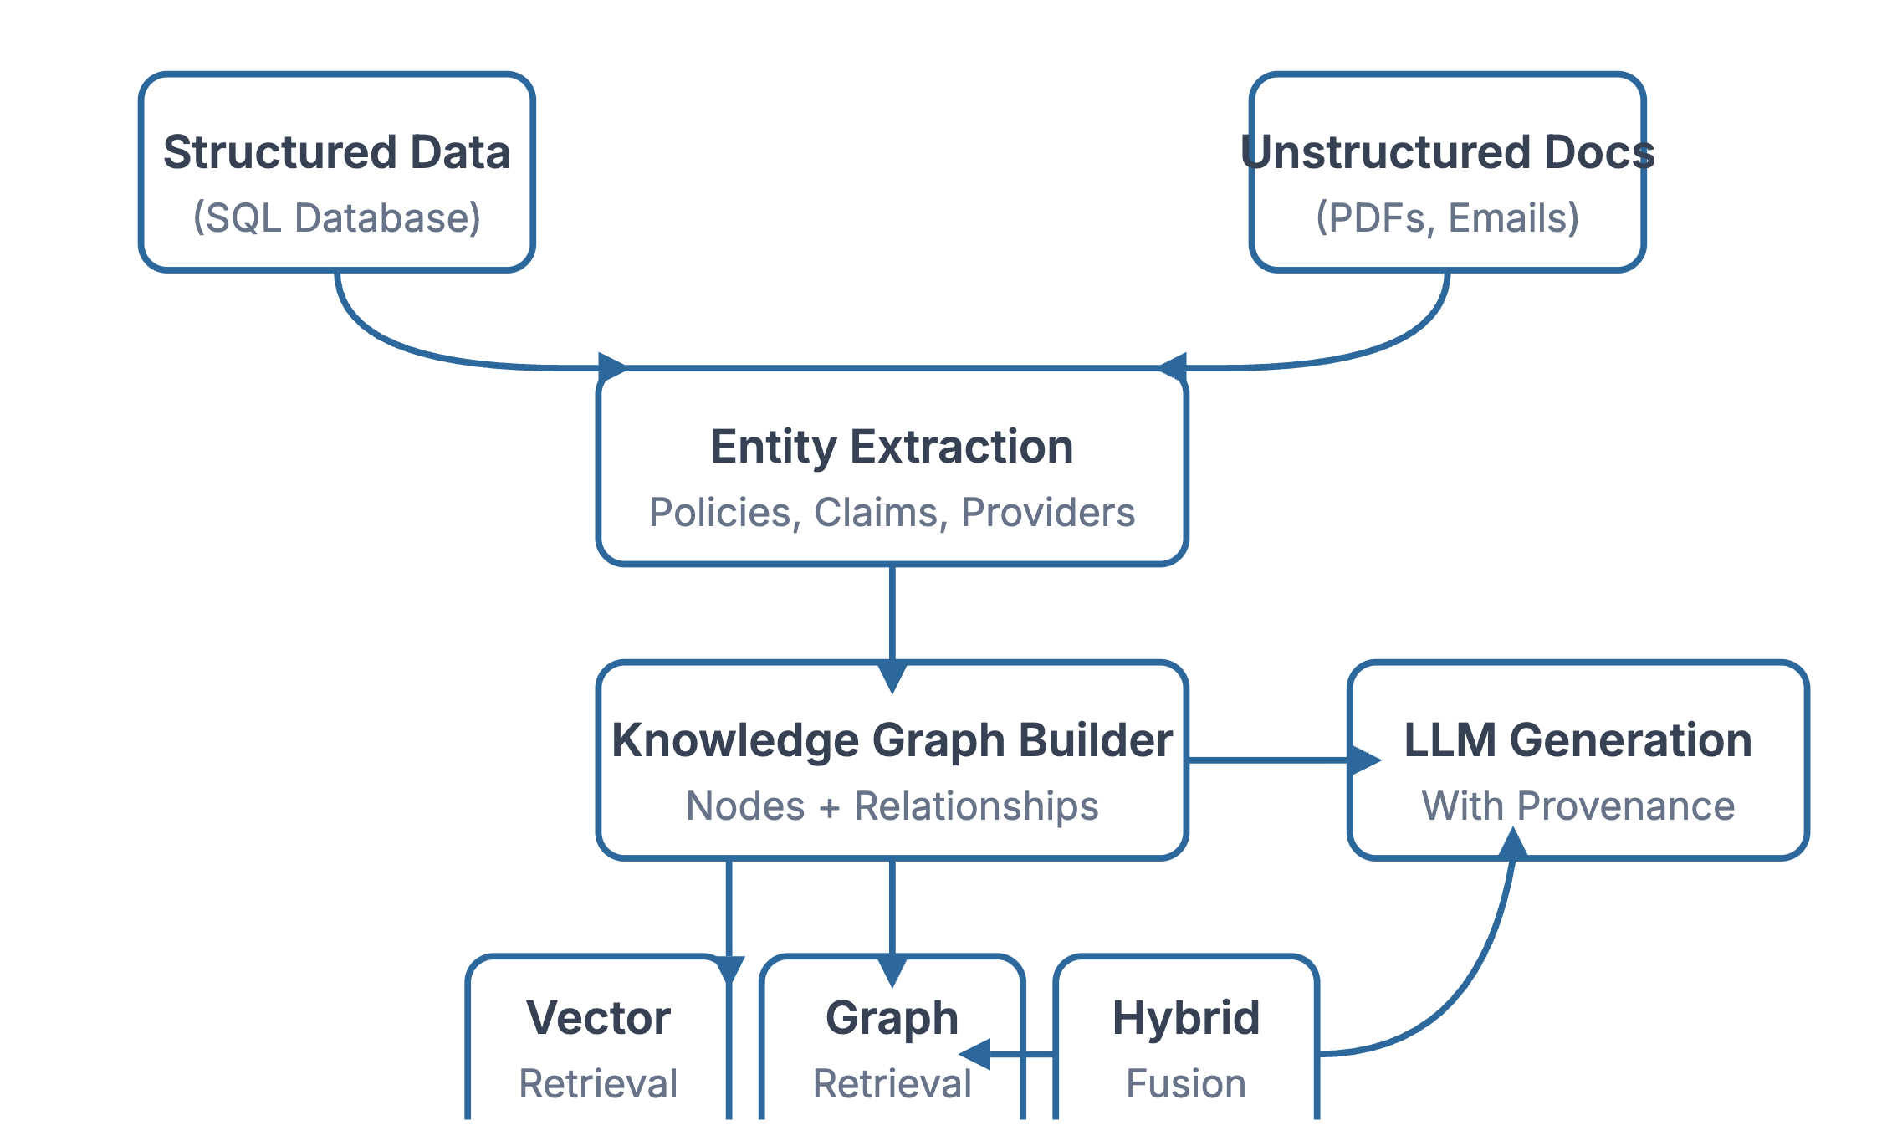
6. Architecture Sketch
🗄️ Ingests structured data (SQL) and unstructured documents
🕸️ Transforms into knowledge graph (entities + relationships)
🔍 Hybrid retrieval: vector search + graph traversal
🤖 LLM generates explainable answers with provenance

Slide 9
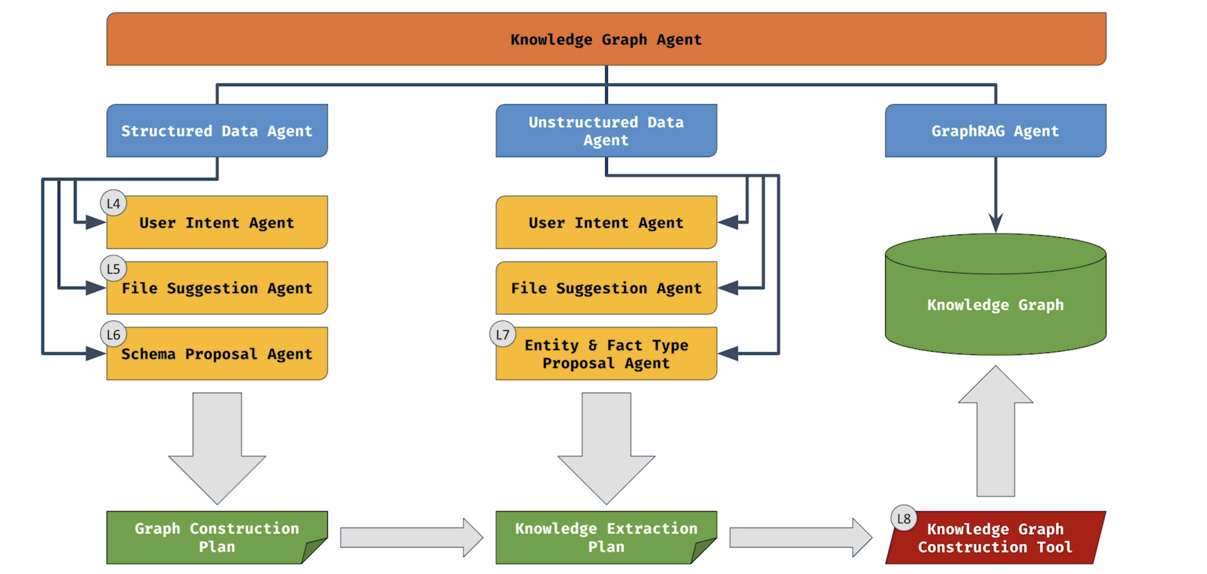

Slide 10
7. Takeaways for Suncorp
🔎 Explainability: trace answers to SQL + docs
🛡️ Compliance: relationships are explicit
⚡ Efficiency: hybrid retrieval is faster and more precise
📈 Scalability: applicable across AI initiatives
Suncorp Group | GraphRAG Implementation — September 2025

