Slide 1
HACKATHON TEAM ID – SGH001547

Slide 2
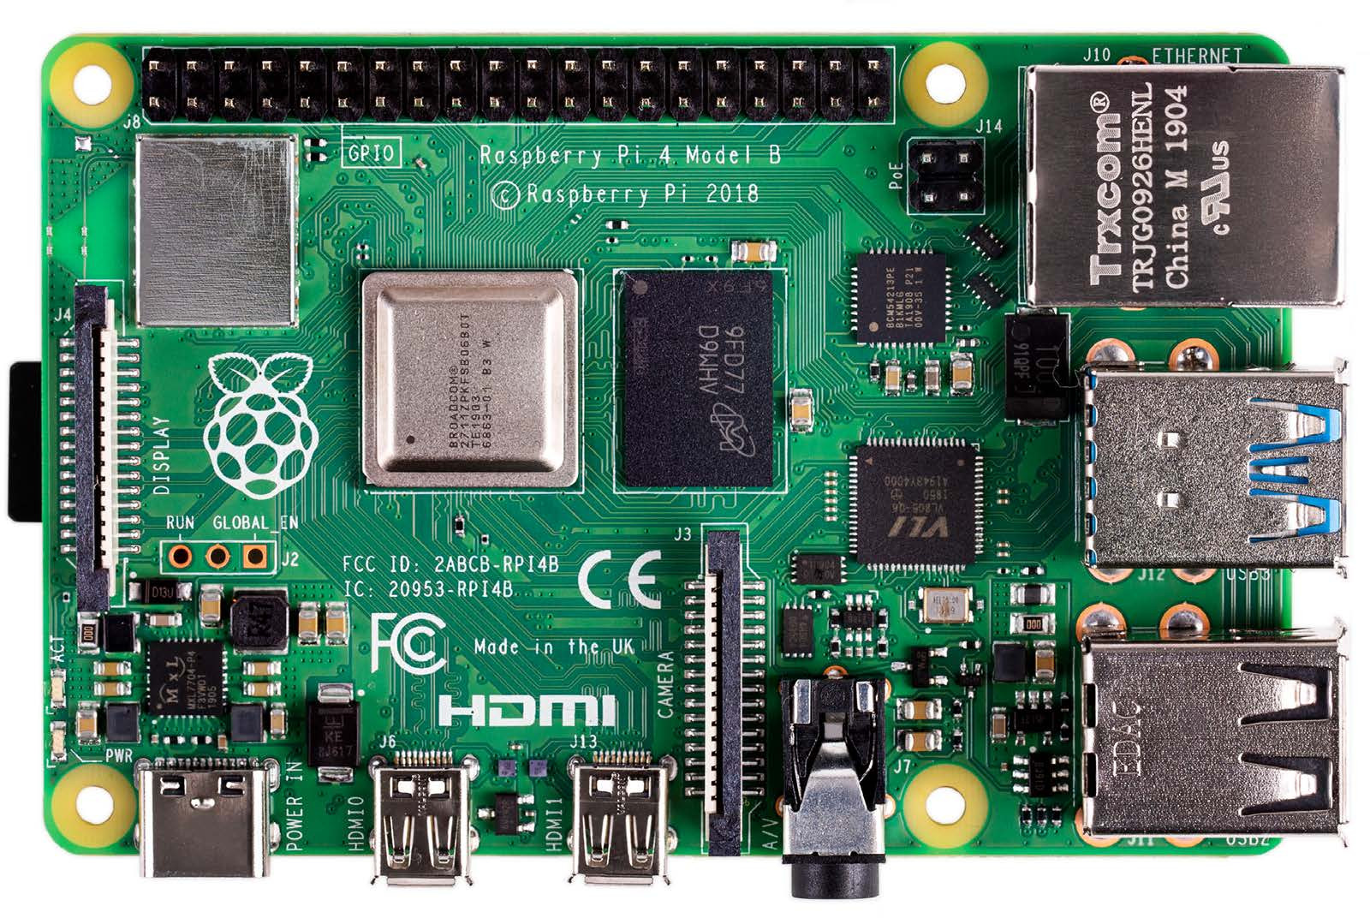
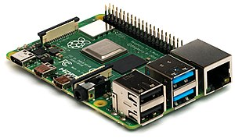
Raspberry pi

Slide 3
ABOUT
Raspberry Pi is the name of a series of single-board computers.
All over the world, people use Raspberry Pis to learn programming skills, build hardware projects, do home automation, and even use them in industrial applications.
the Raspberry Pi is a very cheap computer that runs Linux, but it also provides a set of GPIO (general purpose input/output) pins that allow us to control electronic components for physical computing and explore the Internet of Things (IoT).
The Raspberry Pi can open opportunities for us to create home or industry automation projects.

Slide 4
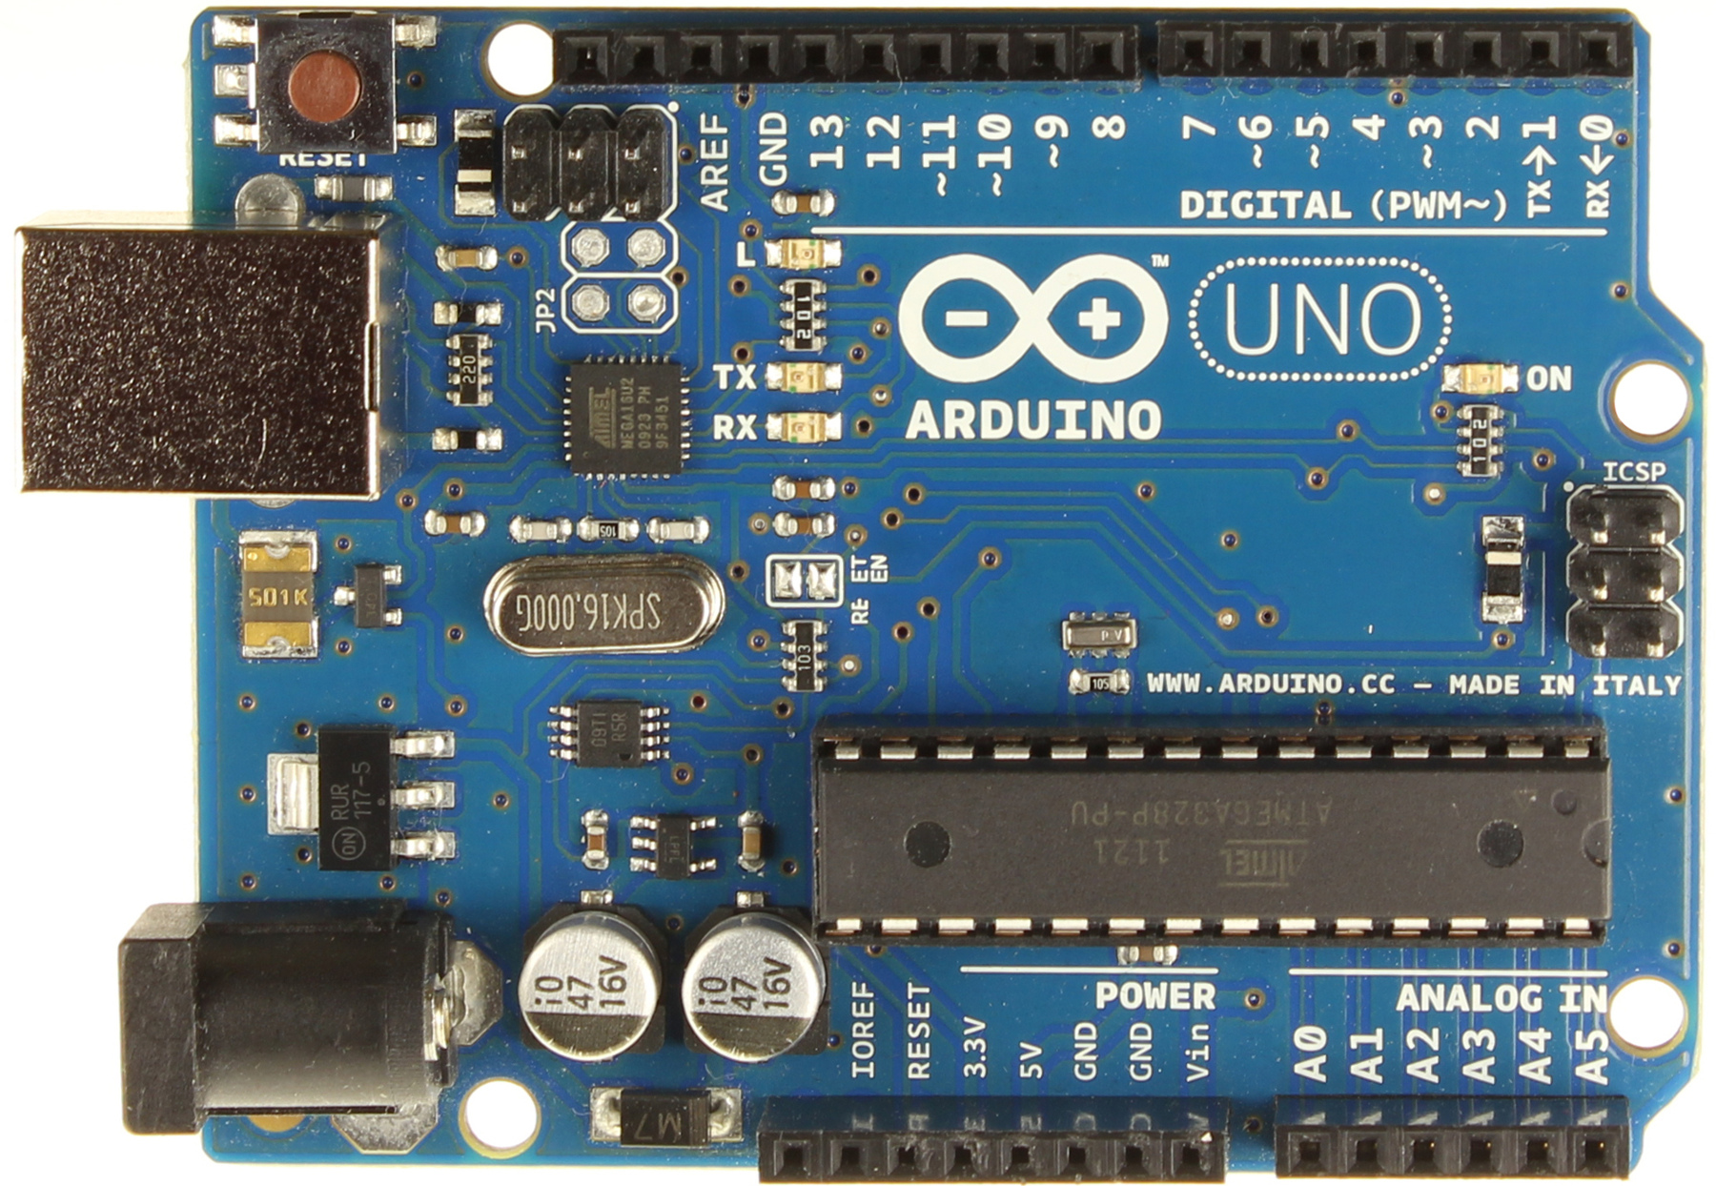
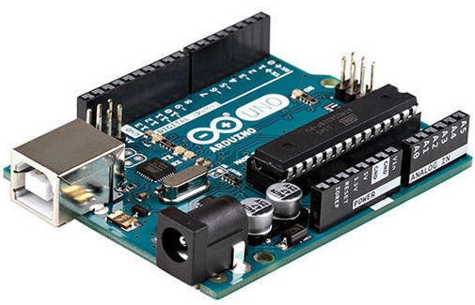
Arduino

Slide 5
ABOUT
Arduino is an open-source electronics platform based on easy-to-use hardware and software.
Applications
Arduboy, a handheld game console based on Arduino.
Arduinome, a MIDI controller device that mimics the Monome
Ardupilot, drone software and hardware
ArduSat, a cubesat based on Arduino.
C-STEM Studio, a platform for hands-on integrated learning of computing, science, technology, engineering, and mathematics (C-STEM) with robotics.
Data loggers for scientific research.
OBDuino, a trip computer that uses the on-board diagnostics interface found in most modern cars
OpenEVSE an open-source electric vehicle charger
XOD, a visual programming language for Arduino

Slide 6
SENSOR
Gas sensor - mq9
Temperature and humidity sensor – dht22

Slide 7
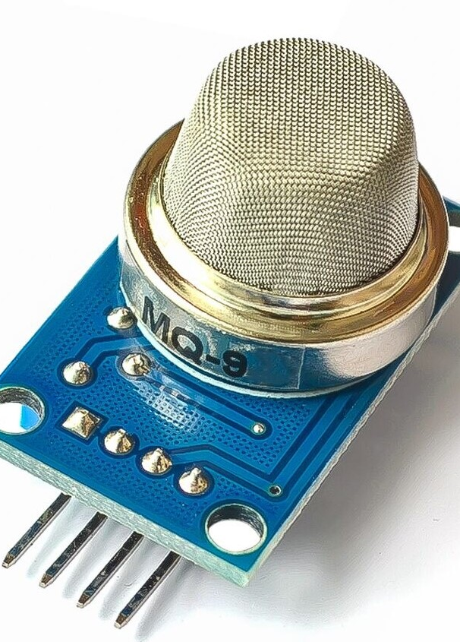
GAS SENSOR – MQ9
MQ-9 gas sensor has high sensitivity to Carbon Monoxide, Methane, and LPG.
The sensor could be used to detect different gases contains CO and combustible gases.
It is with low cost and suitable for different applications.
The sensitivity of the sensor can be adjusted by using the potentiometer.

Slide 8
CHARACTER
HIGH SENSITIVITY TO CO/COMBUSTIBLE GAS
LONG LIFE AND LOW COST
SIMPLE DRIVE CIRCUIT
APPLICATION
INDUSTRIAL GAS DETECTOR
DOMESTIC GAS LEAKAGE DETECTOR
Datasheet
Link :- http://www.datasheet39.com/PDF/904643/MQ-9-datasheet.html

Slide 9
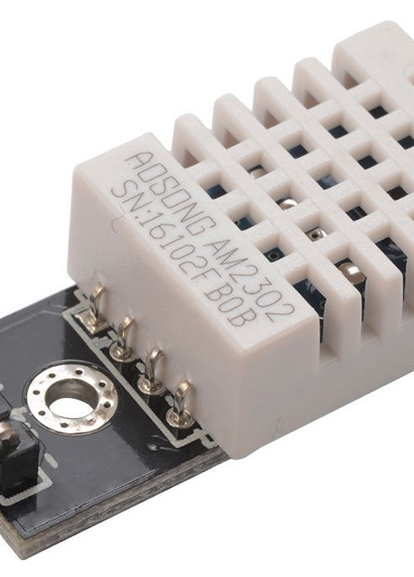
Temperature & humidity sensor – dht22
The sensor includes a capacitive sensor wet components and a high-precision temperature measurement devices, and connected with a high-performance 8-bit microcontroller.
It is capable of detecting 0 to 100% relative humidity and temperatures from (-40) to 125 degree Celsius.
The sensor has excellent quality, fast response, strong anti-jamming capability, and cost-effective.
It can measure the environment temperature and humidity to meet the high demand.
It has high reliability and good stability.

Slide 10
feature
Full range temperature compensated
Relative humidity and temperature measurement
Calibrated digital signal
Outstanding long-term stability
Long transmission distance
Low power consumption
4 pin packaged and fully interchangeable
Datasheet
Link :- https://www.sparkfun.com/datasheets/Sensors/Temperature/DHT22.pdf

Slide 11
THANK YOU

