Slide 1

Team Name : DevTitans
Domain :
Sustainable Smart Technologies
for Better Bharat
Problem :
Heating issues by vary purpose
In industries.
Solution :
Building an cooling system
Based on AI and cloud with IOT.
Team id:
AAnBIT140173

Slide 2
Brief :
Every industry has a problem persisting through controlling system of temperature and performance of machines.Many industries have been using a mechanical form of controlling system that can be handled by manually, either by a man or through a computer.Many industries dealing with high power machine that needs full ventilation by get through cool environment facility.But at a point it can not be suitable for outer environmental air to keep desired temperature for that machine.We made a solution to keep an AI based system on duty to keep an eagle eye on basic temperature details obtained from temperature sensors, A light weight web application that provide tracking data to related authority.A cloud information gateway built to store, filter and manage data.AI based data analysis in terms to provide full safety measurement to machines as well as workers on the field.

Slide 3
Human Harm
Absence of Reading
High temperature
cause permanent damage
Swapping of measured values
High temperature
low efficient machines
Reaction timing error
Damage protection cost increase
Maintenance cost increase
Cooling System based on AI and Cloud with use of IOT

Slide 4
Cooling System
Hardware
Software
Algorithm
Raspberry Pi
Cloud
Sensors
Cooling
(fan)
Connection
Wire
ML Script
Firebase
Database
Web Application

Slide 5
Our Solution :
Design and Build Cloud-Enabled & AI-Powered Cooling System for Industry.
We build a device that can automatically turn on the cooling system for the machine whose temperature becomes very high using machine learning and artificial intelligence.
Even in this device, the authenticated person from anywhere can see the machine's temperature and if he /she feels to turn ON/OFF the cooling system, he/she can from anywhere.

Slide 6

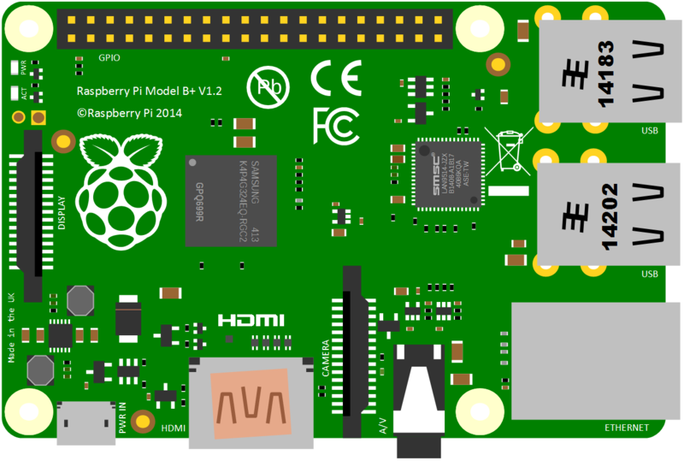




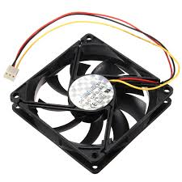
Sample Solution :
Sending Data to Database
Sensor data
ML
Script
Sensors :
-> Temperature sensor
-> Pressure sensor
-> Gas sensor
Raspberry Pi
Web application
Manual Override
Fan Control

Slide 7

Thank You
Do you have any
Questions?

