Slide 1
TCSS545 - HW3 - Inventory Management System
Group7
Adam Shandi, Deepthi Warrier, Sumitha Ravindran

Slide 2
Application Description
An Inventory Management System App for a grocery store
Allows Managers to Register with the system
Authenticated managers can login to the system
Once logged in, managers can View Items present in the store’s inventory
Managers can add an item to the inventory
Managers can update the price for an item
Managers can delete an item
Managers can view the items which had a price hike of more than 20$

Slide 3
Technologies Used
MySql Database for storing data
Cloud Platform: Amazon Web Services (AWS) RDS Instance
The Backend : developed using node.js
Front end : Express
Styles for frontend : Bootstrap

Slide 4
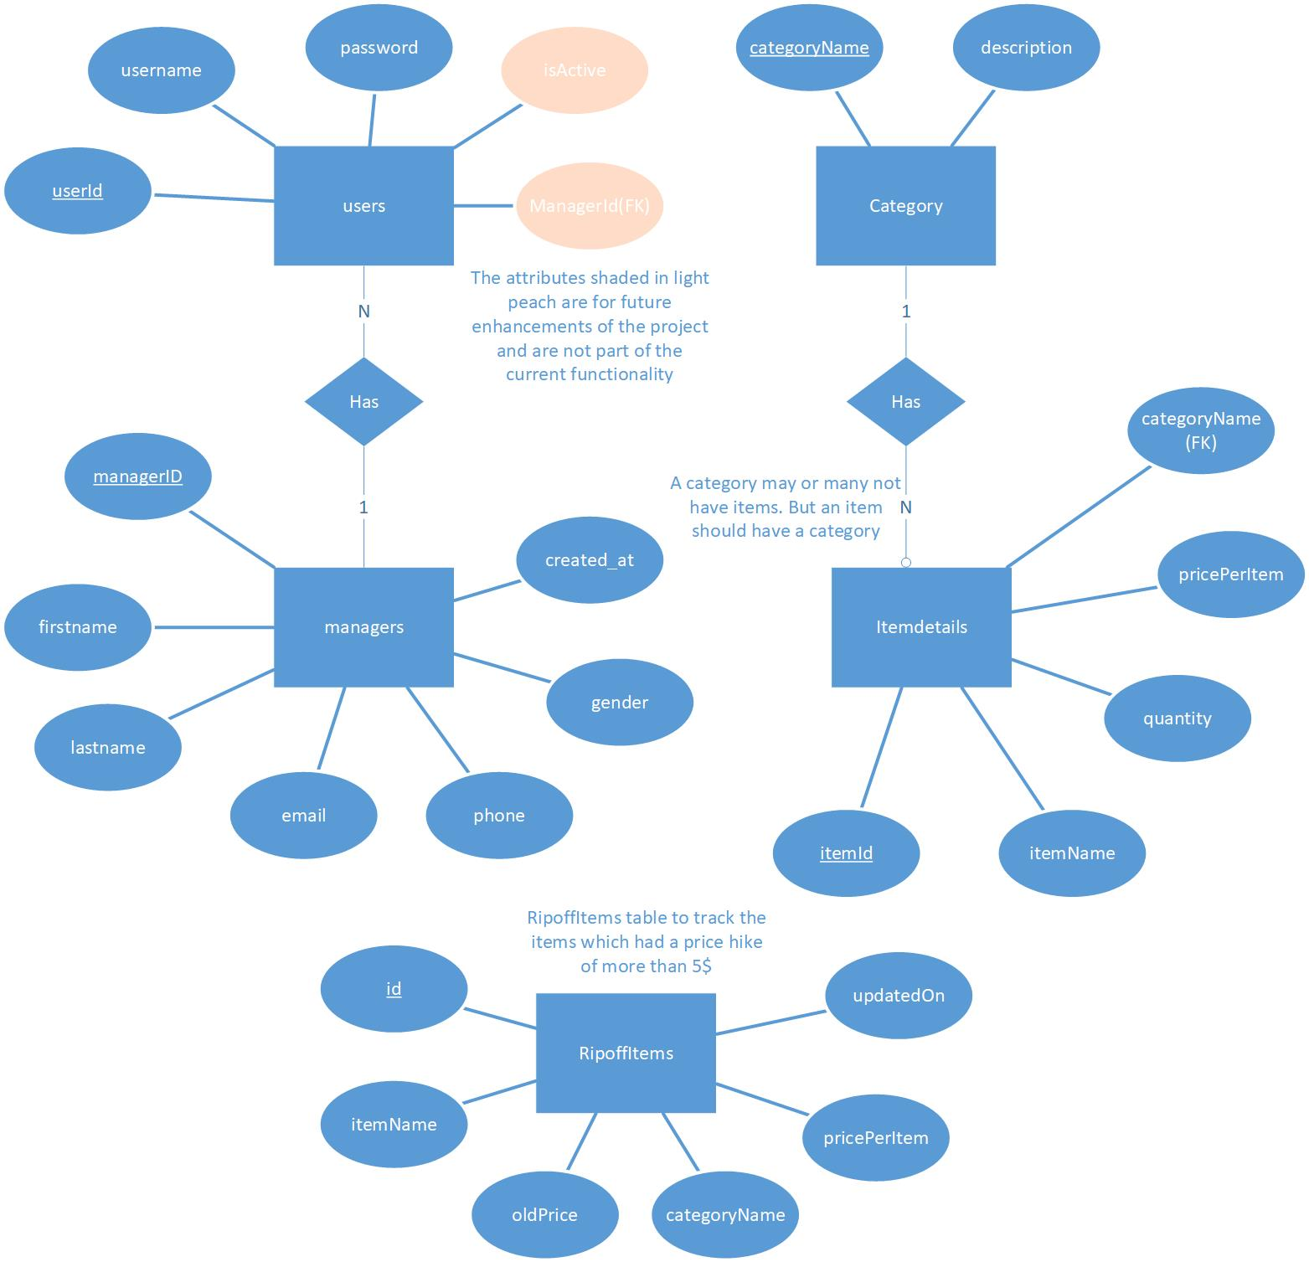
ER Diagram
Entities:
1. users
2. managers
3. category
4. itemdetails
5. RipoffItems

Slide 5
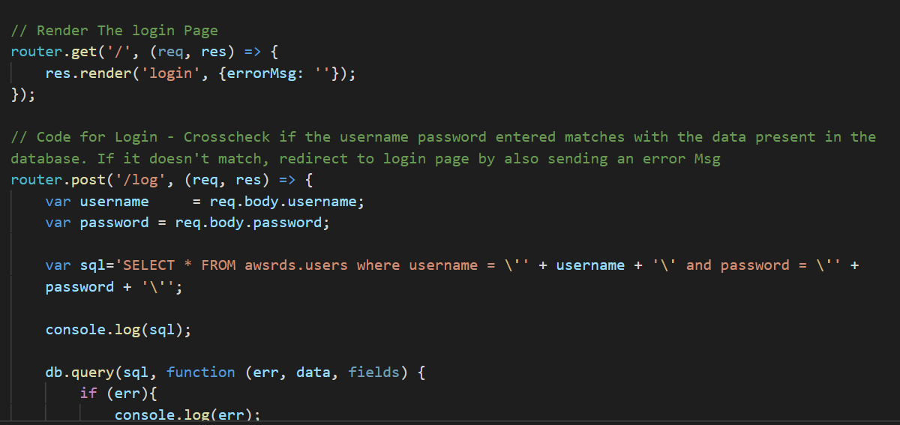
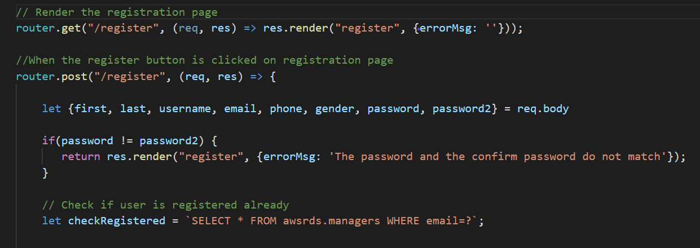
Back End Design
Two major backend files: users.js and inventory.js
Users.js: Has the routes for login and register

Slide 6
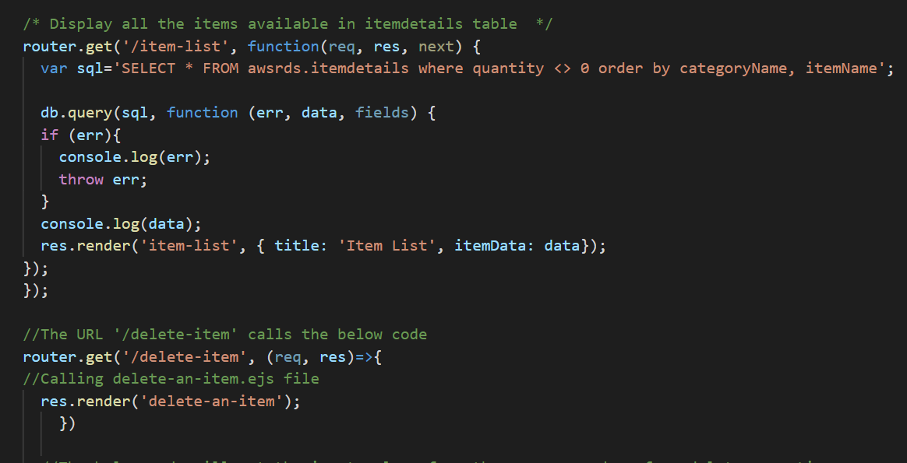
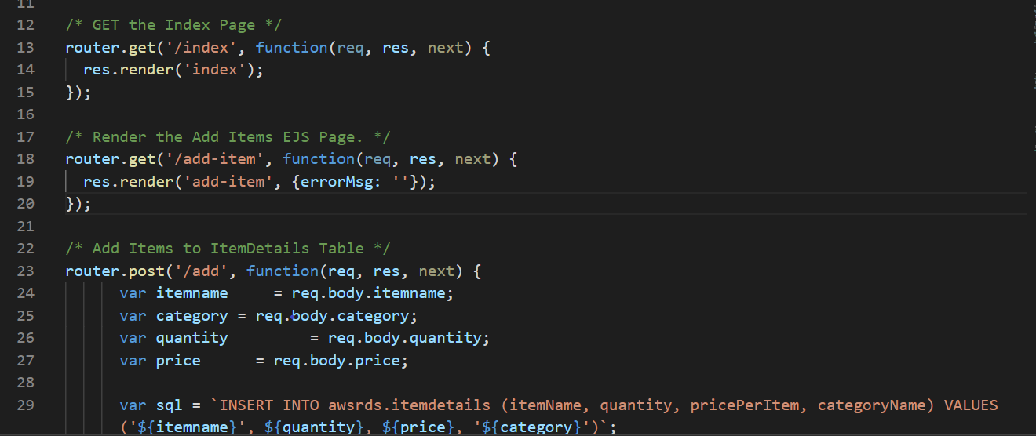
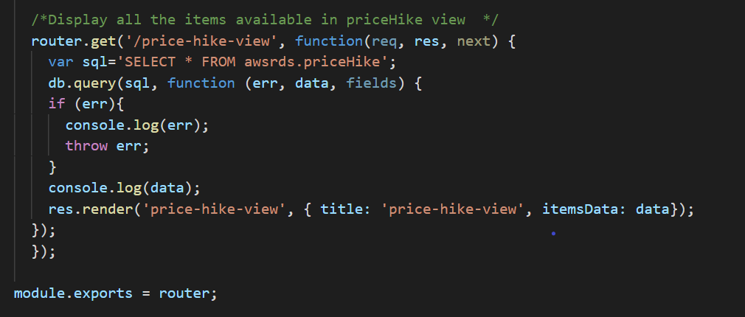
Back End Design Continued...
Inventory.js: To handle routes for View, Add, Update, Delete, Price hike functionalities

Slide 7
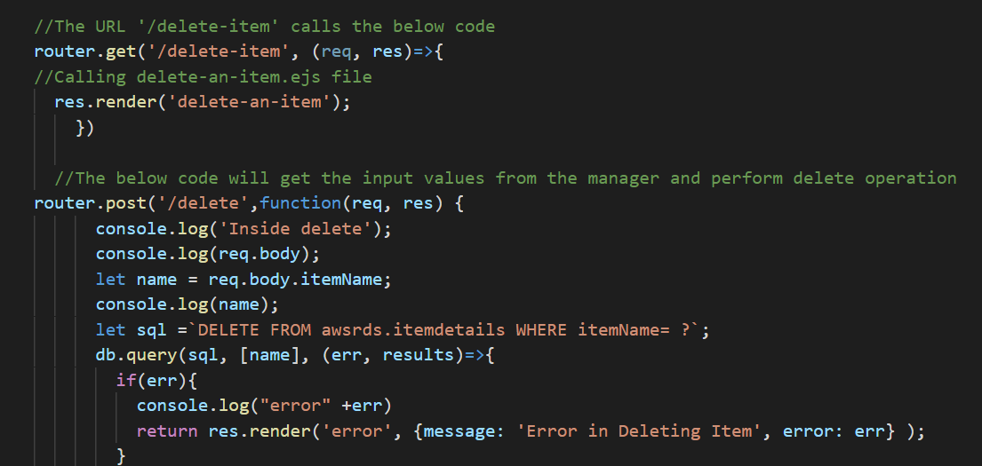
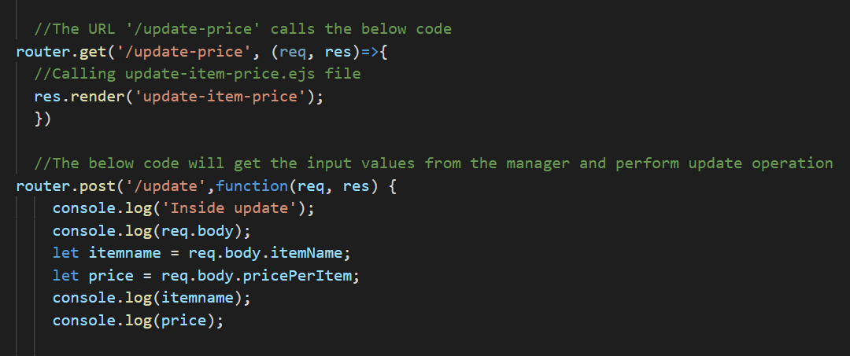
Back End Design Continued...
Inventory.js: To handle routes for View, Add, Update, Delete, Price hike functionalities

Slide 8
Functionalities
Login
Register Manager
View Items
Add an item
Update an item price
Delete an item
View Price Hike

Slide 9
Triggers
CategoryTrig:
When adding an item to the inventory if the category of the item does not exist in the category table, the new category will be added to the category table.
ItemPriceTrig:
When the items price is updated, if the price hike is more than 5$, the trigger would insert the item details into RipoffItems table.

Slide 10
Views
priceHike:
The priceHike View is used to display the items that have had a priceHike of more than 20$.
Helps in further analysis to prevent price gouging
itemName_Index:
itemName_index is created for the itemName column in itemDetails table, since for updates and deletion of items, itemName is frequently used.

Slide 11
Demo

Slide 12
Future Enhancements
This system can be extended to add the following functionalities:
Forgot Password: The users table will have additional two columns - isActive and ManagerId column to handle the same.
Hash the Manager’s Password and store it in the database.
Update quantity of an item.
More Analysis based functionalities based on data.

Slide 13
Division of Labor
Adam Shandi:
Coding: Login, Register Manager
Documentation: ReadMe.md, Screenshots for AWSRDS Instance
Deepthi Warrier:
Coding: View Items, Add an Item, Trigger for Category Addition, Collaborated with Adam for Login & Register functionality.
Documentation: Proposal(Except Database Table Diagram), Presentation
Source Code Version Control: Integrating and merging the individual code
Sumitha Ravindran:
Coding: Update Price, Delete an Item, Trigger for Price Hike, View for Price Hike.
Documentation: Proposal(Database Table Diagram) , Test cases document, Presentation

Slide 14
References
Slides from TCSS 545 A -Database Design class.
Node.js tutorials online : https://www.w3schools.com/nodejs/
Styles for the FrontEnd : https://bootswatch.com/darkly/

Slide 15

Thank you!!!

