Slide 1
Music Store Data Analysis using SQL
This project analyzes A digital music store database (chinook) using SQL to uncover business insights related to customers, sales, music genres, artists, and playlists. The analysis demonstrates practical use of SQL for real-world data analysis and decision-making.
Key Insights
Identified top-spending customers and high-revenue countries
Analyzed overall and monthly sales performance
Discovered most popular genres, tracks, and artists
Examined playlist composition and customer purchasing behavior

Slide 2
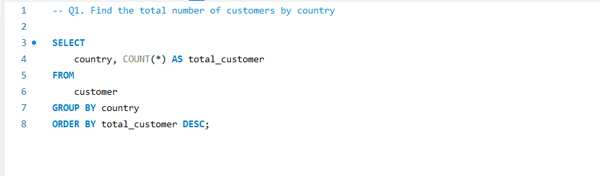
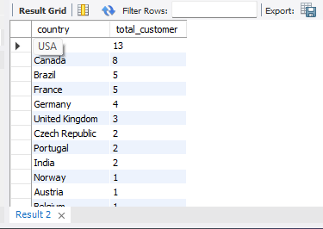

Slide 3
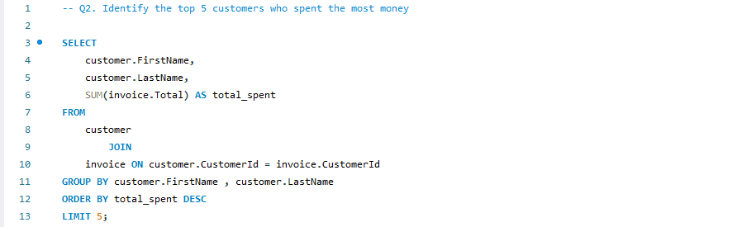
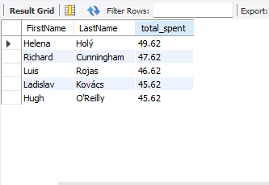

Slide 4
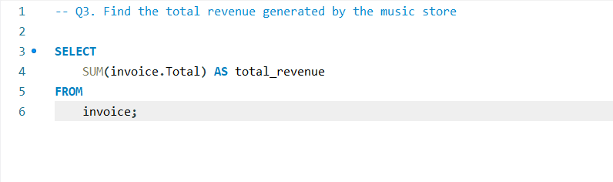
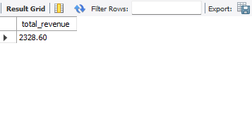

Slide 5
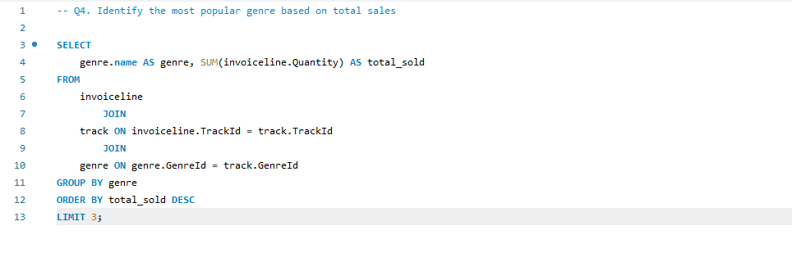
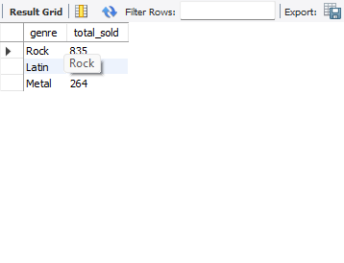

Slide 6
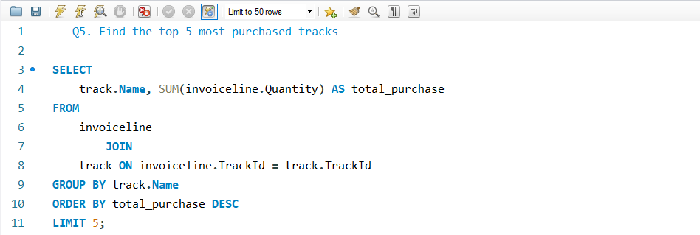
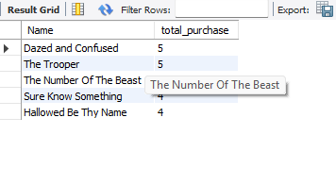

Slide 7
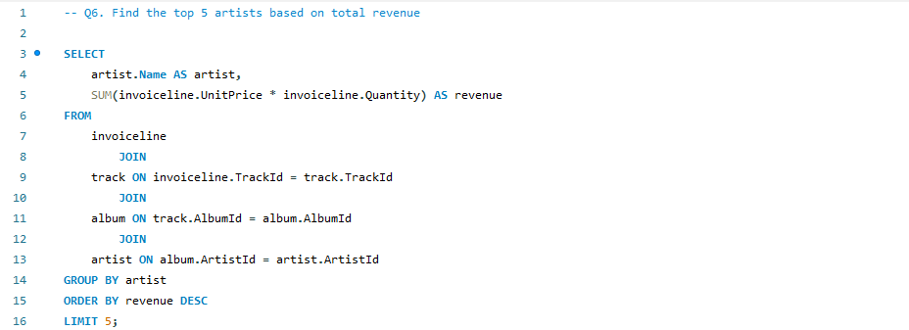
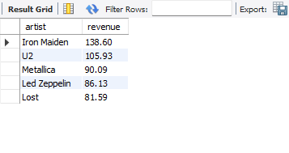

Slide 8
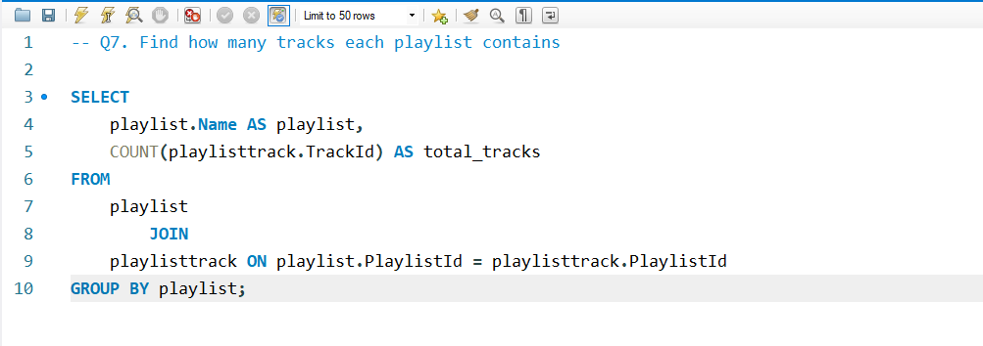
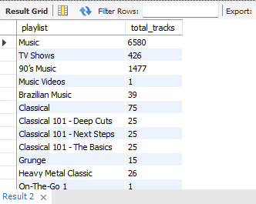

Slide 9
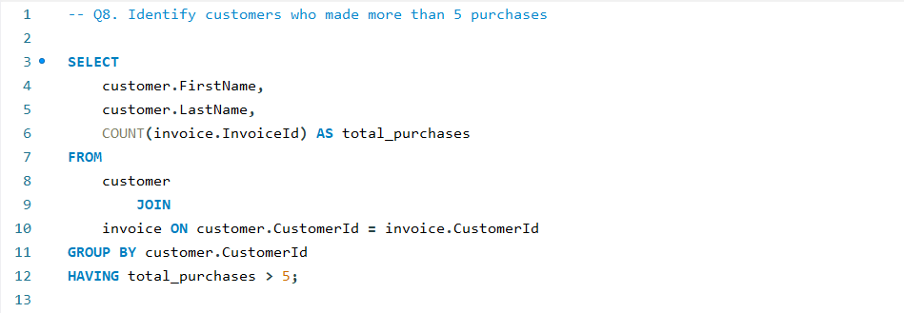
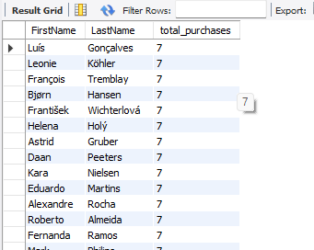

Slide 10
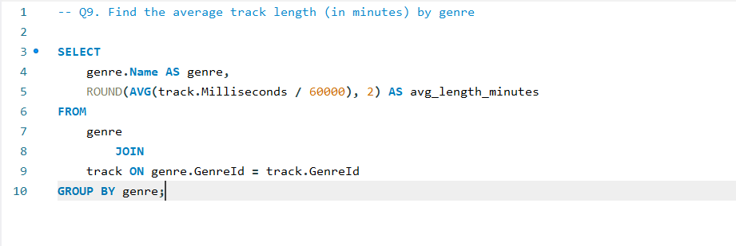
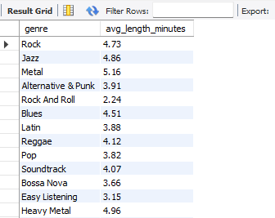

Slide 11
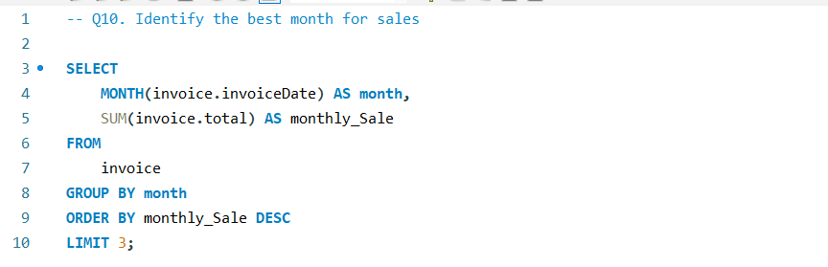
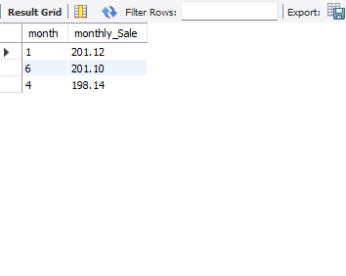

Slide 12
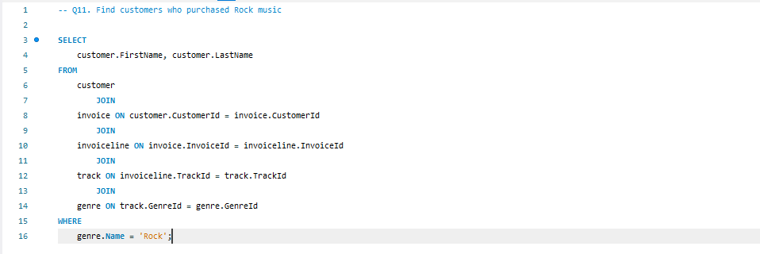
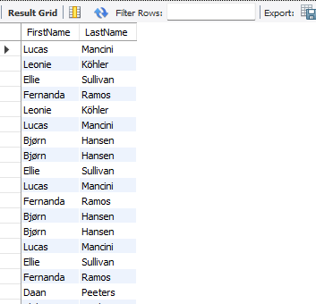

Slide 13
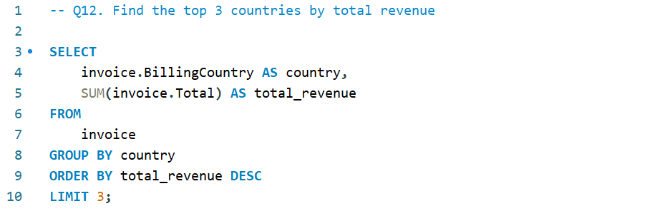
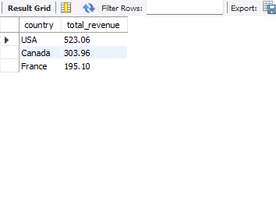

Slide 14
Skills Covered in This Project
SQL Query Writing & Optimization
Joins (INNER JOIN) across multiple tables
Data Aggregation (GROUP BY, HAVING)
Filtering & Sorting (WHERE, ORDER BY, LIMIT)
Sales & Revenue Analysis
Customer & Genre Analysis
Relational Database Understanding (MySQL)
Business Insight Generation using Data

