Slide 1
PETNOCARE
GROUP MEMBERS
ABHAY DIWAKAR
DEEP SHEKHAR DHEERENDER SINGH DUSHYANT
SOCIAL ENTREPRENEURSHIP
PRESENTATION

Slide 2
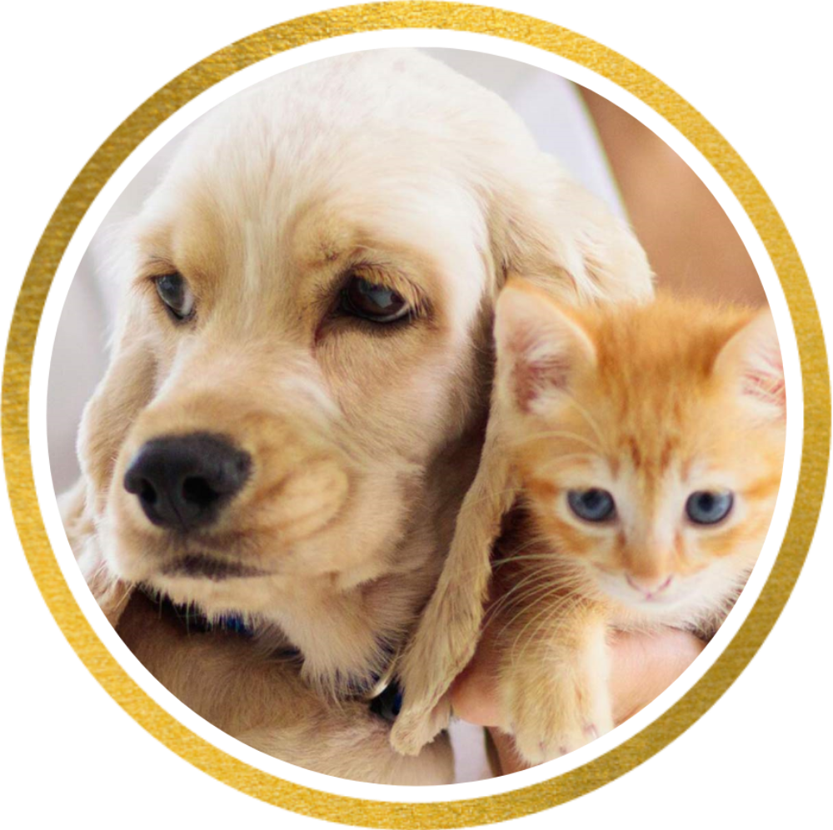

INTRODUCTION
Petnocare.com - a virtual pet healthcare platform that provides pet owners with easy access to licensed veterinarians and a range of pet-related goods and services.
Our mission is to enhance the health and wellness of pets and make it convenient for pet owners to get practical and trustworthy advice on their pets' dietary and medical needs. With the increasing demand for online healthcare solutions in India, Petnocare.com aims to be a leading player in the pet healthcare industry.

Slide 3
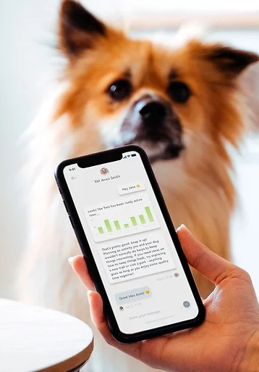

MARKET RESEARCH
The pet industry in India is growing at a CAGR of 16%.
The pet population in India is estimated to be around 10 million and is expected to grow at a rate of 10-12% annually.
The pet healthcare market in India is underdeveloped, with only a few players providing virtual consultation services.
India has a significant need for virtual pet healthcare services, in Tier 1 and Tier 2 cities where access to high-quality veterinary treatment is constrained.
Pet owners are seeking for trustworthy, affordable, and practical solutions to meet the health and wellness needs of their animals.
We also identified a gap in the market for affordable pet food and medication, which we plan to offer on our platform.
pet owners in India are willing to pay a premium for high-quality pet food and medication, but the options available in the market are limited and expensive.

Slide 4

BUSINESS PLAN
MP
HRP
FP
OP
MARKETING PLAN
We have developed a comprehensive marketing strategy that focuses on our target market, which is pet owners who value convenience, affordability, and high-quality pet care. Our marketing plan includes social media campaigns, search engine optimization, and email marketing, among other tactics.
HUMAN RESOURCES PLAN
We have identified the personnel we need to operate Petnocare.com, including veterinarians, healthcare
FINANCIAL PLAN
We have projected our revenue streams, estimated our expenses, and calculated our profits for the next two years. We plan to achieve profitability within the first year of operation by keeping our expenses under control and maximizing our revenue streams.
OPERATIONS PLAN
We have a detailed operations plan that outlines how we will conduct virtual consultations,
manage pet medical records, and provide pet-related goods and services. We will continuously improve our operations by incorporating customer feedback and keeping up with industry trends.
professionals, and IT experts.
We will prioritize employee satisfaction and development to ensure a committed and qualified workforce.

Slide 5

Impact
At Petnocare.com, we are committed to improving the health and well-being of pets across India. We believe that by providing easy access to high-quality virtual consultations, affordable pet food and medication, and timely veterinary care, we can make a meaningful impact on the lives of pets and their owners.
1. Improved Pet Health: By providing easy access to virtual consultations and affordable pet food and medication, we aim to help pet owners take better care of their pets. This, in turn, is expected to improve pets' overall health, reduce the
likelihood of illness, and increase their lifespan.
Increased Convenience: Our virtual consultation platform will make it easier for pet owners to access veterinary care without leaving their homes. This will save them time and money and reduce the stress of traveling to a vet clinic.
3. Better Access to Care: Our pet care van will provide on-site veterinary services to pet owners who cannot travel to a clinic or require urgent care. This will ensure that pets receive timely and competent care, regardless of their location.
2.
Job Creation: By hiring qualified veterinarians, healthcare professionals, and IT experts, we will create job opportunities for individuals with the right skill set. This will help drive economic growth in the veterinary and pet care sectors.
Increased Awareness: Through our marketing and outreach efforts, we aim to increase awareness about the importance of pet health and wellness. This is expected to have a positive impact on the pet care industry and help drive demand for our
services.
Overall, we believe that Petnocare.com has the potential to make a significant impact on the lives of pets and their owners across India. By providing easy access to high-quality veterinary care and pet-related products, we hope to become a trusted partner in the pet care community

Slide 6

Start-up Phase
Now, let's take a look at our plans for the startup phase of Petnocare.com. During this phase, we will focus on setting up the business infrastructure, building our team, and launching our platform.
Secure funding: We must secure sufficient funding to launch our platform and sustain the business during the initial phase. We will approach potential investors and financial institutions to secure the required funding.
Build our team: We will recruit a team of experienced and qualified professionals in the areas of veterinary medicine, healthcare, and IT. This team will be responsible for developing and launching our platform and providing our services.
Develop our platform: We will work towards developing a user-friendly, secure, and accessible online platform. The platform will be equipped with the tools required to conduct virtual consultations, archive pet medical records, and provide pet-related goods and services.
Launch our platform: Once our platform is developed and tested, we will launch it to the public. We will also begin marketing our services through various channels to reach our target audience.
Establish partnerships: We will work towards establishing partnerships with other businesses in the pet care industry, such as pet food manufacturers, veterinarian practices, and animal welfare organizations. This will help us expand our reach and provide more comprehensive services to our customers.
Overall, our goal during the startup phase is to establish a strong foundation for the business and set the stage for future growth and expansion.

Slide 7
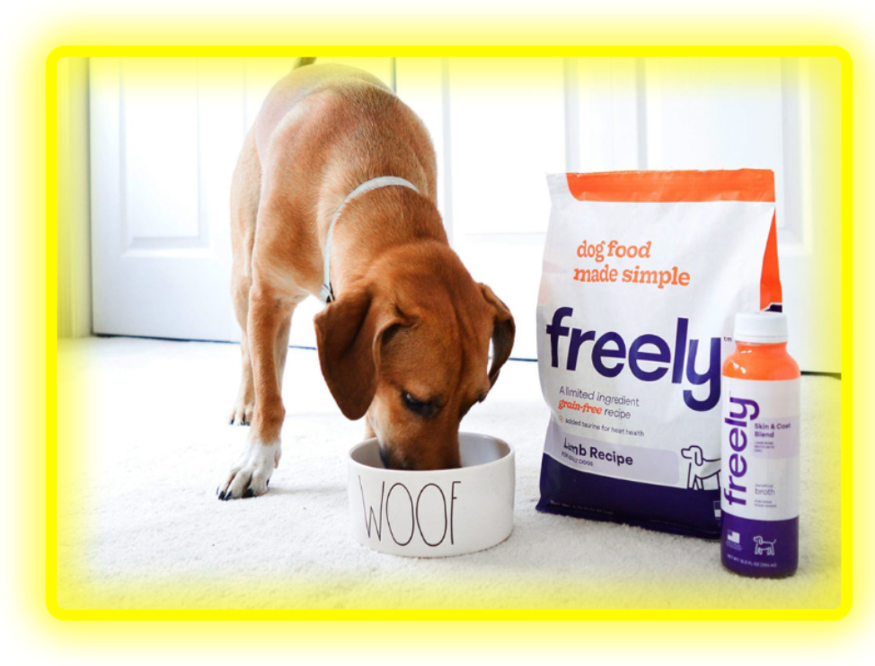
SUBSEQUENT PHASE
During the subsequent phase, we plan to expand our services and reach out to a larger audience.
This phase will be focused on scaling our business and increasing our revenue streams.
In the first year, we aim to establish partnerships with leading pet food manufacturers and veterinarians to offer a wider range of products and services.
This will help us enhance our platform's credibility and reputation and provide pet owners with a more comprehensive suite of solutions for their pets.
To achieve this goal, we plan to allocate a significant portion of our budget towards marketing and outreach activities.
We will be leveraging social media campaigns, email marketing, and other digital marketing channels to promote our services and reach out to a broader audience.
In the second year, we plan to expand our pet care van services to other cities and regions in India.
This will enable us to provide on-site veterinary care to more pet owners in remote locations and underserved communities.
Additionally, we will be investing in research and development activities to improve our platform's features and functionality continually.
We aim to develop new tools and features that can help pet owners manage their pets' health and well-being better.

Slide 8

CONCLUSION
In conclusion, Petnocare.com is dedicated to providing pet owners with accessible and reliable virtual veterinary consultations, pet food and medication, and on-site veterinary services through a pet care van. Our ultimate goal is to enhance the health and wellness of pets and give pet owners practical and easy-to-reach answers for their animals' dietary and medical requirements.
Over the next two years, we aim to expand our services and strengthen our brand in the market. We will focus on growing our customer base, developing new partnerships, and continuously improving our services to meet the evolving needs of our target market.
We are excited about the potential for Petnocare.com to make a
positive impact on the lives of pets and their owners.
Prototype for website
:https://www.canva.com/design/DAFiBiFJWTc/A9CRev3T7uye-0_GgIv1Gg/edit?utm_content=DAFiBiFJWTc&utm_campaign=designshare&utm_medium=link2&utm_source=sharebutton

Slide 9

PETNOCARE
THANK YOU

