Slide 1
Superstore Sales Analysis Report
Power BI Dashboard Summary

Slide 2
📁 Project Overview
This Power BI dashboard analyzes sales data from a retail superstore.
It covers city-wise and region-wise performance, customer segments, discounts, and profitability.
The goal is to derive business insights for better strategic decisions.

Slide 3
📊 Key Metrics
- Total Sales: ₹2.30M
- Total Profit: ₹286.4K
- Total Quantity: 38K units
- Total Discount: ₹1.56K

Slide 4
📈 Dashboard Components
- Tree Map of Sales by City
- KPI Cards (Sales, Profit, Discount, Quantity)
- Profit vs Discount by Region and Segment
- Sales by Region and Product Category

Slide 5
🎯 Business Insights
- New York City is the top performer in sales.
- Corporate and Consumer segments are dominant contributors.
- Negative profits in some cities suggest loss-making zones.
- High discounts do not always correlate with high profits.

Slide 6
🛠️ Tools Used
- Power BI Desktop
- DAX for custom metrics and aggregations
- Built-in visuals like Tree Map, Donut Chart, Line Graph, KPI Cards

Slide 7
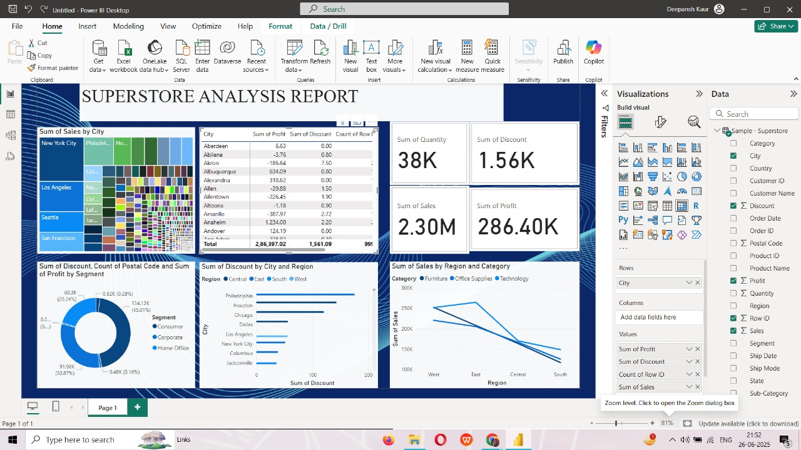
📸 Dashboard Preview

