Slide 1

A Data-Driven Analysis of Movie Profitability
The movie industry is inherently risky, characterised by substantial budgets and uncertain returns. Our aim is to unravel the core drivers of profitability and construct predictive models for success.
1
Industry Challenges
High production costs coupled with unpredictable audience reception make profitability a complex challenge.
2
Research Objective
To identify key profit determinants and develop robust predictive models using empirical data.
3
Data Scope
Analysis is based on a comprehensive dataset of 4,769 feature films from IMDb, ensuring a solid foundation.
4
Analytical Approach
Utilising descriptive analysis, regression, and advanced machine learning techniques to derive actionable insights.

Slide 2



Data & Methodology
Our analytical framework is built upon a rigorously prepared dataset and a multi-faceted approach to uncover the determinants of movie profitability.
Data Acquisition
Key Variables
Data Preparation
Initial dataset of 5,438 IMDb entries refined to 4,769 unique feature films after meticulous cleaning.
Focus on critical metrics: score, votes, genre, rating, budget, gross revenue, runtime, release timing, and ultimately, profit.
Involved parsing release dates, adjusting budgets for inflation, calculating profit margins, managing outliers, and creating dummy variables for categorical data.
01
02
03
Descriptive Analysis
Multiple Linear Regression
Machine Learning Models
Initial exploration through statistics and visualisations to understand data distributions and trends.
Quantifying the linear relationships between variables and movie profitability.
Application of Decision Tree and Neural Network models for robust prediction and validation.

Slide 3


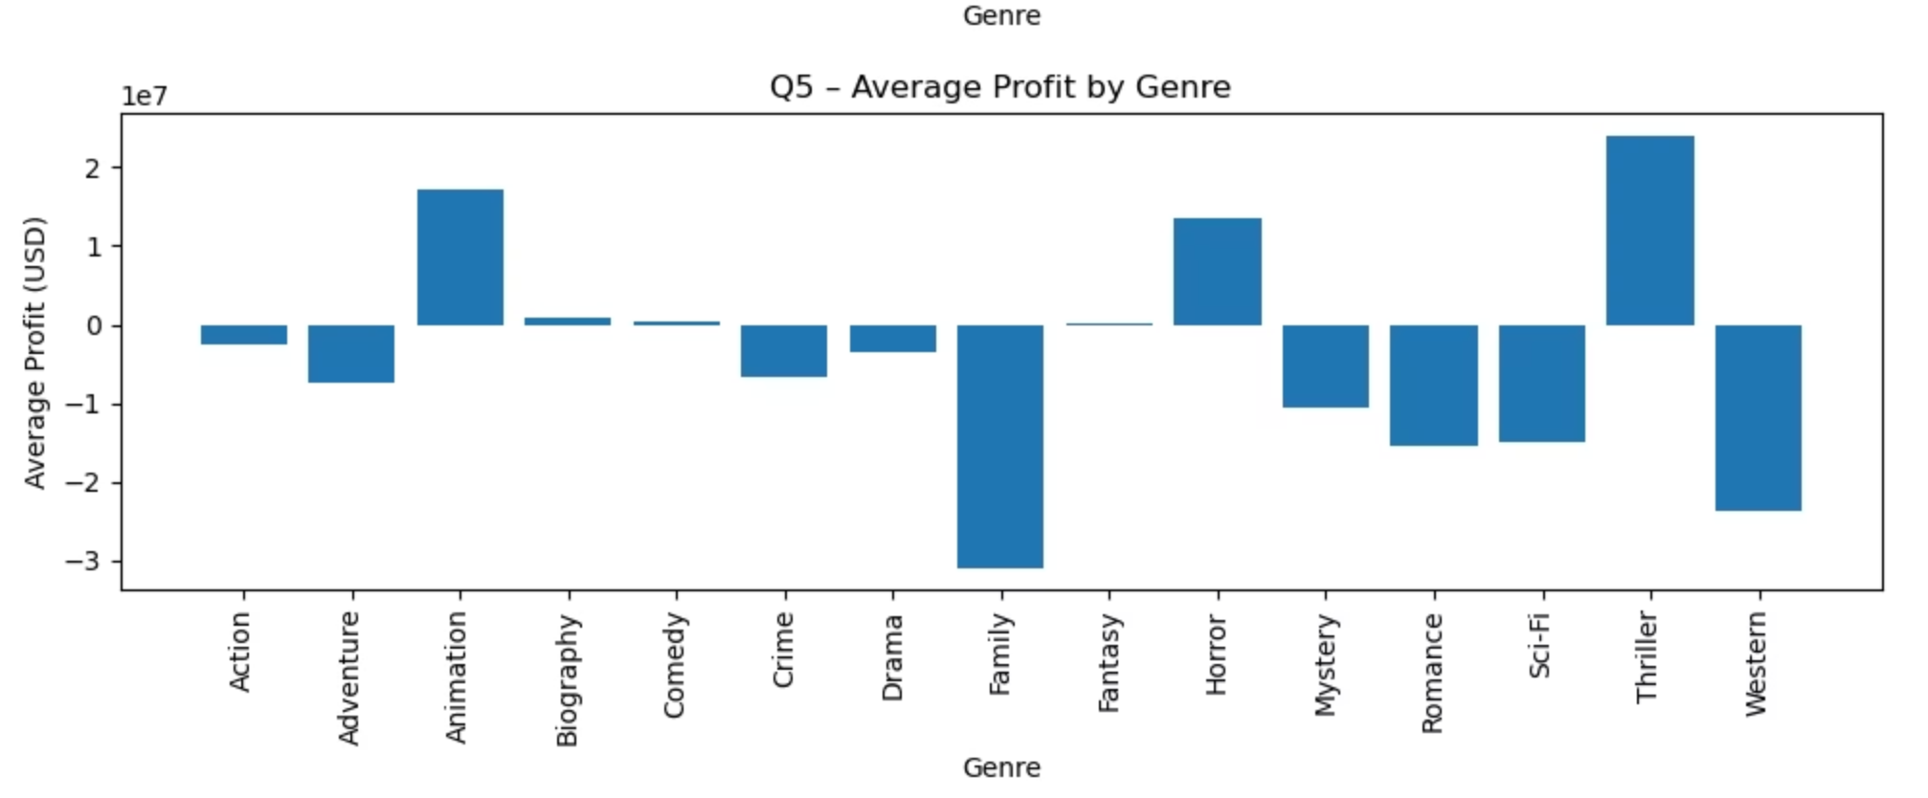


Part B – Profitability by Genre
An initial examination of average profit by genre reveals significant differences in financial performance.
Horror & Comedy Lead
These genres consistently demonstrate the strongest average profits, indicating broad audience appeal and cost-effective production.
Underperforming Genres
Family, Romance, and certain Drama categories tend to show lower average profitability, suggesting potential saturation or narrower appeal.
Strategic Implications
Genre selection is highlighted as a pivotal business decision, profoundly impacting a film's potential for financial success.

Slide 4

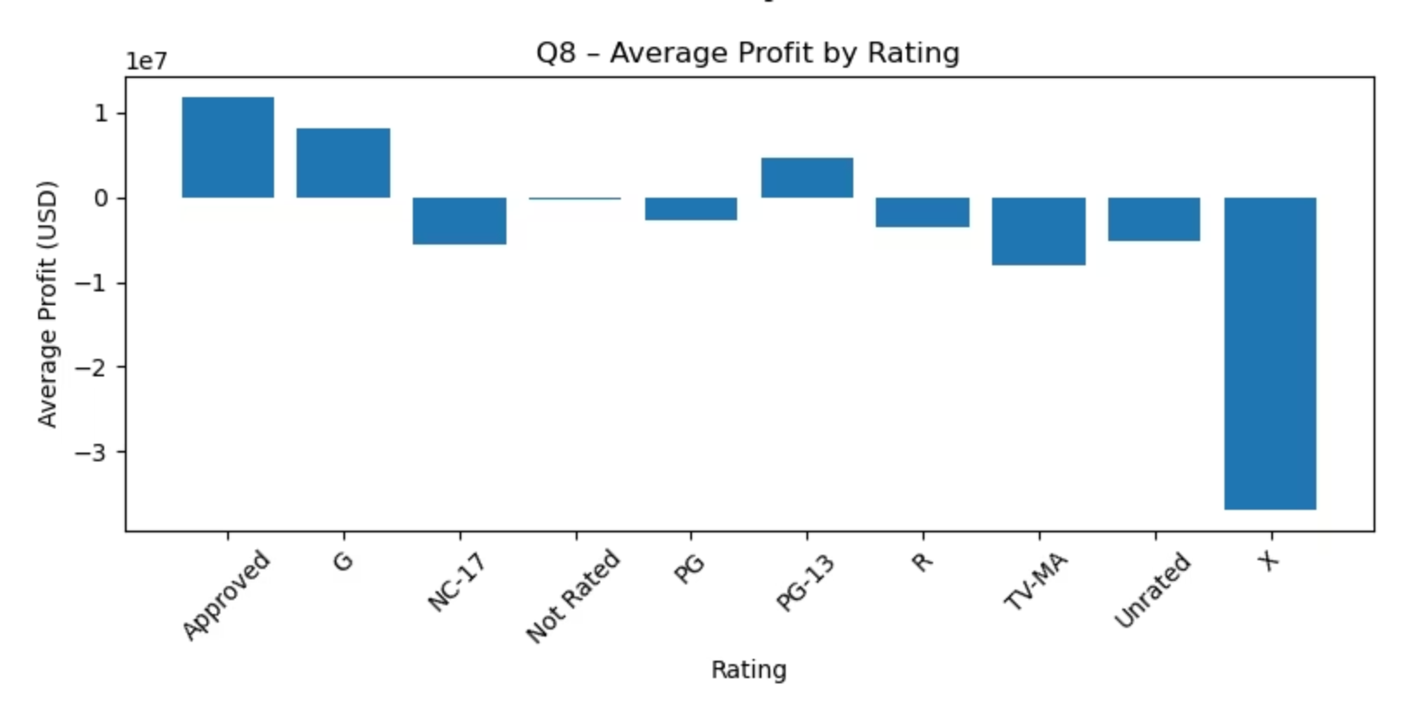
Part B – Profitability by Rating
An analysis of movie profitability by MPAA rating reveals distinct trends, though these can be misleading without further controls.
PG and PG-13 Dominance
Films with these ratings generally achieve the highest average profits, appealing to a broad demographic.
R-Rated Volatility
While some R-rated titles achieve significant success, many underperform, indicating a high-risk, high-reward segment.
Niche Ratings
NC-17 and "Not Rated" films occupy niche markets, consequently exhibiting limited commercial reach and lower average profits.
Regression Insights
Subsequent regression analysis demonstrates that rating alone often becomes insignificant once other influencing factors are controlled for.

Slide 5
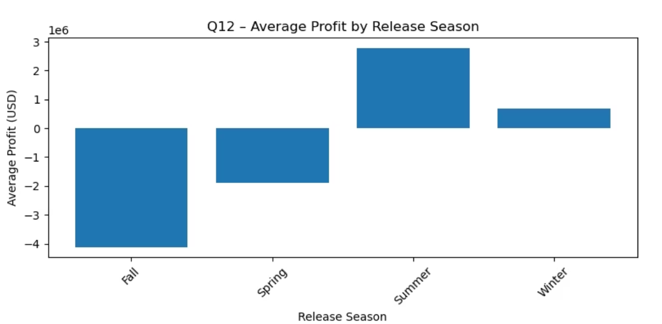
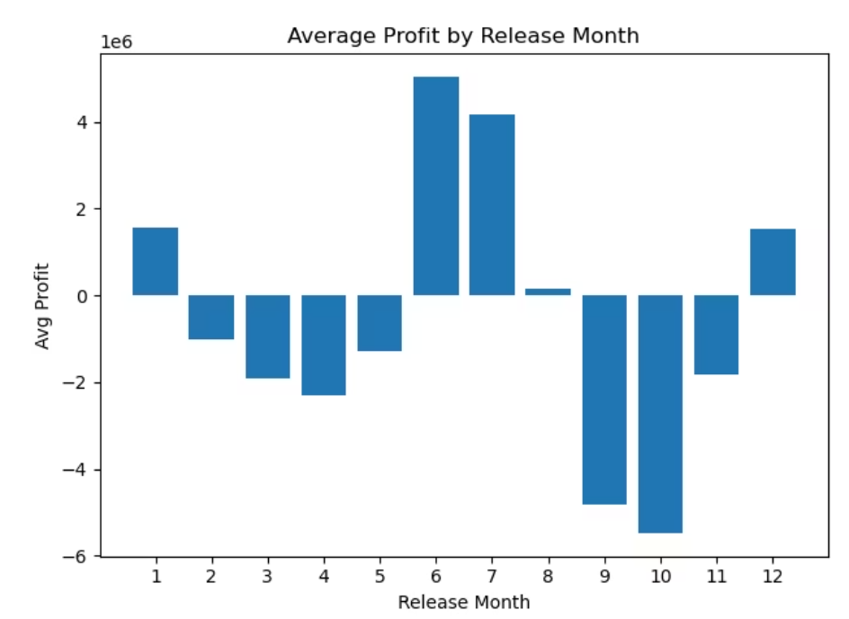
Part B – Profitability by Month and Season
Release timing plays a crucial role in a film's financial success, with distinct seasonal patterns emerging from the data.
Summer Blockbuster Peak
Autumnal Dip
June and July consistently emerge as the most profitable months, aligning with the traditional summer blockbuster release window.
September, October, and November exhibit significantly lower average profits, suggesting a less favourable release period.
Seasonal Strength
Strategic Lever
Overall, summer is identified as the strongest season for movie profitability, whereas winter tends to be weaker.
Release timing is clearly a key strategic lever for maximising a film's financial returns, demanding careful consideration.

Slide 6

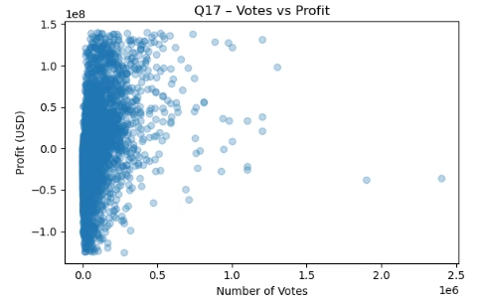
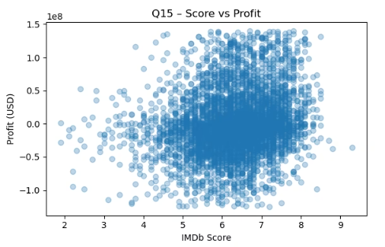
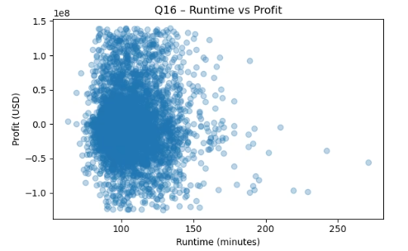
Part B – Score, Votes, and Runtime vs Profit
Examining continuous variables against profit reveals varying degrees of influence on a film's financial performance.
Votes vs. Profit
Score vs. Profit
Runtime vs. Profit
A clear upward trend demonstrates that higher audience engagement, as measured by votes, correlates strongly with increased profitability.
While a positive relationship exists, it is relatively weak, indicating that good reviews contribute but are insufficient on their own for significant profit.
The relationship here is almost flat, suggesting that movie length does not, by itself, significantly determine financial success.

Slide 7
Part C – Regression Results (Profit as Dependent Variable)
Our multiple linear regression model elucidates the primary drivers of movie profitability, with profit as the dependent variable.
Unstandardized Beta Standardised Beta p-value Hypothesis Supported
Votes
0.15
0.42
0.000
Yes
Score
0.08
0.12
0.001
Yes
Years_since_production
-0.03
-0.18
0.000
Yes
Genre: Comedy
0.22
0.15
0.000
Yes
Genre: Horror
0.18
0.10
0.000
Yes
Month: September
-0.10
-0.07
0.002
Yes
Month: October
-0.11
-0.08
0.001
Yes
Month: November
-0.09
-0.06
0.005
Yes
MPAA Rating
N/S
N/S
>0.05
No
Model Fit
The model explains approximately a quarter of the variation in profit (R² ≈ 0.25, Adj. R² ≈ 0.246), providing a reasonable but not exhaustive explanation.
Key Positive Drivers
Audience 'Votes' demonstrate the largest standardised beta, followed by 'Score'. 'Comedy' and 'Horror' genres also show strong positive effects compared to the baseline.
Significant Negative Impacts
'Years_since_production' negatively affects profit, and films released in 'September', 'October', and 'November' experience significant profit reduction.
Non-Significant Factors
After accounting for other variables, MPAA ratings and day-of-month dummy variables largely lose their statistical significance.

Slide 8
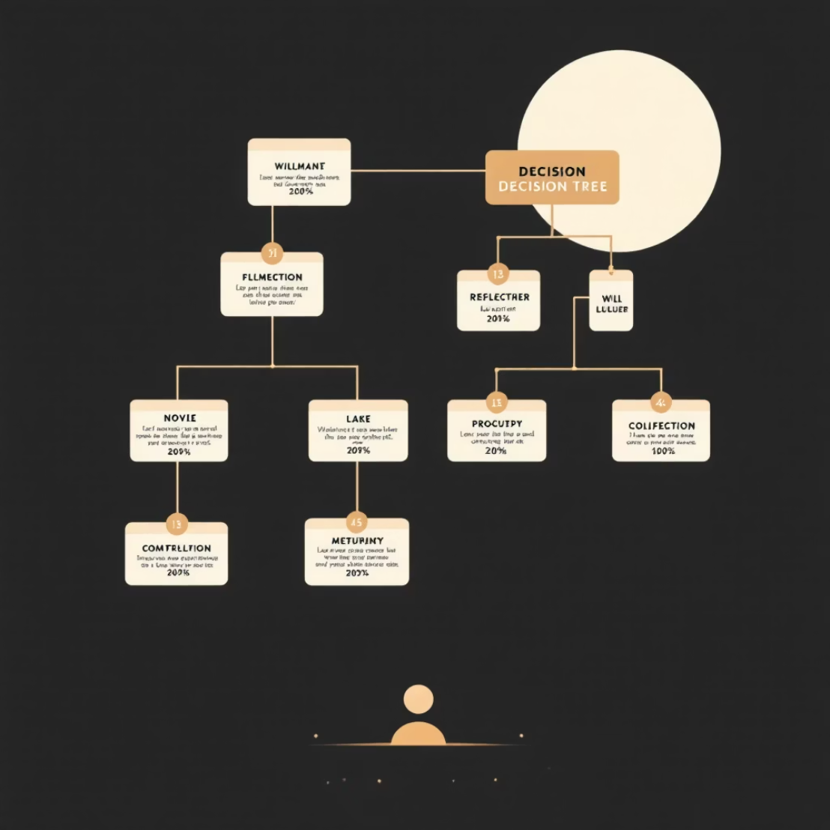

Part D – Decision Tree vs Neural Network
We evaluated two machine learning models for their predictive power, revealing a clear outperformer for movie profitability forecasting.
Data Split
Decision Tree Regressor
The dataset was divided into 70% for training and 30% for testing, meticulously ensuring no leakage from gross revenue or adjusted budget variables.
Achieved a test R² of approximately 0.27 with an RMSE of $41M, effectively capturing non-linear patterns and complex interactions within the data.
Neural Network (MLP)
Model Selection
Performed less effectively, yielding a test R² of approximately 0.01 and an RMSE of $48M, primarily due to convergence issues with high-dimensional dummy variables.
The Decision Tree clearly surpassed the Neural Network in performance, establishing itself as the preferred model for future predictions.

Slide 9
Part D – Predictions for New Movies
Applying our selected Decision Tree model, we generated profit predictions for three hypothetical, unreleased movies, illustrating the model's practical application.
Gorga
$44,266,022.70
King Wolf
$44,266,022.70
Hellish Gray
$44,266,022.70
1
2
3
Consistent Attributes
Identical Predictions
Directional Planning
All three hypothetical movies were assigned similar attributes for critical variables such as audience votes and release timing.
Consequently, the Decision Tree model routed these inputs into the same leaf, resulting in identical predicted profit figures for each film.
The model is best suited for providing directional guidance and establishing a rough profit range for planning, rather than precise, individual movie predictions.

Slide 10










Main Drivers of Movie Profitability
Synthesising insights from correlation, regression, and machine learning, we identify the most influential factors dictating movie profitability.
Film Age
Audience Engagement
Newer films generally yield higher profits; profitability exhibits a clear decline with the passage of time since release.
Quantified by 'votes', this is the strongest and most consistent predictor across all analytical methods.
Genre Impact
Specific genres such as Comedy and Horror significantly outperform baseline genres in regression analyses.
Rating Influence
Descriptively, ratings appear important, but their significance diminishes once other factors are controlled for in multivariate analyses.
Release Timing
Releasing films during autumn months (September-November) significantly depresses profits, whereas summer releases are most advantageous.

Slide 11
Managerial Recommendations for Producers
Lean toward genres with stronger profit profiles
Target PG or PG-13 ratings
Prioritize summer releases
Focus on genres like Horror, Comedy, and some Thriller when the commercial aspect is a primary driver.
Maximize potential audience size by aiming for PG or PG-13 ratings, where the story permits.
Strategically launch films in June and July; avoid the September–November window for major commercial endeavors.
Manage budgets carefully
Invest in marketing and audience engagement
High budgets do not independently guarantee increased profitability once other influencing factors are accounted for.
Focus efforts on generating word-of-mouth and increasing audience votes, which are more impactful than solely chasing critic scores.

Slide 12
Limitations and Final Takeaways
Data Exclusions
Future Model Exploration
Our analysis does not include marketing spend, competitive landscape, franchise status, or the impact of streaming platforms.
The neural network performance suggests an opportunity to explore more sophisticated machine learning models, such as Random Forests, Gradient Boosting, or ensemble methods, in future research.
Profitability Factors
Practical Toolkit for Studios
Despite data limitations, our analysis confirms that film profitability is not random. Key factors include audience votes, genre selection, release timing, and the freshness of the film concept.
By combining descriptive analysis, regression modeling, and decision trees, studios gain a robust and practical toolkit for informed decision-making regarding budget planning, genre selection, and strategic release date scheduling.

