Slide 1
History behind JSP/Java Servlet
Developer : Sun Microsystems, Inc (now Oracle)
First release
Java Servlet 1.0 : 1996
JSP 1.0 : 1997
JSP is an extension of Java Servlet technology
Technology | Number of Releases | Current Version
Java Servlet | 8 | 3.0
JSP | 4 | 2.1

Slide 2
Development Environment
Java 2 Enterprise Edition (J2EE) SDK
Open source IDE :
Eclipse
NetBeans
Open source web server:
Apache Tomcat
GlassFish

Slide 3
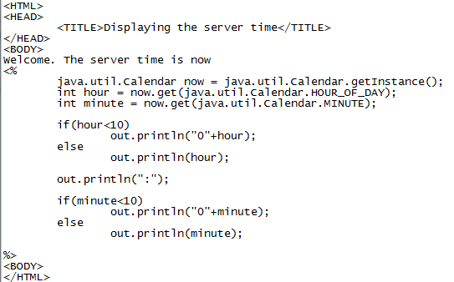
Code Snippet

