Slide 1

ENVIRONMENT AWARE IRRIGATION SYSTEM

Slide 2
ABOUT THIS PROJECT
Course : Advanced Embedded Software Development
Team Members : Deepesh Sonigra, Madhumitha Tolakanahalli
Time Span : 22 days (80 hours)
Notes:
This project was for the course Advanced Embedded Software Development which involved learning concepts like concurrent programming, designing state machines, writing robust code covering corner cases and so on. I worked with my partner Madhumitha for this project. And the project work lasted for 22 days with an average of 4 hours work per days.

Slide 3
AGENDA
PROJECT REQUIREMENTS
PROJECT DESCRIPTION
SYSTEM BLOCK DIAGRAM
SENSOR NODE BLOCK DIAGRAM
CONTROL NODE BLOCK DIAGRAM
DESIGN CHOICES
CHALLENGES FACED
KEY LEARNINGS
FUTURE SCOPE
DISCUSSION

Slide 4
PROJECT REQUIREMENTS
To design and implement a monitoring system comprised of a controller (Control Node) connected to and controlling a remote sensor (Remote Node) forming a closed loop system.
To create a multi-controller “product” using the BeagleBone Green, Tiva C-Series Launchpad development board, sensors and output devices.
To achieve high reliability and robustness by performing Power-on Self Test.
The system shall support a degraded level of service in the absence/failure of any single sensor, appropriate error reporting, fault detection, fault tolerance, and fail-safe behavior.
Logging implementation to trace all the messages for post-event analysis review.
Notes:
We had to design a closed loop application which comprised of a Control Node and the Remote Node. Remote node had the sensors and actuators connected. The Control node communicates control messages to the remote node. The goal is to create a Fault Tolerant System. Hence the system should perform a Power-On self test and should support various modes of operations if there is a failure in the system. Logging should be implemented for post-event analysis and could also help in debugging.

Slide 5
PROJECT DESCRIPTION
The Remote node senses the moisture in soil, temperature, luminosity and communicates it to Control Node. Control Node takes decision based on the values and communicates back to the remote node the actions to be performed.
The system performs a Power-on Self Test on startup and provides and overview about the sensors connected to the system.
The systems works in either Normal Mode or various levels of Degraded modes based on the types of system failure.
The logging is implemented both on the Control Node as well as Remote Node for post-run analysis.
Notes:
In this project we developed a concurrent, multi-controller product with closed- loop machine control involving a Remote Node (Tiva C-Series) and a Control Node (Beaglebone Green). The application provides a full-duplex cross operating system communication using UART enabling exchange of sensor data and control data.
The application runs a Power-on Self-Test to examine the status of the system and then decide the operational mode. The Control Node has an alerting mechanism to indicate three levels of application operation – normal operation, degraded, failed/out-of-service. To support performance and failure analysis, the system provides logging and log management functions to record and retrieve data and events. The entire application is implemented in form of hierarchical code with focus on modularity and reusability.

Slide 6
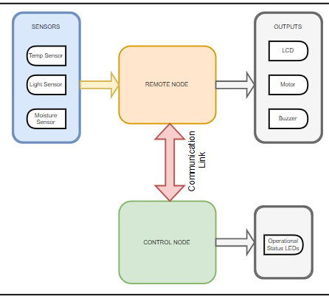
SYSTEM BLOCK DIAGRAM
The Control Node comprises of the BeagleBone Green running a customized Linux image.
The Remote Node comprises of the Tiva C-Series LaunchPad board running your customized FreeRTOS image.
The two nodes are connected using full-duplex method to support the application’s need for communicating control/sensor information, transmit data, events, and logs.

Slide 7
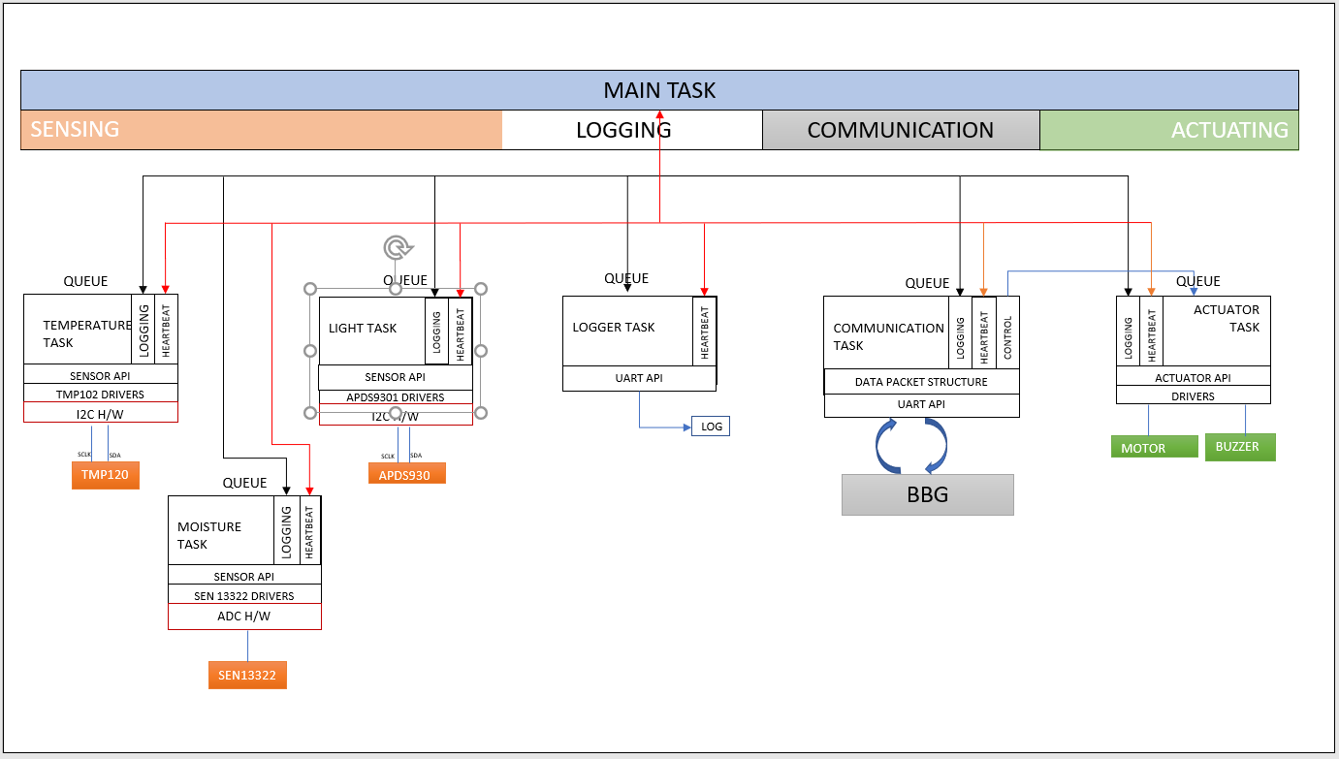
SENSOR NODE BLOCK DIAGRAM
Notes:
There are 6 task the main thread creates : the temp task, moisture task, light task, logger task, communication task and the actuator task.
The temperature and light sensor are connected via I2C interface. The Moisture sensor is connected using ADC (12-bit precision) interface. There are two actuators the motor and the buzzer which are controlled by the actuator task. The logger task receives logs from all the other tasks using message queues. The communication task is responsible for sending the sensors values to the control node and receive control messages from the control node.
There is a heartbeat mechanism for each thread to keep track of them being alive. I will be talking about this more in the future slides.

Slide 8
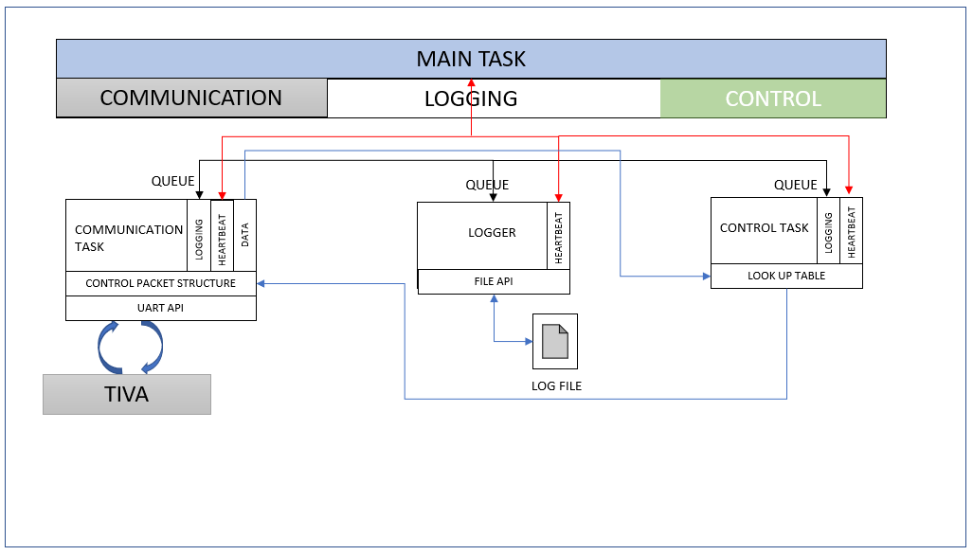
CONTROL NODE BLOCK DIAGRAM
Notes:
The main task here as well is responsible for the heartbeat mechanism. The communication task receives the data from the remote node and sends it to control task using message queues. The control task responds to the communication task based on the sensor values the control message using message queues as well. Here the queues are implemented in non blocking way. The logger task logs all the events in the log file

Slide 9
POWER-ON SELF TEST
The Power-on Self Test is performed on both the nodes on startup of the system.
The POST comprises of Device Test and Communication Link Test.
Device Test : Testing and verifying the presence of the sensors.
Communication Link Test : Testing and verifying the communication between the nodes
Based on the results of the POST, the system works in various operational modes.
Notes:
The POST runs on start up trying to communicate with the sensors. Sensor disconnect was checked by i2c no ack received for some time.
ADC was connected to a pull up resistor, so if nothing is connected value will be the highest.
The communication link sends a Self test message and waits for it to receive ack.
The control node waits on the self test message indicating degraded mode if not received for a while.
The POST does not sense the actuators connected to the system.

Slide 10
FAULT TOLERANT SYSTEM
The system continues to work in degraded mode on failure of either the temperature sensor or the light sensor.
The moisture being the critical sensor, on failure alarms the user about the system failure.
If the communication link breaks the data is stored into the EEPROM(50 packets) and as soon as the connection is re-established the entire data is sent back to the control node.
If the communication link is inactive for longer periods, the remote node takes decision based on the moisture level of the soil.
Notes:
If temperature or/and Light sensor doesn’t work the system works in degraded mode.
If moisture sensor does not work the system fails.
If the communication link doesn’t work EEPROM mechanism was implemented to save data that was to be sent to control node.
EEPROM could save only 50 packets and then it was overwritten with new data.

Slide 11
DESIGN CHOICE - HEARTBEAT MECHANISM
Heartbeats are implemented to indicate normal operation and create a fault tolerant system.
Heartbeat notifications are implemented using Request-Response model.
The main thread is responsible for requesting the heartbeats from the threads and other book-keeping activities.
Request-response model was chosen as it would help keep track of number of missed heartbeats which could be used for analysis of the system.
Notes:
Heartbeats are implemented to keep track of the threads.
All the threads wait on their queue to receive heartbeats. On receiving their heartbeats threads send an ack heartbeat to the main thread.
Request response was chosen for keeping track of how many heartbeats failed.
If a threads fails for 5 heartbeats the systems marks the thread as failed. The system ideally should restart itself.

Slide 12
DESIGN CHOICE - LOGGING
The Control Node logs the system events to support performance and failure analysis the system.
Some examples of events that are recorded included failure of a sensor, loss of communication with the Remote Node, and degraded operational state.
The Control Node logs all these events into a log file which are used for post-run or post-event analysis.
Logging using log file results in the retrieval of log even on reboot or power cycle of the system.
Notes:
The Control Node logs all the events for the remote node as well as the control node. The remote node logs using a UART mainly used for debugging. The Remote Node sends all the events to the control node through the communication link. On the communication link failure the events are stored into the EEPROM to send it over to the control node. Events like Failure of sensors, Alerts, degraded modes are logged into the log file with timestamp. The timestamp for FreeRTOS is the relative to the start time of the system. Extra computation would be required for the actual timestamp. This can be done by noting the first time-stamp of the heartbeat and subtracting that to the receiving part of it.

Slide 13
DESIGN CHOICE - MULTITHREADING
Improved throughput : many concurrent computation operations and each thread can be assigned for each sensor.
Superior application responsiveness : one failed thread (sensor) does not stall the entire application.
Maximizing processor performance : gain better performance through simultaneous execution of tasks.
Inter Process Communication : sharing large amounts of data through separate threads of execution. Logger thread receives messages from all the threads and logs the events.
Notes:
Multithreading was chosen as multiple threads can run concurrently calculating values for their respective sensors. Each sensor having its own threads isolates itself and failure of any sensor would not stall the application. An entire application will not block, or otherwise wait, pending the completion of another request.
Logging as a separate thread is easier to implement as the threads could just send the events to the queue and continue working. Multi-threading allows threads to run at different priorities, leading to critical functions to run first.

Slide 14
DESIGN CHOICE - QUEUES
Message Order : the order in which the messages are received will be preserved.
Ease of scalability : Each thread can have its own queue, and thus each thread can communicate with each other using that queue.
No need of External Synchronization : Queues are self synchronized, thus eliminating the use of semaphores and mutexes
Notification Mechanism : specifying signal to be sent when an element is added to an empty queue.
Queue Size: The programmer may set ceilings on the number of messages that can be on the queue, and the size of each message.
Notes:
Order of the messages is preserved in the queue. This would be essential for logging understanding the sequence of the events.
Queues were chosen as IPC as Each thread could have its own queue and each thread could communicate with other thread.
Queues are implemented in a non blocking, hence they do not block any code.
Queues being synchronized does not need locks to share information between them. One of the advantages of queues is that it has a notification feature which could be used as a trigging event.

Slide 15
DESIGN CHOICE – PACKET STRUCTURE
Packet structure is used to transfer the data between the remote node and the control node.
The advantages of packet structure is that all the application-dependent data objects of different types can be grouped with each other.
Packet structure also supports scalability if more data fields need to be added.
The packed structure reduces memory usage and prevents padding leading to continuous data byte stream.
Notes:
Packet structure is used to communicate between the two nodes. Packet structure gives an advantage of having all the information under one roof and sending it over. It is easier to decode on the receiving side as well. It makes the code more readable. If another data field needs to be added, modification of the code would be simpler. Packet structure could be converted into the byte stream to sent it over the communication link.

Slide 16
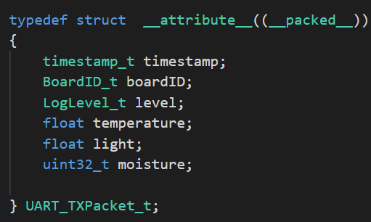
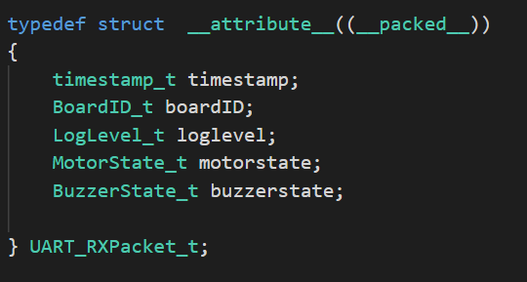
DESIGN CHOICE – PACKET STRUCTURE
Notes:
The left side is the UART Transmission packet consisting of the sensor data. Right one is the RX packet consisting of the control messages. Board ID was induced in the packet structure for scalability. Considering if multiple boards are connected to the system board ID would differentiate it.
The log level consisted of different log levels like INFO, STATUS, HEARTBEAT, HB_FAIL, Degraded Modes, ERROR, EXIT,
The structure was packed to avoid the padding from the processor. If padding is not avoided, this could lead to a problem in the system if they have different endiness.

Slide 17
DESIGN CHOICE - SYNCRONIZATION
As the system makes use of global variables for temperature, light and moisture, synchronization of these global variables are required.
These variables are manipulated in their respective threads and used in the communication thread to send data to the control node.
Mutexes are used to provide this synchronization between the threads.
The reason mutexes were used is because there is ownership associated with mutex, and only the owner can release the lock (mutex).
Notes:
The one thread writes it and the other thread reads the data.
Mutexes gives mutual exclusion to the resource. I think spin locks would have been a better solution for this situation as the critical section was small. I would like your inputs as well on this topic.

Slide 18
DESIGN CHOICE – INDICATION SYSTEM
An indication system is used for the data to be sent to the control node.
The flags are used to indicate the change in either of the sensor data or status from its previous state.
The idea behind this implementation is that the packet should be sent only if the state of the system has been changed.
This prevents unnecessary computations at the control node, reducing CPU cycles.
This could be of great use if multiple remote nodes are connected to one control node.
Notes:
Initial design included sending the sensor data to the control node after every specific time cycle. Later the design was changed to only send the sensor data or system status if it has changed from the initial state. This avoids sending the same packet to the control node.

Slide 19
DESIGN CHOICE – SIGNAL HANDLING
As the system needs to be fault tolerant, signals should be captured, and corresponding action need to be taken.
In this application, signals are captured, and the program is gracefully terminated.
On receiving the signals, resources are released like timers are stopped and deleted, memory is freed, mutexes and semaphores are deleted, and the events are logged.
User signals were captured for future implementation of any interrupt-based feature.
Notes:
A signal is a software interrupt delivered to a process.

Slide 20
CHALLENGES FACED
Different padding problems seen from both the nodes.
Debugging code in a multi-threaded environment.
Synchronizing UART across two platforms.
Stack smashing issues while logging the data in Control Node.
Implementing a fault tolerant system.
Tried to implement a wireless communication between the nodes but couldn’t due to lack of time.
Notes:
Padding issues as compiler would add padding which will be difficult to decode on receiving side.
Multithreaded code, Logging the thread events helped in debugging.
The structure needs to be shared between both the nodes. Understanding termios for uart config on the buildroot. We referred linux man pages for termios.

Slide 21
KEY LEARNINGS
Aspects of fault tolerance like the redundancy, error detection, error correction, error recovery and error prevention were deeply studied.
Writing modular hardware sensor driver libraries, resulting in portability and reusability.
Learning inter-process communication techniques and applying concurrent programming concepts to an application distributed between two node systems.
Applying basic software error reporting, fault detection and fault tolerance techniques to an application
Collaborating with team member, professors and applying project management techniques.
Notes:
Redundancy – CRC codes or adding redundant data for error detection.

Slide 22
FUTURE SCOPE
The system could be made more reliable by integrating sensors for detecting more environmental variables.
A database could be created for different types of soils and their properties.
Wireless communication could be established between Control and Remote Node for covering a wider area.
System can be made scalable with multiple remote nodes connected to the same control node.

Slide 23
COLLABORATION AND ACKNOWLEGMENT
I would like to thank Madhumitha Tolakanahalli for collaborating with me for this project.
It was a great learning experience, working in team, brainstorming design ideas and implementations.
We used Git Version Control extensively which helped with remote collaboration, code management and feature tracking.

Slide 24

Questions

Slide 25
Thank You

