Slide 1

ECEN 5833
Low Power Embedded Design Techniques

Slide 2

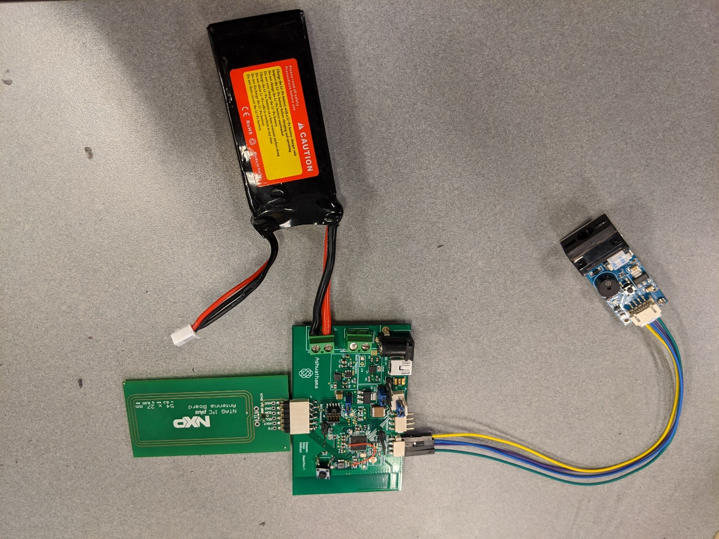

Team: Ashwathama Self-Checkout Shopping cart
Members: -
Deepesh Sonigra
Satya Mehta
Siddhant Jajoo

Slide 3
Presentation Roadmap
Project Description & Use Cases
System Block Diagram
Hardware Block Diagram
Hardware Design
Software Design
Low Power Mode timeline
Proof of Concept Implementation
Summary and Lessons Learned

Slide 4
Project Description & Use Cases
The “Self-Checkout Shopping Cart” is an innovative consumer purchasing product that is designed to help shoppers fast-track their shopping experience. The shopping cart has an inbuilt barcode scanner which can be used to scan the items to be purchased.
The device communicates with the phone over the Bluetooth and bill is generated based on the items.
Android app can be used for payment and faster checkout.
With the advent of energy efficient devices and low power nodes, we are designing nodes in order to consume minimal energy and address the issues.

Slide 5
Project Description & Use Cases
Automatic bluetooth Pairing using NFC so that the connecting process is hassle free.
Barcode scanner scans QR Code/Barcode and the board decodes it and sends it to the Android application.
Android app shows all the product details and final bill amount.

Slide 6
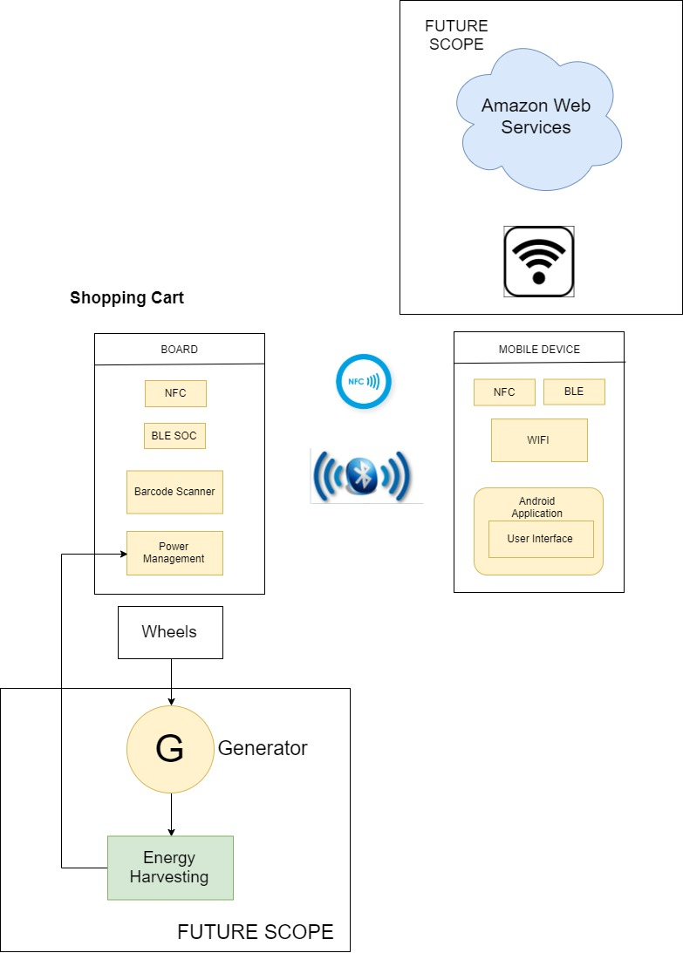
System Block Diagram

Slide 7
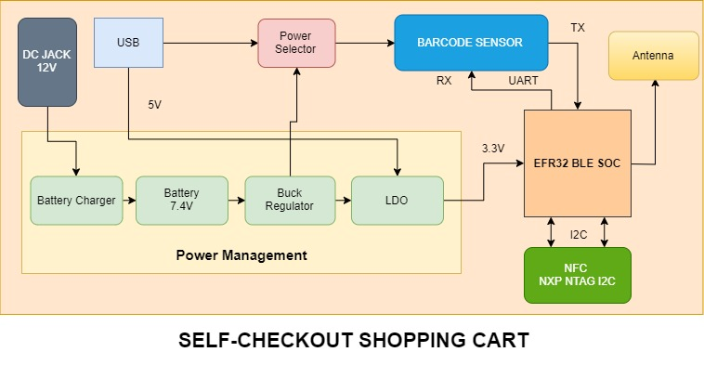
Hardware Block Diagram

Slide 8
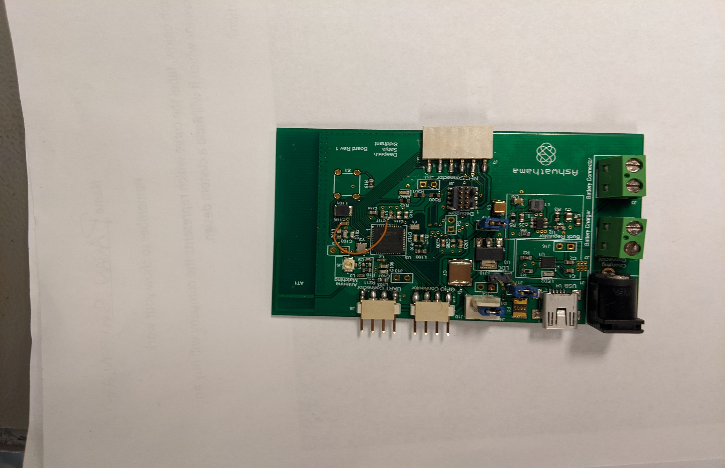
Hardware Design

Slide 9
Power Management
Battery
7.4V Dual Cell Battery.
Buck Regulator
Texas Instruments TPS560430
7.4V battery input to 5V.
Provides power to barcode sensor which works on 5V.
Battery Management
Dual-Cell Battery charger
Can charge battery with 1A constant current. We configured to charge with 500mA.
LDO
3.3V Output.
Provides supply to processor.

Slide 10
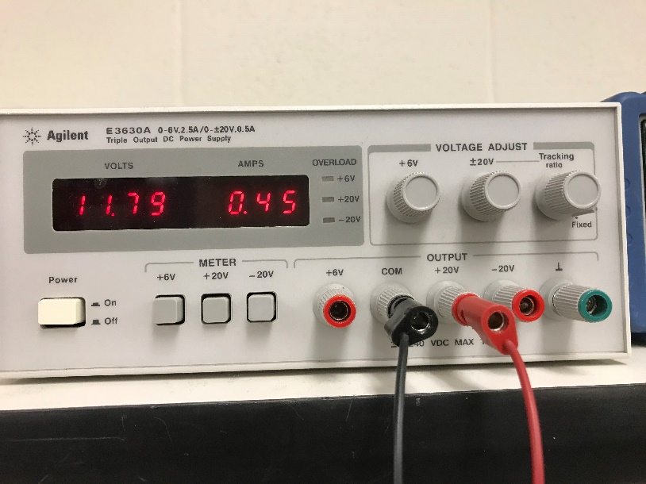
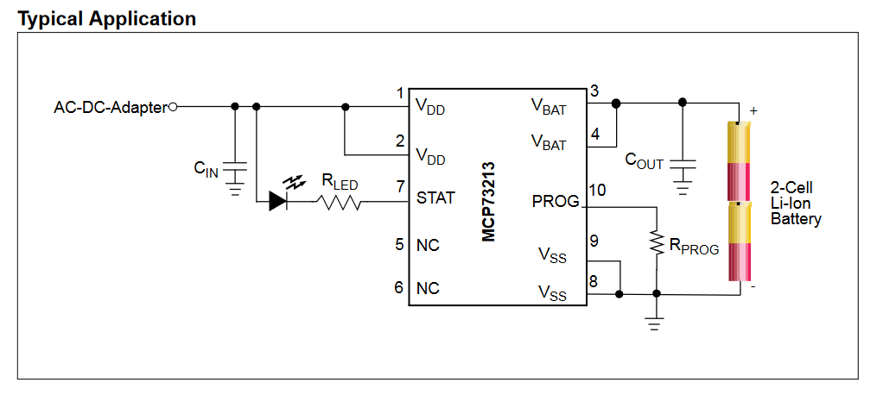
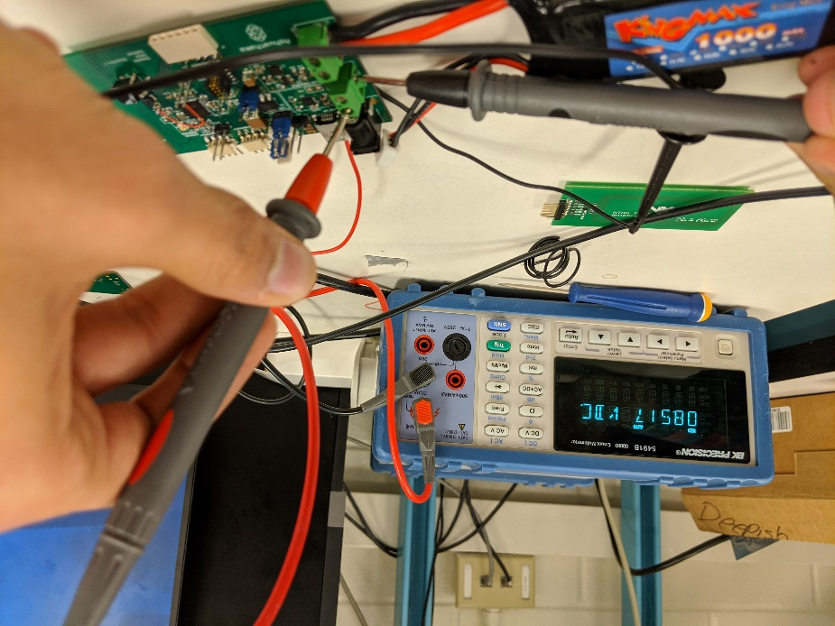
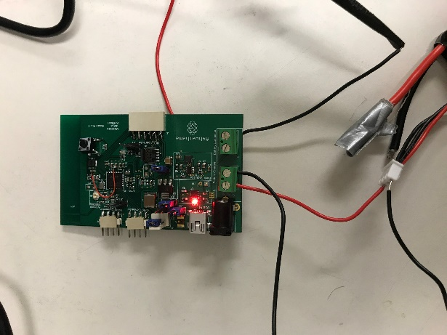
Battery Management MCP73213
Dual-Cell battery charger with overvoltage protection.
Generates 8.4V/500mA power to charge the battery.

Slide 11
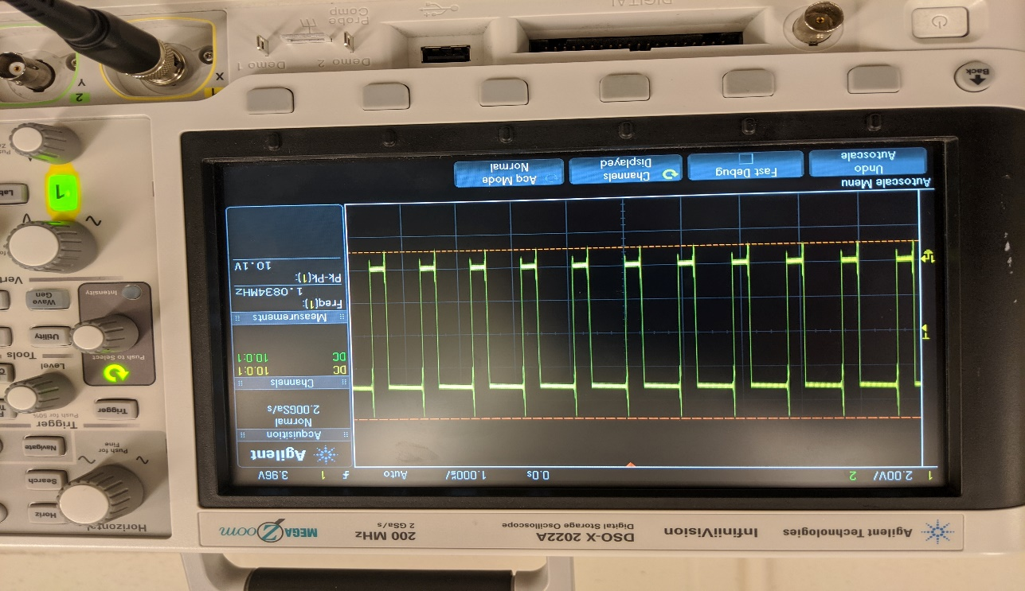
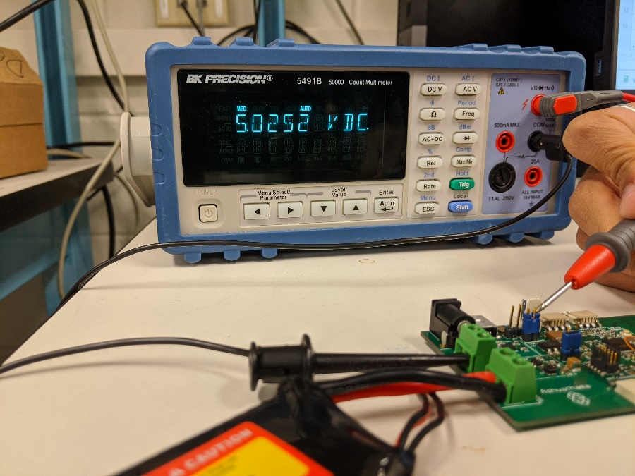
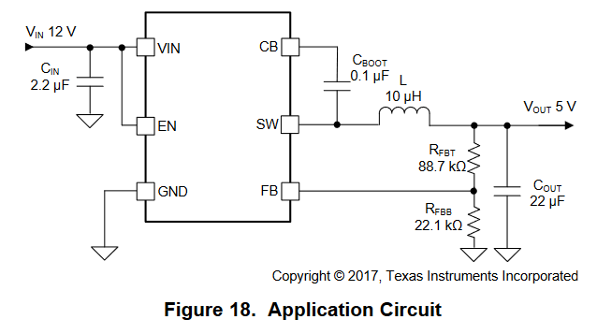
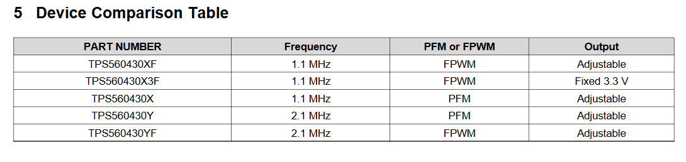
Buck Regulator TPS560430

Slide 12
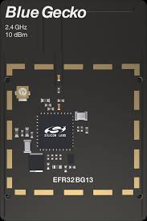
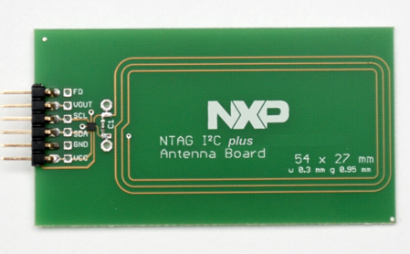
Radio
NXP NTAG NFC Module
I2C Interface.
Used for bluetooth pairing of Shopping cart and mobile app.
EFR32BG13 BLE SOC.
32 bit ARM Cortex M4 processor.
512KB internal flash

Slide 13
Software Design
Custom BLE Gatt Service.
LEUART(Low Energy), GPIO Interrupt.
I2C blocking, used to write data to NFC at initialization.
Simplicity Studio IDE.
On board debugger to program SOC and print logs via VCOM on serial terminal.
Minimum Energy mode - EM2. Current consumption of 22uA.
BLE Stack handles all the events.

Slide 14
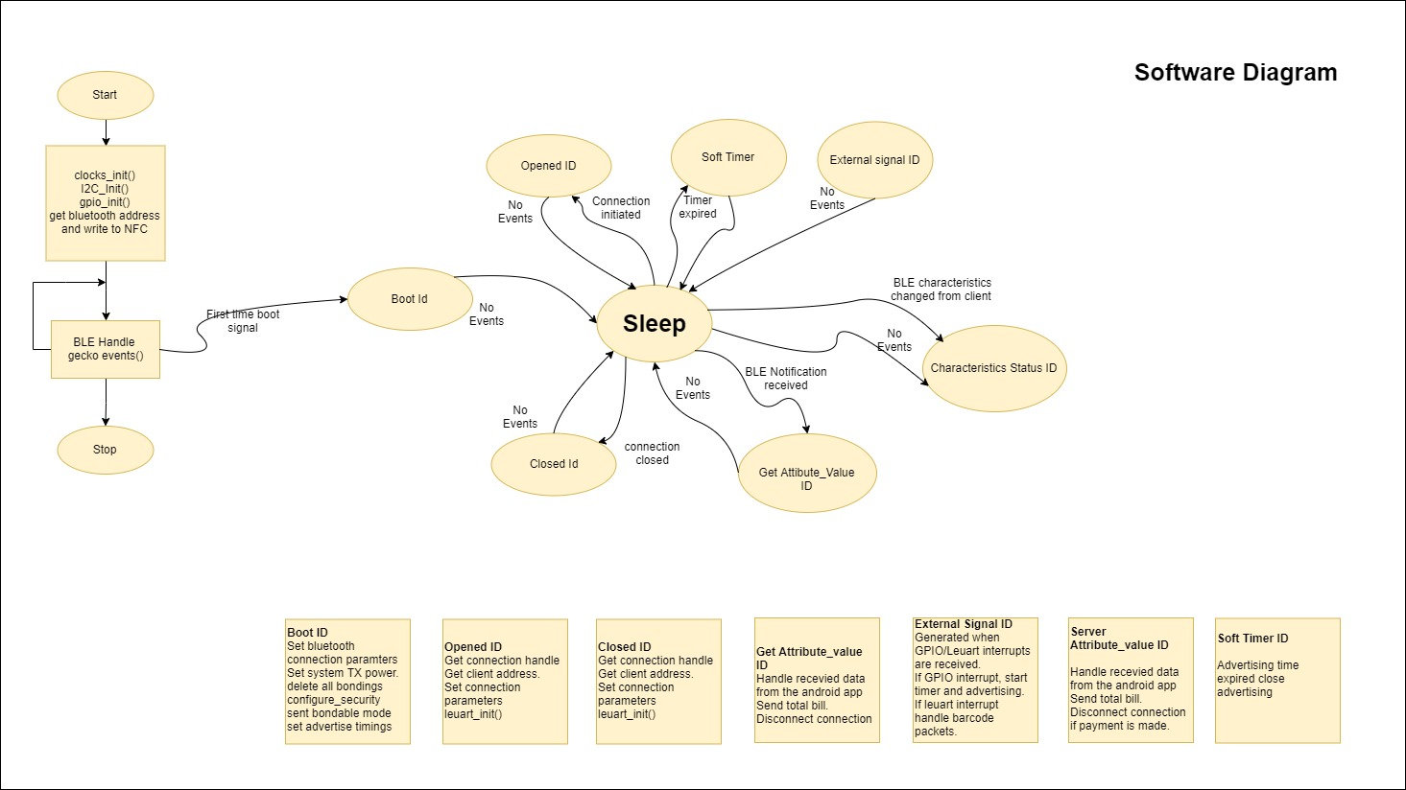
Software Design

Slide 15
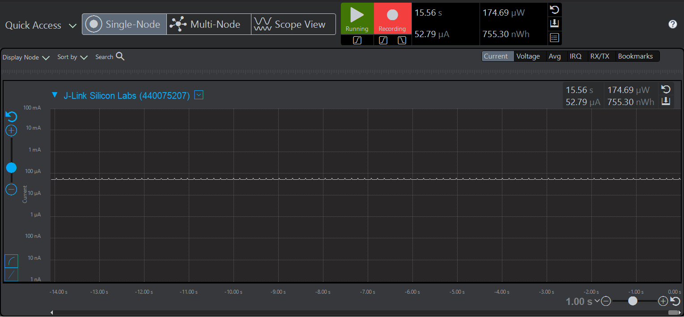
Low Power Mode Timeline

Slide 16
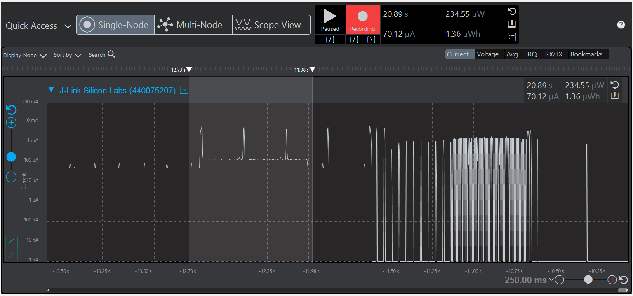
Low Power Mode (Cont..)

Slide 17
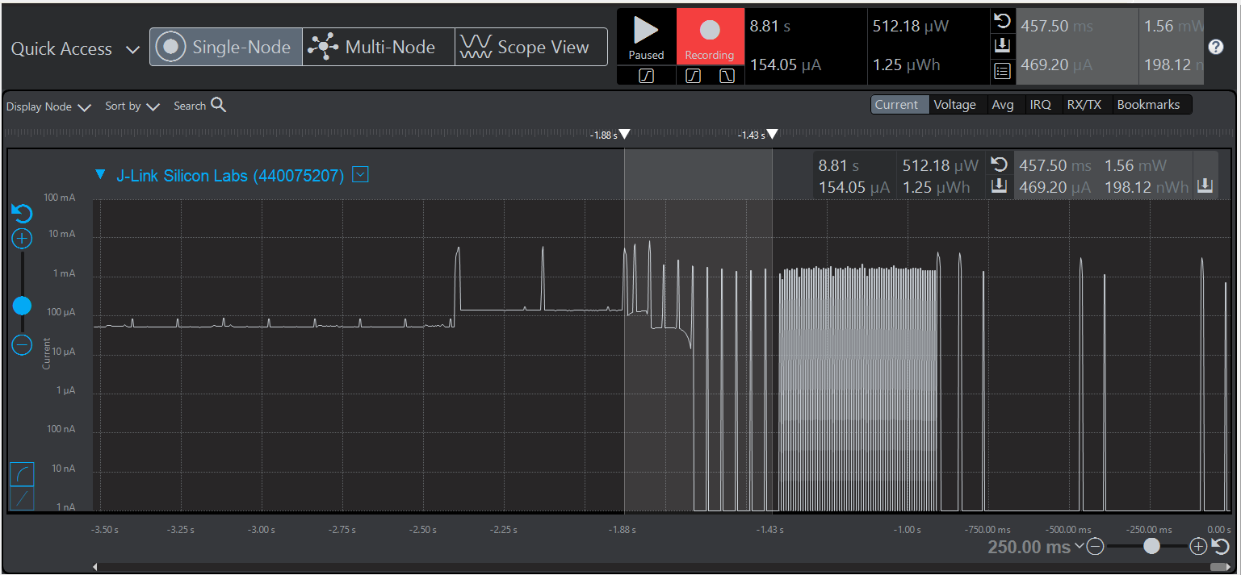
Low Power Mode (Cont..)

Slide 18
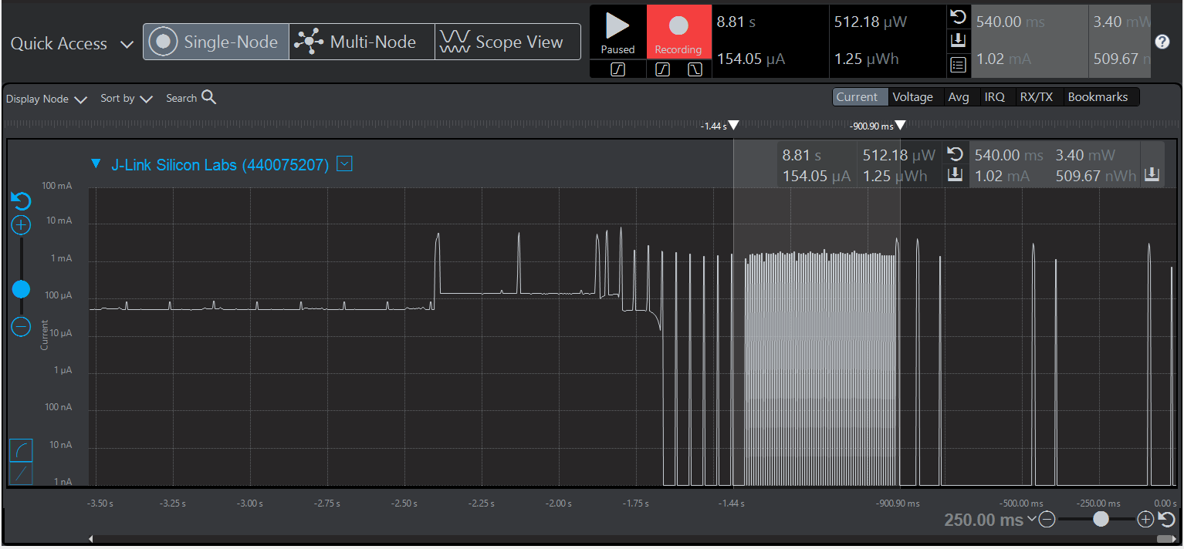
Low Power Mode (Cont..)

Slide 19
Proof-of-concept Realization
Bluetooth pairing using NFC.
Custom Gatt characteristics profile.
Bluetooth data to android app

Slide 20
Summary
We were able to achieve the following:
Designing power management and processor circuit.
Integrating inverted-F antenna and matching circuit for bluetooth communication.
Successfully interfacing scanner and scanning QR codes.
Successfully achieved BLE pairing using NFC.
Achieving Low power mode by designing state machine.
Designed an Android app.
Communication between Android app and processor.

Slide 21
DEMO TIME
Demo Video

Slide 22
Lessons Learned
Always verify your PCB footprints. Mainly major IC’s.
Check dry solder and connections even if you think they are connected.
Do not have test points of power and ground next to each other.
Have through hole connectors for better and firm grip.
Always follow and update your Gantt chart.

Slide 23
Hardware Bugs
The reference design had DVDD pin connected to 1.8V instead of 3V3 volts which we connected. Datasheet recommended that 3V3 should be the maximum voltage which can be connected to this pin.
Processor footprint was smaller than the 48 pin QFN package.
Reset switch was connected wrong on the PCB.

Slide 24
Questions and Answers?
Thank You

