Slide 1
Advantages and Disadvantages of a BYOD Model in an Organization and Legal Issues that Businesses Need To Consider
Deepa Natarajan
Department of Management Information Systems,
Bellevue University
CIS 515: IT Infrastructure
Professor James Krohn
May 5, 2021.

Slide 2
BYOD- Bring Your Own Device
It is policy in the organization, a phenomenon referred to as IT consumerization.
This policy permits the employees to bring the personal device like smartphones, laptops and tables to work.
Using these devices, they can access company’s-data, systems and applications.

Slide 3
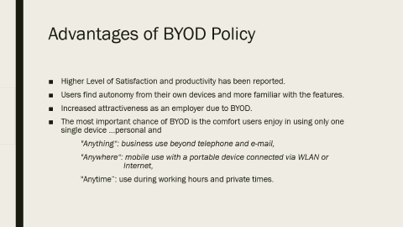
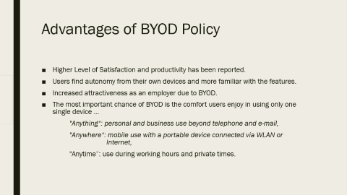
Advantages of BYOD Policy
Higher Level of Satisfaction and productivity has been reported.
Users find autonomy from their own devices and more familiar with the features.
Increased attractiveness as an employer due to BYOD.
The most important chance of BYOD is the comfort users enjoy in using only one single device …personal and
"Anything“: business use beyond telephone and e-mail,
"Anywhere“: mobile use with a portable device connected via WLAN or Internet,
"Anytime“: use during working hours and private times.

Slide 4
Disadvantages of BYOD
The confidentiality, Integrity and authenticity of the organization data is threatened by the use of personal devices.
It is also assumed that the negligent or incautious behavior in using the private device will be carried while working with company’s data and application.
Mobile devices are the highest security thread in this BYOD policy.
A lack of distinction between the company and personal space would lead to security threat.
Any installation of software or malfunction need a technical support from the organization.
If the device is lost or theft, will the company have a plan to erase the data that is present in the device.
Another important issue with BYOD is of scalability and capability.

Slide 5
Legal/Ethical Issues with BYOD:
Maintaining and Storing Data
-This is an integrity issue. This problem can be overcome by using virtualized private networks , so all the data can be transferred in a secured channel.
BYOD Security:
Organization have little control on the employees devices.
BYOD and Employee Privacy:
Organization have all the rights to monitor employee’s devices, the privacy trade –off should be explained clearly.

Slide 6
Legal/Ethical Issues with BYOD:
Remote Wiping and Blocking
Wiping, bricking or blocking of a device could damage the device or could remove the personal data of the employee
Secure destruction of corporate data
The requirement of destruction of data comes when either the company wants an updated configured device or the employee wants to upgrade their personal device.
Breach Response, Notification and Investigation
Employees should be made aware about the consequences of previous security breach incidents and their responsibility of following procedures after the incident happened.

Slide 7
Conclusion
Bring your own device (BYOD) has proved to be a successful technology nowadays.
It is up to company to develop such BYOD policy that not only protects sensitive data but also take care of employee rights.
organizations need more systematic integrated procedures for
managing threats
maintaining the employee devices
legal implications of the BYOD approach.

Slide 8
Reference
Georg, D., & Carsten, K., (2013). BYOD Bring Your Own Device. Procedia Technology, volume (9), 43-53, https://doi.org/10.1016/j.protcy.2013.12.005
Madhavi Dhingra., (2016), Legal Issues in Secure Implementation of Bring Your Own Device (BYOD). Procedia Computer Science, Volume (78), 179-184, https://doi.org/10.1016/j.procs.2016.02.030

