Slide 1

GitHub Copilot Hackathon
Team Name-WinningsCrew
Team Leader Name- Deepa Priyanka P
Team Leader Email Address-dp555990@gmail.com

Slide 2

Brief Summary of Project:
Theme 3: PERSONAL FINANCE TRACKER using JavaScript
The Personal Finance Tracker is a web-based application built using JavaScript, HTML, and CSS. Its main purpose is to help users manage their personal finances effectively. The application provides a user-friendly interface for adding, editing, and deleting income and expense transactions, as well as displaying the current balance.
The core functionality of the Personal Finance Tracker includes:
Adding Transactions: Users can input their income and expenses by entering relevant details such as transaction type, amount, date, and category.
Editing Transactions: Users have the ability to modify existing transactions, allowing them to update any changes or corrections.
Deleting Transactions: Users can remove transactions from their financial records when they are no longer relevant or accurate.
Balance Calculation: The application calculates and displays the current balance based on the income and expense transactions entered by the user.
To aid in the development process, GitHub Copilot has been utilized as an AI-powered coding assistant. It assisted in implementing features, handling user input, and designing a responsive user interface, thereby enhancing productivity and efficiency.

Slide 3
Business Challenge /Use Cases
Data Security
User Adoption
Expense Tracking Accuracy
Integration with Finance Institutes
Budget Management
Financial Goal Setting
Investing Monitoring
Tax preparation
Expense Reimbursement
Financial Education

Slide 4
Proposed Solution
User Authentication: Implementing a user authentication system to allow users to create accounts, log in, and securely access their personal finance data.
Dashboard: Designing a dashboard that displays key financial information such as current balance, income, expenses, and transaction history. This provides users with an overview of their financial status at a glance.
Transaction Management: Allow users to add, edit, and delete income and expense transactions. Users can enter transaction details such as date, category, amount, and description. The application will calculate the balance based on these transactions.
Categorization: Enable users to categorize transactions to gain insights into spending patterns and easily track expenses by different categories such as food, transportation, utilities, etc.
Reports and Analytics: Generate reports and visualizations to help users analyze their financial data. This can include charts and graphs to illustrate income vs. expenses, monthly trends, and category breakdowns.
Budgeting: Provide users with the ability to set budgets and track their progress. The application can send notifications or alerts when users approach or exceed their budget limits.
Reminders and Notifications: Implement reminders and notifications for upcoming bills, payment due dates, or any financial events to ensure users stay on top of their financial obligations.
Data Persistence: Store user data securely, either in a database or locally on the user's device, to maintain transaction history and preferences across sessions.
Responsive Design: Create a responsive and mobile-friendly layout that adapts to different screen sizes, allowing users to access their personal finance tracker on various devices.
By incorporating these features, the Personal Finance Tracker aims to provide users with a comprehensive and convenient solution for effectively managing their personal finances.

Slide 5
Technology/Tool Stack Used:
Frontend:
HTML
CSS
JavaScript
Backend:
Node js
Express js
Database:
MYSql

Slide 6
Mention of usage of Github Copilot :
Code Generation: GitHub Copilot has assisted in generating code snippets and even entire functions based on the context and desired functionality. It has suggested code patterns, syntax, and API usage, saving time and effort during development.
Error Prevention: Copilot helped to prevent common programming errors by providing suggestions and warnings based on best practices and code patterns. It has caught potential bugs and issues in the code and propose alternative solutions.
Guided Implementation: Copilot guided us by providing suggestions and examples for implementing specific features as well in handling user input. It helped in designing the user interface, handling data storage and retrieval, and implementing validation.
Learning Resource: GitHub Copilot served as a valuable learning resource for us in the usage of certain frameworks used in the Personal Finance Tracker.
Efficiency and Productivity: With the assistance of Copilot, we were able to write code more efficiently and has increased productivity. It reduced the time we spent on searching for documentation or references by suggesting code snippets and relevant functions, allowing us to focus on higher-level tasks.
Code Consistency: GitHub Copilot aided to maintain code consistency throughout the project by suggesting consistent naming conventions, formatting styles, and code structure. It also assisted in adhering to coding standards and guidelines, resulting in cleaner and more maintainable code.

Slide 7
Source code Github link :
Github repository link to access the Source Code
https://github.com/deepa-priyanka/PersonalFinanceTracker

Slide 8

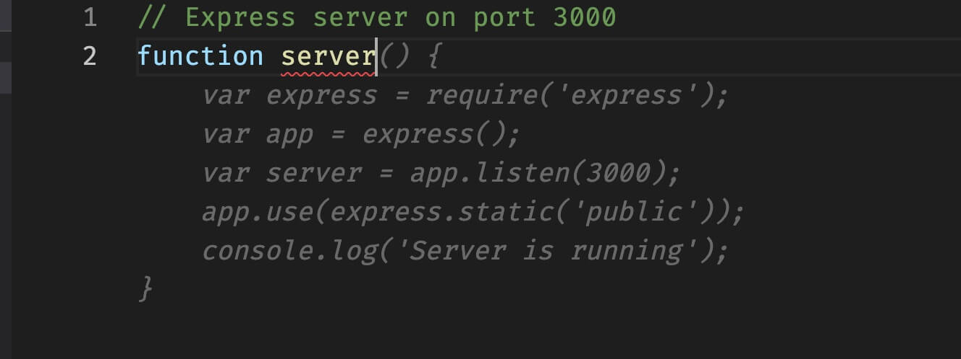
Execution Demo(Screenshots) showing usage of the Github Copilot :

Slide 9
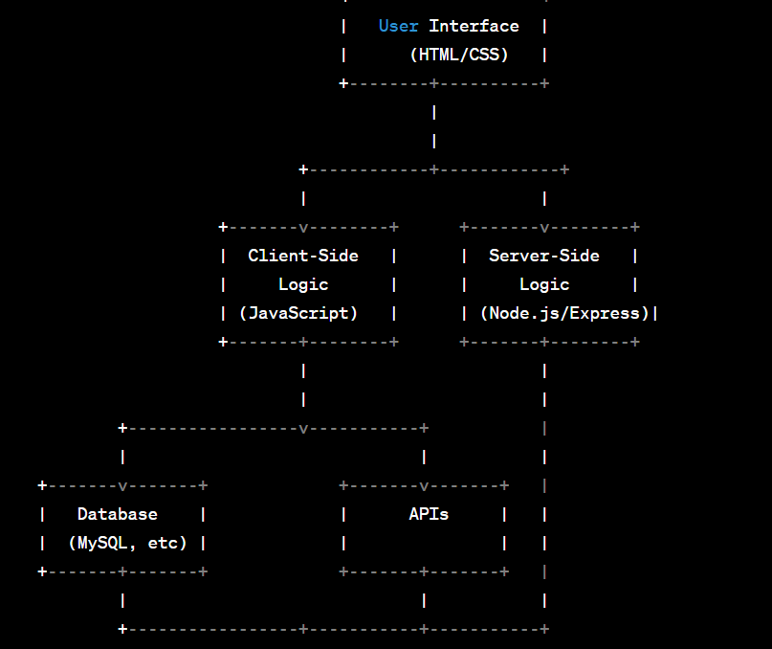

High Level Architecture :

Slide 10
THANK YOU

