Slide 1



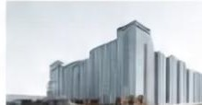

Digital Portfolio
STUDENT NAME: ATCHAYADEEPA
REGISTER NO:24131030500122005
NMID: A997652D687E5F28B7C4A8EF3630D753 DEPARTMENT: BCA-BACHELORE OF COMPUTER APPLICATION COLLEGE:GOVERNMENT ARTS COLLEGE CHIDAMBARAM

Slide 2
PROJECT TITLE
Digital portfolio :
A digital portfolio is an online collection of an individual's work, skills, achievements, and experiences. It serves as a modern resume or showcase, often used by students, professionals, and creatives to highlight their capabilities to potential employers, collaborators, or clients.

Slide 3


AGENDA
Problem Statement
Project Overview
End Users
Tools and Technologies
Portfolio design and Layout
Features and Functionality
Results and Screenshots
Conclusion
Github Link Problem
3/21/2024 Annual Review
3

Slide 4

PROBLEM STATEMENT
Explain why creating a portfolio is important. Mention challenges faced by individuals in showcasing their skills and connecting with professionals.

Slide 5

PROJECT OVERVIEW
Given a brief description of your portfolio project. Highlight its purpose (e.g., showcasing education, skills, and projects) and its impact.

Slide 6


WHO ARE THE END USERS?
Identify who will benefit from the portfolio (e.g., recruiters, collaborators, or potential employers).

Slide 7

TOOLS AND TECHNIQUES
List the tools you used:Programming languages: HTML, CSS, JavaScriptDatabase: MySQLFrameworks, if applicable.

Slide 8

POTFOLIO DESIGN AND LAYOUT
Explain the design choices (e.g., clean sections for About Me, Skills, Projects). Include sketches or screenshots of the layout.

Slide 9

FEATURES AND FUNCTIONALITY
Highlight key features:User-friendly navigationSections for education, skills, projectsLinks to social profiles like LinkedIn.

Slide 10

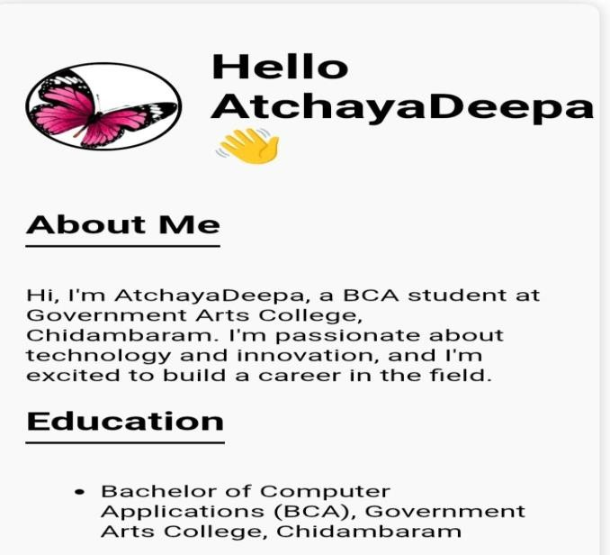
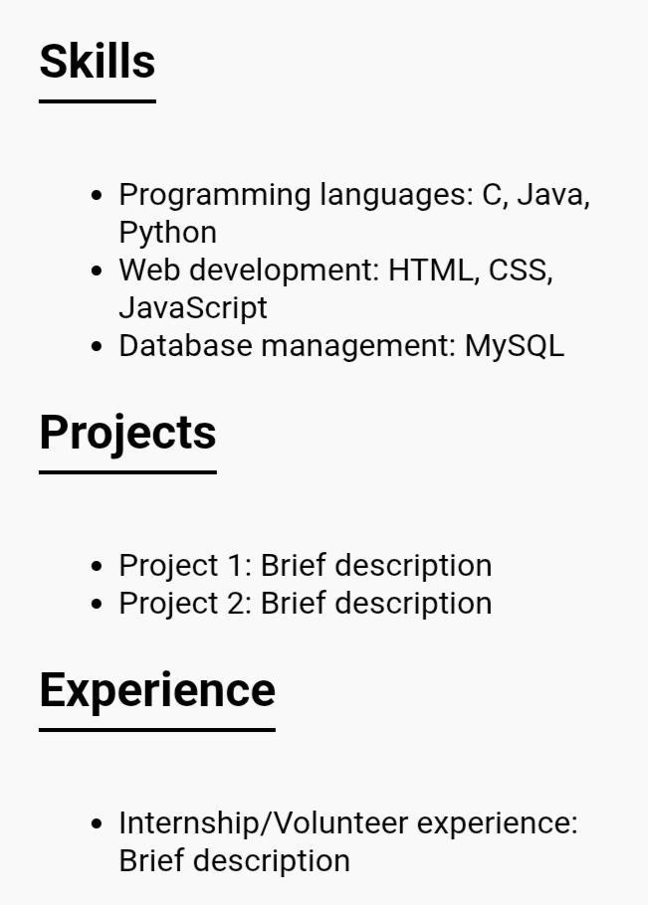
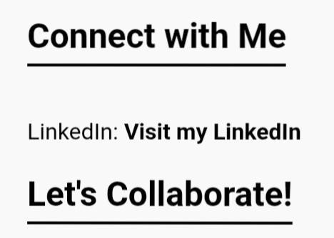
RESULTS AND SCREENSHOTS
Share screenshots of the portfolio website. Mention how it helps in showcasing your profile effectively.
3/21/2024 Annual Review
10

Slide 11

CONCLUSION
Summarize the importance of having a portfolio. Reiterate how it supports career-building and networking.
11

