Slide 1


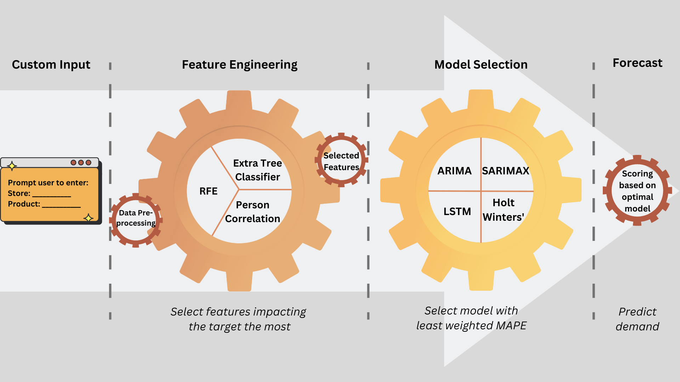
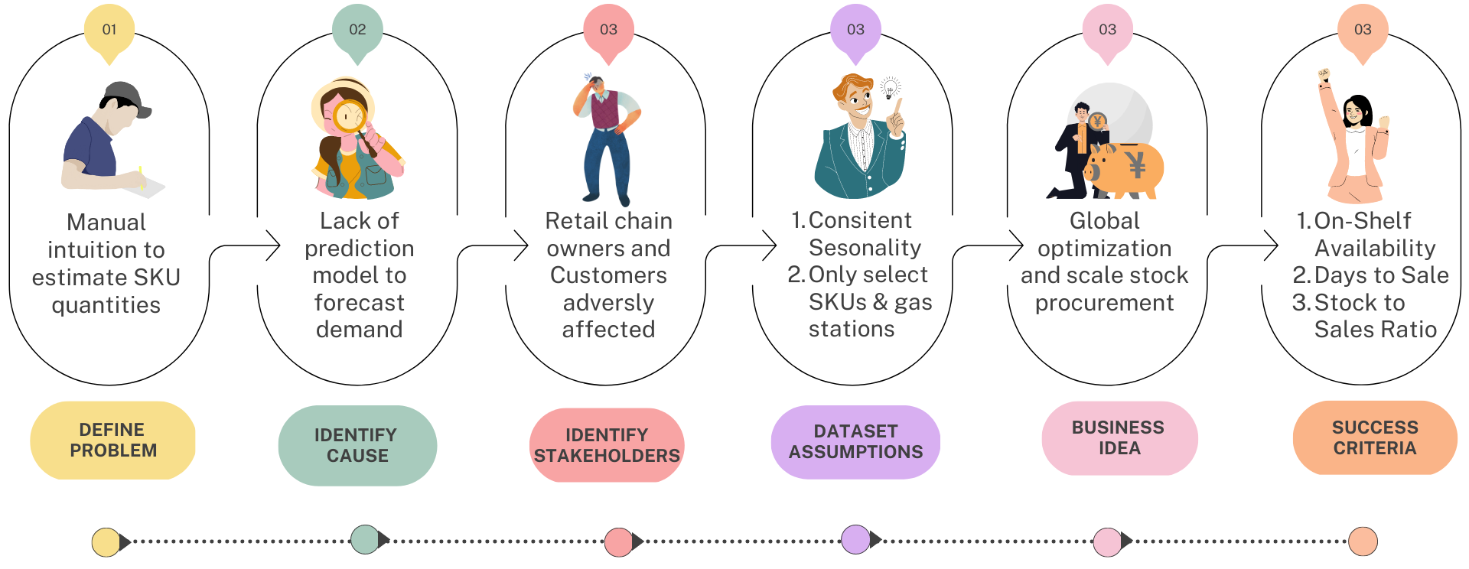
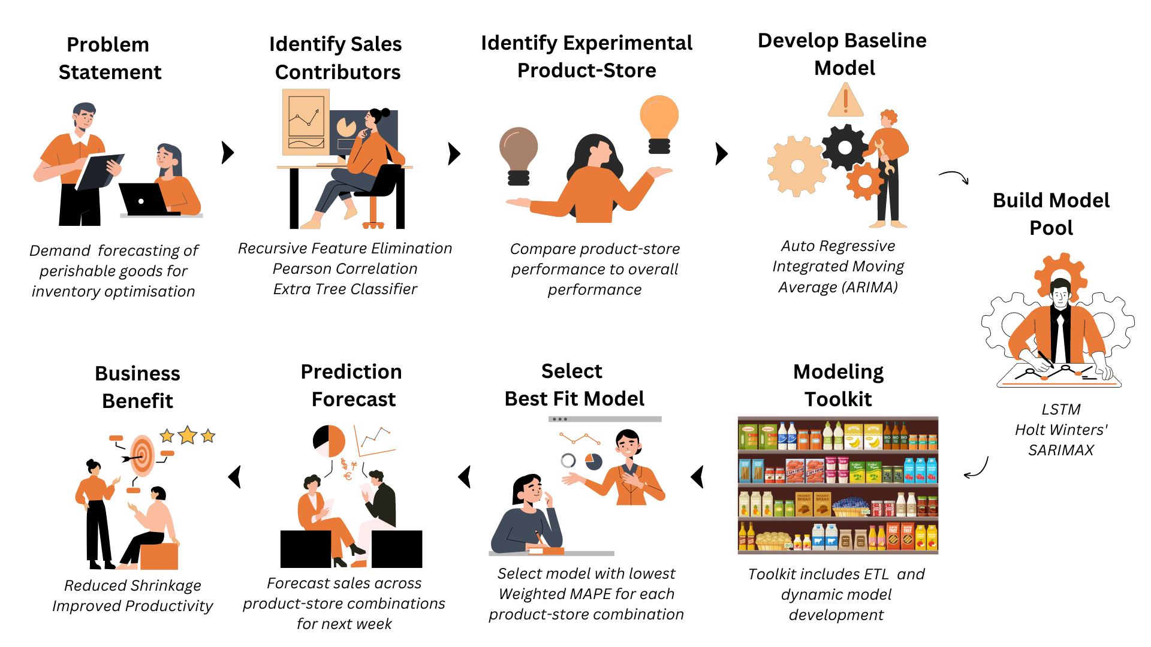






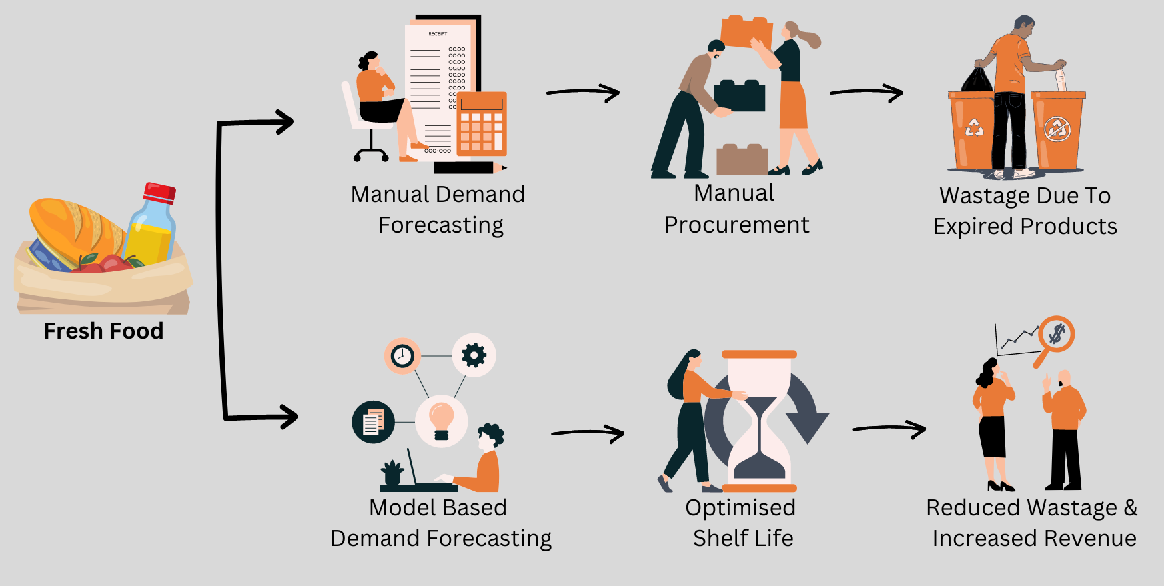

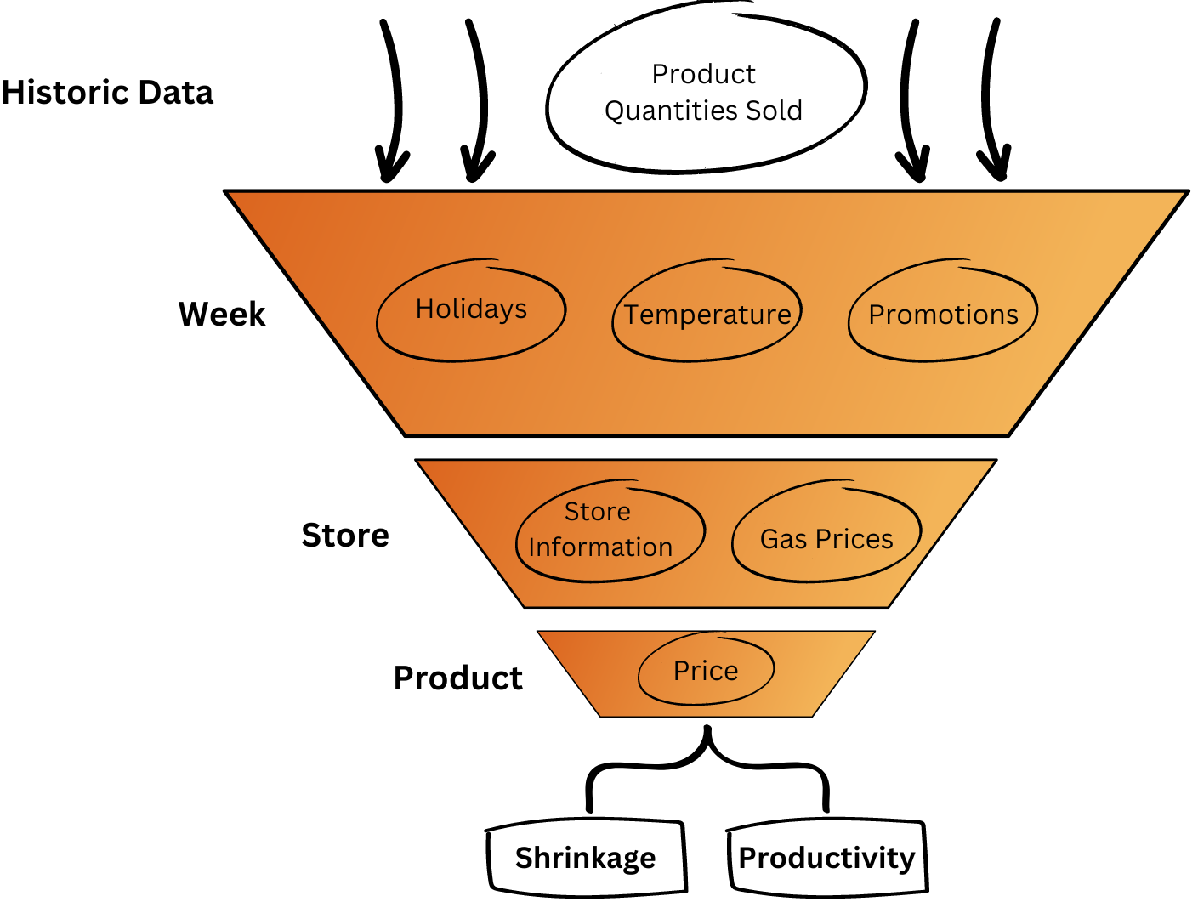


Forecast Enhanced Inventory Management: Utilizing Demand Sensing Techniques to Optimize Stocking
DEPLOYMENT & LIFE CYCLE MANAGEMENT
Self Serve Demand Forecasting Toolkit
Gauri Bhawarkar, Lavanya Karthikeyan, Niharika Kulkarni, Deepa Narayanan, Vaishakh Prakash, Matthew A. Lanham
Purdue University, Krannert School of Management
gbhawark@purdue.edu; karthikl@purdue.edu; kulka105@purdue.edu; narayad@purdue.edu; prakasv@purdue.edu; lanhamm@purdue.edu
ANALYTICS PROBLEM FRAMING
METHODOLOGY
The purpose of this tool is to dynamically select important features for a given combination of product and store to forecast demand for future inventory to avoid wastage of perishable goods and ensure on-shelf availability.
BUSINESS PROBLEM FRAMING
Legacy processes for inventory management are often manual, time-consuming, and error-prone, resulting in suboptimal inventory levels and wasted resources in contrast to an automated system.
Sophisticated end-to-end analytics toolkit – Data ETL, modelling and forecasting pipelines provide a one-stop solution that delivers fast and reliable inventory.
Leveraging advanced analytics and machine learning algorithms - Ensures real-time insights into demand patterns, enabling store teams to make well-informed decisions and optimizes inventory.
Improved employee efficiency and consistent shelf availability - Retailers can deliver a superior shopping experience, drive business growth and reduce shrinkage.
IMPACT
Leading retail store chains, recognize that a superior shopping experience is key to business growth. Demand forecasting for their fresh food service helps streamline inventory and demand planning while reducing wastage of perishable items.
However, the effectiveness of existing inventory management system is limited by a manual recommendation of order quantity for the finished product in the Fresh Food Service. The inclusion of Digital Order Book (DOB) will improve demand planning.
Optimized shrinkage:
Percentage of inventory that is lost due to spoilage or expiration
Value of spoiled inventory/the total value of inventory on hand
MODEL BUILDING
Our cutting-edge model has evaluated across 200+ stores, for 50 specific perishable products. Model results showcased are for the top products in the most popular store.
Best models was chosen for every store-product combination based on RMSE.
Analysis shows that the SARIMAX and LSTM models as the best for the top products.
With varying performance for other products, it provides the versatility and adaptability of our cutting-edge approach.
DATA
Improved Productivity:
Reduced time spent on planning order placement
Increase in availability of time spent for non-inventory processes.
Store | Product | SARIMAX | Holt-Winters | ARIMAX | LSTM
158 | 536565 | 1.315 | 28.651 | 26.317 | 1.143
158 | 536611 | 9.068 | 70.206 | 82.875 | 3.023
158 | 536904 | 3.411 | 36.787 | 32.251 | 1.135
158 | 537516 | 0.429 | 1.135 | 1.004 | 0.692
158 | 537690 | 17.780 | 674.676 | 262.655 | 12.235
158 | 537704 | 2.035 | 12.653 | 12.140 | 1.287
158 | 537800 | 7.911 | 34.496 | 33.215 | 4.727
158 | 538252 | 14.206 | 67.325 | 66.527 | 21.158
ACKNOWLEDGEMENTS
We would like to thank our industry partner for their guidance and support on this project as well as the Purdue MS BAIM program for partially funding this work.
To address this challenge, this solution seeks to develop an innovative solution that leverages advanced analytics to incorporate product-level demand forecasting into the DOB. It will enable store teams to accurately plan their inventory and reduce financial losses resulting from overstocking and wastage.
By leveraging data-driven insights, this analytics tool-kit aims to optimize their operations and deliver a superior shopping experience to their customers.
* Results for model simulation for the most popular store and top 10 frequently bought products
Areas of improvement
Improve the iterations and epochs for better fit.
Use exogenous variables such as daily footfall, shop size, promotional data, product assortment, vehicles visiting the gas station.
Larger number of data points will lead to a more reliable forecast, alternatively explore oversampling methods to simulate the same.

