Slide 1
AIR QUALITY ANALYSIS
TEAM MEMBERS
PRATHIBA.S
POOJA.E
KEERTHANA.N
RASHIKA.S
SHAHRUKH KHAN.B

Slide 2
INTRODUCTION
Air analysis a critical component of environmental science involves the systematic assessment of air quality, composition, and pollutants in the Earth's atmosphere. This introduction will guide you through the initial steps of the process. We'll explore how to import essential libraries, load the Air quality dataset and perform critical preprocessing steps.

Slide 3
DATA PREPROCESSING
Data preprocessing is a crucial step in air quality analysis, just as it is in any data analysis task. Here are some common data preprocessing steps for air quality analysis:
1.Data Collection
2.Data Cleaning
3.Data Integration
4.Data Transformation
5.Data Loading
6.Data Visualization
7.Data Report

Slide 4
DATA COLLECTION
Obtain the air quality data from relevant sources, which may include government agencies, environmental organizations, or sensor networks. Ensure that the data is accurate and up-to-date.
The dataset is obtained from kaggle here. The data has been made publicly available by the Central Pollution Control Board: https://cpcb.nic.in/ which is the official portal of Government of India.

Slide 5
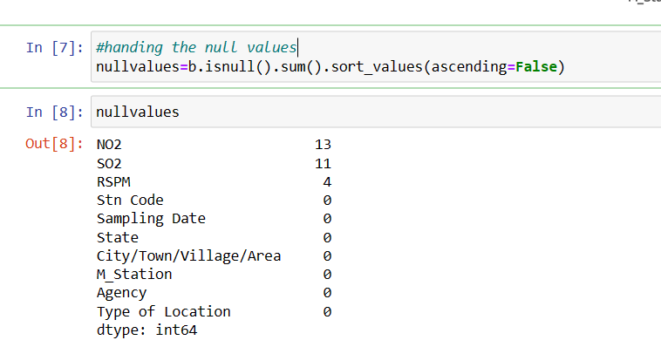
DATA CLEANING
This involves handling missing values, removing duplicates, and correcting any inconsistencies or errors in the data. Use data cleaning tools or scripting languages like Python or R for this task.The dataset contains lots of missing values.

Slide 6
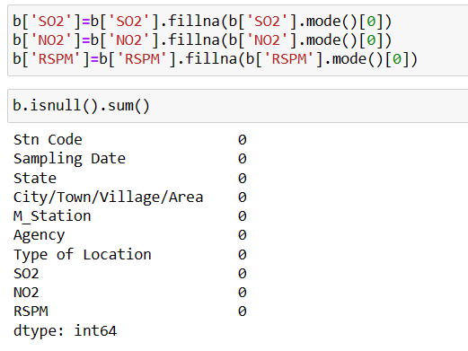
Sometimes csv file has null values, which are later displayed as NaN in Data Frame. Just like pandas dropna() method manage and remove Null values from a data frame, fillna() manages and let the user replace NaN values with some value of their own.

Slide 7
DATA INTEGRATION
Data integration is the process of combining data from multiple sources into a cohesive and consistent view. This process involves identifying and accessing the different data sources, mapping the data to a common format, and reconciling any inconsistencies or discrepancies between the sources. The goal of data integration is to make it easier to access and analyze data that is spread across multiple systems or platforms, in order to gain a more complete and accurate understanding of the data.

Slide 8
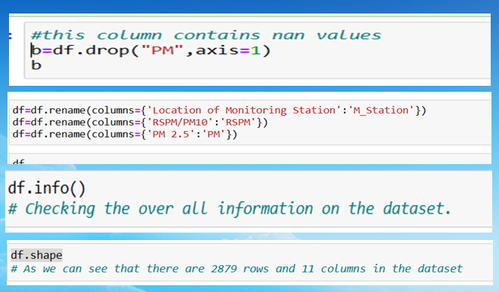
The column contains the null values so i dropped the column (PM)
It is very complex to handle the names so renamed it as we use it wisely
The info() method is used to get information about dataset.
The shape() is used to get the rows and columns in the dataset

Slide 9
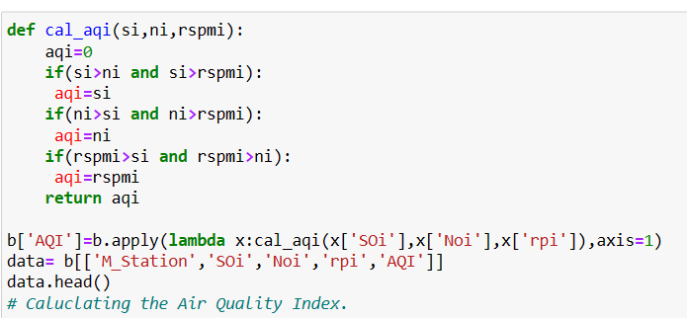
DATA TRANSFORMATION
The Air Quality Index (AQI) displayed on this page provides a comparison of air pollutants, standardising measurements of ozone, carbonmonoxide, nitrogendioxide and airborne particles in the environment in the ACT.

Slide 10
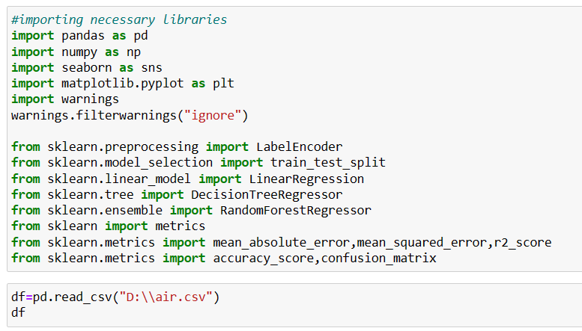
DATA LOADING
Import the cleaned and transformed data into your analysis tools or software. Common tools for data loading and analysis include Python libraries.

Slide 11
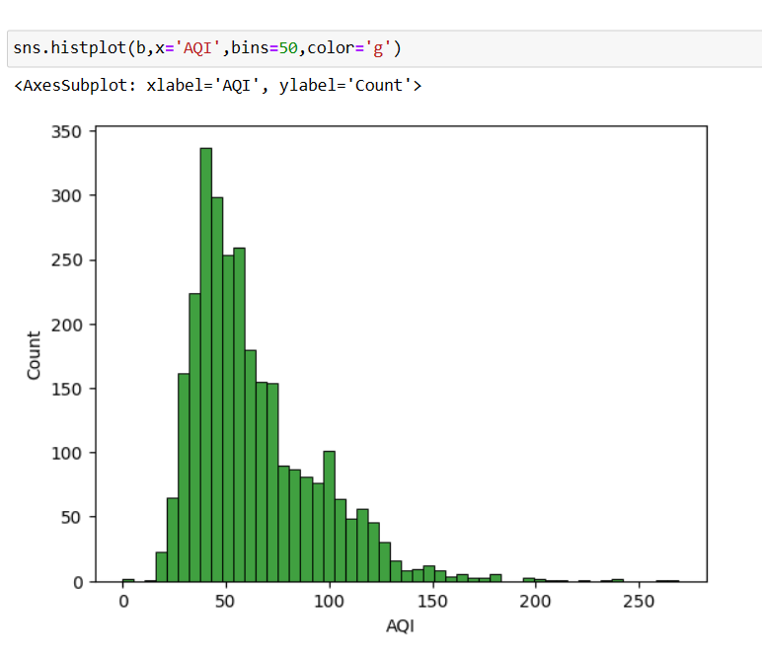
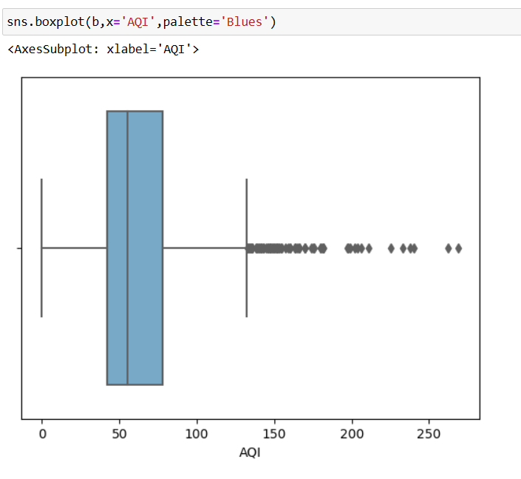
DATA VISUALIZATION
Data visualization is the representation of data through use of common graphics, such as charts, plots, infographics, and even animations. These visual displays of information communicate complex data relationships and data-driven insights in a way that is easy to understand.

Slide 12
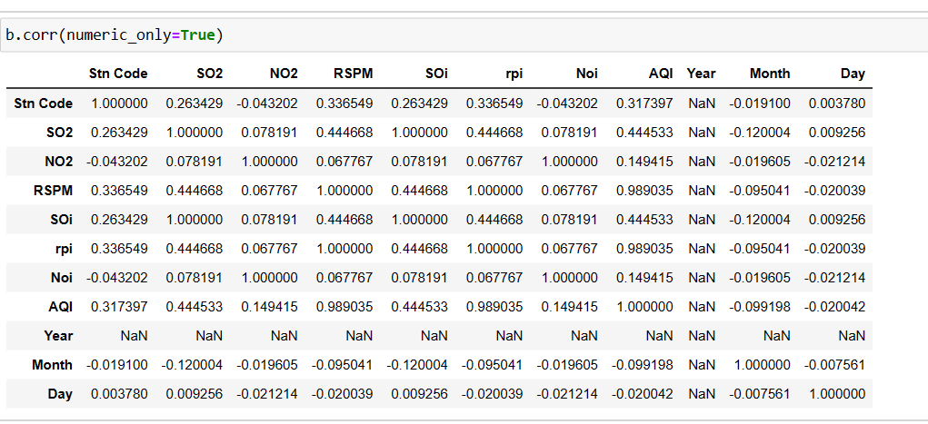
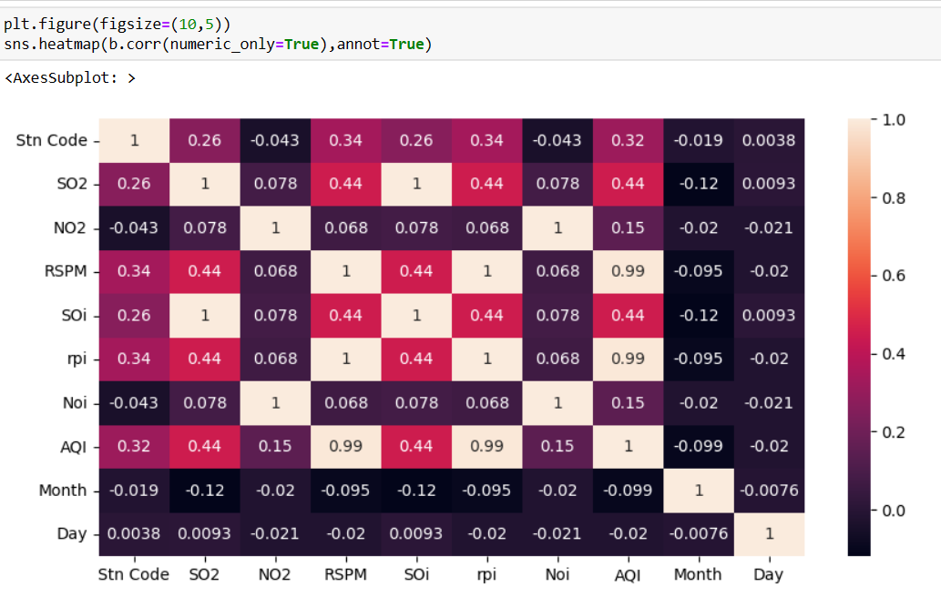
CORRELATION
Correlation analysis is a statistical method used to measure the strength of the linear relationship between two variables and compute their association. Correlation analysis calculates the level of change in one variable due to the change in the other

Slide 13
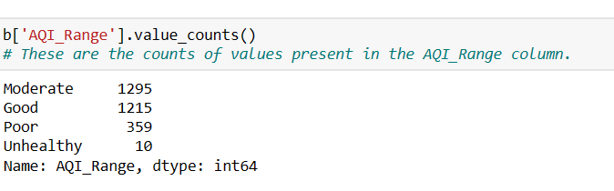
EXPLORATORY ANALYSIS
Exploratory Data Analysis (EDA) refers to the method of studying and exploring record sets to apprehend their predominant traits, discover patterns, locate outliers, and identify relationships between variables. In this dataset we need to explore the good , average , moderate rate over the cities.

Slide 14
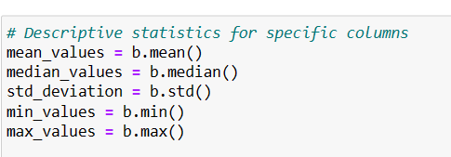
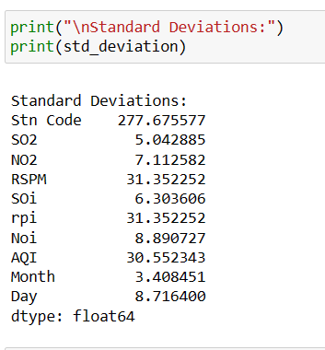
DESCRIPTIVE ANALYSIS
Measures of central tendency include the mean, median, and mode, while measures of variability include standard deviation, variance, minimum and maximum variables.

Slide 15
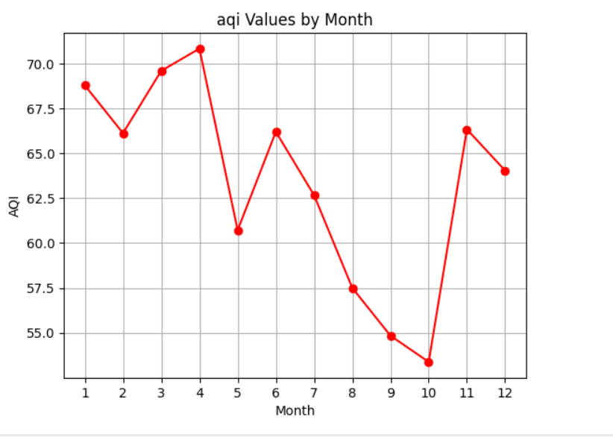
DATA REPORTING
Atlast we can conclude that in the year 2014 April month
the AQI range was high and
it was lowered in the month
of October due to some acts
and awareness created.

Slide 16
THANK YOU

