Slide 1
DATA ANALYTICS CERTIFICATION PROJECT
E-Commerce Return
Logistics Performance
& Cost Optimization
Python / MySQL / Power BI
Presented by Deepa K Raj

Slide 2
01 / PROJECT CONTEXT
The Business Challenge
Why analyzing returns matters
Customer experience
Operational effort
Cost visibility
Unexpected product quality, incorrect items and unclear descriptions can lead to returns.
Returns create additional handling, coordination and inventory challenges.
Understanding return patterns helps identify where efficiency improvements may be possible.
Project question: Which return patterns can inform better logistics and cost-management decisions?
E-COMMERCE RETURN LOGISTICS • DEEPA K RAJ
02

Slide 3
01 / PROJECT CONTEXT
Objectives & Analytical Approach
From raw transaction data to practical business recommendations
Understand return behavior
Measure overall return rate and compare categories, regions and reasons.
END-TO-END
Clean
Explore cost-related indicators
Compare recorded shipping-cost and profit-margin fields by return status.
Analyze
Visualize
Present actionable insights
Build Power BI dashboards and suggest targeted operational improvements.
Recommend
E-COMMERCE RETURN LOGISTICS • DEEPA K RAJ
03

Slide 4
02 / DATA & TOOLS
Dataset at a Glance
Synthetic Kaggle e-commerce orders dataset
34,500
1,903
5.52%
22
Total orders
Returned orders
Overall return rate
Prepared columns
Original data
Engineered features
19 columns covering products, order dates, return status, customer attributes and recorded financial fields.
delivery_days, return_days and delivery_group created during Python preprocessing.
E-COMMERCE RETURN LOGISTICS • DEEPA K RAJ
04

Slide 5
02 / DATA & TOOLS
Project Workflow
One cleaned dataset supports all three analytical stages
PYTHON
MYSQL
POWER BI
→
→
Clean, validate, derive fields and explore patterns
Store 34,500 rows and run structured SQL analysis
Create KPIs, slicers, charts and business recommendations
Python-cleaned CSV → MySQL database → Power BI dashboard
E-COMMERCE RETURN LOGISTICS • DEEPA K RAJ
05

Slide 6
03 / IMPLEMENTATION
Python: Preparation & Exploration
A reliable foundation before SQL and dashboard development
Data validation
Checked missing values and duplicates; no duplicate records were found.
OUTPUT
Date processing
Converted order, delivery and request dates into datetime fields.
34,500
Feature engineering
validated records
Derived delivery_days, return_days and delivery_group.
Exploratory analysis
ecommerce_cleaned.csv
Compared return rates, reasons, regions, prices and shipping costs.
E-COMMERCE RETURN LOGISTICS • DEEPA K RAJ
06

Slide 7
03 / IMPLEMENTATION
MySQL: Structured Analysis
Database: ecommerce_returns • Table: ecommerce_data
Data import & verification
Confirmed all 34,500 cleaned records were available for SQL analysis.
EXAMPLE QUERY
Return performance
SELECT returned,
COUNT(*) AS orders
FROM ecommerce_data
GROUP BY returned;
Calculated order counts, return rates and category-level comparisons.
Return reasons & financial fields
Analyzed reported reasons, shipping costs, profit-margin values and prices.
E-COMMERCE RETURN LOGISTICS • DEEPA K RAJ
07

Slide 8
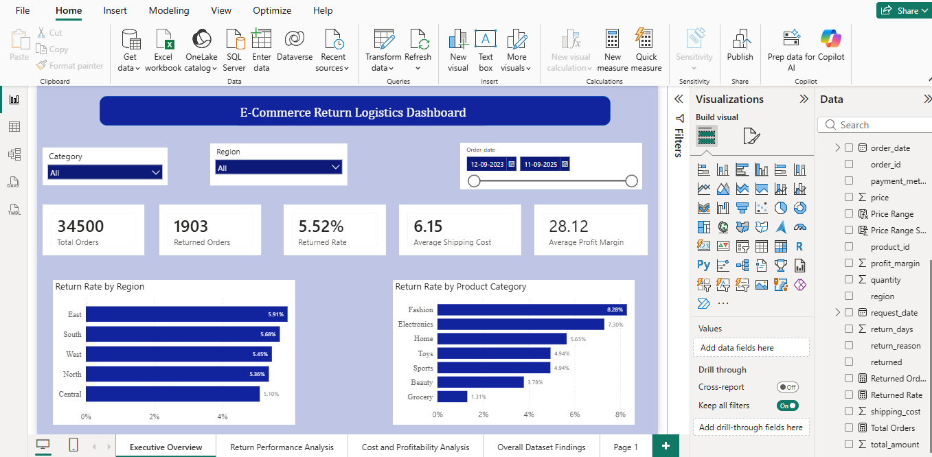
04 / DASHBOARD
Power BI: Executive Overview
Key KPIs and return-rate comparisons in one interactive view
5 KPI cards
Orders, returns, return rate, shipping cost and profit margin.
Interactive filters
Category, region and order-date slicers.
E-COMMERCE RETURN LOGISTICS • DEEPA K RAJ
08

Slide 9
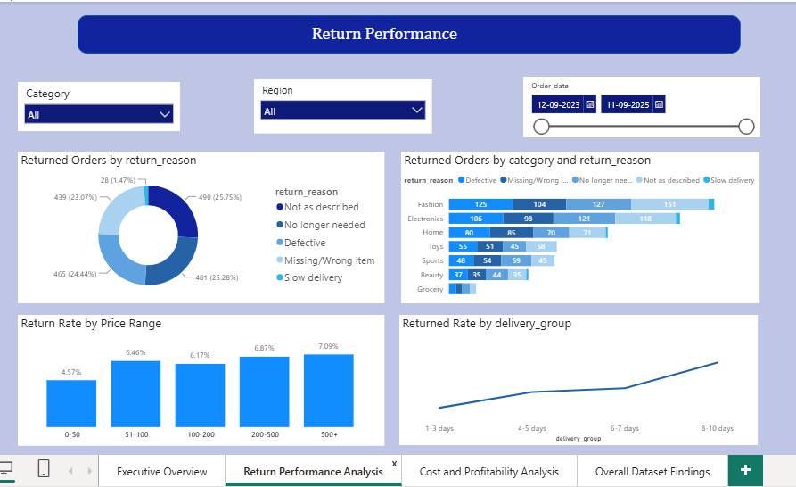
04 / DASHBOARD
Power BI: Return Performance
Understanding why and where returns occur
Return reasons
“Not as described” leads with 490 returns (25.75%).
Price & delivery
Return rates by price band and delivery-duration group.
E-COMMERCE RETURN LOGISTICS • DEEPA K RAJ
09

Slide 10
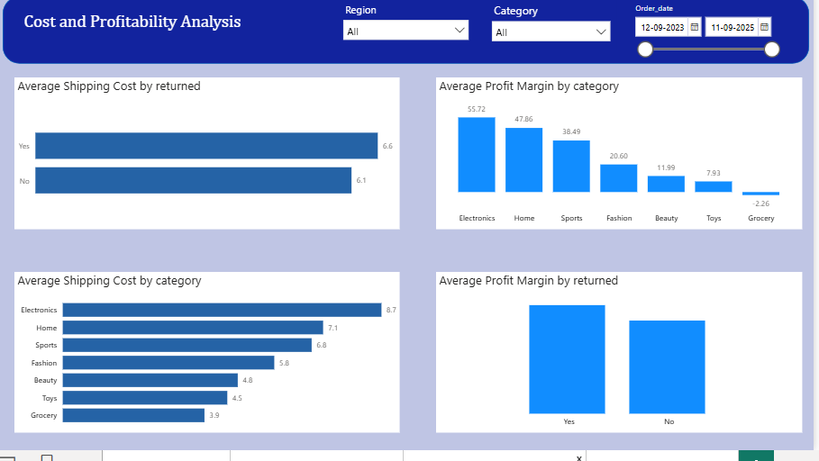
04 / DASHBOARD
Power BI: Cost & Profitability
Descriptive comparisons of recorded dataset fields
Shipping-cost comparison
Returned: 6.63 | Non-returned: 6.12
Interpret with care
These values are not actual return-processing costs.
E-COMMERCE RETURN LOGISTICS • DEEPA K RAJ
10

Slide 11
05 / FINDINGS
Where Are Returns Concentrated?
Category-level return rates from the analyzed dataset
Fashion
8.28%
Electronics
7.30%
Home
5.65%
Toys
4.94%
Sports
4.94%
Beauty
3.78%
Grocery
1.31%
Fashion and Electronics are priority categories for further investigation.
E-COMMERCE RETURN LOGISTICS • DEEPA K RAJ
11

Slide 12
05 / FINDINGS
Why Do Customers Return Products?
Reported return reasons among 1,903 returned orders
Not as described
490 orders
25.75%
No longer needed
481 orders
25.28%
Defective
465 orders
24.44%
Missing / wrong item
439 orders
23.07%
Slow delivery
28 orders
1.47%
Return reasons are customer-reported categories, not independently verified root causes.
E-COMMERCE RETURN LOGISTICS • DEEPA K RAJ
12

Slide 13
06 / RECOMMENDATIONS
Executive Recommendations
Operational actions informed by the observed patterns
01
Improve product information
02
Focus on high-return categories
Better descriptions, images, specifications and sizing guidance.
Investigate Fashion and Electronics product and fulfillment issues.
03
Strengthen order accuracy
04
Review shipping efficiency
Improve quality checks, packing verification and defect prevention.
Assess packaging, delivery practices and logistics-provider performance.
E-COMMERCE RETURN LOGISTICS • DEEPA K RAJ
14

Slide 14
07 / CONCLUSION
Limitations & Future Opportunities
Responsible interpretation and next steps
Current limitations
Future scope
• Synthetic data, not actual business records
• No separate reverse-shipping, handling or refund costs
• No machine-learning prediction
• No real-time operational integration
• Test models for predicting return likelihood
• Collect actual reverse-logistics expense data
• Connect dashboards to live operations
• Validate recommendations with real business data
Outcome: an end-to-end analytics workflow that identifies return patterns and potential optimization opportunities.
E-COMMERCE RETURN LOGISTICS • DEEPA K RAJ
15

Slide 15
Thank You
Questions & Discussion
Deepa K Raj • Data Analytics Certification

