Slide 1
Electricity Billing System
DEEPA A

Slide 2
Agenda
Introduction
Algorithm Used
Implementation and Output
Summary

Slide 3
Introduction
At Electricity Billing System is a Desktop-based application.
•This project aims at serving the department of electricity by computerizing the billing system.
•It mainly focuses on the calculation of units consumed during the specified time and the money to be charged by the electricity offices.
•This computerized system will make the overall billing system easy, accessible, comfortable, and effective for consumers.

Slide 4
Algorithm Used
1. Initialization
Initialize the system with basic information, such as customer data.
2.Data Input
Collect meter readings for each customer at the beginning and end of the billing period.
3.Calculate Electricity Consumption
For each customer, subtract the initial meter reading from the final meter reading to calculate the electricity consumption during the billing period. Store the consumption data.
4.Calculate Bill Amount
Apply the tariff rates to the electricity consumption for each customer to calculate their bill amount. Consider different tariff structures, such as charges based on the different slabs of units consumed.
5.Generate Bills
Create and format bills for each customer, including details such as consumer ID, customer name,, consumption, charges, and total amount due, due date.

Slide 5
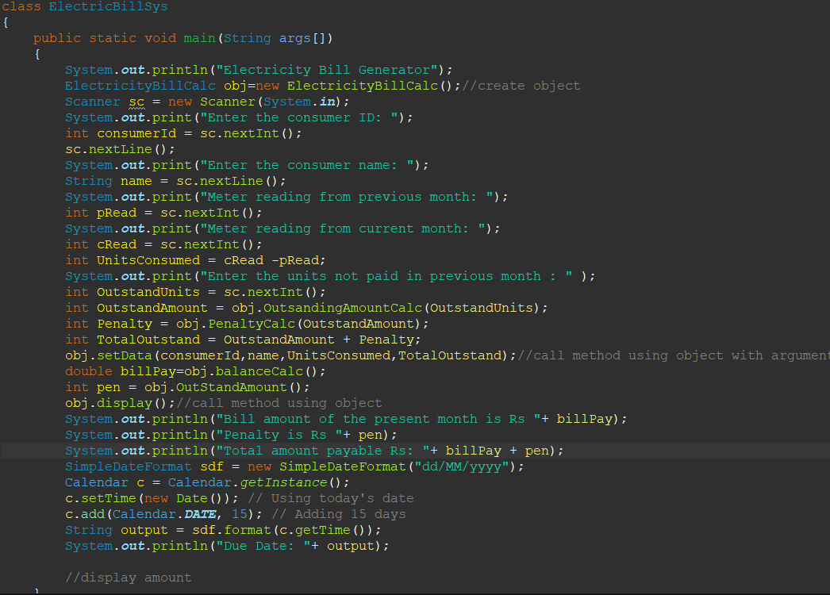
Code

Slide 6
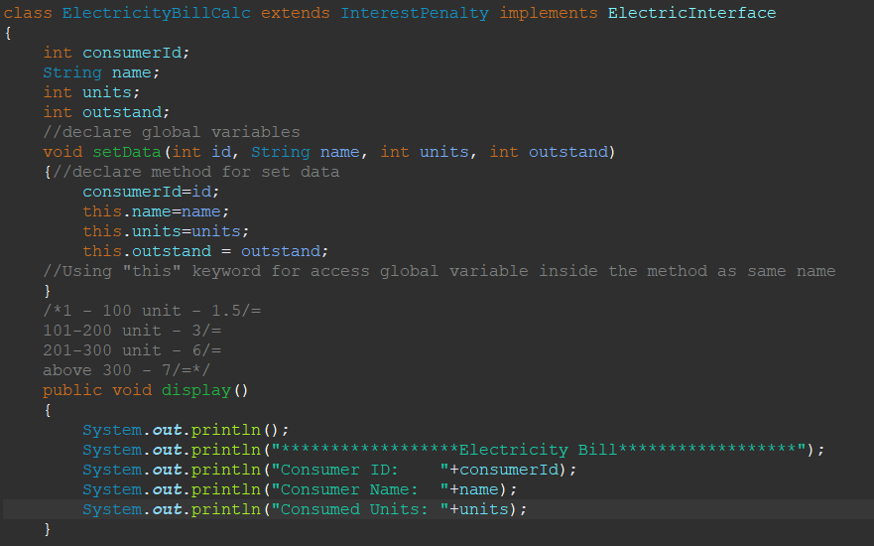
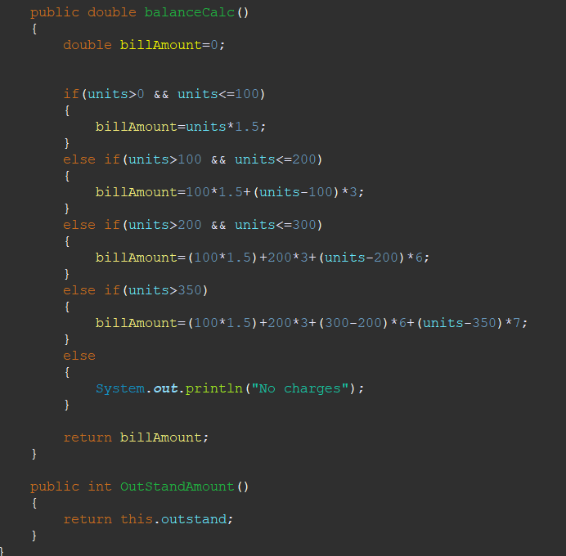
Code - Continuation

Slide 7
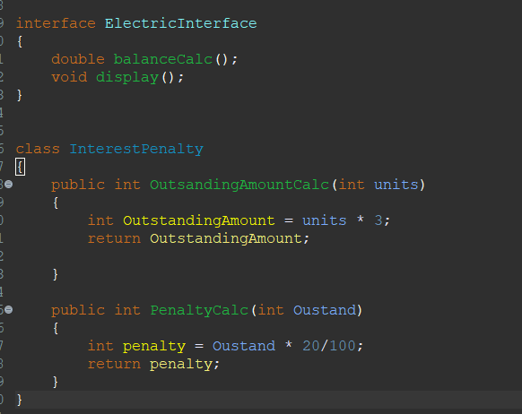
Code - Continuation

Slide 8
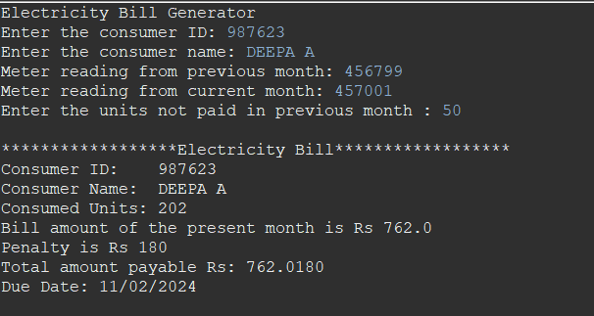
Output

Slide 9
Summary
❖ It is a software which helps the user to work with the billing cycles.
❖This software reduces the amount of manual data entry and gives greater efficiency. The User Interface of it is very friendly and can be easily used by anyone.
❖It also decreases the amount of time taken to write details and other modules

Slide 10
Thank you
DEEPA A
deepa.ak682@gmail.com

