Slide 1
Inheritance
DEEPA A

Slide 2

Introduction
In OOP, computer programs are designed in such a way where everything is an object that interacts with one another. Inheritance is an integral part of Java OOPs which lets the properties of one class to be inherited by the other. It basically, helps in reusing the code and establish a relationship between different classes.

Slide 3
Code Reusability: The code written in the Superclass is common to all subclasses. Child classes can directly use the parent class code. Method Overriding: Method Overriding is achievable only through Inheritance. It is one of the ways by which Java achieves Run Time Polymorphism. Abstraction: The concept of abstract where we do not have to provide all details is achieved through inheritance. Abstraction only shows the functionality to the user.
Why Do We Need Java Inheritance?

Slide 4
Java Inheritance Types
Single Inheritance
Multilevel Inheritance
Hierarchical Inheritance

Slide 5
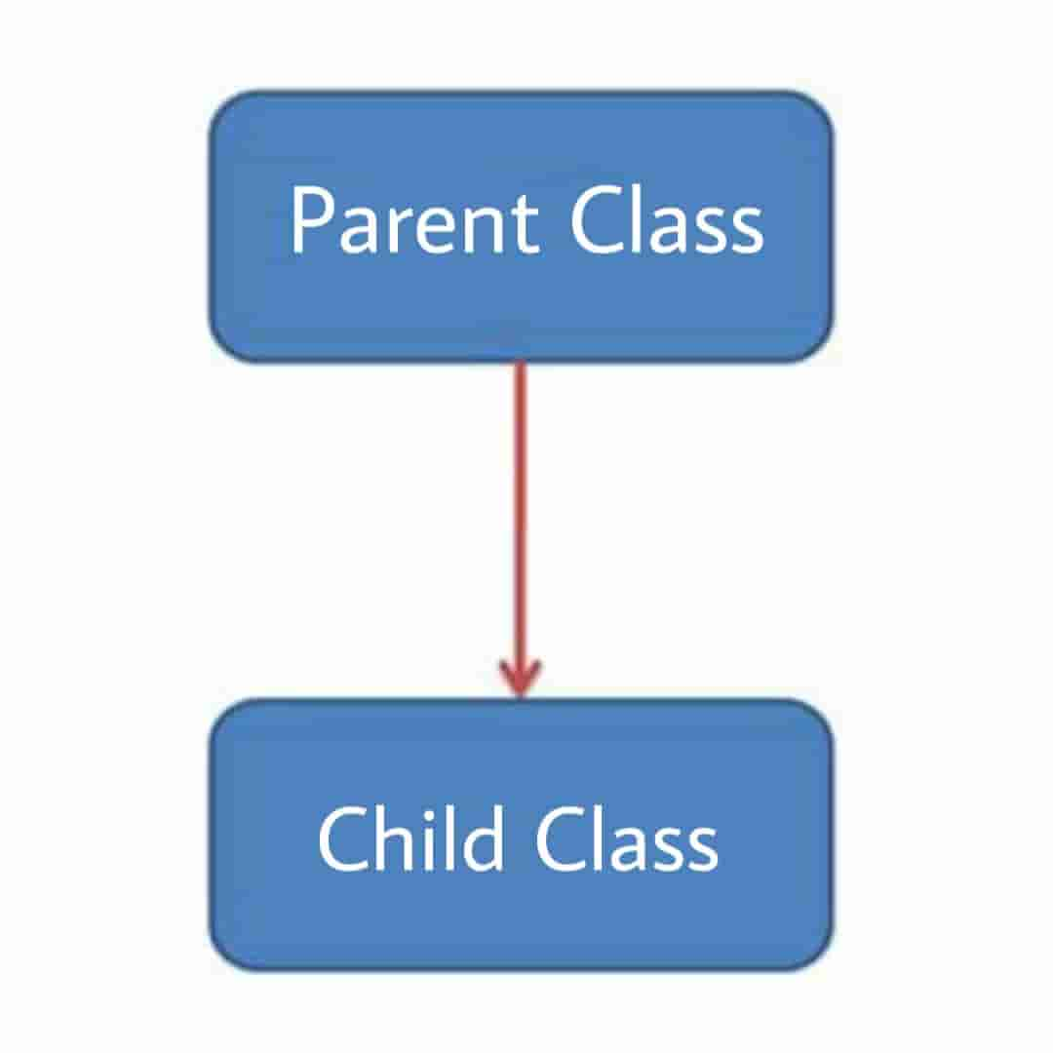
Single Inheritance
As the name suggests, in single inheritance, a sub-class inherits features of only one parent class.

Slide 6
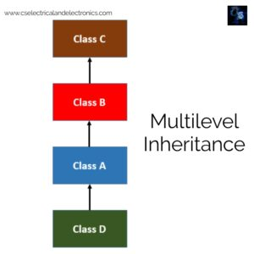
Multilevel Inheritance
In multilevel inheritance, at least two classes are involved. A derived class that has just been inherited from a base class becomes the base class for new classes. Moreover, the inherited attributes and features in multilevel inheritance in Java are from several base classes.

Slide 7
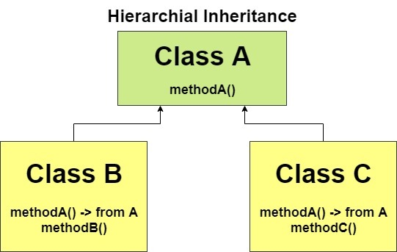
Hierarchical Inheritance
Hierarchical inheritance in Java refers to when multiple subclasses are derived from a single superclass. It is a mixture of various inheritance types. The difference between this and multilevel inheritance is that in hierarchical inheritance, various classes are descended from a single class and acquire features and methods of that class.

Slide 8
thank you
DEEPA A

