Slide 1
CardCore: Flashcard Flutter App
Recall Concepts with Ease – Multi-language Support, Cheatsheets, Quizzes
Submitted by : Deepa Behrani

Slide 2
Overview
CardCore is a Flutter-based flashcard app designed to help users recall and strengthen their programming concepts.
- Difficulty Levels: Easy, Medium, Hard
- Multi-language Support: Python, Java, JavaScript, Flutter, TypeScript
- Cheatsheet for quick reference
- Interactive quizzes for self-evaluation

Slide 3
Difficulty Levels
Users can select the difficulty level of flashcards based on their expertise:
- Easy: Basic concepts and syntax
- Medium: Intermediate topics and use cases
- Hard: Advanced programming patterns and best practices

Slide 4
Multi-language Support
CardCore supports the following programming languages:
- Python
- Java
- JavaScript
- Flutter (Dart)
- TypeScript
Switch easily between languages to match your learning goals.

Slide 5
Cheatsheet and Quiz
- Cheatsheet: Quick access to commonly used syntax, functions, and tips.
- Quiz: Evaluate your learning with difficulty-based quizzes.
- Instant feedback and score tracking to measure progress.

Slide 6
Conclusion
CardCore is a comprehensive flashcard app to support programming education.
- Ideal for students, professionals, and coding enthusiasts
- Covers multiple languages and difficulty levels
- Enhances learning with quizzes and quick reference tools

Slide 7
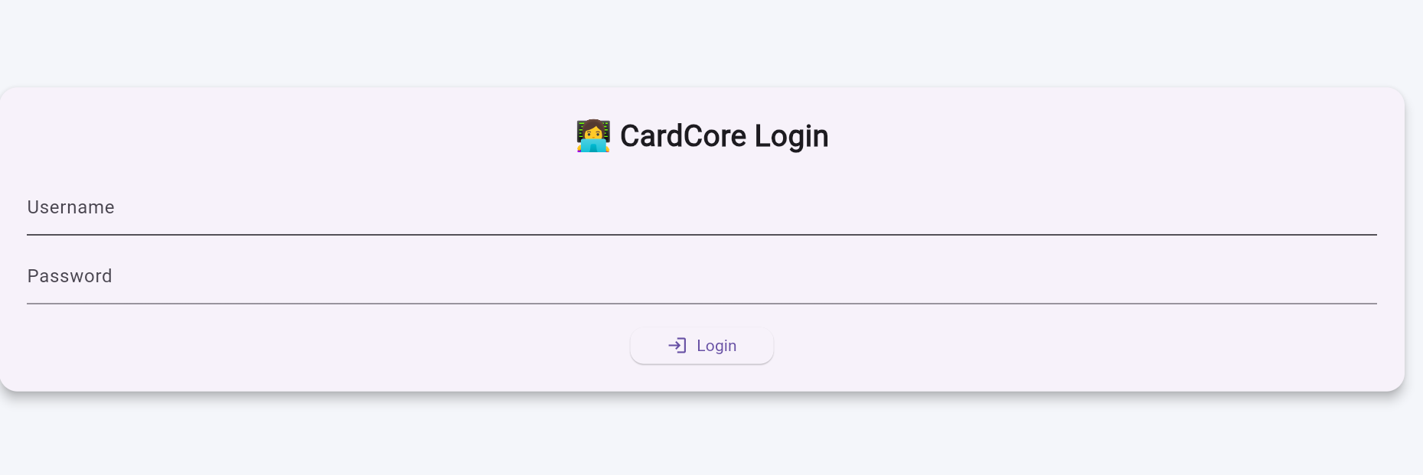
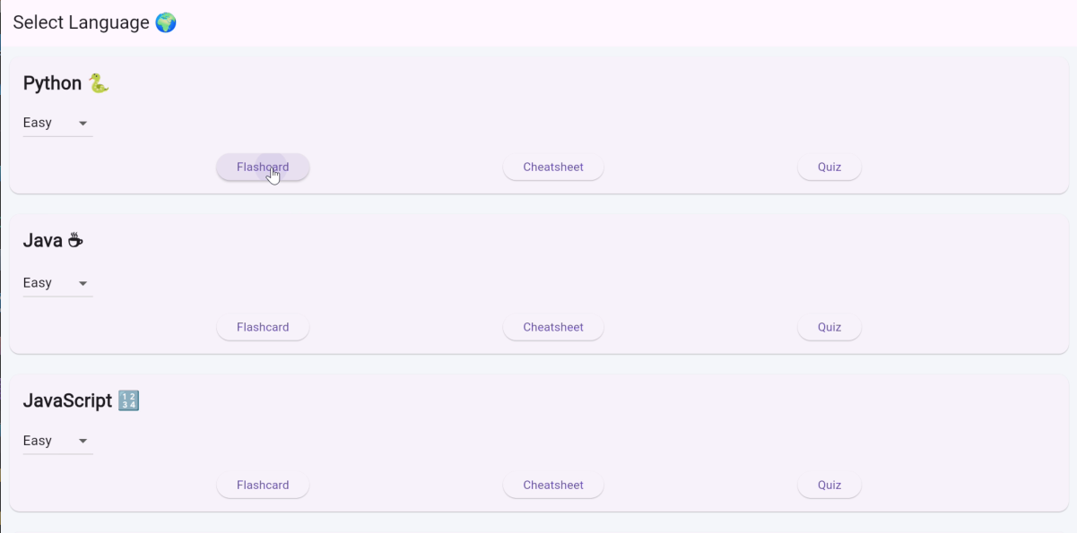
VISUAL REPRESENTATION

Slide 8
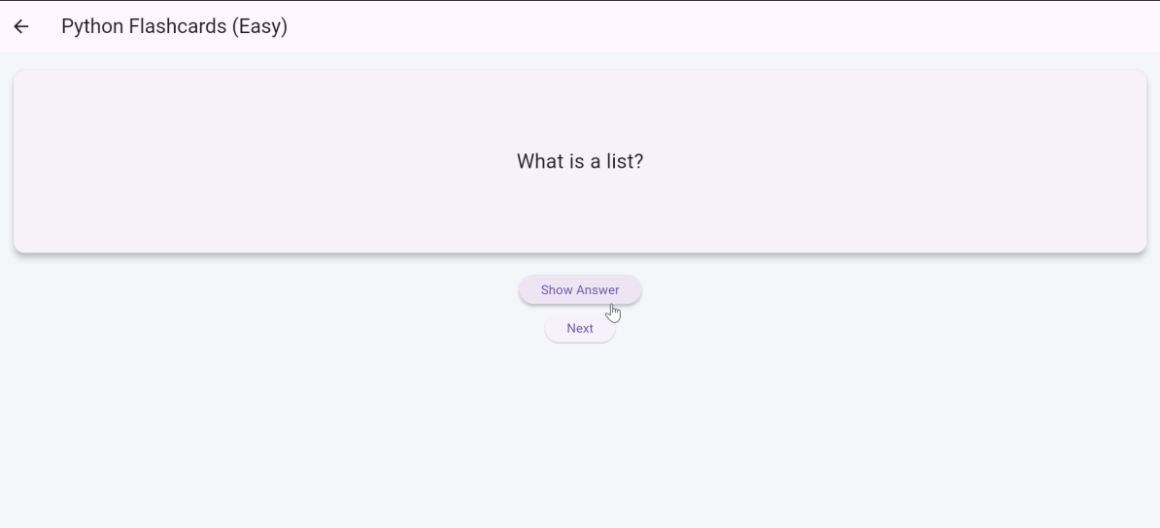
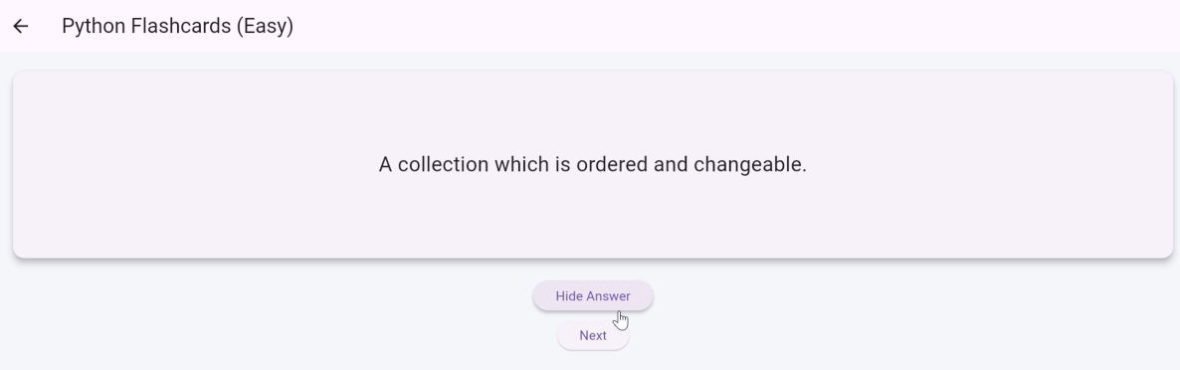
VISUAL REPRESENTATION

Slide 9
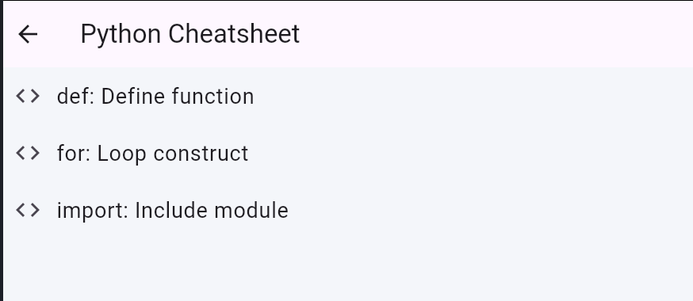
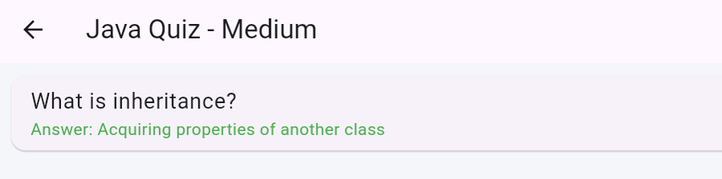
VISUAL REPRESENTATION

Slide 10
THANK YOU

