Slide 1

Object-Oriented Programming
Part 1
Programming Language Concepts
Lecture 18
Prepared by
Manuel E. Bermúdez, Ph.D.
Associate Professor
University of Florida

Slide 2
Object Oriented Programming
Over time, data abstraction has become essential as programs became complicated.
Benefits:
1. Reduce conceptual load (minimum detail).
2. Fault containment.
3. Independent program components.
(difficult in practice).
Code reuse possible by extending and refining abstractions.

Slide 3
Object Oriented Programming
A methodology of programming
Four (Five ?) major principles:
  Data Abstraction.
  Encapsulation.
  Information Hiding.
  Polymorphism (dynamic binding).
  Inheritance. (particular case of polymorphism ?)
Will describe these using C++, because ...

Slide 4
The C++ language
An object-oriented, general-purpose programming language, derived from C (C++ = C plus classes).
C++ adds the following to C:
  Inlining and overloading of functions.
  Default argument values.
  Argument pass-by-reference.
  Free store operators new and delete, instead of malloc() and free().
  Support for object-oriented programming, through classes, information hiding, public interfaces, operator overloading, inheritance, and templates.

Slide 5
Design Objectives in C++
Compatibility. Existing code in C can be used. Even existing, pre-compiled libraries can be linked with new C++ code.
Efficiency. No additional cost for using C++. Overheadof function calls is eliminated where possible.
Strict type checking. Aids debugging, allows generation of efficient code.
C++ designed by Bjarne Stroustrup of Bell Labs (now at TAMU).
Standardization: ANSI, ISO.

Slide 6
Non Object-Oriented Extensions to C
Major improvements over C.
    Stream I/O.
    Strong typing.
    Parameter passing by reference.
    Default argument values.
    Inlining.
We’ve discussed some of these already.

Slide 7
Stream I/O in C++
Input and output in C++ is handled by streams.
The directive #include <iostream.h> declares 2 streams: cin and cout.
cin is associated with standard input. Extraction: operator>>.
cout is associated with standard output. Insertion: operator<<.
In C++, input is line buffered, i.e. the user must press <RTN> before any characters are processed.

Slide 8
Example of Stream I/O in C++
A function that returns the sum of
the numbers in the file Number.in
int fileSum();
{
ifstream infile("Number.in");
int sum = 0;
int value;
//read until non-integer or <eof>
while(infile >> value)
sum = sum + value;
return sum;
}

Slide 9
Example of Stream I/O in C++
Example 2: A function to copy myfile into copy.myfile
void copyfile()
{
ifstream source("myfile");
ofstream destin("copy.myfile");
char ch;
while (source.get(ch))
destin<<ch;
}

Slide 10
Line-by-line textfile concatenation
int ch;
// Name1, Name2, Name3 are strings
ifstream f1 (Name1);
ifstream f2 (Name2);
ofstream f3 (Name3);
while ((ch = f1.get())!=-1 )
if (ch =='\n')
while ((ch = f2.get())!=-1) {
f3.put(ch);
if (ch == '\n') break;
}
else f3.put(ch);
}

Slide 11
Why use I/O streams ?
Streams are type safe -- the type of object being I/O'd is known statically by the compiler rather than via dynamically tested '%' fields.
Streams are less error prone:
  Difficult to make robust code using printf.
Streams are faster: printf interprets the language of '%' specs, and chooses (at runtime) the proper low-level routine. C++ picks these routines statically based on the actual types of the arguments.

Slide 12
Why use I/O streams ? (cont’d)
Streams are extensible -- the C++ I/O mechanism is extensible to new user-defined data types.
Streams are subclassable -- ostream and istream (C++ replacements for FILE*) are real classes, and hence subclassable. Can define types that look and act like streams, yet operate on other objects. Examples:
  A stream that writes to a memory area.
  A stream that listens to external port.

Slide 13
C++ Strong Typing
There are 6 principal situations in which C++ has stronger typing than C.
  The empty list of formal parameters means "no arguments" in C++.
    In C, it means "zero or more arguments", with no type checking at all. Example:
    char * malloc();

Slide 14
C++ Strong Typing (cont’d)
    In C, it's OK to use an undefined function; no type checking will be performed. In C++, undefined functions are not allowed.
    Example:
    main()
    f( 3.1415 );
// C++: error, f not defined
// C: OK, taken to mean int f()

Slide 15
C++ Strong Typing (cont’d)
    A C function, declared to be value-returning, can fail to return a value. Not in C++. Example:
    double foo() {
    /* ... */
    return;
    }
    main() {
    if ( foo() ) { ... }
    ...
    }
    // C : OK
    // C++: error, no return value.

Slide 16
C++ Strong Typing (cont’d)
    In C, assigning a pointer of type void* to a pointer of another type is OK. Not in C++. Example:
int i = 1024;
void *pv = &i;
// C++: error,
// explicit cast required.
// C : OK.
char *pc = pv;
int len = strlen(pc);

Slide 17
C++ Strong Typing (cont’d)
    C++ is more careful about initializing arrays: Example:
char A[2]="hi";
      // C++: error,
      // not enough space for '\0'
// C : OK, but no '\0' is stored.
It's best to stick with char A[] = "hi“;

Slide 18
C++ Strong Typing (cont’d)
    Free store (heap) management. In C++, we use new and delete, instead of malloc and free.
    malloc() doesn't call constructors, and free doesn't call destructors.
    new and delete are type safe.

Slide 19
Object-Oriented Programming
Object-oriented programming is a programming
methodology characterized by the following concepts:
  Data Abstraction: problem solving via the formulation of abstract data types (ADT's).
  Encapsulation: the proximity of data definitions and operation definitions.
  Information hiding: the ability to selectively hide implementation details of a given ADT.
  Polymorphism: the ability to manipulate different kinds of objects, with only one operation.
  Inheritance: the ability of objects of one data type, to inherit operations and data from another data type. Embodies the "is a" notion: a horse is a mammal, a mammal is a vertebrate, a vertebrate is a lifeform.

Slide 20
O-O Principles and C++ Constructs
O-O Concept C++ Construct(s)
Abstraction Classes
Encapsulation Classes
Information Hiding Public and Private Members
Polymorphism Operator overloading,
templates, virtual functions
Inheritance Derived Classes

Slide 21
O-O is a different Paradigm
Central questions when programming.
  Imperative Paradigm:
      What to do next ?
  Object-Oriented Programming
      What does the object do ? (vs. how)
Central activity of programming:
  Imperative Paradigm:
      Get the computer to do something.
  Object-Oriented Programming
      Get the object to do something.

Slide 22
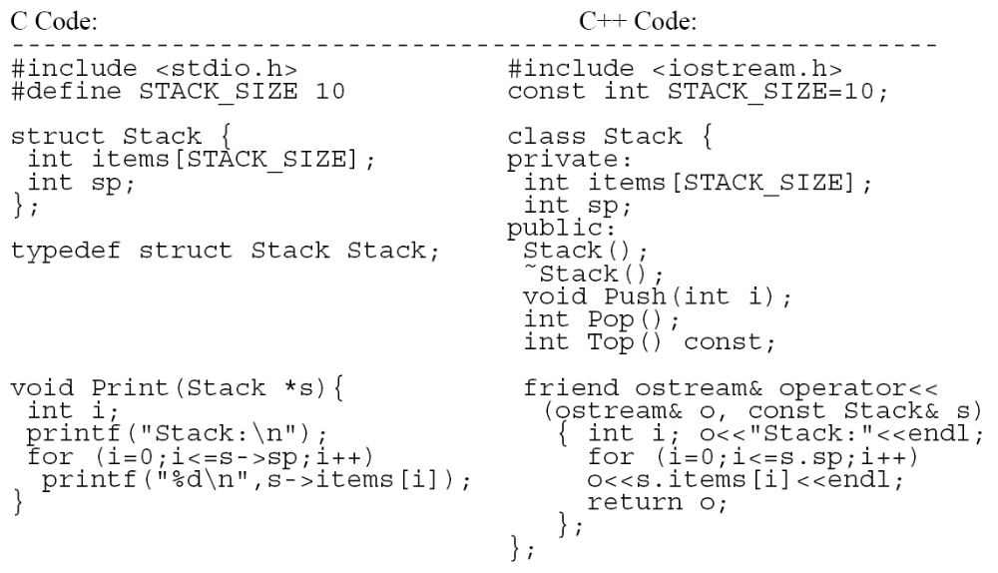
C vs. C++, side-by-side

Slide 23
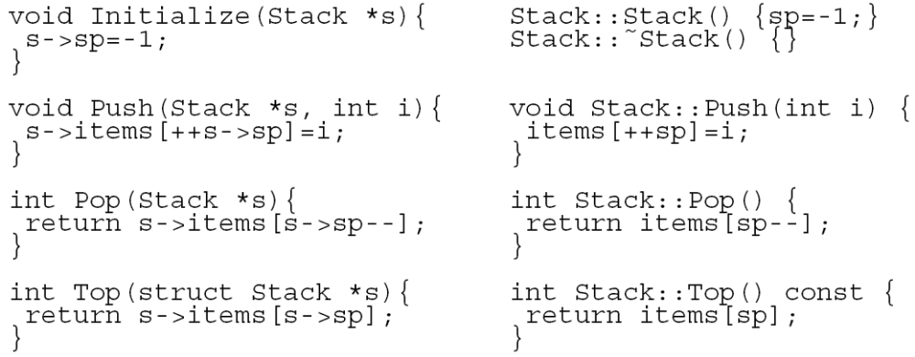
C vs. C++, side-by-side (cont’d)
In C++, methods can appear inside the class definition (better encapsulation)

Slide 24
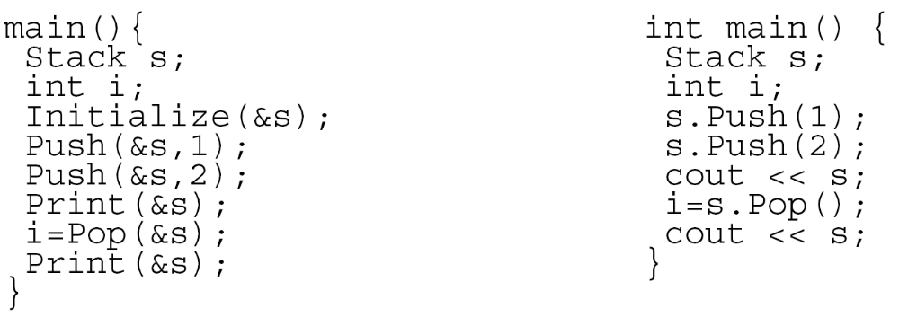
C vs. C++, side-by-side (cont’d)
In C++, no explicit referencing.
Could have overloaded <<, >> for Stacks:
s << 1; s >> i;

Slide 25
Structures and Classes in C++
Structures in C++ differ from those in C in that members can be functions.
A special member function is the “constructor”, whose name is the same as the structure. It is used to initialize the object:
struct buffer {
buffer()
{size=MAXBUF+1; front=rear=0;}
char buf[MAXBUF+1];
int size, front, rear;
}

Slide 26
Structures and Classes in C++
The idea is to add some operations on objects
of type buffer:
struct buffer {
buffer() {size=MAXBUF+1;front=rear=0;}
char buf[MAXBUF+1];
int size, front, rear;
int succ(int i) {return (i+1)%size;}
int enter(char);
char leave();
}

Slide 27
Structures and Classes in C++
The definition (body) of a member function can be
included in the structure's declaration, or may
appear later. If so, use the name resolution
operator (::)
int buffer::enter(char x) {
// body of enter }
char buffer::leave() {
// body of leave }

Slide 28
Public and Private Members
Structures and classes are closely related in C++:
struct x { <member-dclns> };
is equivalent to
class x { public: <member-dclns>};
Difference: by default, members of a structure are
public; members of a class are private. So,
class x { <member-dclns> };
is the same as
struct x { private: <member-dclns> };

Slide 29
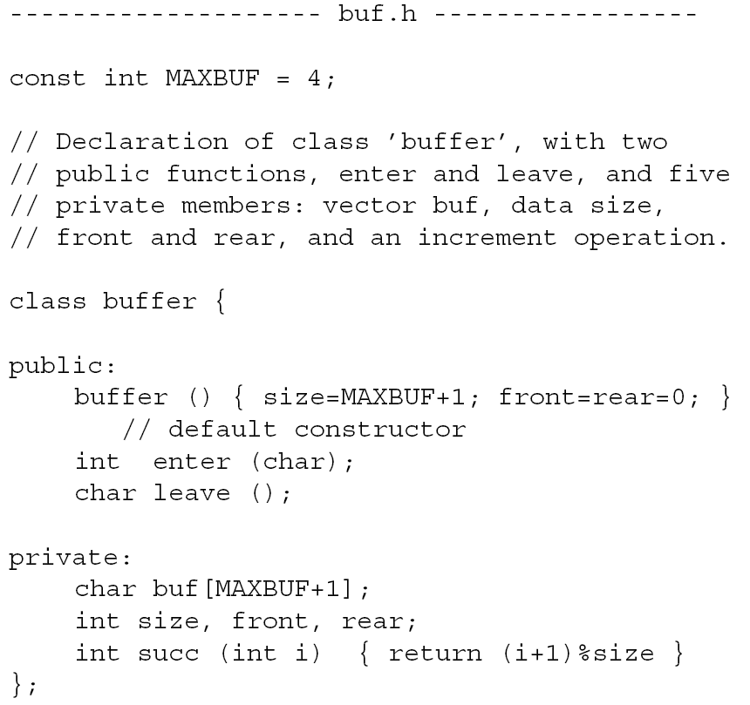
Header File Partitioning

Slide 30
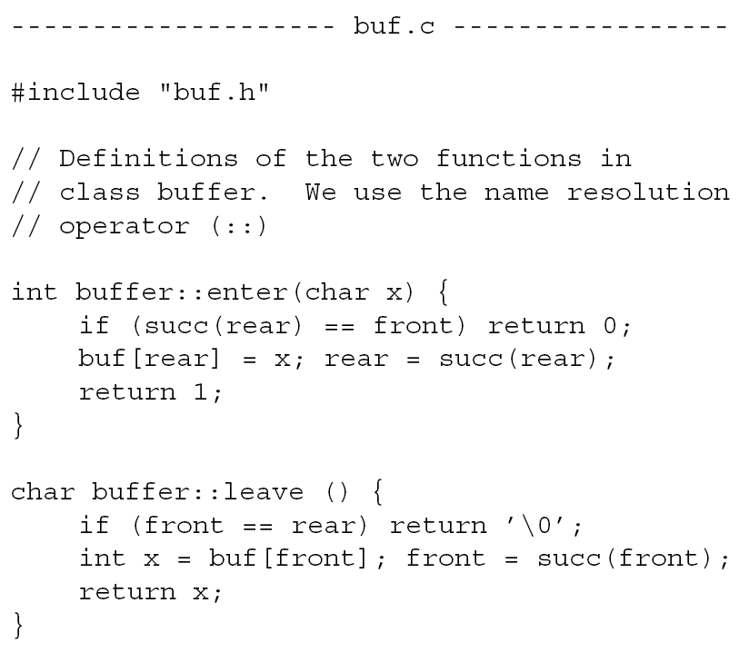
Header File Partitioning (cont’d)

Slide 31
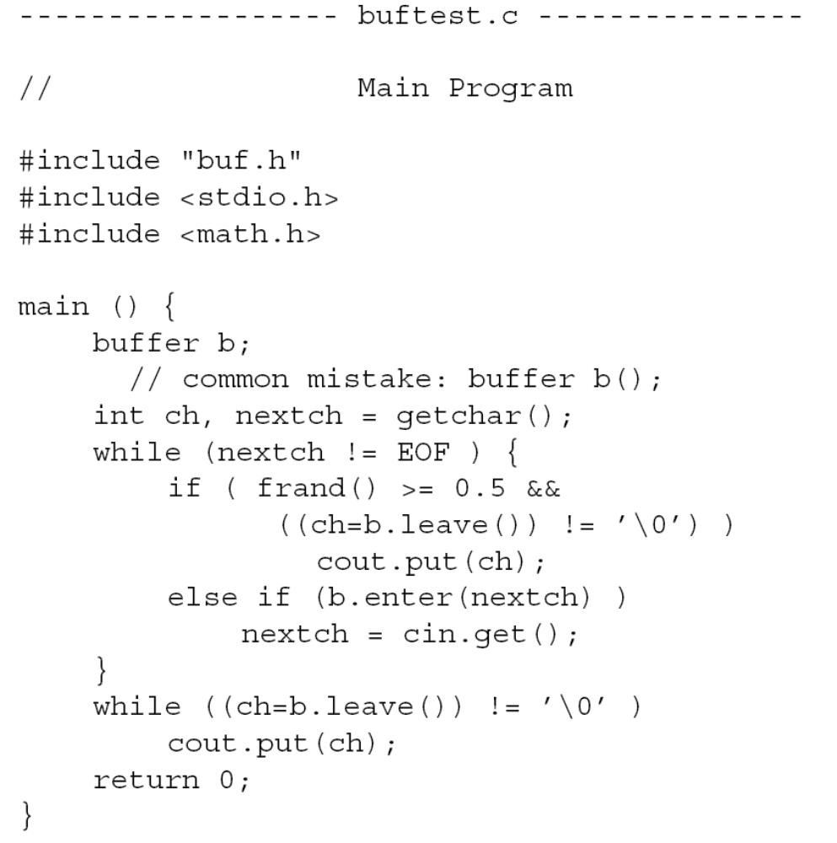
Header File Partitioning (cont’d)

Slide 32
Object-Oriented Programming
Part 1
Programming Language Concepts
Lecture 18
Prepared by
Manuel E. Bermúdez, Ph.D.
Associate Professor
University of Florida

