Slide 1
A Merry Overview of the Python Programming Language
By Doug Purcell

Slide 2

A Very Special Thanks to Our Venue Sponsor!
Event venue: https://generalassemb.ly

Slide 3
Why Learning Python Fundamentals Matter
Mastering the fundamentals helps you to understand data structures and algorithms better which are a must for technical interviews.
Strong fundamentals makes learning more advanced topics like web dev, machine learning, and blockchain easier.
By showing mastery of python it increases your chances of gaining internships and starting a brand new career in the hot software engineering field.

Slide 4
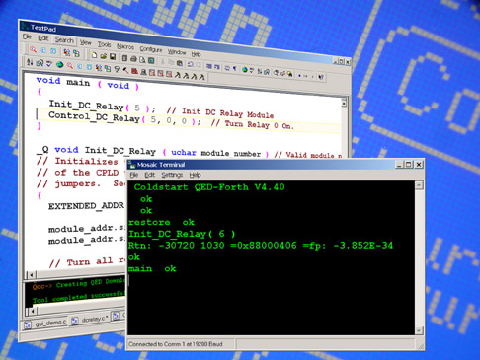
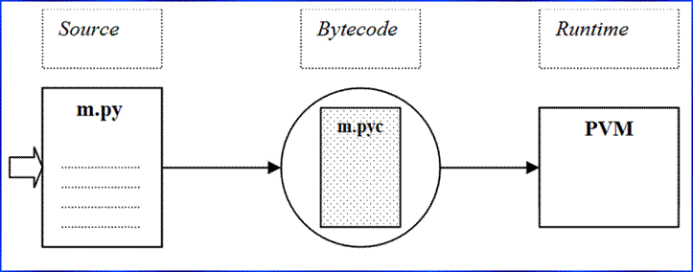
Setting Up Your Python Programming Environment

Slide 5
Getting Python Installed On Your Machine
Python is cross-platform so therefore you can install it on multiple machines including Windows, MacOS, or various flavors of Linux.

Slide 6
You Need to Install Python if You Get This Message
'python' is not recognized as an internal or external command, operable program or batch file

Slide 7
Installing Python on Windows
Step one: Download the latest version of python on your machine: https://www.python.org/downloads
Step two: Start the Windows installer that matches your system. If you click “Install Now” then Python is installed in the “user” directory, but if you change its location then just remember where it’s installed.
Step three: You’ll have an option to add Python to PATH which is where the computer searches for Python when you type it via command prompt. If you check this box then Python will be available via this option, if not then an error will occur.

Slide 8
Install Python on macOS
An easy way is to install the latest-and-greatest version of python on macOS is to use the appropriate macOS installer that matches your system: https://www.python.org/downloads

Slide 9
Installing Python on Linux (Ubuntu 18.04)
Step one: Open up the terminal by typing: ctr + alt + t
Step two: sudo apt-get update
Step three: sudo apt-get install python3.7.3

Slide 10
Online Python Interpreters: A Short Term Solution
Online GDB: https://www.onlinegdb.com/online_python_interpreter
Repl.it: https://repl.it/languages/python3
Another online python interpreter: http://mathcs.holycross.edu/~kwalsh/python

Slide 11





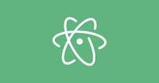
Which IDE to Use For Python???

Slide 12
What I Use

Slide 13
Try Them All Out & See Which Ones Tick With You
A comprehensive list of IDEs for Python: https://wiki.python.org/moin/IntegratedDevelopmentEnvironments

Slide 14
How to Install Python on All Machines
Windows:
Download the PyCharm installer, run the executable file, and follow the installer steps. Here’s the instructions on the PyCharm website: https://www.jetbrains.com/help/pycharm/installation-guide.html?section=Windows
· MacOs:
Download the PyCharm disk image and mount and drag the image to the Applications folder: https://www.jetbrains.com/help/pycharm/installation-guide.html?section=macOS
· Linux: If you have Ubuntu 16.04 you can install PyCharm through the command line using the snappy package manager:
o $ sudo snap apt-get install pycharm-community

Slide 15
Hello World with PyCharm
Once PyCharm is installed the next step is to run the proverbial Hello World program. Here are the steps...

Slide 16
Create a Brand Spanking New Project
Create a new project by doing the following: File → New Project
A project is an organizational unit in PyCharm. Name the project SampleProjects;

Slide 17
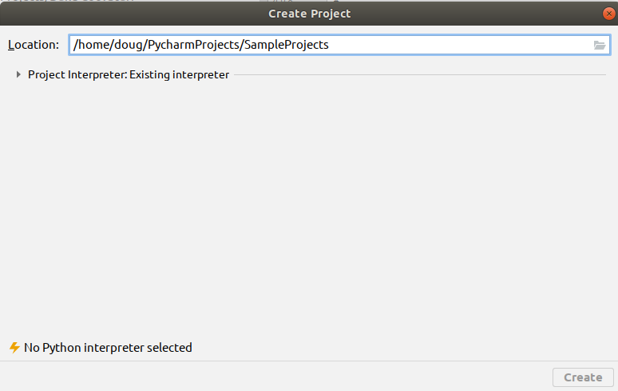
Here’s a Screenshot of How it Should Look

Slide 18
Add an Interpreter
Select the python interpreter that you want to use. Click the arrow that’s next to Project Interpreter:Existing Interpreter, and then select a python 3.6 or up.

Slide 19
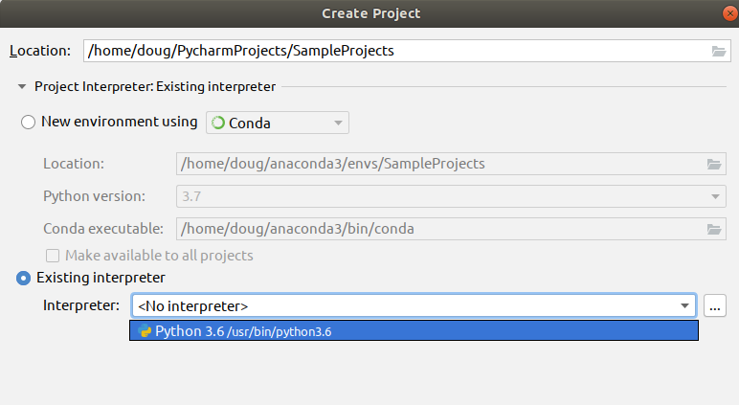
How Things Should Look?

Slide 20
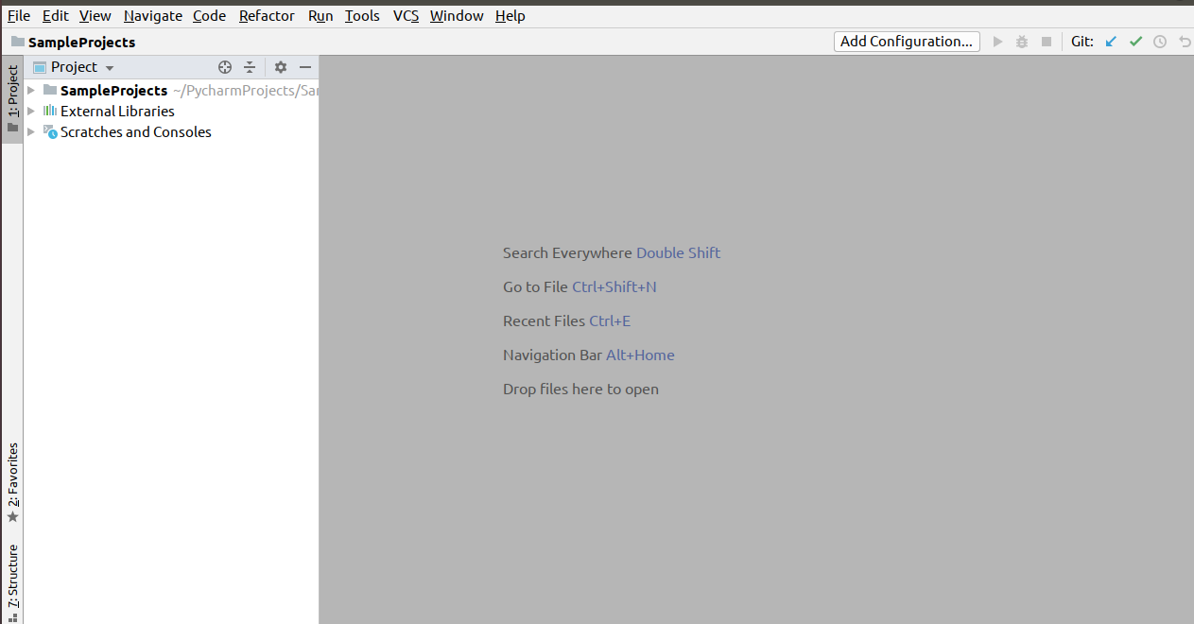
Click The Create Button
Here’s how the state of the IDE should look:

Slide 21
Create a Fresh Python File
Create a new project by doing the following: File → New Project

Slide 22
What’s a Project in PyCharm
A project is an organizational unit in PyCharm. Name the project SampleProjects.

Slide 23
How a Project Looks Thus Far
Here’s a screenshot of what the setup should look like thus far:

Slide 24
Create a Fresh Python File
At the main menu on PyCharm, or the portion where you see the various menus such as File, Edit, and View, do the following: File → New File → python file

Slide 25
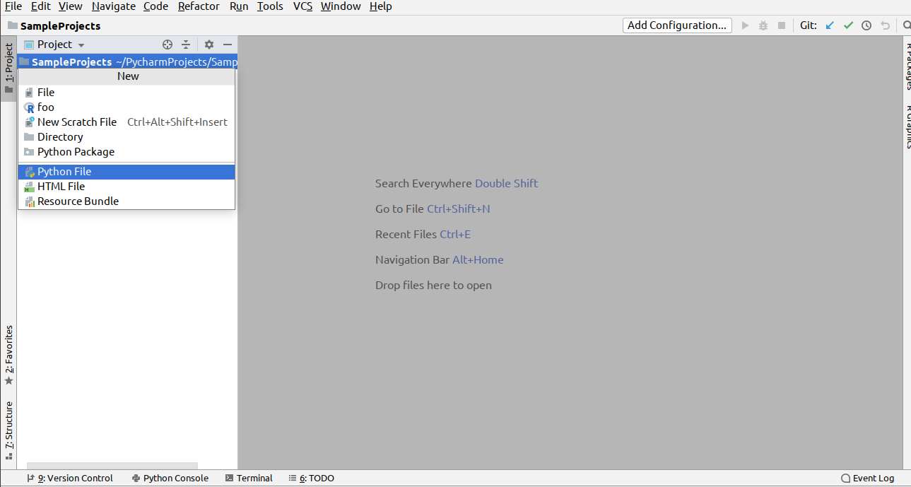
Here’s How Pycharm Should Look

Slide 26
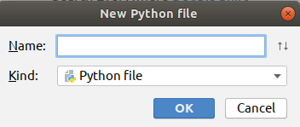
A Text Box Should Appear Which Looks Like the Following

Slide 27
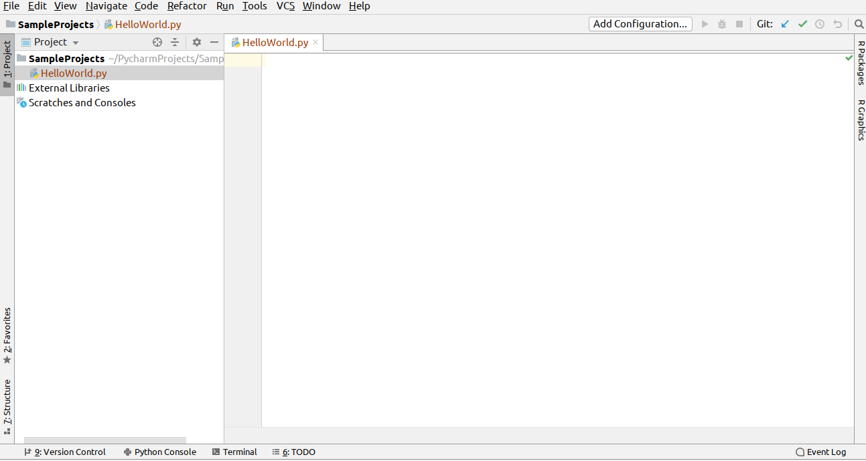
Do the following...
Enter in the name HelloWorld and select the OK button. Once done here’s how your project setup should look:

Slide 28
What You’re Looking At
The blank white space is known as the editor. That’s where you’ll spend most of your time hacking away. The left hand side is known as the project manager, that’s where you can see the organization of files in a project.

Slide 29
Add Code and run the file
Copy the following code into the editor:
print('Hello World!!!')

Slide 30

How to run the file
To run the file click the following on the main menu: run → run
A dialog box should appear which looks like the following:
Select the HelloWorld program. Once the program has executed you should see the text: Hello World!!!

Slide 31
If all went well then...
Congrats, you’ve ran your first python program.
If not, then raise your hand and the TA will provide you some one-on-one help.

Slide 32
Free Resources for Learning PyCharm
Quick Start Guide: https://www.jetbrains.com/help/pycharm/quick-start-guide.html
PyCharm blog: https://blog.jetbrains.com/pycharm
Learn keyboard shortcuts for editing, navigating, refactoring, and debugging: https://www.jetbrains.com/help/pycharm/mastering-keyboard-shortcuts.html

Slide 33
Now That Your Environment is Setup, Let’s get to Some Interesting Stuff

Slide 34
Variables in Python
A variable in python is similar to a variable in mathematics. It’s something that has a changeable state.

Slide 35
Examples of Variables in Python
a = 10
b = 1.598
c = .1987
d = 100.579

Slide 36
Printing Output
print(a)
print(b)
print(c)
print(d)

Slide 37
Swapping Variables
x = 5
y = 10
z = 30
x, y, z = z, x, y
print(x)
print(y)
print(z)

Slide 38
Here’s the Output
30
5
10

Slide 39
Variable Naming Tips Cheat Sheet
Variable names can have letters, numbers, and underscores.
Can't use a reserved word like print.
Be as descriptive as possible with your variable names. This reduces ambiguity and helps make your code more maintainable when other developers follow in after you.
Python IS case sensitive so apple is not the same as Apple.
Put constants or variables that value is fixed in all CAPS. I.e., DAYS_OF_WEEK = 7

Slide 40
Refer to PEP 8 For More Details
PEP is short for python enhancement proposals. Learn more about it here: https://www.python.org/dev/peps/pep-0008

Slide 41
Python Math Operators
Let’s look at some of the math operators available in python: +, -, *, **, /, //, %

Slide 42
Code Demo of Python Math Operators
print(10 + 10)
print(50 - 10)
print(10 * 10)
print(20 ** 2)
print(9 / 5)
print(8 // 3)
print(11 % 5)
print(1e10)

Slide 43
Here’s the Output
20
40
100
400
1.8
2
1
10000000000.0

Slide 44
How to Use Python as a Souped Calculator
Use the built in math module. You can use it by using the import statement.

Slide 45
Math Module Example
import math
print(math.log(1000000, 2))
print(math.sqrt(9))
print(math.cos(100) + math.sin(90) + math.tan(90))
print(math.pi**2 * math.e)
...
19.931568569324174
3.0
-0.23888487632000044
26.828366297560617

Slide 46
Strings in Python and Beyond
If you have ever sent an SMS text, used Facebook chat, or sent an email then you have used strings. A string is a sequence of characters wrapped in quotes; in python it could be single, double, or triple quotes. The single or double quotes can be used interchangeably. The triple quotes are typically used as doctrings, or comments inside methods, functions, or classes.

Slide 47
String Examples Python Part I
city = 'Los Angeles'
# indexing: python is a zero based indexed language
print(city[0]) # L
print(city[3]) # empty space is a string!
print(city[4]) # capital A
print(city[-1]) # negative indices are permitted
# len() function: gets the length of the string
print(len(city)) # 11
print(city[len(city)-1]) # s

Slide 48
String Examples in Python Part II
# concatenation: the combining of multiple strings
print('john ' + 'doe ' + 'public') # john doe public
# slicing: retrieves ranges of a string
print(city[0:3]) # Los
print(city[4:11]) # Angeles
print(city[::]) # Los Angeles
print(city[::2]) # LsAgls
print(city[::-1]) # selegnA soL

Slide 49
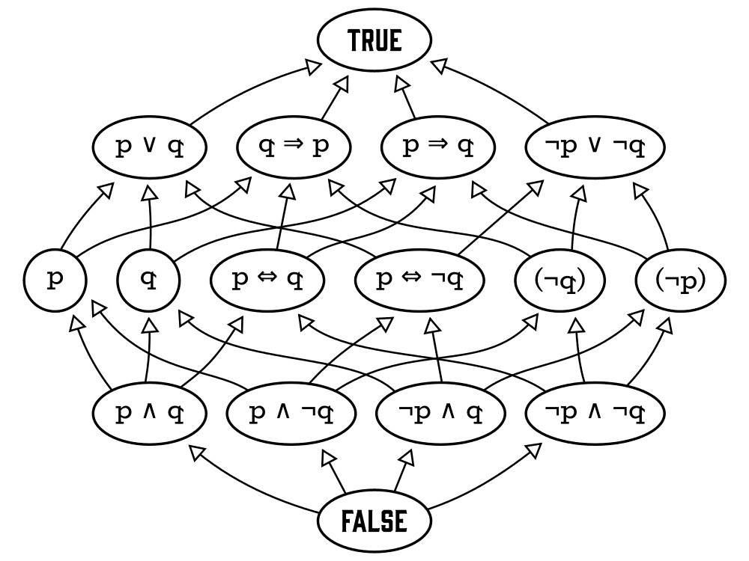
Boolean Algebra

Slide 50
Boolean Algebra is Prevalent in Many Languages
Learning Boolean algebra for python means that you can apply that set of logic to a wide array of languages like Java, C++, Haskell, Erlang, or R.

Slide 51
How Does It Work?
In python what we need to worry about are the values of True or False, which can also be denoted by 1 or 0 respectively. The main operations that we’ll discuss are “and” (conjunction), “or” (disjunction), as well as “negation.” There’s also the lesser used “xor” operator.

Slide 52
How the Truth Table Looks
Below is a sample of how the truth table looks:
x y x and y x or y not x
0 0 0 0 0
1 0 0 1 1
0 1 0 1 0
1 1 1 1

Slide 53
Boolean Algebra in Python Example # 1
is_the_sky_blue = True
do_cats_bark = False
print(is_the_sky_blue) # True
print(do_cats_bark) # False

Slide 54
Boolean Algebra in Python Example # 2
print(True and True) # True
print(True and False) # False
print(False and False) # False
print(False and True) # False

Slide 55
Boolean Algebra in Python Example # 3
print(True or True) # True
print(True or False) # True
print(False or False) # False
print(False or True) # True

Slide 56
Boolean Algebra in Python Example # 4
print(True ^ True) # False
print(True ^ False) # True
print(False ^ True) # True
print(False ^ False) # False

Slide 57
How to Next Use Boolean Algebra? Control Flow
Once you understand Boolean algebra you can apply that newfound knowledge to control flow, or the order in which statements are executed. Python uses the if, else, and elif statements for this.

Slide 58
if/else statement
x, y, z = 5, 10, 15
if x < y and z > y:
print(x)
else:
print(y)

Slide 59
elif statement
from random import randint
# picks a random number in range 1...100
grade = randint(1, 100)
if grade >= 90 <= 100:
print('A')
elif grade >= 80 <= 89:
print('B')
elif grade >= 70 <= 79:
print('C')
elif grade >= 60 <= 69:
print('D')
else:
print('F!')

Slide 60
Ternary Statement
This is a special type of operator that evaluates something based on a condition being True or False.
mood = True
state = 'nice' if mood else 'not so nice'
print('state = {}'.format(state))

Slide 61
It prints nice because if mood evaluates to True.

Slide 62
Comments in Programming
At this point you may have saw the hash symbol (#) followed by text. This is known as a comment in python and this portion of the code is ignored by the interpreter. However, it’s still very useful to include in your programs as it helps other programmers that may be messing around in your code to understand the logic.

Slide 63
Examples of Comments
# This is a comment
# This is a comment and will be ignored by the interpreter
# I think you get the memo!

Slide 64
Data structures in python 3.7.3
There are four built-in data structures in python which are lists, tuples, dictionaries, and sets. Here’s a quick rundown of each one...

Slide 65
Lists
Mutable collections of objects.

Slide 66
List Demo 1
evens = [0, 2, 4, 6, 8, 10]
# reverses the list
>>> evens.reverse()
[10, 8, 6, 4, 2, 0]
# adds an object to the list
>>> evens.append(100)
[10, 8, 6, 4, 2, 0, 100]
# merges another list with the list
>>> evens.extend([1, 3, 5, 7, 9])
[10, 8, 6, 4, 2, 0, 100, 1, 3, 5, 7, 9]
# pops an item from the list
>>> evens.pop()

Slide 67
Tuples
These are an immutable sequence. Unlike lists once you create a tuple they cannot be modified, and trying to do so will cause an error.

Slide 68
Tuple Examples
>>> a = (5, 10)
>>> a
(5, 10)
>>> a[0] = 10
Traceback (most recent call last):
File "<stdin>", line 1, in <module>
TypeError: 'tuple' object does not support item assignment
>>> a = (10, 20)
>>> a
(10, 20)

Slide 69
Tuples Are Immutable Therefore...
They don’t support item re-assignment. Here’s some more code snippets for better understanding:
>>> x = (5, 10)
>>> y = (5, 10)
>>> x == y
True
>>> x is y
False
>>> id(x), id(y)
(54484704, 54530096)

Slide 70
Dictionaries
These are key/value pairs or associative arrays in other languages. The concept is very similar to the dictionary reference source. You’re given a set of words which have corresponding definitions.

Slide 71
Dictionary Example in Python
vowels = {'a': 0, 'e': 0, 'i': 0, 'o': 0, 'u': 0}
>>> vowels.items()
dict_items([('a', 0), ('e', 0), ('i', 0), ('o', 0), ('u', 0)])
>>> vowels.get('a')
0
>>> vowels.values()
dict_values([0, 0, 0, 0, 0])
>>> vowels.keys()
dict_keys(['a', 'e', 'i', 'o', 'u'])
>>> vowels.pop('e')
0
>>> vowels
{'a': 0, 'i': 0, 'o': 0, 'u': 0}

Slide 72
Sets in Python
The set data structure stores unique items. Here’s a demo of a set in python:

Slide 73
A demo of sets in python
>>> letters = {'a', 'a', 'a', 'b', 'b', 'b'}
>>> letters.intersection({'b', 'c'})
{'b'}
>>> letters.pop()
'a'
>>> letters.add('c')
>>> letters.union({'a', 'e', 'i', 'o'})
{'i', 'c', 'e', 'b', 'o', 'a'}
>>> sorted(letters)
['b', 'c']

Slide 74
Iteration in Python
Iteration is the process in which computers do repetitive tasks. Humans despise repetition while computers are amazing at it. Humans can do repetitive tasks like summing all of the numbers from 1-100 manually (assuming no mathematical formulas are used), but these tasks are tedious and error prone. Computers can do number crunching like this in very quick times, like in a couple of freaking nanoseconds. There’s two ways to do iteration in python which is while or for loops.

Slide 75
While loop
# sets while loop starting at
i = 0
# condition
while i < 10:
print('i = {}'.format(i, end=' '))
i += 1 # increment i

Slide 76
The Output
0 … 9

Slide 77
Another Example of a While Loop
# Sum numbers from 1...1000 in nanoseconds
i, sum = 0, 0
while i < 1000:
i += 1
sum += i
>>> print('The summation of 1...1000 = {}'.format(sum))
…
The summation of 1...1000 = 500500

Slide 78
for loop
This is another way to iterate in python. It can be used with the range function to iterate over a sequence of numbers or it can be used standalone to iterate over data structures like lists or sets.

Slide 79
range() example
for x in range(10):
print(x, end=' ')
…
The above prints the numbers 0 … 9 on the same line separated by a space.

Slide 80
The for loop is also good for...
Iterating over data structures.

Slide 81
How to Iterate Over a List
>>> odds = [1, 3, 5, 7, 9] >>> for x in odds: ... print(x) ... 1 3 5 7 9

Slide 82
Fibonacci Numbers
x, y = 0, 1
for z in range(10):
next = x + y
x, y = y, next
print('12th fib number = {}'.format(next))
>>> print('12th fib number = {}'.format(next))
...
12th fib number = 89

Slide 83
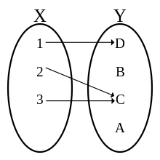
A function in mathematics

Slide 84
How to create functions in python?
Use the def keyword.

Slide 85
Function Example in Python
def scale_number(num, amount):
return num * amount
>>> print(scale_number(10, 5))
...
50

Slide 86
Keyword Arguments
def area_triangle(height=11, width=7.5):
return 1/2 * (height * width)
>>> print(area_triangle())
...
41.25
>>> print(area_triangle(height=20, width=100))
...
1000.0

Slide 87
Accepting an arbitrary number of input
def multiply(*args, y=1):
for x in range(len(args)):
y *= args[x]
return y
>>> print('multiply=', multiply(1, 2, 3, 4))
...
multiply= 24

Slide 88
Reading in an arbitrary number of keyword arguments
def key_value(**kwargs):
for key, value in kwargs.items():
print('{} {}'.format(key, value))
>>> key_value(a=5, b=10, c=15)
a 5
b 10
c 15

Slide 89
Classes and Objects
Object oriented programming is a style of programming that involves the heavy use of classes and objects. Classes are typically described as blueprints, while objects are described as the templates that are created from the classes.

Slide 90
Let’s Model a Point
A point in mathematics refers to an element of some set called a space. Let’s model a point in python by using a class.

Slide 91
class Point:
"""Simple class in python. This is an example
of a docstring, or a string that's used like a
comment to document a segment of code."""
def __init__(self, x, y):
self.x = x
self.y = y
def get_x(self):
return self.x
def get_y(self):
return self.y

Slide 92
def set_x(self, new_x):
self.x = new_x
def set_y(self, new_y):
self.y = new_y
def get_point(self):
return self.x, self.y

Slide 93
How to Use a Class in Python?
Create an instance and then call it’s methods. Below is a simple example of how to create an instance of a class:
class Apples:
pass
green = Apples()

Slide 94
Methods vs Functions
A method is binded to an object while a function is not:
def do_homework():
return
…
class Schedule:
def __init__(self):
pass
def do_homework(self):
return

Slide 95
What do __init__ do?
This is short for initializer, and it initializes the state of the class. Like with a method it can contain parameters which must match when an instance of the class is created.

Slide 96
The self convention
When you create a class in python all of the methods must have this convention. The self parameter is the first argument of every method in python and it’s used to pass the object.

Slide 97
Now, Back to the Point Class
p = Point(5, 10)
print()
print(p.get_point())
p.set_x(100)
p.set_y(200)
print(p.get_point())
...
(5, 10)
(100, 200)

Slide 98
Exception Handling
Exceptions are special ways in handling errors and unintended conditions in our program. In other words, it makes your program more robust and avoids crashes in programs.

Slide 99
A simple try/except statement
def divide(num, den):
try:
x = num / den
print('{} / {} = {}'.format(num, den, num / den))
except ZeroDivisionError:
print("can't divide by zero.")
>>> divide(10, 5)
>>> divide(0, 10)
>>> divide(10, 0)
10 / 5 = 2.0
0 / 10 = 0.0
can't divide by zero.

Slide 100
The statement that wants to be executed is located within the try block. If an error occurs within the try block then the except block is executed. ZeroDivisionError is one of the many builtin exceptions in python3.

Slide 101
Another Example of a try/except statement
def import_test():
try:
import math
import operating
import sys
print(math.pi)
print(sys.version_info)
except ImportError:
print("Couldn't import something")
>>> import_test()
...
Couldn't import something

Slide 102
Explanation
The reason for this is because operating is not a built-in module in python and therefore an error was triggered while in the try block. You can also use the raise statement to force an exception to occur.

Slide 103
The raise statement
try:
a = input('Enter an integer ')
raise Exception("Something strange happened")
except ValueError:
print("An exception happened.")
>>> Enter an integer 10
Traceback (most recent call last):
File "<stdin>", line 3, in <module>
Exception: Something strange happened

Slide 104
try/except/finally statement
def divide(a, b):
try:
result = a / b
except ZeroDivisionError:
print("Can't divide by 0")
else:
print(result)
finally:
print('This is in the finally statement')
>>> divide(10, 2)
...
5.0
This is in the finally statement

Slide 105
Image Credits
Python Interpreter: https://learning-python.com/class/Workbook/unit02.htm
Mosaic IDE: http://www.mosaic-industries.com/Products/Software/IDE.html
Boolean Algebra: https://www.investopedia.com/thmb/tYahC_el76R8oETvnxgfH9uVdZo=/1000x750/smart/filters:no_upscale()/Free-boolean-algebra-hasse-diagram-a30ae4a9499547d186f0343e31eda288.png
Functions: https://upload.wikimedia.org/wikipedia/commons/thumb/8/83/Injection_keine_Injektion_2a.svg/220px-Injection_keine_Injektion_2a.svg.png

Slide 106
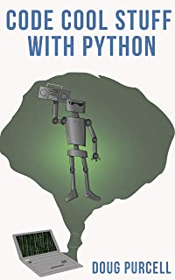
Check Out The E-book
#1 new release on Amazon! Grab your copy here: https://www.amazon.com/Code-Cool-Stuff-Python-Purcell-ebook/dp/B081XJMNRB

