Slide 1
Crafting Catchy Computer Art with Python Turtle
Doug Purcell

Slide 2
I’m Doug Purcell
A software engineer
4X published author
A creative entrepreneur

Slide 3
Why This Talk Can Unveil A New World of Possibilities!
Perfect for educators that want to find a way for students to stay motivated in programming.
Suitable for artists, designers, or creative folks that want to learn programming but can’t find the motivation to stick with it.
Excellent for those who are completely new to programming and are having trouble mastering the fundamentals such as data types, data structures, iteration, and forming solutions.
Suitable for new developers that want to learn algorithmic programming.
Great for beginners that want to code something that they can showcase.

Slide 4
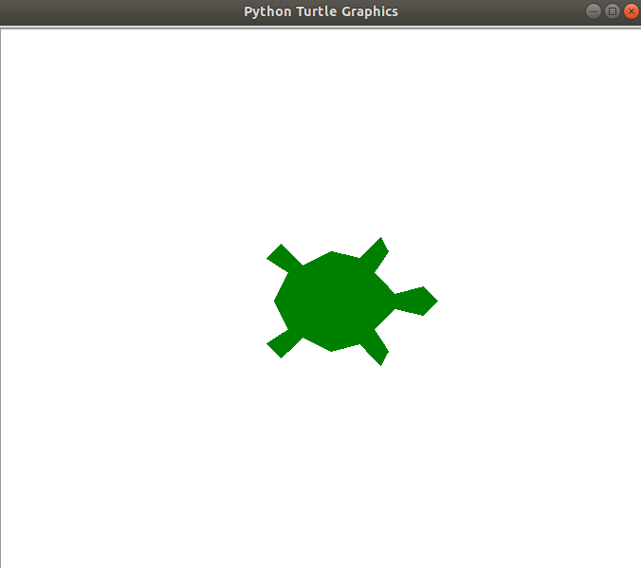
Let’s Program This Image

Slide 5
Code for the Big Green Turtle
import turtle
leonardo = turtle.Turtle()
leonardo.shape('turtle')
leonardo.shapesize(7.5, 7.5)
leonardo.color('green')
turtle.done()

Slide 6
Line One
>>> import turtle
Imports the turtle module so that we can use all of the builtin functionality.

Slide 7
Line Two
>>> leonardo = turtle.Turtle()
Once the module is imported we can go ahead and call the Turtle constructor.

Slide 8
Line Three
>>> leonardo.shape('turtle')
We can change the default shape of the turtle object to something more appealing like a green turtle using shape.

Slide 9
Line Four
>>> leonardo.shapesize(7.5, 7.5)
Stretches the turtle shape. The first parameter corresponds to the width while the second one corresponds to the length.

Slide 10
Line Five
>>> leonardo.color('green')
Sets the color of the turtle to green.

Slide 11
Line Six
>>> turtle.done()
Starts the event loop which in essence calls Tkinter’s main loop function.

Slide 12
Want to Explore all of the Cool Functionality of Turtle?
https://docs.python.org/3.3/library/turtle.html?highlight=turtle

Slide 13
How Would You Define a Square?

Slide 14
A Square Has...
Four sides of equal length
Four right angles
How can we use this definition to code a square in turtle?

Slide 15
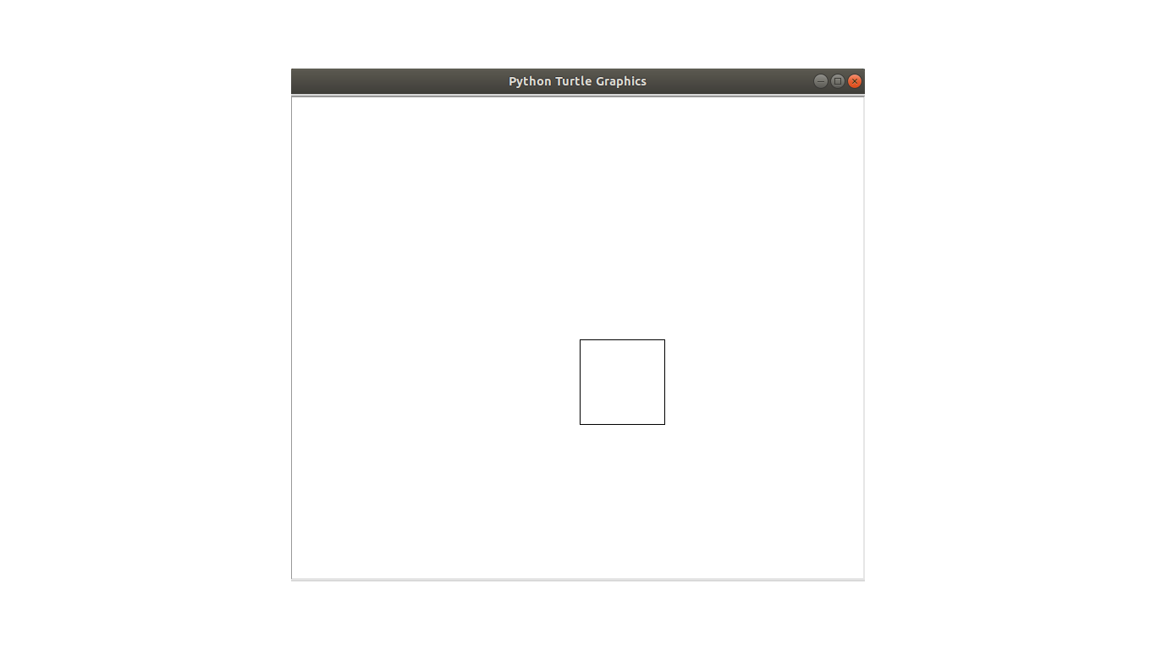
A Simple Square Image in Python

Slide 16
Here’s The Code
import turtle
square = turtle.Turtle()
square.hideturtle()
square.forward(100)
square.right(90)
square.forward(100)
square.right(90)
square.forward(100)
square.right(90)
square.forward(100)
turtle.done()

Slide 17
A lot of Repeated Statements in The Code
4 calls to forward and 3 calls to right

Slide 18
Shorten The Code With a for Loop
import turtle
square = turtle.Turtle()
square.hideturtle()
for x in range(4):
square.forward(100)
square.right(90)
turtle.done()

Slide 19
Adding Colors to Turtle Graphics
Just like how film would be humdrum with traditional black-and-white television, the same concept applies to your turtle computer graphics.
We can spice things up by adding color to our images. Turtle enables pythonistas the ability to do this via the color function.
You can read about it in the turtle module here: https://docs.python.org/3.3/library/turtle.html?highlight=turtle#turtle.color
You can call it with no arguments, one argument, or two arguments. When you pass in one argument it returns the pencolor and current fillcolor as a pair; it doesn't actually manipulate the color, just returns what color is in the turtle object.

Slide 20
This is Great, But...
Sometimes when you’re creating images you’re not exactly sure what colors to use… Ta-da, this is where the PyRandomColor comes to the rescue.

Slide 21
The PyRandomColor Open source Module
An open source module that I created under the GPL license that allows pythonistas to randomly add colors to their turtle graphics.
There’s two simple ways to download PyRandomColor:
$ pip install pyrandomcolor
$ git clone https://github.com/purcellconsult/PyRandomColor.git

Slide 22
A list of functions from PyRandomColor
get_random_color(): Picks any random color.
whites_and_pastels(): Returns a random color that’s within the white and pastel color scheme.
grays(): Returns a random color that’s within the gray color scheme.
blues(): Returns a random color within the blue color scheme.
greens(): Returns a random color within the green color scheme.
yellows(): Returns a random color within the yellow color scheme.
browns(): Returns a random color within the brown color scheme.
oranges(): Returns a random color within the orange color scheme.
pinks_violets(): Returns a random color within the pinkish and violetish color scheme.

Slide 23
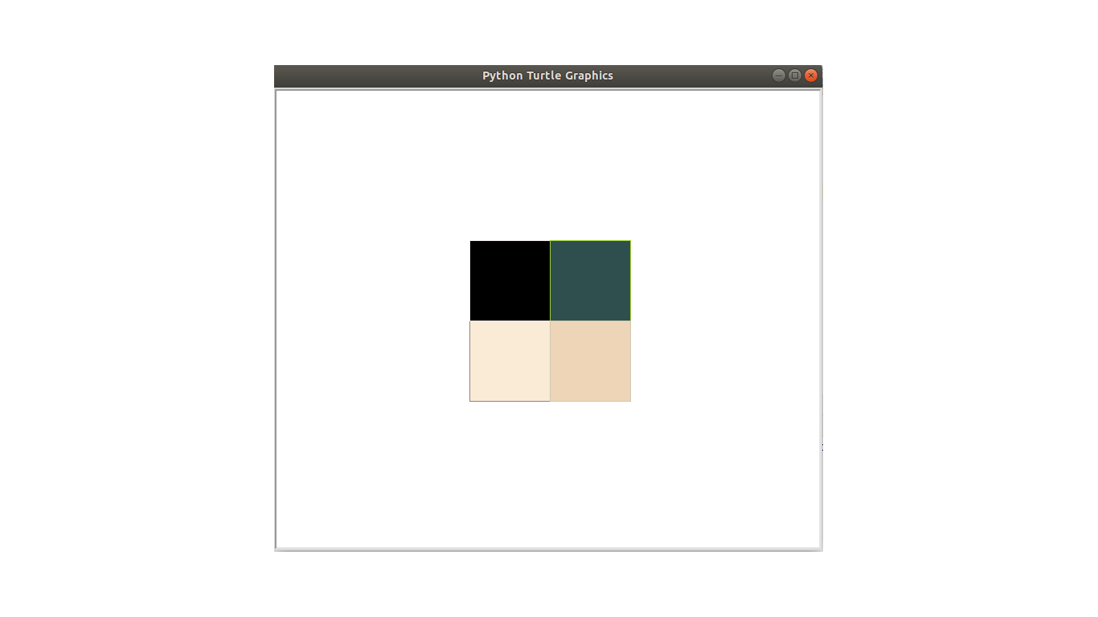
Let’s Create a Square Portrait Like The Below

Slide 24
Let’s See This in Action
$ python multi_color_cube.py

Slide 25
import turtle
from random_colors import get_random_color
square = turtle.Turtle()
square.hideturtle()
for x in range(4):
square.color(get_random_color(), get_random_color())
square.begin_fill()
square.right(90)
for y in range(4):
square.forward(100)
square.right(90)
square.end_fill()
turtle.done()

Slide 26
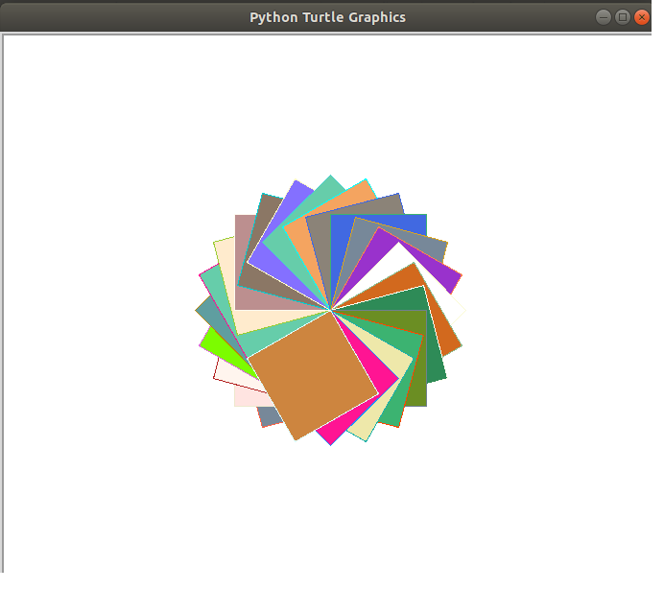
More Square Artwork

Slide 27
import turtle
from random_colors import get_random_color
square = turtle.Turtle()
square.hideturtle()
square.speed(0)
for x in range(50):
square.color(get_random_color(), get_random_color())
square.begin_fill()
square.right(35)
for y in range(4):
square.forward(100)
square.right(90)
square.end_fill()
turtle.done()

Slide 28
Let’s Move On to Another Shape
How about a circle?

Slide 29
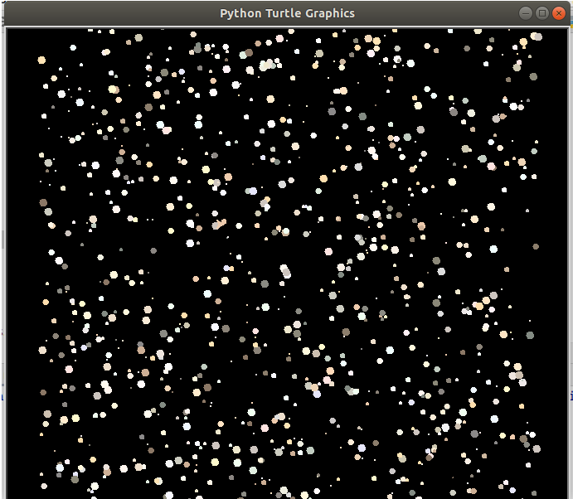
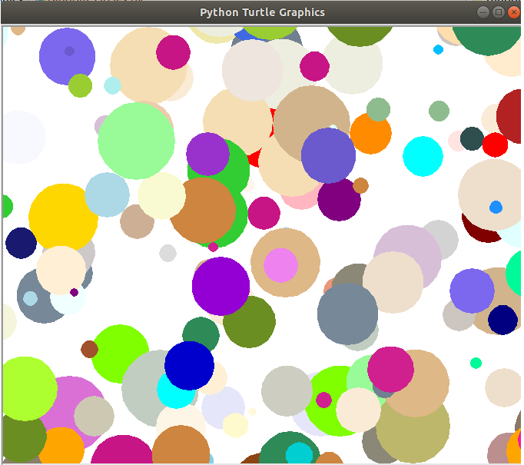
We’ll Create Cool Artwork Like The Following
Notes:
What does the image on the left look lilke?

Slide 30
How to Create a Circle in Python Turtle
turtle.circle(radius, extent=None, steps=None)

Slide 31
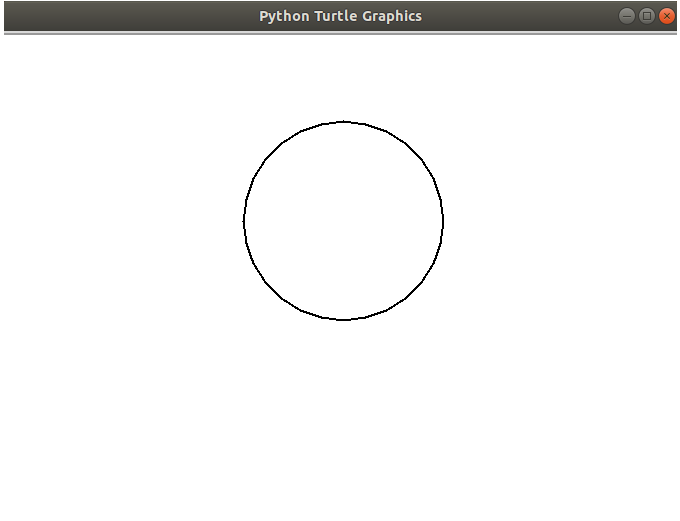
How to Create a Simple Square in Turtle?

Slide 32
Code
import turtle
x = turtle.Turtle()
x.hideturtle()
x.pensize(2)
x.circle(100)
turtle.done()

Slide 33
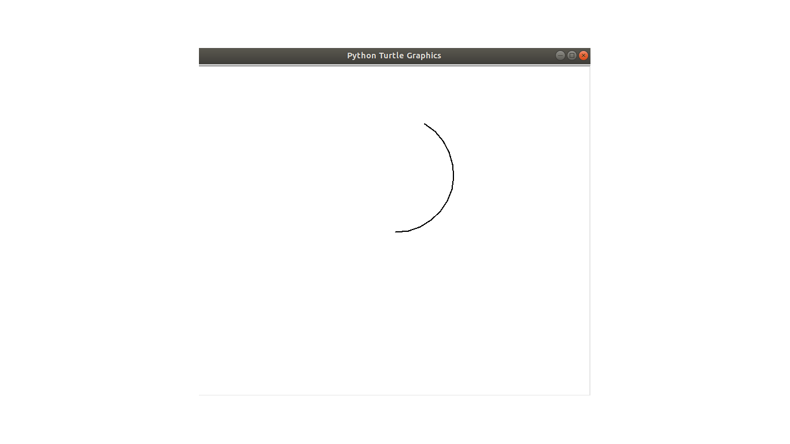
To Create an Arc

Slide 34
Do The Following
import turtle
x = turtle.Turtle()
x.hideturtle()
x.pensize(2)
x.circle(100, extent=150)
turtle.done()

Slide 35
Ok, So How Do We Code A Randomly Generated Night Sky?

Slide 36
Demo of the Night Sky
$ python night.py

Slide 37
Our Checklist
What we know thus far:
How to create circles
How to randomly color objects
What we don’t know:
How to change the background color of the screen
How to randomly position various circles on the screen

Slide 38
How to change the background color?
>>> turtle.Screen().bgcolor('black')

Slide 39
How to randomly position circles on the screen?
There are three methods in turtle that can help out with this:
· penup: Picks the pen up, no drawing happens.
· pendown: Puts the pen down.
· goto(x, y=None): Move the turtle to the x and y coordinates.

Slide 40

Imagine That You’re Drawing

Slide 41
What happens when...
You’re chilling at your desk drawing a masterpiece on a blank piece of paper. What would happen if you decide to pick your pen up and move it to a different position on that same paper? The pen will now appear at the new spot. When you put the tip of your pen back down this is when the drawing happens.

Slide 42
Similar logic in Turtle
The penup and pendown methods operate in a similar fashion to how you draw on a piece of paper. When the penup function is called the pen is in the air, and when the pendown function is called that is like placing the tip of your pen on the paper to start drawing. These two functions are important because when you use the goto function, if you don’t call the penup function then nasty squiggly lines will be drawn along the way, like if you’re sketching a stickman on a piece of paper.

Slide 43
Night Sky Solution
def create_night_sky(stars=1000):
sky = turtle.Turtle()
back_ground = turtle.Screen()
back_ground.bgcolor('black')
num = stars
sky.speed(0)
for x in range(num):
sky.color(whites_and_pastels())
sky.begin_fill()
sky.penup()
sky.goto(randint(-300, 300), randint(-300, 300))
sky.circle(randint(1, 5))
sky.pendown()
sky.end_fill()
turtle.done()

Slide 44
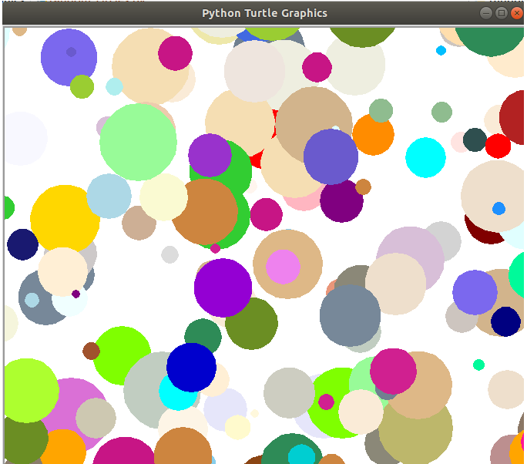
More Circle Art

Slide 45
Demo the Circle Ar
$ python random_circles.py

Slide 46
Source Code here: https://github.com/purcellconsult/Code-Cool-Stuff-With-Python/blob/master/sourcecode/ch_04/random_circles.py

Slide 47
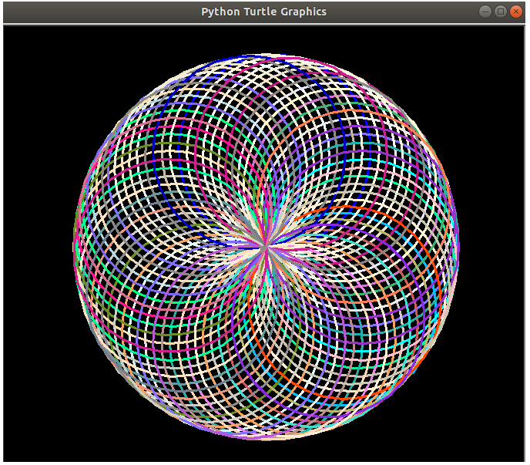
Let’s Create a Spirograph

Slide 48
Show Demo
$ python spirograph_1.py

Slide 49
The Solution
import turtle
from random_colors import get_random_color
def create_circles(cycles=100):
turtle.bgcolor('black')
turtle.pensize(3)
turtle.speed(0)
for i in range(cycles):
turtle.color(get_random_color())
turtle.circle(125)
turtle.right(25)
turtle.done()

Slide 50
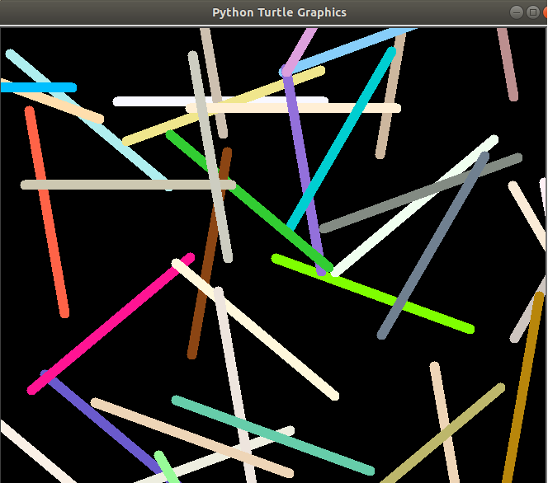
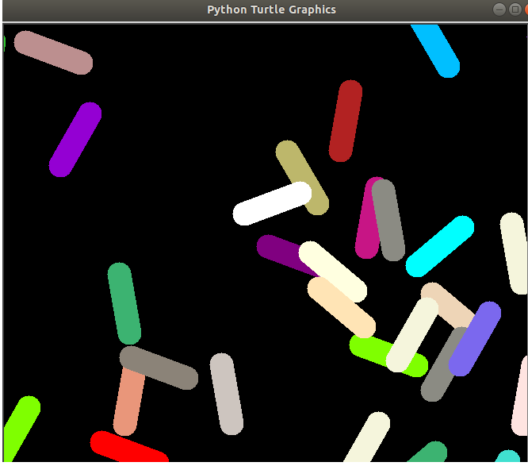
Creating Artwork With Lines in Turtle

Slide 51
How to Create Lines in Turtle?
Simply use the forward function

Slide 52
What Image Does the Following Produce?
import turtle
line = turtle.Turtle()
line.hideturtle()
line.pensize(3)
for x in range(8):
line.forward(200)
line.goto(0, 0)
line.left(45)
turtle.done()

Slide 53
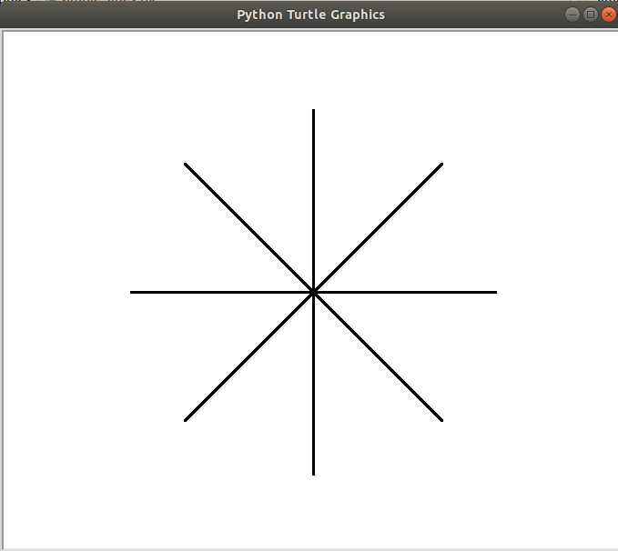

Slide 54
Demo Party Lights
$ python party_lights.py

Slide 55
Solution
https://github.com/purcellconsult/Code-Cool-Stuff-With-Python/blob/master/sourcecode/ch_04/party_lights.py

Slide 56
Show mike and ike demo
$ python mike_and_ike_candies

Slide 57
View the source code
https://github.com/purcellconsult/Code-Cool-Stuff-With-Python/blob/master/sourcecode/ch_04/mike_and_ike_candies.py

Slide 58
One Last Thing to Do With Turtle!
Let’s create a simple racing game.

Slide 59
Let’s Call The Game 4 Little Turtles
a) Create a game that consists of 4 little turtles with unique colors.
b) Include a countdown that starts the game.
c) Create a graphical finish line with the text “Finish Line” directly above it.
d) Randomly generate the speed of the turtles.
e) Write an algorithm to accurately determine which turtle crossed the finish line first.
f) Write a message to let the user know which turtle won.
g) Write a simple algorithm to make the winning turtle spin and then grow in size afterwards.
h) Have fun playing and showing the game off to your friends and family!

Slide 60
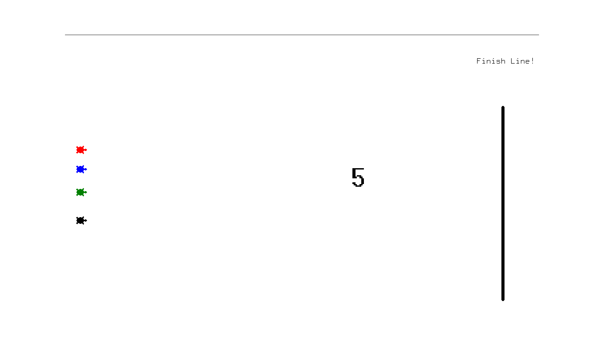
Screenshot 1

Slide 61
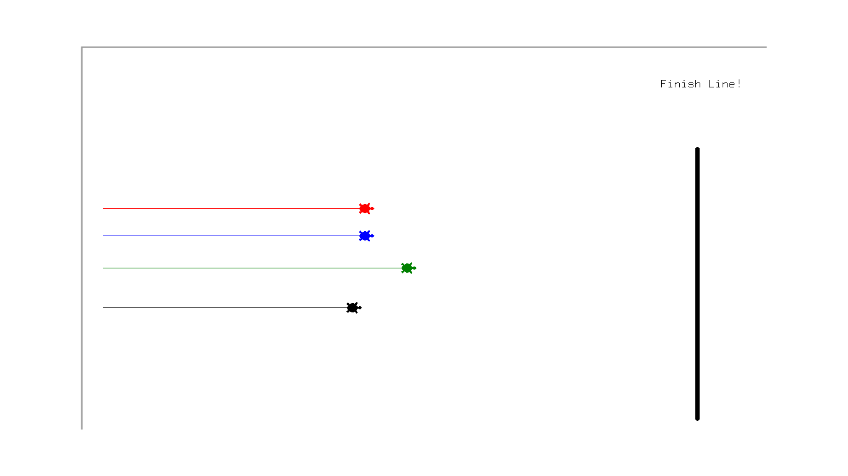
Screenshot 2

Slide 62
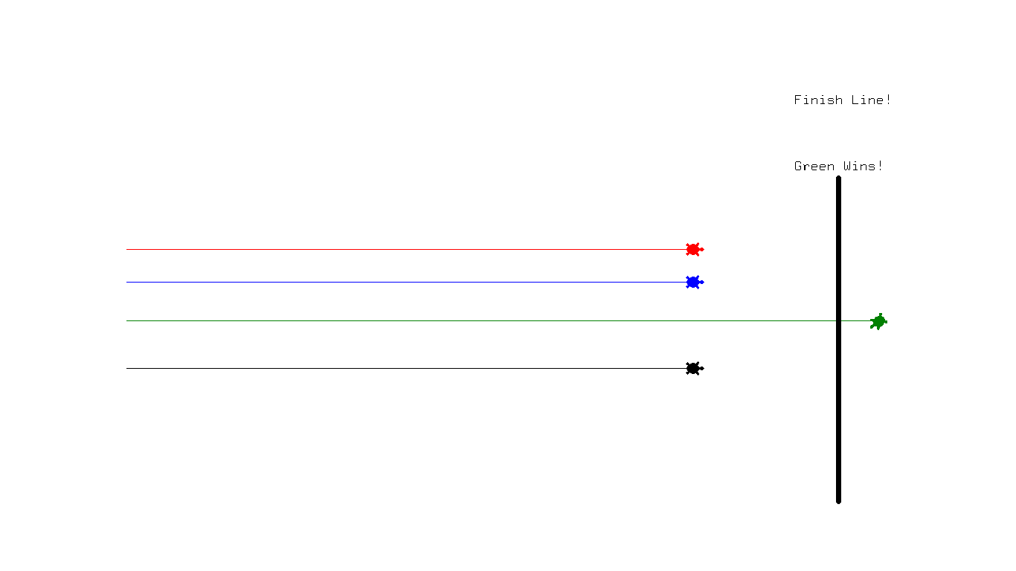
Screenshot 3

Slide 63
Let’s View The Demo
>>> python turtle_racing_game.py
Can anyone guess the winner?

Slide 64
Let’s Define Our Functions
__init__: The constructor which creates the four turtle objects along with getting the height and width of the screen.
start_turtles: Sets the default positions of the turtles.
finish_line: Draws the finish line in the racing game and aligns it on the right hand portion of the screen.
countdown_timer: Starts the countdown timer for the script starting at 5. Use the sleep function from the time module to pause the program.
set_turtle_speeds: Randomly sets the speed of the turtles within the range of 1-25.

Slide 65
Study The Full Source Code
https://github.com/purcellconsult/Code-Cool-Stuff-With-Python/blob/master/sourcecode/ch_04/turtle_racing_game.py

Slide 66
The End :-)

