Slide 1

ZIGBEE Based Coal Mine Safety System Using ARM Microcontroller
Presented by
1)Azhar Uddin:-1410040091 2)Bipasha Dhar:-1410040069
3)Deepa Das:-1410040070 4)Mithun Datta:- 1410040104
5) Ripa Debnath:-1410040076 6)Rupam das:-1410040110
7)Tanmoy Debnath:-1410040120
Under the guidance of :
Mr.Bijit Debbarma
HOD (I/C) (Dept. of ETCE)
North Tripura District Polytechnic,Bagbassa

Slide 2
Flow of presentation
1. Objective
2. Motivation
3. Abstract
4. Introduction
5.ZIGBEE
6.WHY ZIGBEE???
7.REQUIREMENT
8.THERMISTOR
9.MOISTURE SENSOR
10.BLOCK DIAGRAM
11.POWER SUPPLY MODULE
12.GAS SENSOR
13.Conclusion

Slide 3
1. Objective
To develop a social relevant project.
To learn ZIGBEE technology.
To develop a embedded system to provide safety to the mine workers.
To learn embedded system design.

Slide 4
2. Motivation
Coal mine safety is of utmost concern to the health condition of the mine workers.
Due to various unforeseen accidents that occur frequently may be due to leakage of poisonous gases, exceed in safe temperature, increase in humidity and other physical conditions, many workers lose their valuable lives.
To save their valuable lives it motivated us to undergo some sort of model project using ARM microcontroller and connecting it to LCD and necessary material in our further study.

Slide 5
3. Abstract
This paper addresses a cost-effective, flexible solution of underground mine workers’ safety. A module of MEMS based sensors are used for underground environment monitoring and automating progression of measurement data through digital wireless communication technique is proposed with high accuracy, smooth control and reliability.
In this project(ongoing) the research method of Mine Safety Monitoring System based on Zigbee is elaborated, and the hardware design of Zigbee sensor node and system software design are discussed. Zigbee-based Mine Safety Monitoring System can achieve a variety of safety factors of production, and underground environment (such as gas, temperature, humidity and other environmental indicators) for monitoring, controlling mine production, safety management to provide a good basis for decision making.

Slide 6
4. Introduction
Industrial safety is one of the main aspects of industry specially mining industry.
Communication is the main key factor for any industry today to monitor different parameters and take necessary actions accordingly to avoid any types of hazards.
Coal mine safety monitoring system based on wireless sensor network can timely and accurately reflect dynamic situation of staff in the underground regions to ground computer system.

Slide 7
5. ZIGBEE
Zigbee wireless network technology is a new standard launched and made by Zigbee alliance. The alliance , founded in august 2001, is a fast growing and non-profit organization , and it aims to provide consumers with more flexible and easier electronic products.
Zigbee uses free frequency bands of 2.4 GHz and 900 MHz, and its transmission rate is 20 Kbps to 250 Kbps.
In this project(ongoing) we are using standard Zigbee wireless network modules. The Zigbee Module and protocol have been successfully applied to power systems, medical and some other fields.

Slide 8
6.WHY ZIGBEE???
Zigbee is a worldwide open standard for wireless radio networks in the monitoring and control fields. The standard was developed by the Zigbee Alliance(an association of international Companies) to meet following principle needs:
Low cost
Ultra-low power consumption
Use of unlicensed radio bands
Cheap and easy installation
Flexible and extendable networks
Integrated intelligence for network set-up and message routing

Slide 9
7.REQUIREMENT
Hardware To be Used :
Sensor Circuit
Comparator Circuit
ZIGBEE Module
LCD Module
Power supply module
Software To be Used :
Kiel Microvision4
Philips Flash Magic
Embedded C for coding
9

Slide 10
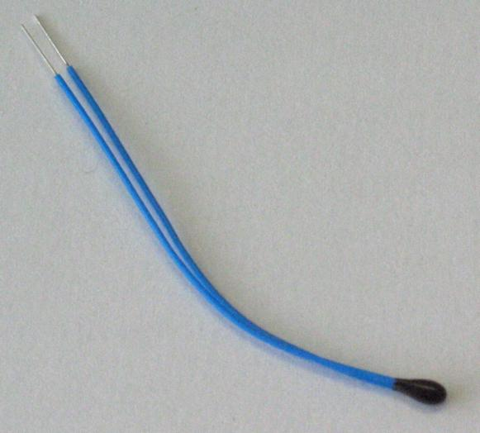
8.THERMISTOR
A thermistor is a type of resistor whose resistance varies significantly with temperature, more so than in standard resistors.
Thermistors are widely used as inrush current limiters, temperature sensors, self-resetting over current protectors and self-regulating heating elements.

Slide 11
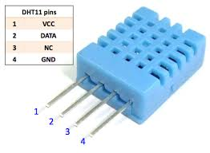
9.MOISTURE SENSOR
Moisture/Humidity is the presence of water in air. The amount of water vapor in air can affect human comfort as well as many manufacturing processes in industries.
Humidity sensing is very important, especially in the control systems for industrial processes and human comfort.
Controlling or monitoring humidity is of paramount importance in many industrial & domestic applications In all such applications and many others, humidity sensors are employed to provide an indication of the moisture levels in the environment.

Slide 12
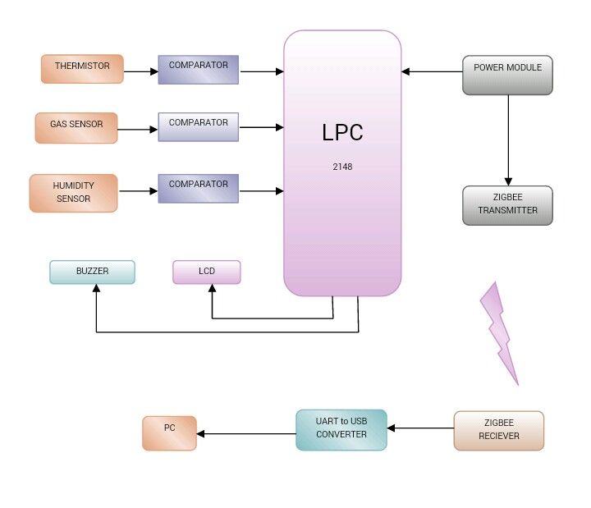
10.BLOCK DIAGRAM

Slide 13
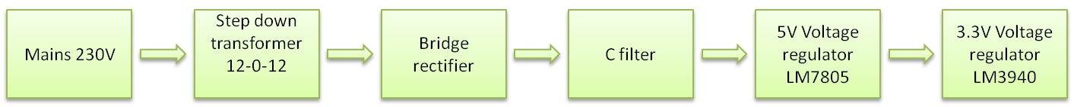
11.POWER SUPPLY MODULE

Slide 14
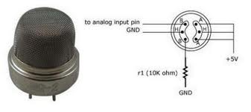
12.GAS SENSOR
A gas detector is a device which detects the presence of various gases within an area, usually as part of a safety system.
This type of equipment is used to detect a gas leak and interface with a control system so a process can be automatically shut down.
Gas detectors can be used to detect combustible, flammable and toxic gases and oxygen depletion. This type of device is used widely in industry and can be found in a variety of locations such as on oil rigs, to monitor manufacture processes and emerging technologies such as photovoltaic.
Fig: MQ2 Gas Sensor.

Slide 15
13.Conclusion
We have studied about various sensors and various interfacing techniques and achieved a rough idea to reach towards our model project.
A through study in detail regarding coding for its proper implementation and display remains to be done.
In fine we are gradually proceeding towards the theoretical implementation of our project(ongoing) and with further study our knowledge about its proper execution is going to be enhanced.

Slide 16
THANK YOU

