Slide 1
Internship Review - Foodiego Food Ordering App
Company: Ziga Infotech Ventures Pvt Ltd, Madipakkam, Chennai
Duration: 16 June 2026 - 15 July 2026
Project: Food Ordering App – Foodiego (Flutter / Firebase)
Name: [Your Name] | Dept: Mobile App Development

Slide 2
Foodiego is a cross-platform food & grocery ordering app for Android, iOS and Web. It solves the problem of manual phone-based ordering which is slow and error-prone. It provides a centralized platform to browse restaurants by cuisine, search dishes, add to cart, place orders and track status in real-time.
Introduction

Slide 3
Ziga Infotech Ventures Pvt Ltd - "Success Delivered"
Location: Madipakkam, Chennai
Works on mobile-first, cloud-backed applications. Provides offline internships with direct mentorship under Project Managers to bridge academic learning and industry requirements.
Company Profile

Slide 4
01
Fast, intuitive interface for browsing restaurants & cuisines
02
Secure sign-in via Mobile OTP and Google Sign-In
03
Cart management restricted to single restaurant
Objectives
04
Real-time order-status notifications via FCM
05
Admin panel to manage restaurants and monitor orders
06
Learn Flutter + Firebase integration (Auth, Realtime DB, Messaging)

Slide 5
System Architecture
No custom server. Client-driven serverless architecture.
1
2
3
Customer
Firebase Authentication
FCM Notification
Flutter App
Realtime Database
Admin Panel
restaurants, cart, orders
Flow: Customer -> Flutter App -> Firebase Authentication -> Realtime Database (restaurants, cart, orders) -> FCM Notification -> Admin Panel. UI updates live using StreamBuilder and onValue listeners.

Slide 6






Proposed System & Capabilities
User Management:
Restaurant Browsing:
Dish Search
Single UID for both OTP & Google login
Live listings, Top chains, Cuisines
across restaurants
Cart:
Order:
Admin:
Add items, live totals
Place order -> orders/{uid} with status "Placed"
Add, edit, delete restaurants

Slide 7
Technologies & Implementation
Frontend: Flutter, Dart
Backend: Firebase Authentication
State: setState + StreamBuilder + CartModel singleton
Single codebase for Android, iOS, Web. Widgets for Hero, Location Picker, Categories, Listings.
Realtime Database (users/{uid}, restaurants/, cart/, orders/), Firebase Cloud Messaging for cart & order notifications.

Slide 8
Testing & Analysis
Tested module-wise on Android Emulator and Chrome.
Module | Test coverage | Observed behavior
Auth | Invalid OTP, unregistered number, cancelled Google login | handled gracefully
Cart | Blocking second restaurant | correctly
Order | Record creation and FCM trigger | verified
Live UI | Changes in Firebase | reflected instantly without refresh

Slide 9
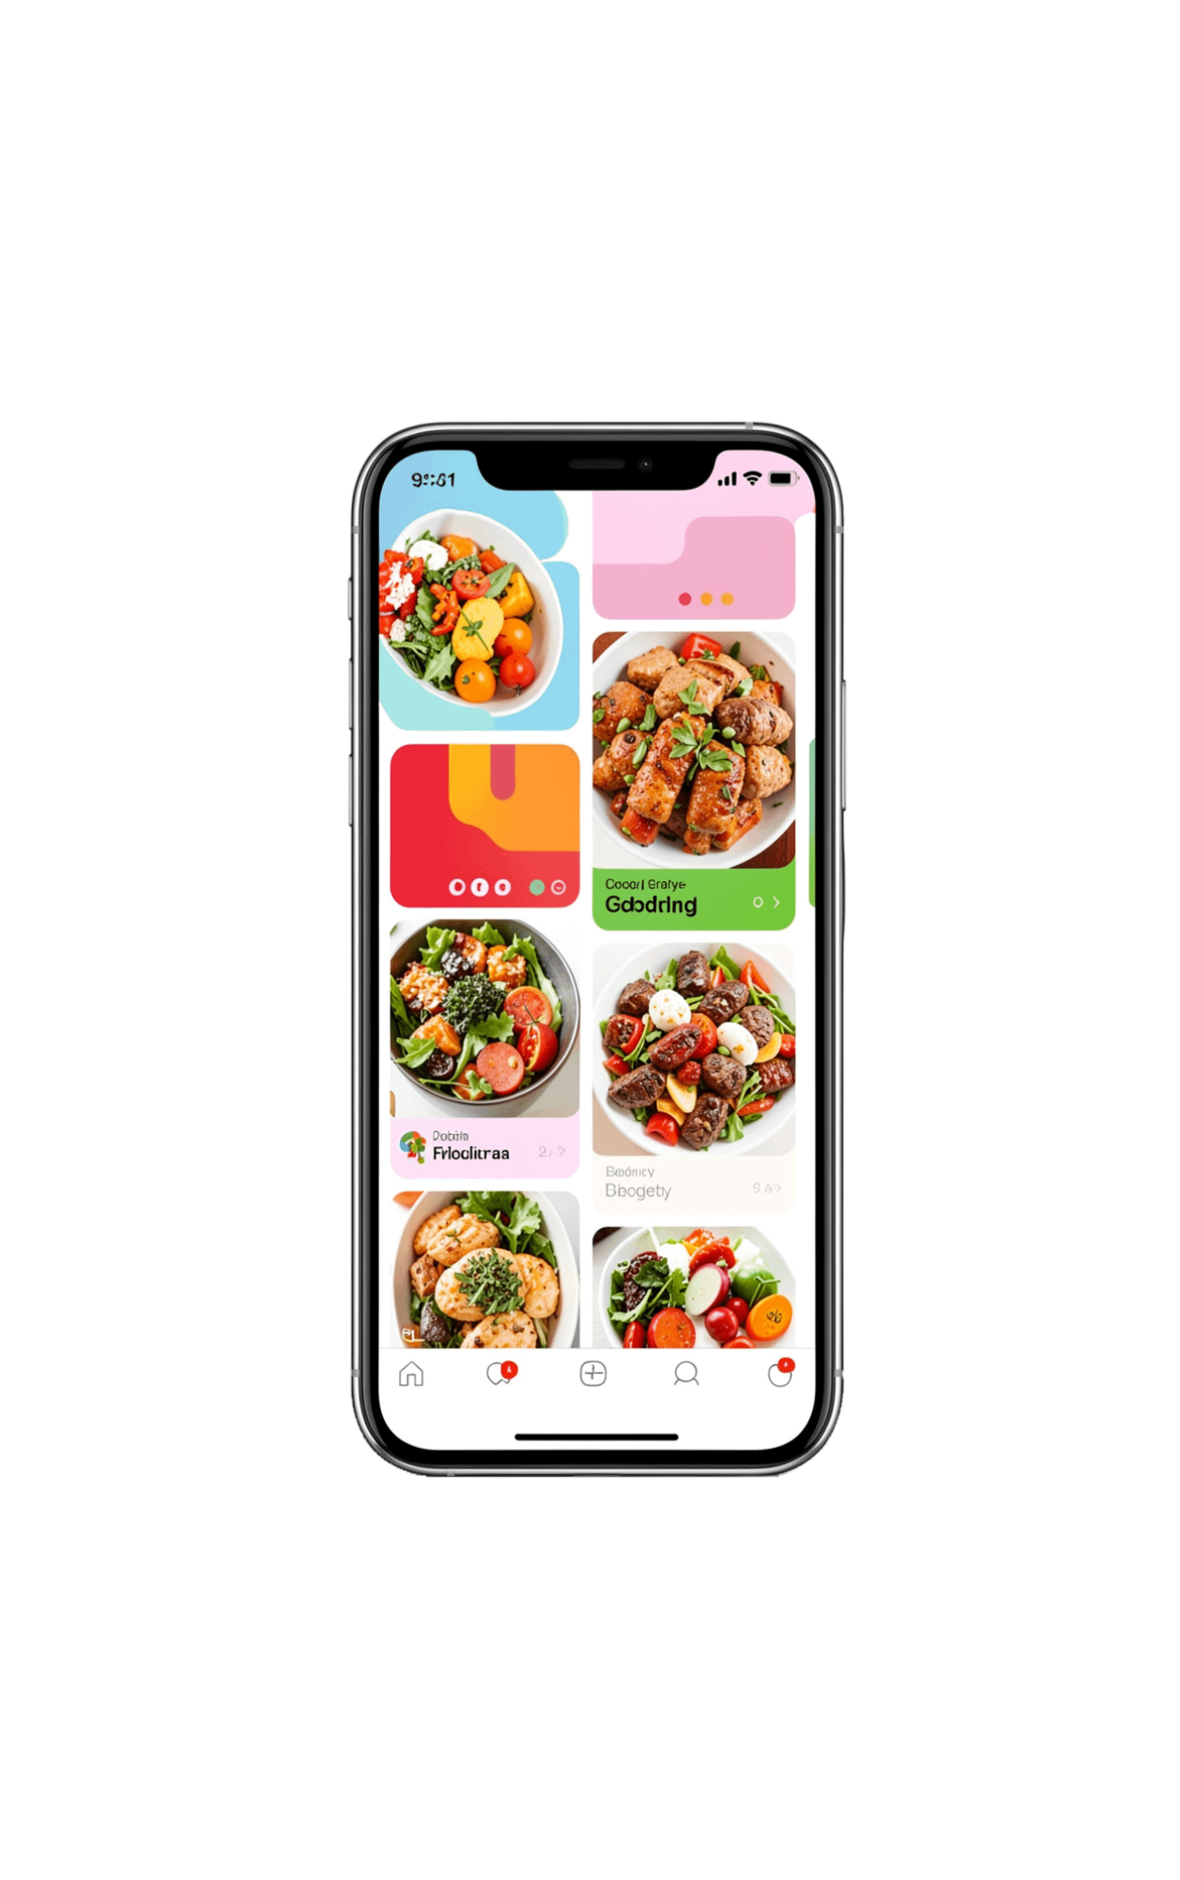
Results / Sample Output
Home Page with hero banner, location (Nandambakkam, Chennai), search bar, cuisine strip (Idli, Dosa, etc.), live restaurant cards with rating, delivery time, offers. Welcome Dialog for Sign Up/Sign In. Cart Page & Order Summary. Admin Add Restaurant Page.

Slide 10
Conclusion & Future Work
Conclusion:
Future:
Successfully demonstrated how Flutter + Firebase can build a complete real-world ordering solution without custom server. Provided hands-on experience in authentication, real-time DB, and push notifications.
Payment gateway (UPI), Live GPS tracking, Ratings & Reviews, AI recommendations, Analytics Dashboard, Multi-language support.
THANK YOU

