Slide 1
Social MEDIA SENTIMENT ANALYSIS
REALTIME TWITTER ANALYSIS
Deepa. A
Dept of CSE,EPCET, 2018-19

Slide 2
USecase
Twitter is a micro-blogging website that has become increasingly popular with the network community. Users update short messages, also known as Tweets, which are limited to 140 characters. Users update their personal opinions on many subjects, discuss current topics and write about life events through tweets. This platform is favoured by many users because it has no political and economic restrictions and is easily available to large number of people. As the number of users increase, micro-blogging platforms are becoming a place to find strong viewpoints and sentiment. People use twitter to forecast and analyse in a lot of different areas.
Sentiment analysis deals with identifying and classifying opinions or sentiments which are present in source text. Social media is generating a huge amount of sentiment rich data in the form of tweets, status updates, reviews and blog posts etc. Sentiment analysis of this user generated data is very useful in knowing the opinion of the crowd.
Dept of CSE,EPCET, 2018-19
Twitter sentiment analysis

Slide 3
DIFFRENCIATOR:
In this project, Twitter Tweets are analyzed Realtime than the Historical Based.
While most previous analysis uses batch processing of social media data, but now days there is a potential need of real time data processing.
This analytics allows an organization the ability to take immediate action for those times when acting within seconds or minutes is significant. The goal is to obtain the insight required to act prudently at the right time - which increasingly means immediately.
Complex event processing (CEP) combines data from multiple sources to detect patterns and attempt to identify either opportunities or threats. The goal is to identify significant events and respond fast. Sales leads, orders or customer service calls are examples.
Operational Intelligence (OI) uses real time data processing and CEP to gain insight into operations by running query analysis against live feeds and event data such as tweets. OI is near real time analytics over operational data and provides visibility over social media data. The goal is to obtain near real time insight using continuous analytics to allow the organization to take immediate action.
Batch data processing is an efficient way of processing high volumes of data is where a group of transactions is collected over a period of time. Data is collected, entered, processed and then the batch results are produced.
In contrast, real time data processing involves a continual input, process and output of data. Data must be processed in a small time period (or near real time). Radar systems, customer services and bank ATMs are examples.
Dept of CSE,EPCET, 2018-19
Twitter sentiment analysis

Slide 4







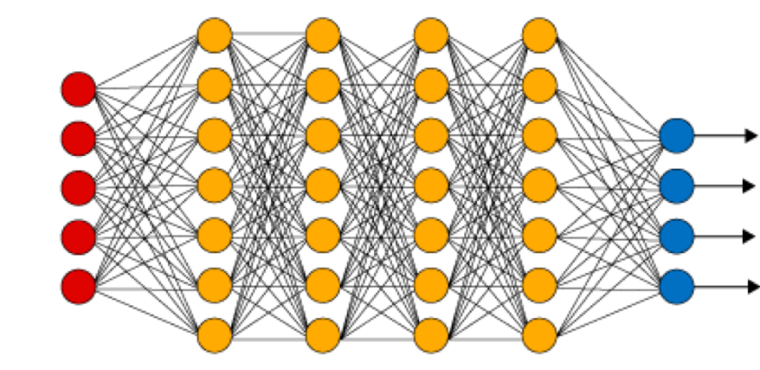


Approach
Data Enrichment
[Extract,
Cleansing,
Transformation]
Core Engine
Elastic Search
Visualization
Twitter API
Indexing, Apis
Deep Learning / Machine Learning
[Language Detection, Sentiment Analysis]
HDFS Checkpoint
Dept of CSE,EPCET, 2018-19
Twitter sentiment analysis

Slide 5
Twitter
Dept of CSE,EPCET, 2018-19
Twitter sentiment analysis

Slide 6
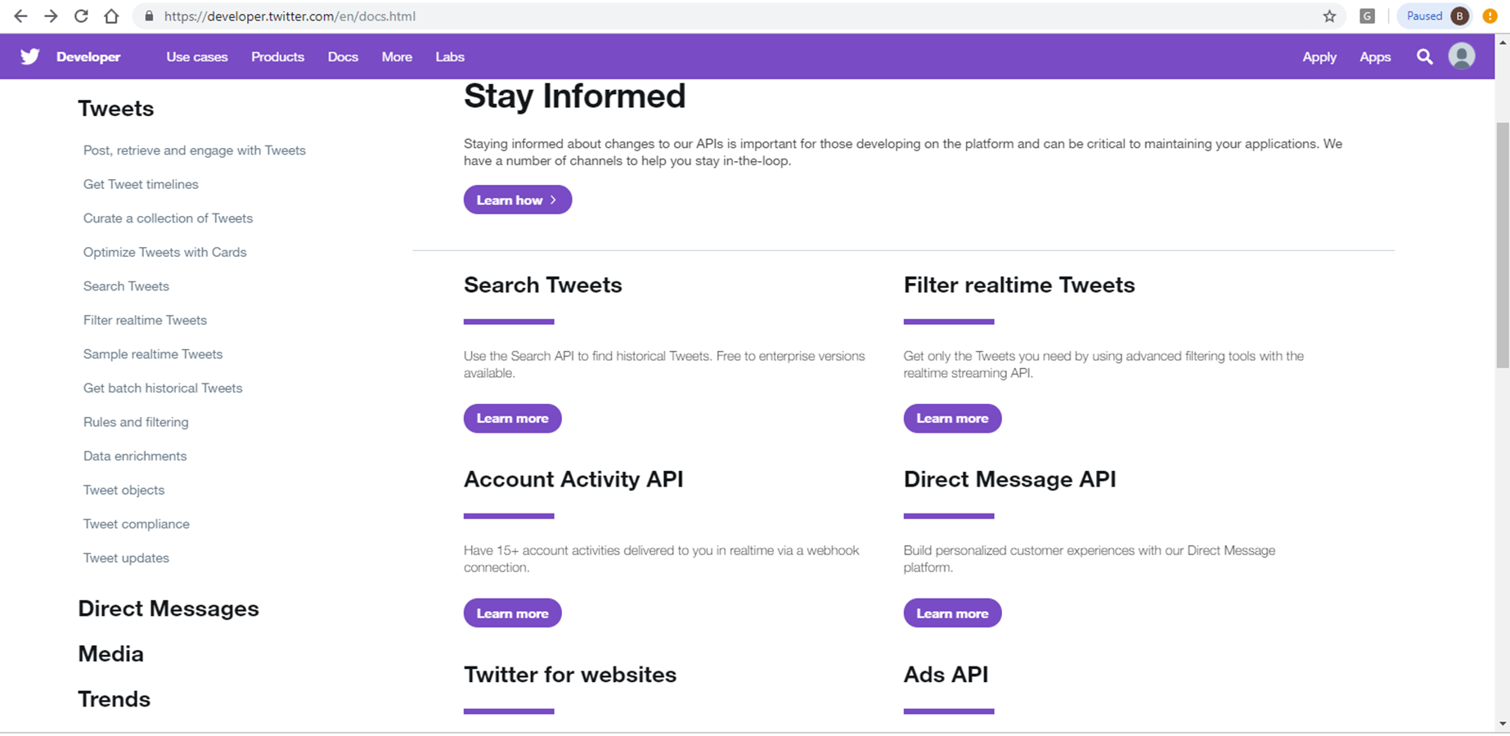
Twitter APIS
Dept of CSE,EPCET, 2018-19
Twitter sentiment analysis

Slide 7
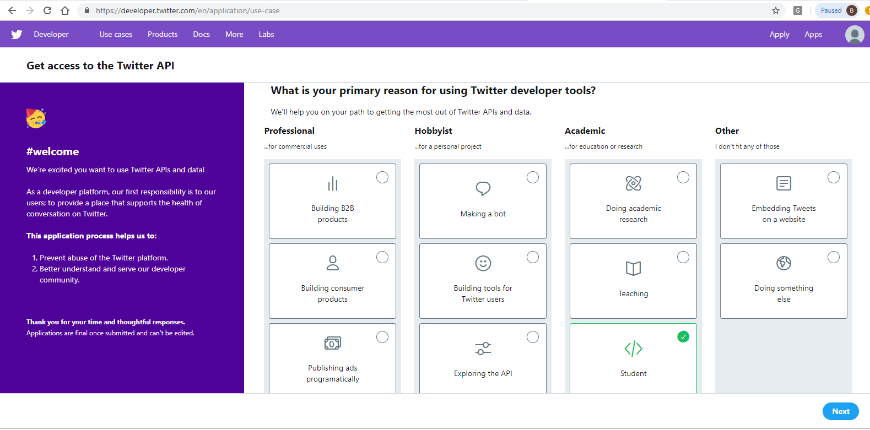
Twitter DEVELOPER ACCOUNT
Dept of CSE,EPCET, 2018-19
Twitter sentiment analysis

Slide 8
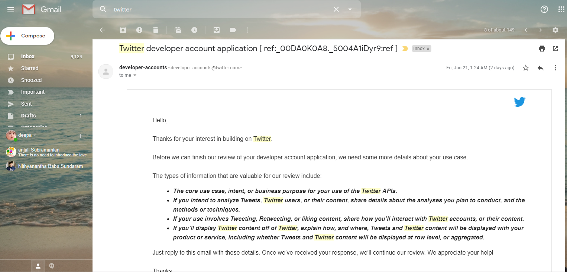
Twitter DEVELOPER ACCOUNT - REVIEW
Dept of CSE,EPCET, 2018-19
Twitter sentiment analysis

Slide 9
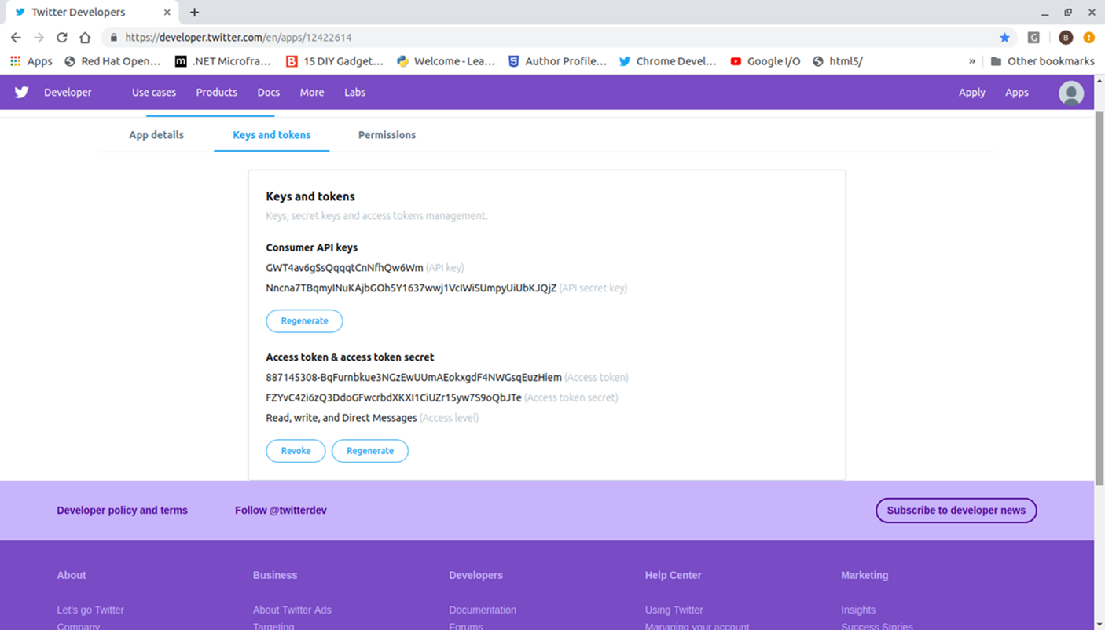
Twitter DEVELOPER ACCOUNT - REVIEW
Dept of CSE,EPCET, 2018-19
Twitter sentiment analysis

Slide 10
SPARK STREAMING
Dept of CSE,EPCET, 2018-19
Twitter sentiment analysis

Slide 11
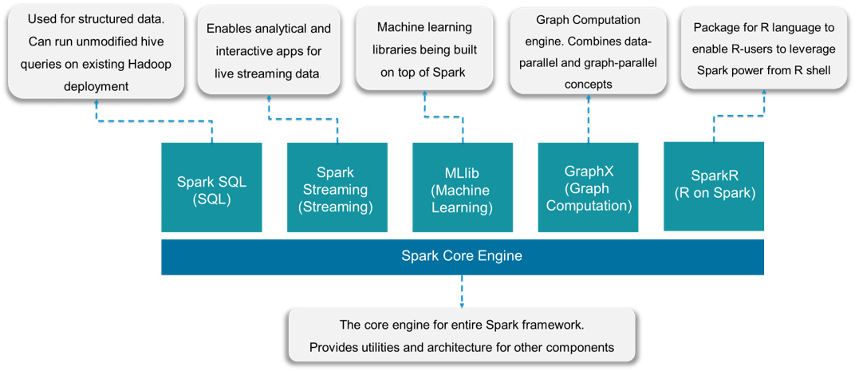
SPARK
Apache Spark™ is a unified analytics engine for large-scale data processing.
Dept of CSE,EPCET, 2018-19
Twitter sentiment analysis

Slide 12
WHY SPARK ?
Apache Spark | Hadoop MapReduce
Parallel Processing Framework | Parallel Processing Framework
Real-time processing | Batch Processing
Stores data in-memory | Read and writes from disk
Up to 100x faster in memory [OR] 10x faster on disk than MapReduce | Fast, but slower than spark
Written in Scala | Written in Java
Real-time or batch processing for big data analysis | Batch Processing for big data analysis
Cost is higher due to RAM Storage requirement | Cost is lower due to disk memory
Dept of CSE,EPCET, 2018-19
Twitter sentiment analysis

Slide 13
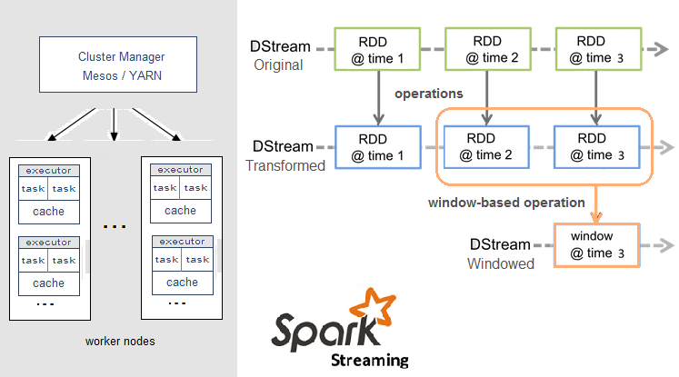
SPARK STREAMING
Dept of CSE,EPCET, 2018-19
Twitter sentiment analysis

Slide 14
STANFORD NLP
Stanford CoreNLP provides a set of natural language analysis ML Framework written in Java.
It can take raw human language text input and give the base forms of words, their parts of speech, whether they are names of companies, people, etc., normalize and interpret dates, times, and numeric quantities, mark up the structure of sentences in terms of phrases or word dependencies, and indicate which noun phrases refer to the same entities.
It was originally developed for English, but now also provides varying levels of support for (Modern Standard) Arabic, (mainland) Chinese, French, German, and Spanish.
Stanford CoreNLP is an integrated framework, which make it very easy to apply a bunch of language analysis tools to a piece of text. Starting from plain text, you can run all the tools with just two lines of code.
Its analyses provide the foundational building blocks for higher-level and domain-specific text understanding applications.
Stanford CoreNLP is a set of stable and well-tested natural language processing tools, widely used by various groups in academia, industry, and government. The tools variously use rule-based, probabilistic machine learning, and deep learning components.
Dept of CSE,EPCET, 2018-19
Twitter sentiment analysis

Slide 15


Elastic search
Dept of CSE,EPCET, 2018-19
Twitter sentiment analysis

Slide 16
ELASTIC SEARCH
Elasticsearch is an open-source, RESTful, distributed search and analytics engine built on Apache Lucene.
It is commonly used for log analytics, full-text search, security intelligence, business analytics, and operational intelligence use cases.
Elasticsearch combines the speed of search instances with the power of analytics for better decision making. It gives insights that make your business streamlined and improves your products by interactive search and other analyzing features.
ElasticSearch is a schema-less database that has powerful search capabilities and is easy to scale horizontally.
Dept of CSE,EPCET, 2018-19
Twitter sentiment analysis

Slide 17

KIBANA
Dept of CSE,EPCET, 2018-19
Twitter sentiment analysis

Slide 18
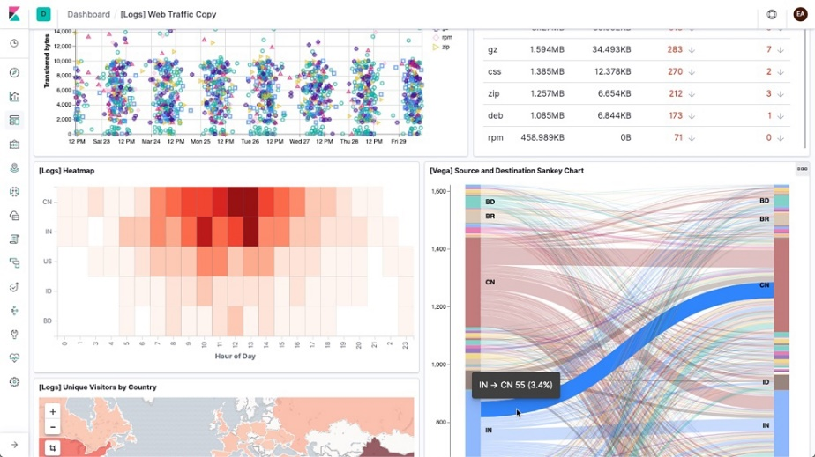
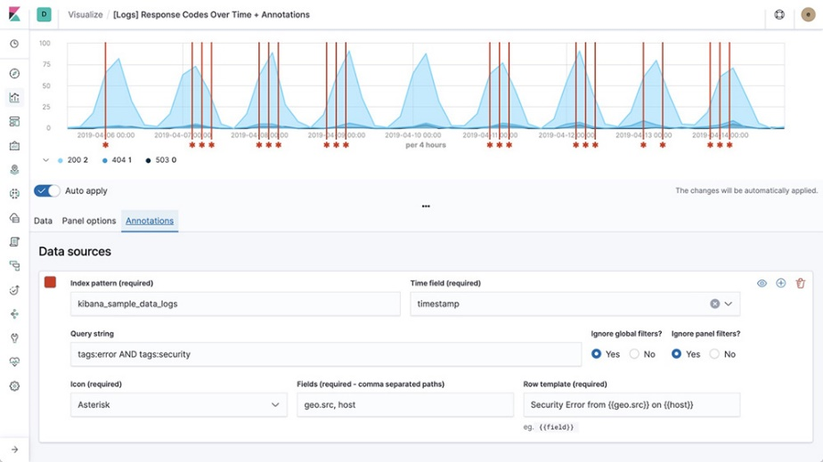
Kibana
Kibana lets you visualize our Elasticsearch Analysis data and navigate the entire transformed modeled data.
Kibana core ships with the classics: histograms, line graphs, pie charts, sunbursts, and more. All leverage the full aggregation capabilities of Elasticsearch.
Perform advanced time series analysis on your Elasticsearch data with our curated time series UIs. Describe queries, transformations, and visualizations with powerful, easy-to-learn expressions.
Dept of CSE,EPCET, 2018-19
Twitter sentiment analysis

Slide 19
< > Code WALKTHROUGH
Dept of CSE,EPCET, 2018-19
Twitter sentiment analysis

Slide 20
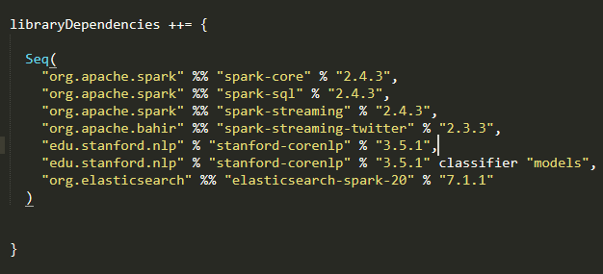
LIBARARIES USED
Dept of CSE,EPCET, 2018-19
Twitter sentiment analysis

Slide 21
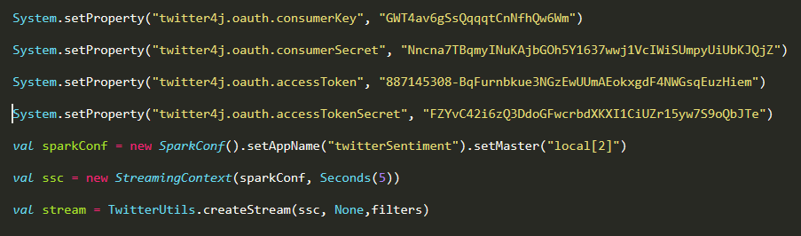
TWITTER -> SPARK STREAMING
Dept of CSE,EPCET, 2018-19
Twitter sentiment analysis

Slide 22
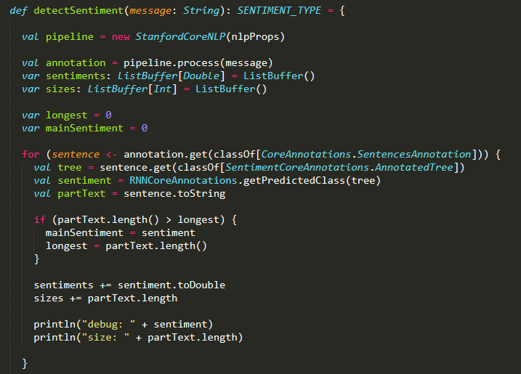
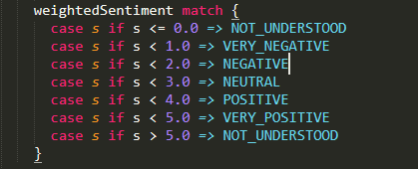
NLP SENTIMENT ANALYSER - CODE WALKTHROUGH
Dept of CSE,EPCET, 2018-19
Twitter sentiment analysis

Slide 23
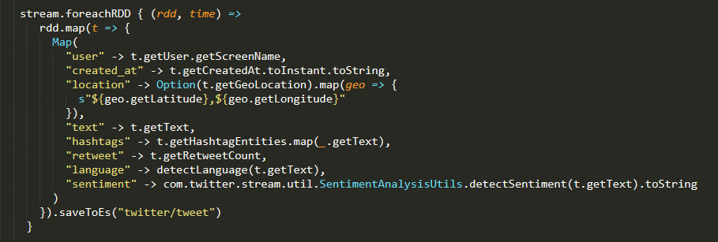
LANGUAGE DETECTION / SEND TO ELASTIC SEARCH
Dept of CSE,EPCET, 2018-19
Twitter sentiment analysis

Slide 24
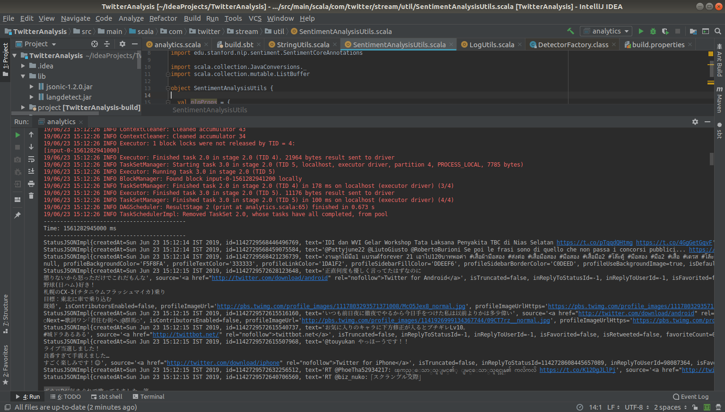
SPARK – STREAMING – REALTIME
Dept of CSE,EPCET, 2018-19
Twitter sentiment analysis

Slide 25
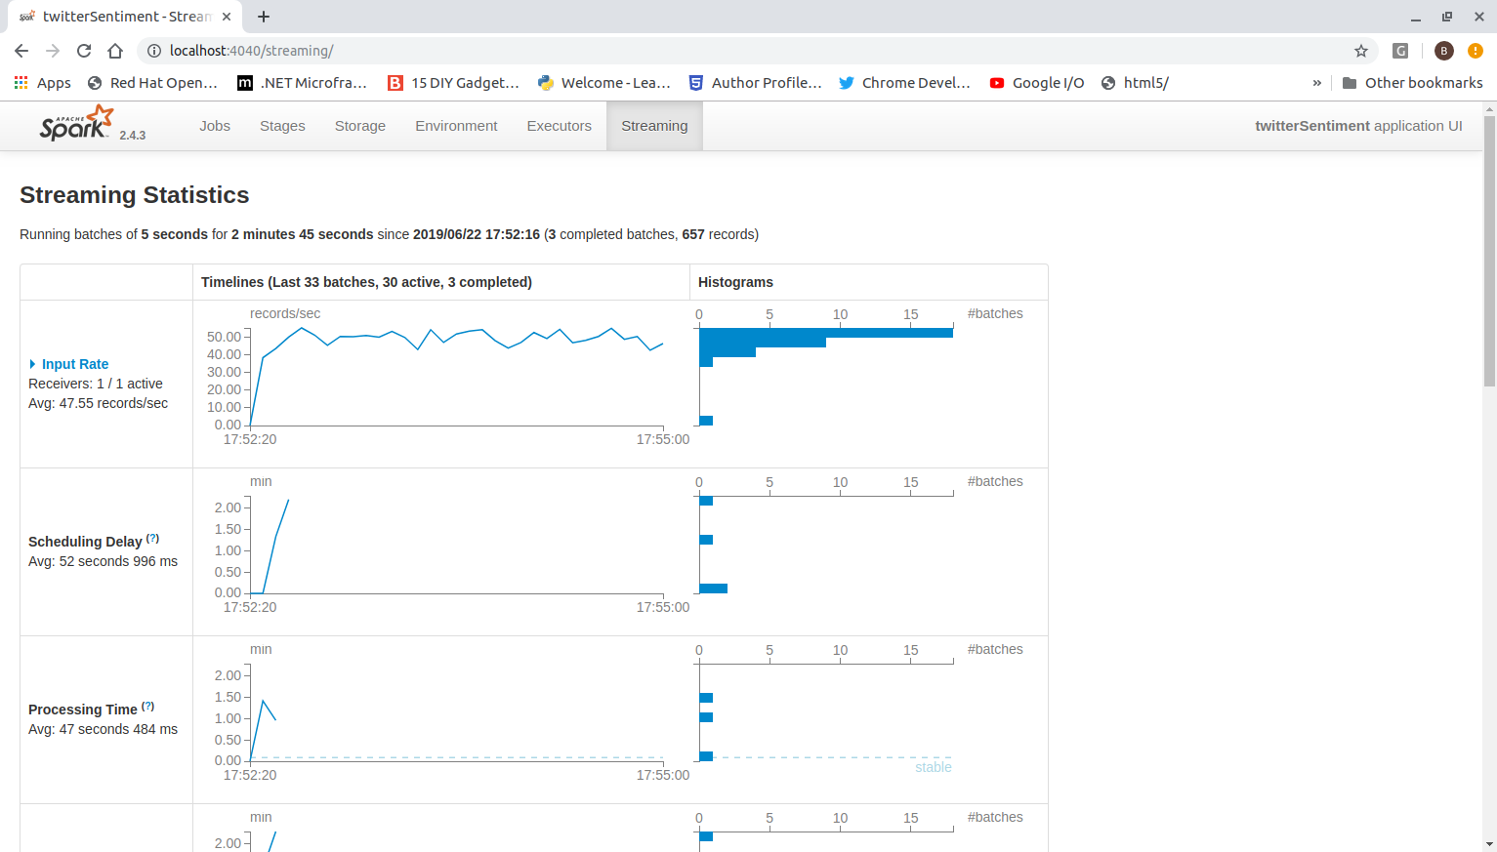
SPARK STREAMING EXECUTION
Dept of CSE,EPCET, 2018-19
Twitter sentiment analysis

Slide 26
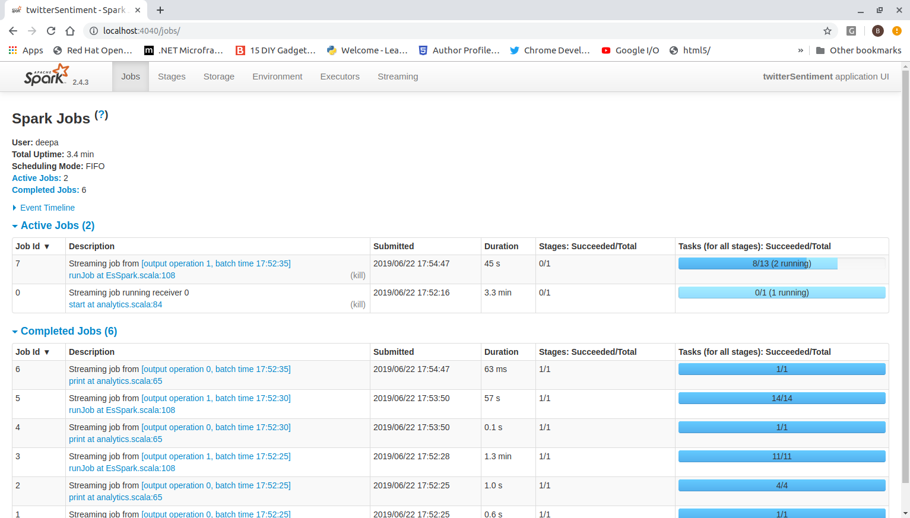
SPARK STREAMING EXECUTION
Dept of CSE,EPCET, 2018-19
Twitter sentiment analysis

Slide 27
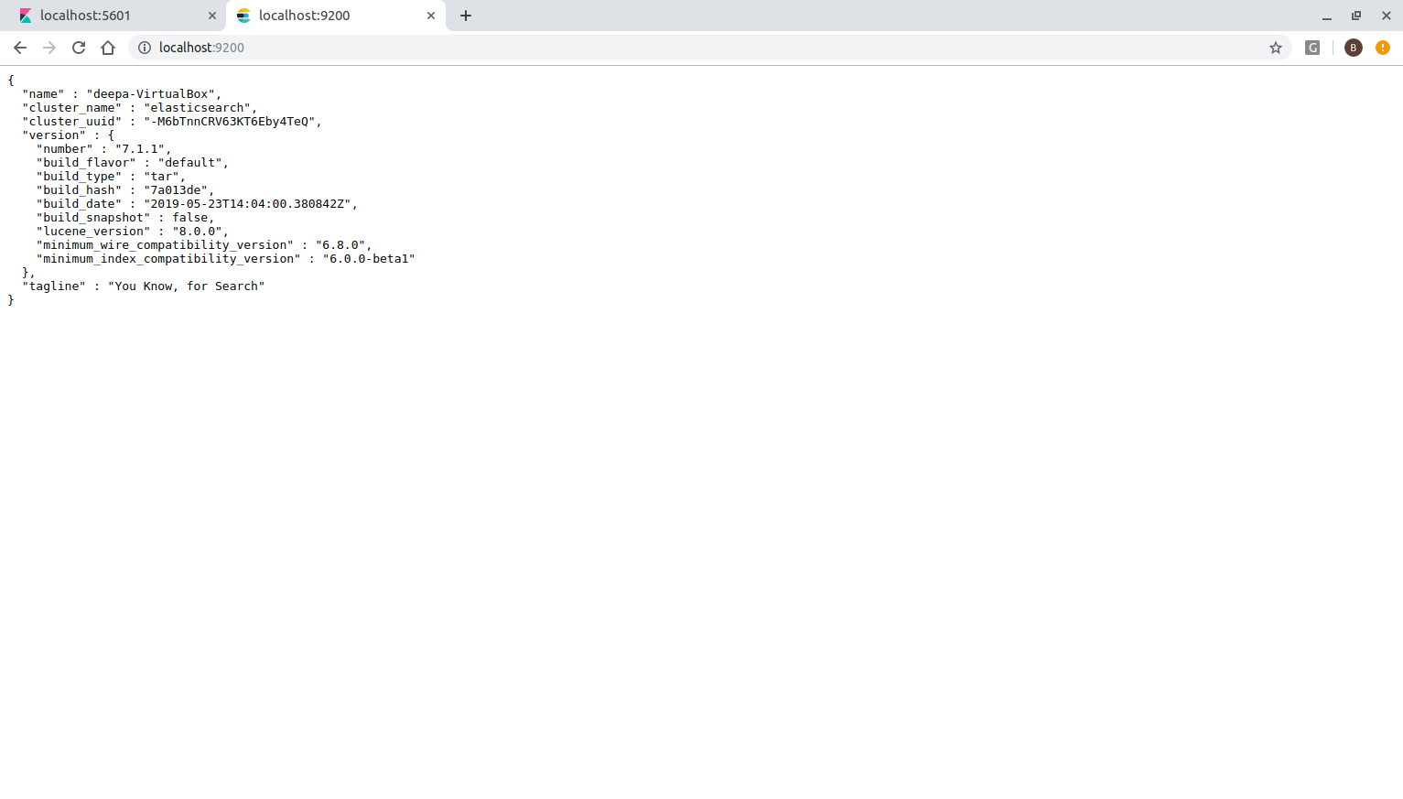
ELASTIC SEARCH - API
Dept of CSE,EPCET, 2018-19
Twitter sentiment analysis

Slide 28
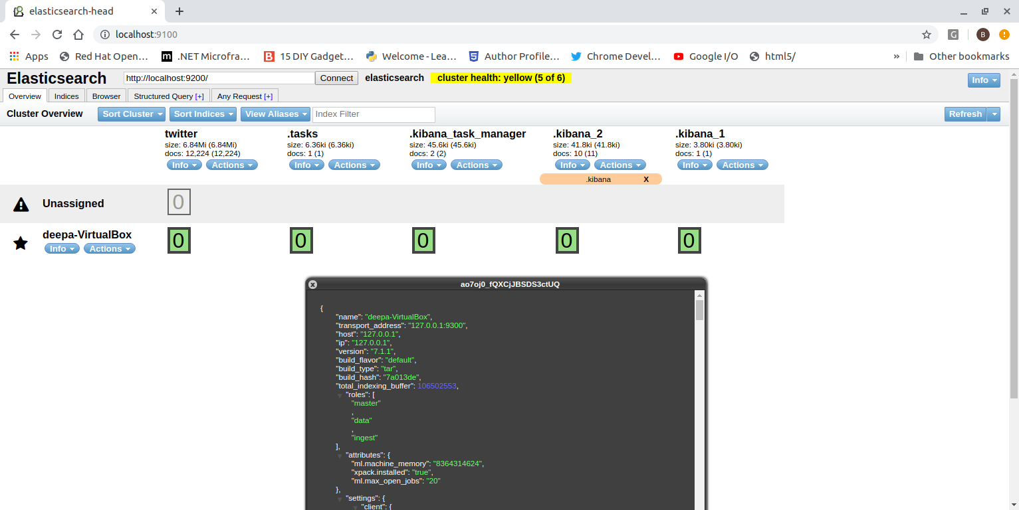
ELASTIC SEARCH – SENTIMENTS INGESTION
Dept of CSE,EPCET, 2018-19
Twitter sentiment analysis

Slide 29
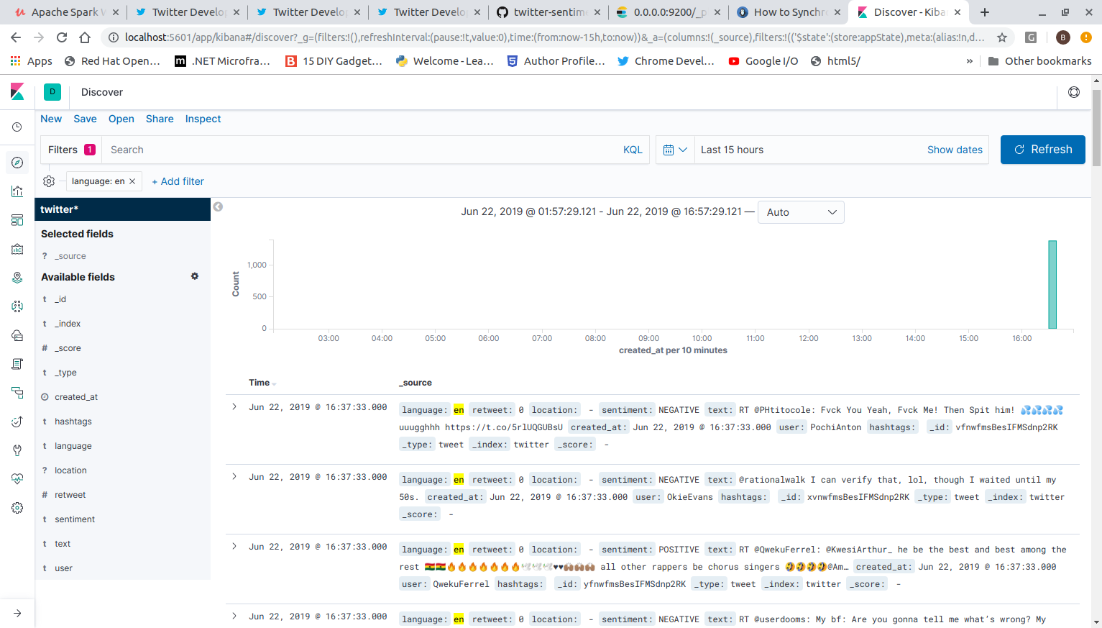
KIBANA – TWEETS INDEX
Dept of CSE,EPCET, 2018-19
Twitter sentiment analysis

Slide 30
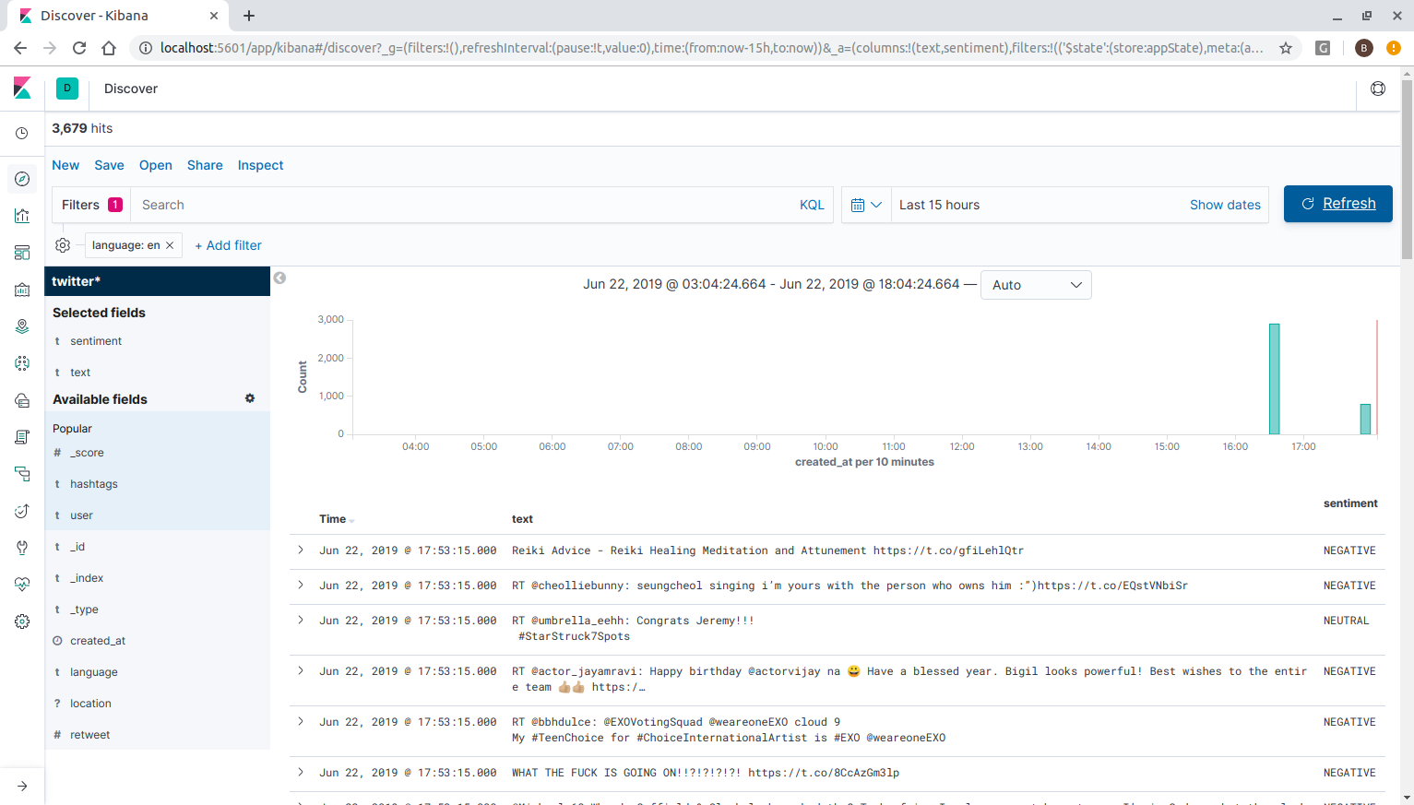
KIBANA – TWEETS INDEX BY SENTIMENTS
Dept of CSE,EPCET, 2018-19
Twitter sentiment analysis

Slide 31
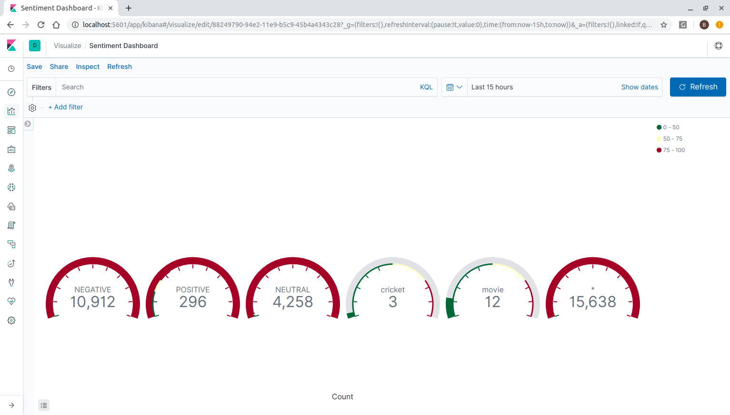
KIBANA – REALTIME SENTIMENTS – GUAGE VIZUALIZATION
Dept of CSE,EPCET, 2018-19
Twitter sentiment analysis

Slide 32
KIBANA – TWEETS INDEX BY SENTIMENTS
Dept of CSE,EPCET, 2018-19
Twitter sentiment analysis

Slide 33
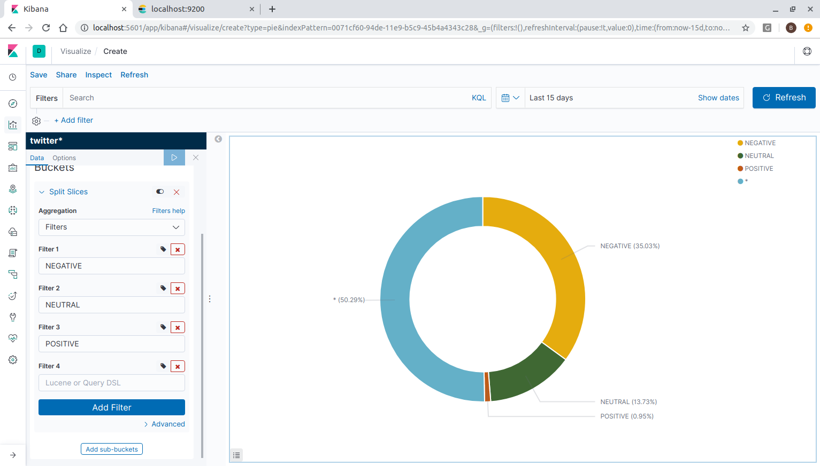
KIBANA – TWEETS SENTIMENTS BY %
Dept of CSE,EPCET, 2018-19
Twitter sentiment analysis

Slide 34
Conclusion
This project has demonstrated the optimized way of extracting the sentiment information from twitter’s social media tweet sources and using it as a general trend predictor.
While opinion data remain a useful sort of information for determining overall market sentiment, they are often difficult to analyse and, since they are often focused on conveying nuanced information, may contain mixed messages. By leveraging deep learning and neural networks as trained in the project will result in business intelligence to understand the subjective reasons why people are or are not responding to popular events in the market.
This project will be useful for creating inputs to a model that recognize context, tone, and previous indications of sentiment can help increase accuracy and get a better overall sense of the people opinions on the matter.
Dept of CSE,EPCET, 2018-19
Twitter sentiment analysis

