Slide 1
Train Ticket Generation
Reporting by: Ashwini H
Shahbaz
Deepak V
Sai Bharadwaj

Slide 2
Overview
Title : Train Ticket Generation
Problem Statement
Requirement
Approach by - Core Java - Spring MVC

Slide 3
Problem Statement
The application should generate a train ticket using the train details and passenger details. The generated ticket should contain the following details
PNR Number, Travel date, Train Number, Train Name, Source Station, Destination Station
Name, age, gender and ticket fare for each passenger
Total Ticket price
The generated ticket should be written to a File.

Slide 4
Requirement
The Trains should be fetched from database using train number
Travel date should be after current Date
The PNR number should be auto-generated by adding first character of source station, first character of destination station, travel date(yyyymmdd).
The ticket Fare for each passenger is calculated using the following rules -> For age < = 12, fare is 50% of ticket price regardless of gender -> For age > = 60, fare is 60% of ticket price regardless of gender -> For Females, 25% discount on the ticket price
The file name for storing the generated ticket should be the PNR Number.
The Ticket details should be stored in a file. The passenger’s should written in ascending order based on name.

Slide 5
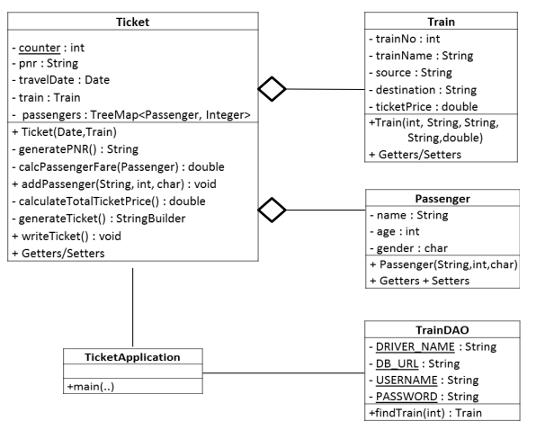
Core Java

Slide 6
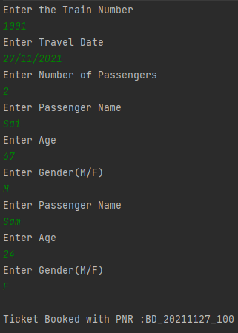
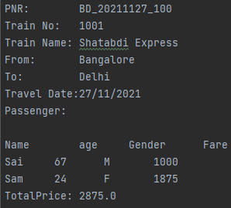
Core Java
Output
Ticket File

Slide 7
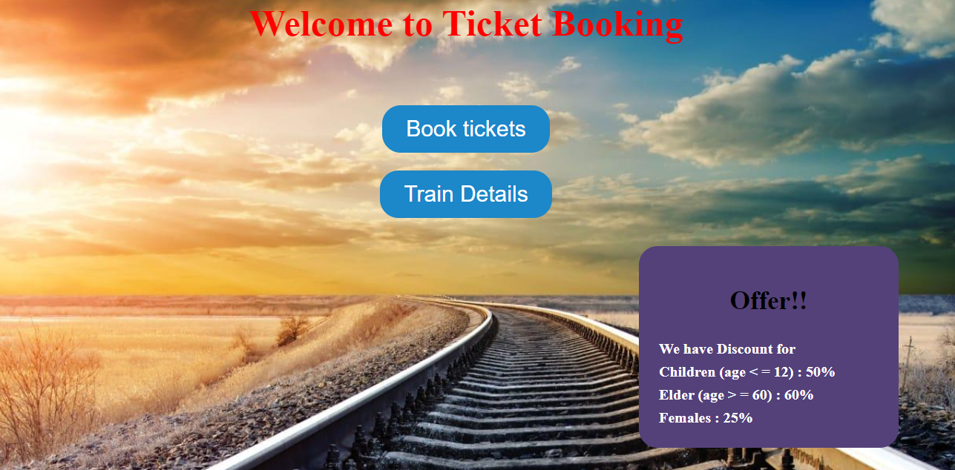
Spring MVC-Flow
Home Page

Slide 8
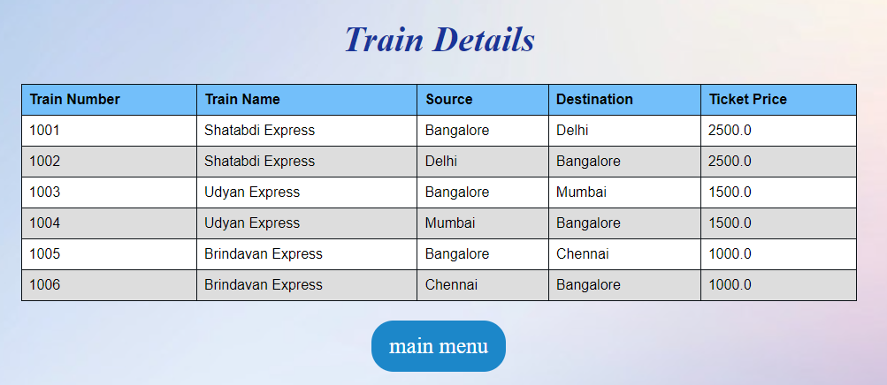
Train Details Page

Slide 9
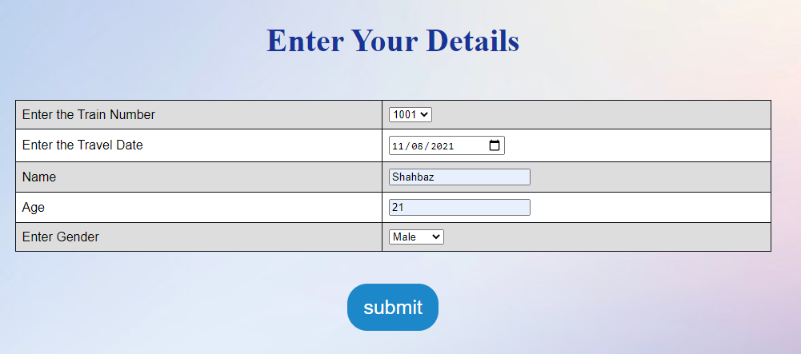
Passenger Details Page

Slide 10
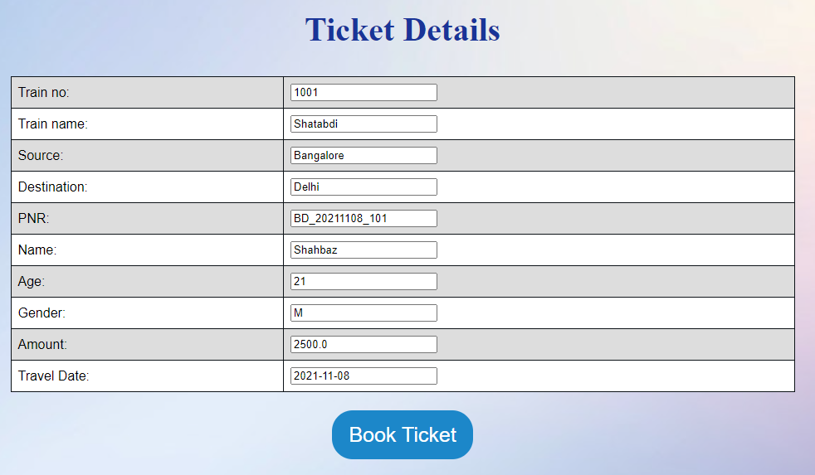
Ticket Details Page

Slide 11
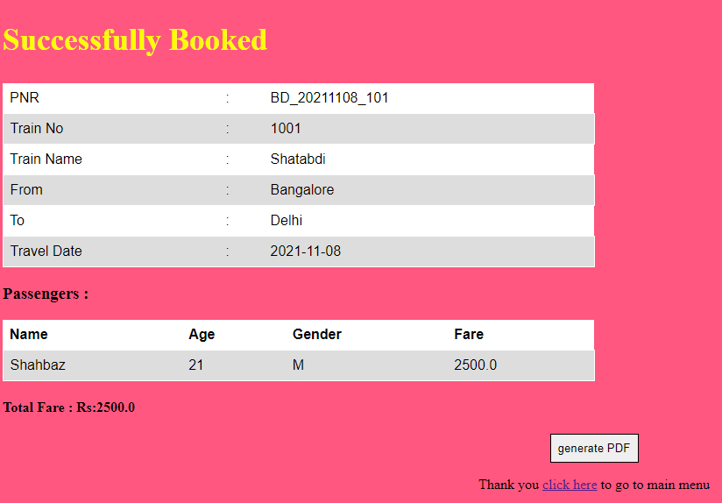
Confirmation Page

Slide 12
Thank YOU

