Slide 1

SQL Server DevOps
Scott Sauber
Slides up at scottsauber.com
scottsauber

Slide 2

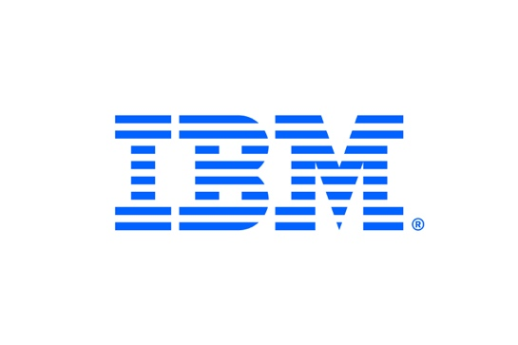





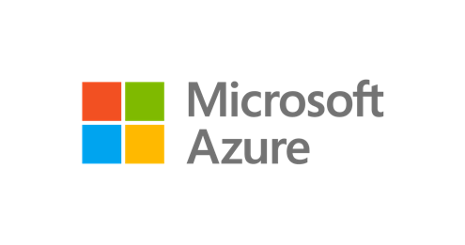
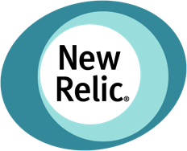












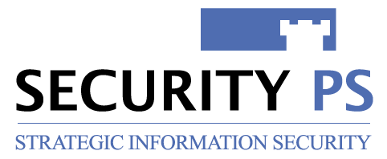















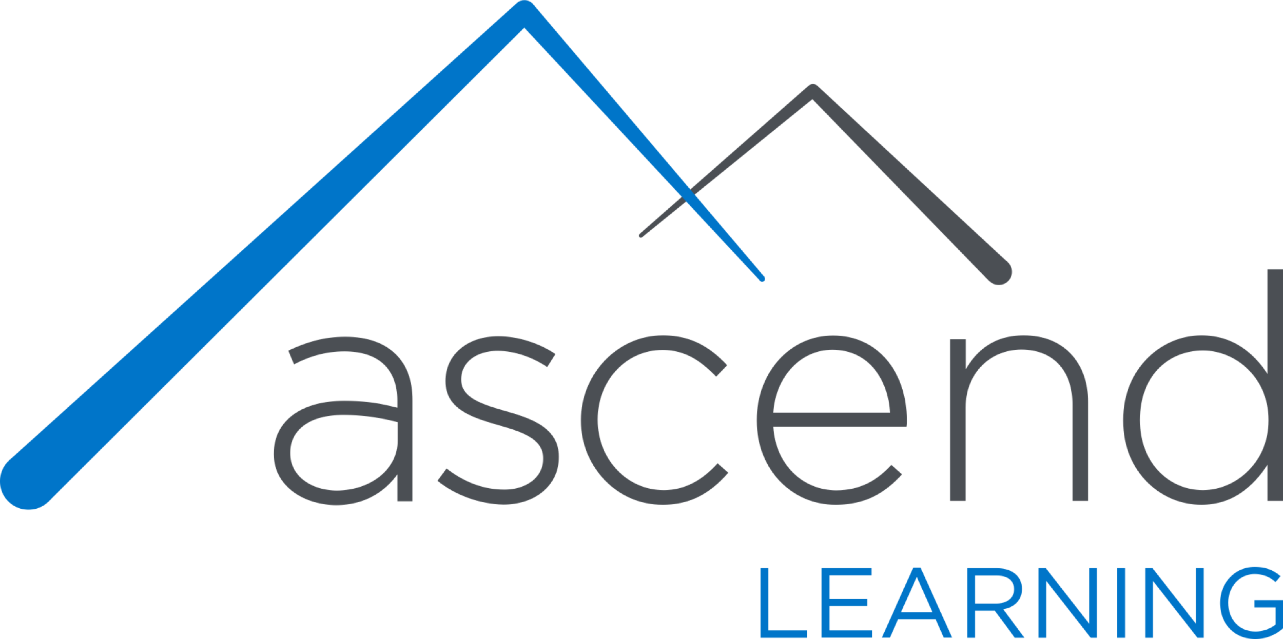








Titanium Sponsors
Platinum Sponsors
Gold Sponsors

Slide 3

Audience
Developers + DBA’s who want to automate their SQL Server builds and deployments
Unsure where to get started
Familiar with SQL Server and it’s terminology
Tables, Views, Stored Procedures, Functions, Triggers, etc.
Poll
Devs?
DBAs?
Managers?
Other?
scottsauber

Slide 4
Agenda
What choices do I need to make?
What are the tradeoffs?
What tools are out there?
What hurdles will I face?
Demos
Questions
scottsauber

Slide 5
Purpose
Ramp up on how to implement automation to your SQL Server
Know the options and tradeoffs of different approaches and tools
scottsauber

Slide 6

Who am I?
Software Consultant at Lean TECHniques
Developer (not a DBA) and big proponent of DevOps
Successfully implemented SQL DevOps Pipeline for over a dozen db’s
Including 25 year old SQL Server db
Blog at scottsauber.com
scottsauber
Notes:
25 year old DB that was multi-tenant where each customer had their own DB instances, each DB had thousands of DB objects, stored procedures that used Linked Servers, dead stored procedures referencing removed columns, etc.

Slide 7
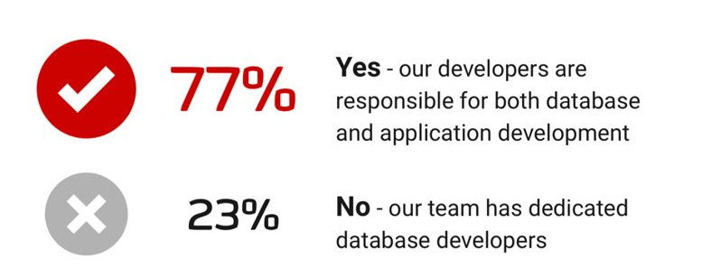
Types of team interactions with DB’s
Devs write, review, and deploy the SQL. No dedicated DBA.
Devs write the SQL and give to DBA to review and deploy.
Devs tell DBA’s what they want, DBA’s write, review and deploy the SQL.
scottsauber

Slide 8
What a manual workflow may look like today
Compare approach (i.e. RedGate SQL Compare)
Developer/DBA works on a development DB
That DB is then compared to a Prod or Prod-like DB to compare changes
Tool generates script to deploy
Script is deployed to Prod
SQL Script approach
Developer/DBA works on a development DB
Developer/DBA accumulates scripts
Developer/DBA runs scripts against Prod
scottsauber

Slide 9
What’s wrong with these approaches?
No Source Control
No traceability
No easy rollbacks
Manual
Tedious
Easy for mistakes
Script order can get out of whack
Development DB + Prod DB could be out of sync
Changes in behavior
Overwriting others (sprocs, views)
Hard to pull in others changes (no forced CI)
scottsauber

Slide 10
What is DevOps?
“DevOps is the union of people, process, and products to enable continuous delivery of value to our end users.”
- Donovan Brown

Slide 11
What is DevOps?
“DevOps is the union of people, process, and products to enable continuous delivery of value to our end users.”
- Donovan Brown

Slide 12
What is DevOps?
“DevOps is the union of people, process, and products to enable continuous delivery of value to our end users.”
- Donovan Brown

Slide 13
What is DevOps?
“You can’t change culture and process with a credit card.”
- Julie Gunderson

Slide 14
Desired Outcomes of SQL Server DevOpsifying
In order of importance:
Database is source controlled
Database deployments are at most a single click of a button
Database builds for verification on each commit
Monitor production database for out-of-band changes
This one is fun because people.
scottsauber
Notes:
This one is fun because the people who need to implement the monitoring are the ones who are the only ones who can make changes to production.

Slide 15
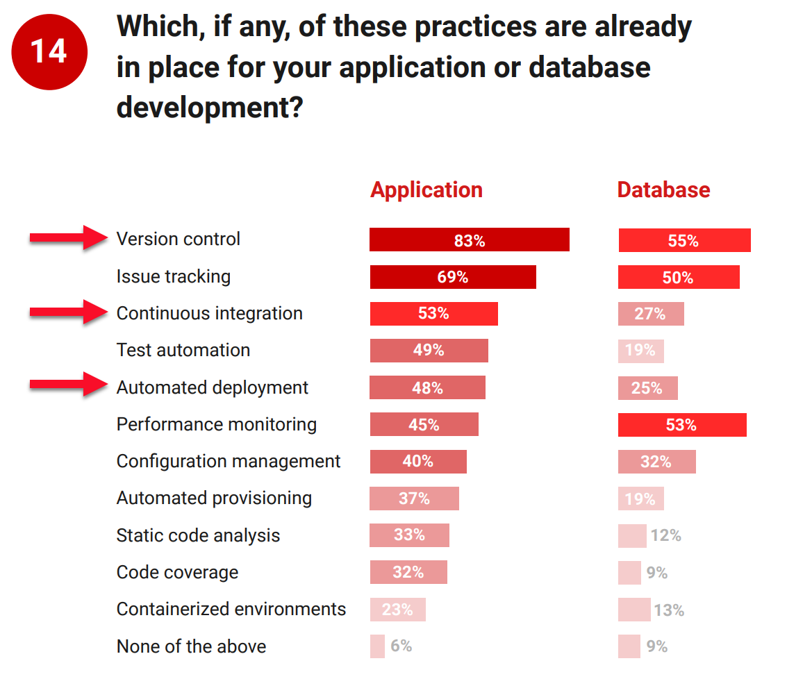
Desired Outcomes of SQL Server DevOpsifying
scottsauber

Slide 16
Why is this hard?
Source Control traditionally not built-in to SQL Server tools (SSMS)
Sins have been committed in your legacy databases over time
Linked servers, DB hopping
Requires Devs + DBA’s to talk to each other
DBA’s think they are getting cut out
Spoiler: they’re not. The crappy part of their job is, so they can do more value add work.
Redgate article on “Implementing DevOps Doesn’t Get Rid Of Database Administrators”
scottsauber

Slide 17
Why is this hard?
66% of companies do not have automated builds and deploys for their databases
Per Redgate Survey
The database is stateful, applications are not (or shouldn’t be.)
Rollback of an app is “delete all these files and replace them with these ones….”
Rollback of a database requires thought
scottsauber

Slide 18
Let’s get to DevOpsing
scottsauber

Slide 19
Source Control: What
Schema Structure
Tables, Views, Stored Procedures, etc.
Static Data
Data required for the application to run successfully
Lookup Tables, Roles table for users in a system, Configuration values, etc.
scottsauber

Slide 20
Source Control: How - Methodologies
Model-based
Migration-based
scottsauber

Slide 21
Source Control: Model-based
Build an “ideal model” of your DB.
Let a tool figure out how to migrate your Production DB to that ideal model.
Examples of tools: Redgate SQL Source Control and Microsoft DACPAC
I do not prefer this approach
Scenarios like Column Renames
Minimal insight into “how” it got there.
This approach is losing mindshare
scottsauber

Slide 22
Source Control: Migration-based
Every change is scripted
Scripts are committed to source control
Scripts run in order (date-based or #-based)
Which scripts have run are kept track in a table
Write them up front during dev
Run the same scripts in every environment
Examples of tools: Redgate SQL Change Automation (hybrid), Flyway, DbUp, and RoundhousE
Migration-based is my preferred approach
scottsauber
Notes:
Running the same script in every environment increases the likelihood of a successful Production deployment. If the exact same set of scripts works in every other environment prior to Production, that can give you a lot of confidence that it will work in Production as well.
This is one of the reasons that the “Compare” method I mentioned earlier fails. Often you are running a deployment for the first time so who knows if you remembered to deploy everything.

Slide 23
Source Control: How
Database Code + Application Code should live together in the same Source Control Repository
One Pull Request/Commit/Checkin for the application code and SQL code
Ideally Final Schema and Migrations live together
scottsauber

Slide 24
Tool Review: Flyway
Open source
Migration-based approach
Command line tool
$950/yr for 10 schemas for Pro, $2950/yr/10 schemas for Enterprise
scottsauber

Slide 25
Flyway Demo
Demo
Config
Baseline
Migrate
scottsauber

Slide 26
Tool Review: Redgate SQL Change Automation
Migration-first approach, but hybrid
Also supports showing the final state of your application
Not used for deployment
Visual Studio Extension
Make changes in DB, use VS to get those changes as migration scripts
SSMS Extension in Beta
Builds your DB from scratch as a dry-run
Integrates with MSBuild, Azure DevOps, TeamCity, and Octopus Deploy
Need SQL Toolbelt (which comes with 13 other tools)
$3095/user for 1 yr of support, $4333/user for 3 yrs
scottsauber

Slide 27
Redgate SQL Change Automation Demo
Demo
Schema
Static data
Stored Procedure
scottsauber

Slide 28
Automated Builds: How
Responsibilities:
Take migrations and deploy them to an independent DB
Spin up new DB for you or have dedicated CI DB
Use a Build tool
Azure DevOps
Jenkins
TeamCity
scottsauber

Slide 29
Automated Deployments: How
Responsibilities:
Deploy to each Environment
Swap out secrets (i.e. connection strings)
Use Deployment tool
Octopus Deploy
Azure DevOps
Jenkins
TeamCity
Bamboo
scottsauber

Slide 30
Proposed Workflow
Developer adds their application code and SQL code
Developer commits to a branch and sends a Pull Request for code review
Another developer reviews the application code
DBA/senior person reviews SQL code
When both are approved, the code is merged into master
Code is built independently to verify the commit
Deployments are then a button push
scottsauber

Slide 31
Workflow Demo
Demo
Add Migration
Reviewed by DBA/senior person
Build server
Deploy changes to databases
Promote through environments
scottsauber

Slide 32
Tool Review: Redgate DLM Dashboard
Monitors and alerts on SQL Server schema changes
Audit history of changes
Finds when someone bypasses the pipeline
scottsauber

Slide 33
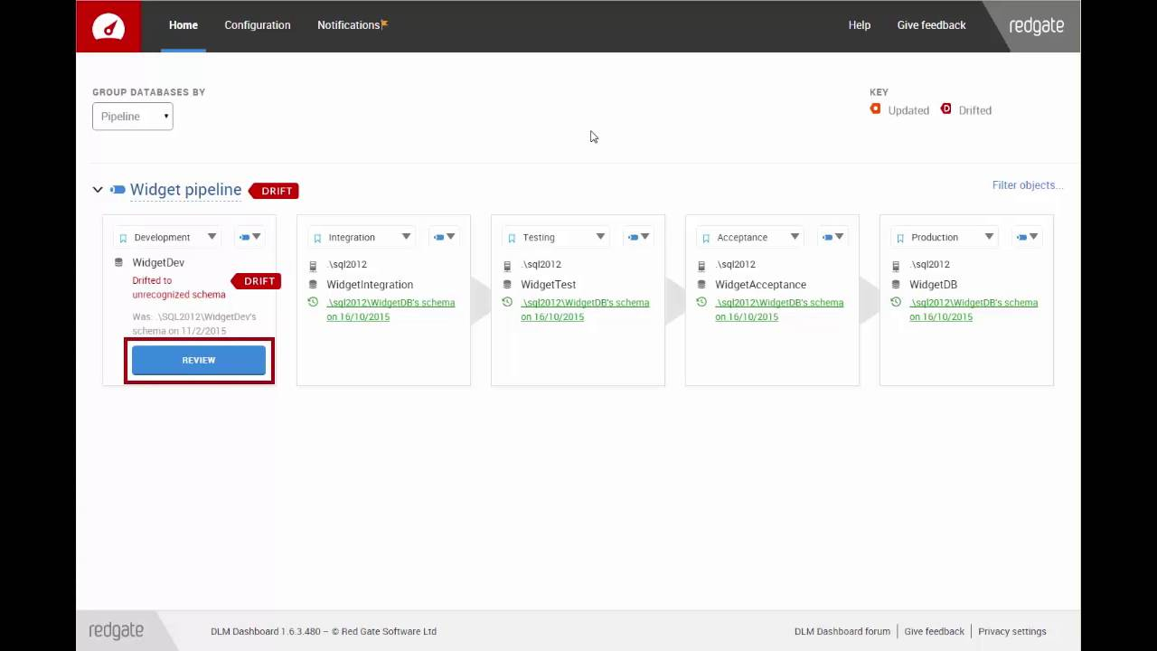
scottsauber

Slide 34
Common Gotcha’s Building The Database
You will pay for the sins of your ancestors
Linked Servers
Cross-Database Hopping
Old Stored Procedures or Views Referencing Old Tables/Columns
Temp Table creation in Stored Procedures
scottsauber

Slide 35
A Word On Rollbacks
They are usually not worth the headache
Why did the deployments succeed in Dev, UAT, etc. but not in Production?
Almost always a failure in people and/or process
How do you rollback something destructive (DROP, DELETE, TRUNCATE, etc.)?
Contextual
Tradeoffs
Restore from backup but lose data in between deployment and restore.
Instead: Roll forward
scottsauber

Slide 36
People Challenges
Mindset shift
The more you can force “no one has Prod” access the better
Force everything to go through the pipeline.
Danny the Deployer
Doesn’t fully buy in to Source Controlling the DB
Goes directly to Prod without Source Controlling
Inevitably causes pain later
“I’ll just do this, this one time.”
Devs + DBA’s Need To Work Together
Customer focus
scottsauber
Notes:
Devs + DBA’s n

Slide 37
Takeaways
Choose a migrations-based approach
Source Control your DB
Auto Deploy the Source Controlled Migrations
Tools you can use
Gotcha’s – tools, existing DB sins, and people
You can do this – the question is, does your organization want to?
scottsauber

Slide 38
Resources
Redgate Simple Talk Blogs
Redgate Database DevOps Blogs
Redgate 2019 State of DevOps Survey
Redgate Training on SQL Change Automation
Redgate YouTube Channel on SQL Change Automation
DB DevOps with Jeffrey Palermo and Paul Stovell
Slides at scottsauber.com
scottsauber

Slide 39
And Now For Something Completely Different
Also giving a HTTP Security Headers talk
1 PM Room 2209 on Friday
Slides at scottsauber.com
scottsauber

Slide 40

Questions?
Slides at scottsauber.com
scottsauber

Slide 41
Thanks!
Slides at scottsauber.com
scottsauber

