Slide 1
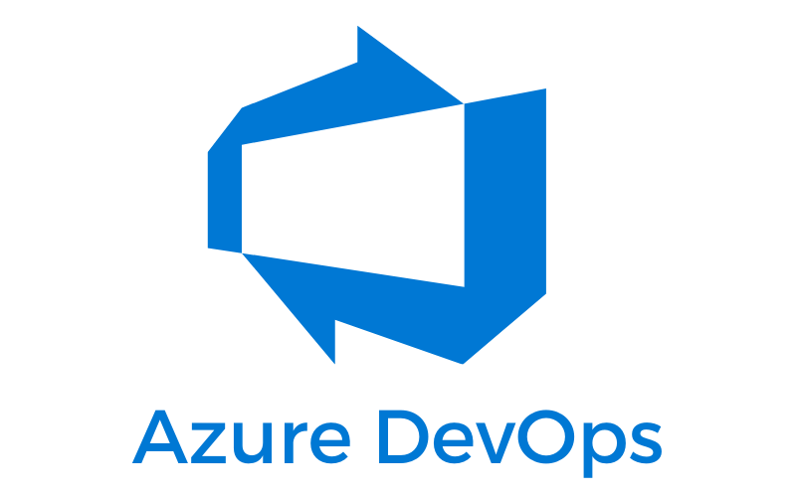
…Not Just For Devs and Ops
Max Zimmerman
Scott Sauber
Notes:
How many people here use Azure DevOps?
What other DevOps tools are people using at work?
What do you want to learn about? Why are you here?

Slide 2
Audience
Anyone wanting to learn more about Azure DevOps

Slide 3
Agenda
What is Azure DevOps?
What functionality is there?
Overview tab
Boards
Repos
Pipelines
Artifacts
Test Plans
Test & Feedback Extension
How does this help me as a QA?

Slide 4
Purpose
Ramp up on knowledge and capabilities of Azure DevOps

Slide 5



Who are we?
Scott Sauber Max Zimmerman

Slide 6
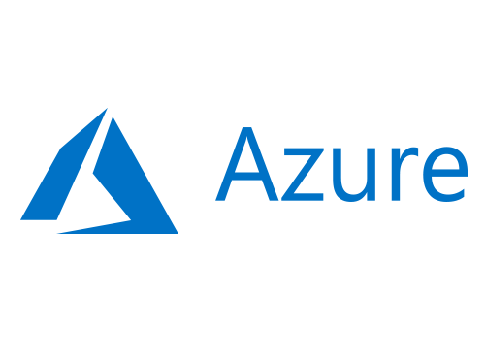
What is Azure?
Notes:
What is Azure?

Slide 7
What is DevOps?
“DevOps is the union of people, process, and products to enable continuous delivery of value to our end users.”
- Donovan Brown

Slide 8
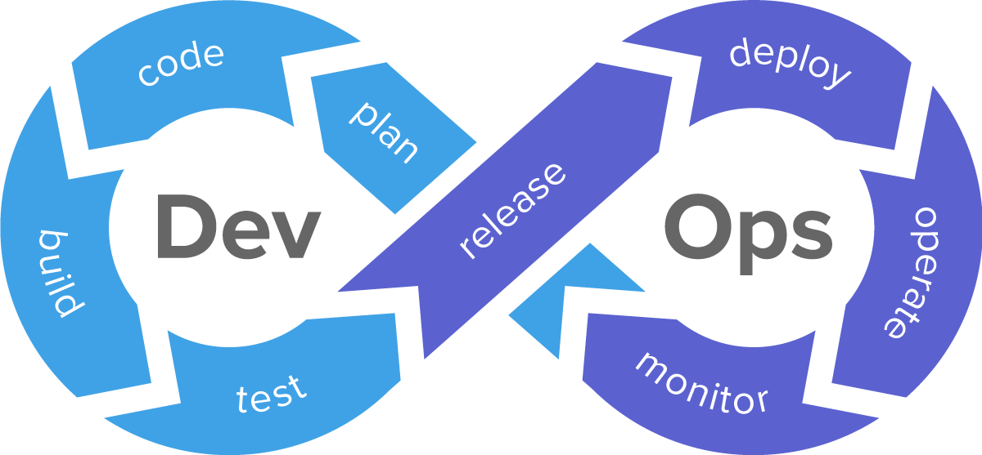
What is DevOps?

Slide 9
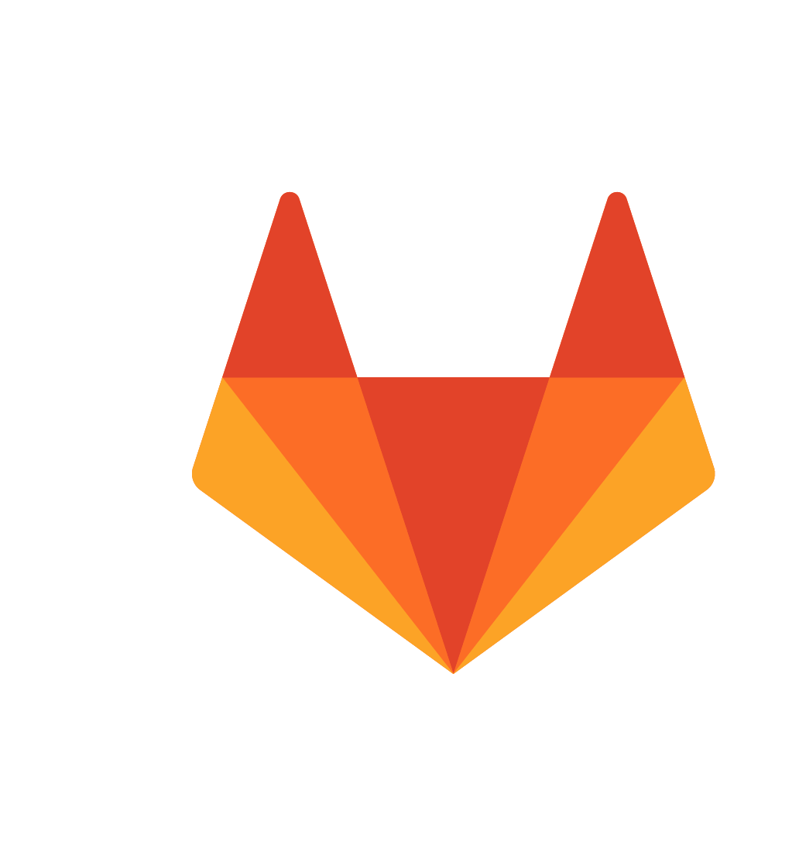





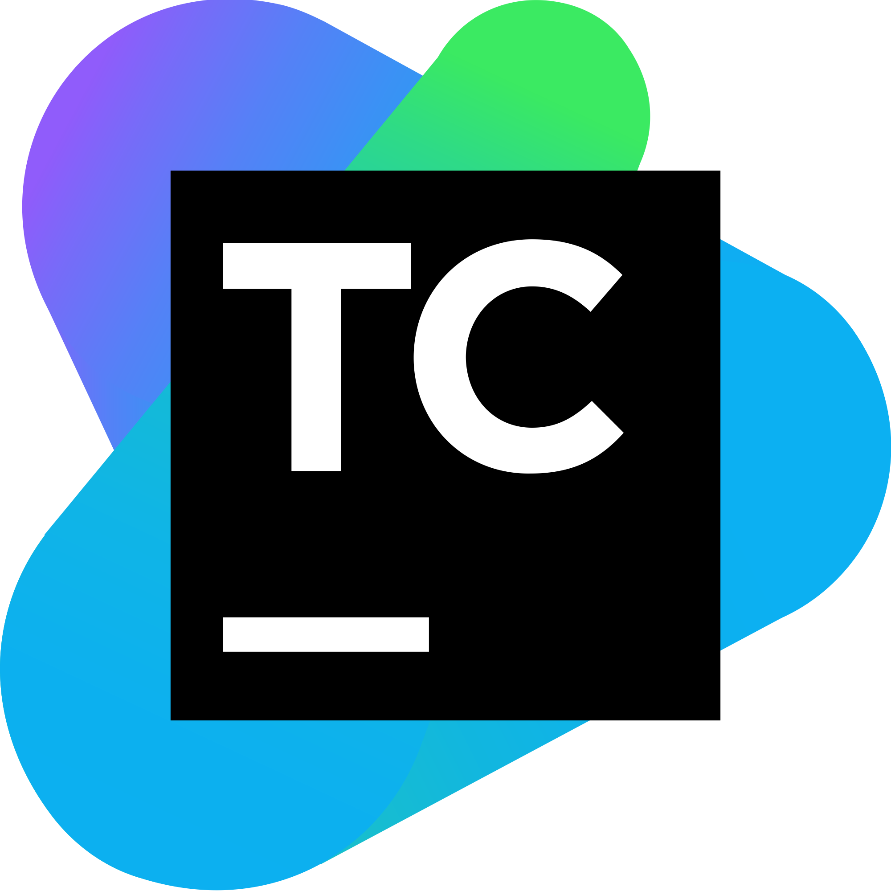





Slide 11
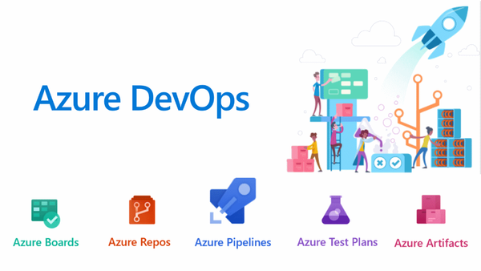
What is Azure DevOps?
Unified tool for managing your DevOps pipeline

Slide 12
Why use it?
End-to-end traceability and visibility from idea to deployment
You can deploy to other clouds (and on-prem), not just Azure

Slide 13
Naming is hard
One of the worst named products on the market
Can be hard to Google
You can deploy to other clouds (and on-prem), not just Azure
Has been renamed many times:
Team Foundation Server (now Azure DevOps Server)
Visual Studio Online
Visual Studio Team Services

Slide 14

Overview
Dashboards
Wiki
Demo
Notes:
Demo covers:
Stats from Overview page
Setting up custom dashboards with custom widgets
Using Wiki

Slide 15

Boards
Manage backlog
Kanban boards
Scrum planning
Custom dashboards
Reporting
Demo
Notes:
Demo covers:
Work Items
Creating Work Item
Filtering on work Item
Boards
Backlogs
Sprints
Queries
What are you using to track your work?

Slide 16

Repos
Source Code Repositories
Code Reviews via Pull Requests
Demo
Notes:
Demo covers:
Show Repo
Show Pull Request

Slide 17

Pipelines
Build Pipelines
Compile code
Create artifacts
Run tests against artifacts
Release Pipelines
Create release containing artifacts
Promote release through multiple environments
Manage secrets
Demo
Notes:
Demo covers:
Show Build Pipeline
Show tests ran and the count
Show how Builds can be triggered on each commit
Show Release Pipeline
Show promoting a release throughout multiple environments
Show the gates for promoting a release
Show the ability to schedule releases getting promoted through different env’s (i.e. refresh production version nightly with sanitization scripts)

Slide 18

Artifacts
Store artifacts related to releases
Store common library packages
Demo
Notes:
Demo covers:
- Just show the page

Slide 19

Test Plans
Create Manual/Exploratory Test Plans
Manual Steps to run
Multiple configurations (i.e. browsers)
Demo
Notes:
Demo covers:
Create a test plan
Create configurations
- Show runs

Slide 20
Test & Feedback Extension
Provide feedback
Capture screenshots, video recordings
Create work items including screenshots and video recordings
Create test cases
Demo
https://docs.microsoft.com/en-us/azure/devops/test/overview?view=azure-devops#exploratory-testing

Slide 21
End-To-End Demo
Create Work Item
Create PR
Allow build to happen
Deploy
Let QA run a manual test plan
Feedback all the way back to dev

Slide 22
New Features
New release to Cloud every 3 weeks
New release to on-prem Server product
Release Notes and what they’re working on: https://docs.microsoft.com/en-us/azure/devops/release-notes/features-timeline

Slide 23
Takeaways
How QA’s can interact with Azure DevOps
Azure DevOps can manage your team’s entire workflow
Sales pitch to team members
Single pane of glass

Slide 24
Resources
Azure DevOps Podcast
RadioTFS
Documentation

Slide 25
Questions?

