Slide 1

DevOps for Databases
Slides up at scottsauber.com
scottsauber
Notes:
Login to GH as me
Login to GH incognito as scottsauberthedba
Open VS Code to database-devops project
Open Data Grip
Make sure docker compose down has been ran
Try to connect to Postgres Azure DBs to make sure that’s good
Reset databases back to 0

Slide 2

Audience
Developers + DBA’s who want to automate their database builds and deployments
Unsure where to get started
Poll
Devs?
DBAs?
Managers?
Other?
scottsauber

Slide 3
Agenda
What choices do I need to make?
What are the tradeoffs?
What tools are out there?
What hurdles will I face?
Demo
Questions
scottsauber

Slide 4
Goals
Ramp up on how to implement automation to your databases
Know the options and tradeoffs of different approaches and tools
scottsauber

Slide 5

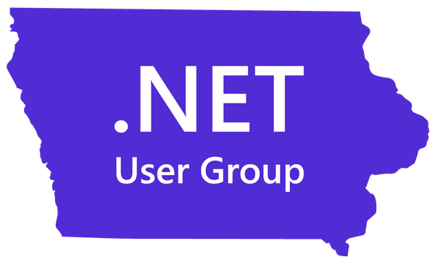
Who am I?
Director of Engineering at Lean TECHniques
Co-organizer of Iowa .NET User Group
Microsoft MVP
Friend of Redgate
Automated dozens of databases
Developer – not a DBA
scottsauber

Slide 6
Typical manual workflows for database changes
Devs write, review, and deploy the SQL
Devs write the SQL and give to DBA to review and deploy
Devs tell DBA’s what they want, DBA’s write, review and deploy the SQL
scottsauber

Slide 7
What a manual workflow may look like today
Compare approach
RedGate SQL Compare, Flyway Desktop, pgadmin, etc.
Gather SQL Scripts approach
scottsauber

Slide 8
What’s wrong with these approaches?
No Source Control
No traceability
Manual
Tedious
Easy for mistakes
Development DB + Prod DB could be out of sync
Changes in behavior
Overwriting others (sprocs, views)
Hard to pull in others changes (no forced CI)
scottsauber

Slide 9
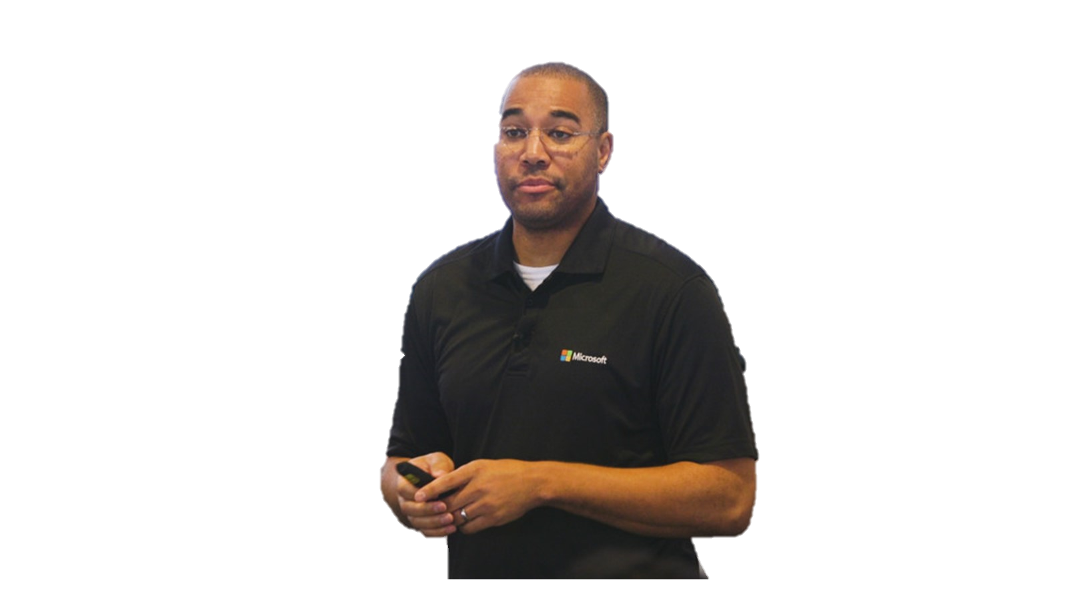
“DevOps is the union of people, process, and products to enable continuous delivery of value to our end users.”
Donovan Brown
Microsoft

Slide 10
“DevOps is the union of people, process, and products to enable continuous delivery of value to our end users.”
Donovan Brown
Microsoft

Slide 11
“DevOps is the union of people, process, and products to enable continuous delivery of value to our end users.”
Donovan Brown
Microsoft

Slide 12

“You can’t change culture and process with a credit card.”
Julie Gunderson
Pager Duty

Slide 13
Desired Outcomes of Database DevOpsifying
In order of importance:
Database is source controlled
Database builds for verification on each commit
Database deployments are at most a single click of a button
scottsauber
Notes:
This one is fun because the people who need to implement the monitoring are the ones who are the only ones who can make changes to production.

Slide 14
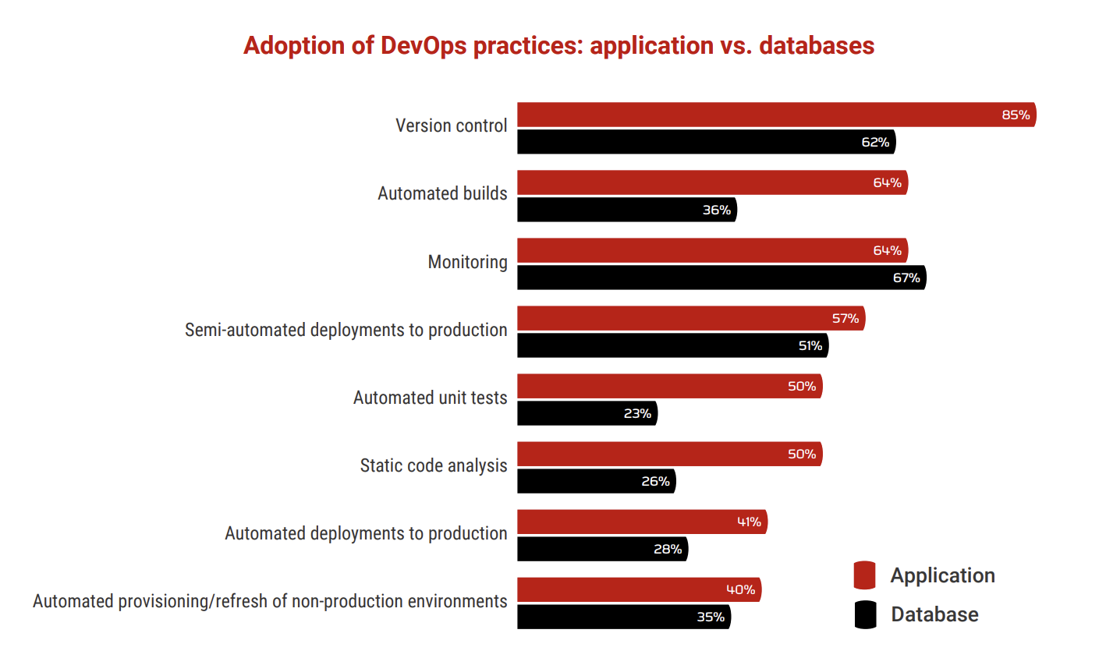
scottsauber

Slide 15
Why is this hard?
72%+ of companies do not have automated builds AND deploys for their databases
Source Control traditionally not built-in to Database tools (SSMS)
Sins have been committed in your legacy databases over time
Linked servers, DB hopping
Requires Devs + DBA’s to talk to each other
DBA’s think they are getting cut out
Spoiler: they’re not. The crappy part of their job is, so they can do more value add work.
scottsauber

Slide 16
Why is this hard?
The database is stateful, applications are not (or shouldn’t be.)
Rollback of an app is “delete all these files and replace them with these ones….”
Rollback of a database requires thought
scottsauber

Slide 17
Why is this hard?
It’s a lot easier on greenfield databases
Start it from the very beginning of a new database
scottsauber

Slide 18
Let’s get to DevOpsing

Slide 19
Source Control: What
Schema Structure
Tables, Views, Stored Procedures, etc.
Static Data
Data required for the application to run successfully
Lookup Tables, Roles table for users in a system, Configuration values, etc.
scottsauber

Slide 20
Source Control: How - Methodologies
Model-based
Migration-based
scottsauber

Slide 21
Source Control: Model-based
Build an “ideal model” of your DB.
Let a tool figure out how to migrate your Production DB to that ideal model.
Examples of tools: Redgate SQL Source Control and Microsoft DACPAC
I do not prefer this approach
Scenarios like Column Renames
Minimal insight into “how” it got there.
This approach is losing mindshare
scottsauber

Slide 22
Source Control: Migration-based
Every change is scripted
Scripts are committed to source control
Scripts run in order (date-based or #-based)
Which scripts have run are kept track in a table
Run the same scripts in every environment
Examples of tools: Flyway, EF Migrations, DbUp, and RoundhousE
Migration-based is my preferred approach
scottsauber
Notes:
Running the same script in every environment increases the likelihood of a successful Production deployment. If the exact same set of scripts works in every other environment prior to Production, that can give you a lot of confidence that it will work in Production as well.
This is one of the reasons that the “Compare” method I mentioned earlier fails. Often you are running a deployment for the first time so who knows if you remembered to deploy everything.

Slide 23
Source Control: How
Database Code + Application Code should live together in the same Source Control Repository
Assuming not a shared database between many apps
One Pull Request/Commit for the application code and SQL code
scottsauber

Slide 24
Automated Builds: How
Responsibilities:
Take migrations and deploy them to an independent DB
Spin up new DB for you or have dedicated CI DB
Use a Build tool
GitHub Actions
Azure DevOps
Jenkins
TeamCity
scottsauber

Slide 25
Automated Deployments: How
Responsibilities:
Deploy to each Environment
Swap out secrets (i.e. connection strings)
Use Deployment tool
Octopus Deploy
GitHub Actions
Azure DevOps
Jenkins
TeamCity
scottsauber

Slide 26
Proposed Workflow (most restrictive)
Developer adds their application code and SQL code
Developer commits to a branch and sends a Pull Request for code review
Another developer reviews the application code
DBA reviews SQL code
When both are approved, the code is merged into main
Code is built independently to verify the commit
Deployments are then at most a button push
scottsauber

Slide 27
Demo using
Flyway + GitHub Actions
Notes:
What is Flyway
SQL folder
Versioneds
Repeatables
docker compose up
docker logs flyway
Flyway_Schema_History table
Add column
docker compose up to test locally
docker logs flyway
Send PR
Watch it deploy

Slide 28
Demo Recap
Overview of Flyway
How to add migrations
Code Review with a PR
Auto validate and test migration via build during PR
Automated deployment to Dev and Prod db’s in Azure
scottsauber

Slide 29
Common Gotcha’s Building The Database
You will pay for the sins of your ancestors
Linked Servers
Cross-Database Hopping
Old Stored Procedures or Views Referencing Old Tables/Columns
Multi-tenant challenges
scottsauber

Slide 30
A Word On Rollbacks
They are usually not worth the headache
Why did the deployments succeed in Dev, UAT, etc. but not in Production?
Almost always a failure in people and/or process
How do you rollback something destructive (DROP, DELETE, TRUNCATE, etc.)?
Contextual
Tradeoffs
Restore from backup but lose data in between deployment and restore.
Instead: Roll forward
scottsauber

Slide 31
People Challenges
Mindset shift
The more you can force “no one has Prod” access the better
Force everything to go through the pipeline.
Danny the Deployer
Doesn’t fully buy in to Source Controlling the DB
Goes directly to Prod without Source Controlling
Inevitably causes pain later
“I’ll just do this, this one time.”
Devs + DBA’s Need To Work Together
Customer focus
scottsauber
Notes:
Devs + DBA’s n

Slide 32
Takeaways
Choose a migrations-based approach
Source Control your DB
Auto Deploy the Source Controlled Migrations
Tools you can use
Gotcha’s – tools, existing DB sins, and people
scottsauber

Slide 33
Resources
https://github.com/scottsauber/database-devops
Redgate Simple Talk Blogs
Redgate Database DevOps Blogs
State of DB DevOps 2021 Survey
DB DevOps with Jeffrey Palermo and Paul Stovell
Slides at scottsauber.com
scottsauber

Slide 34
You can do this…
…does your organization want to?

Slide 35
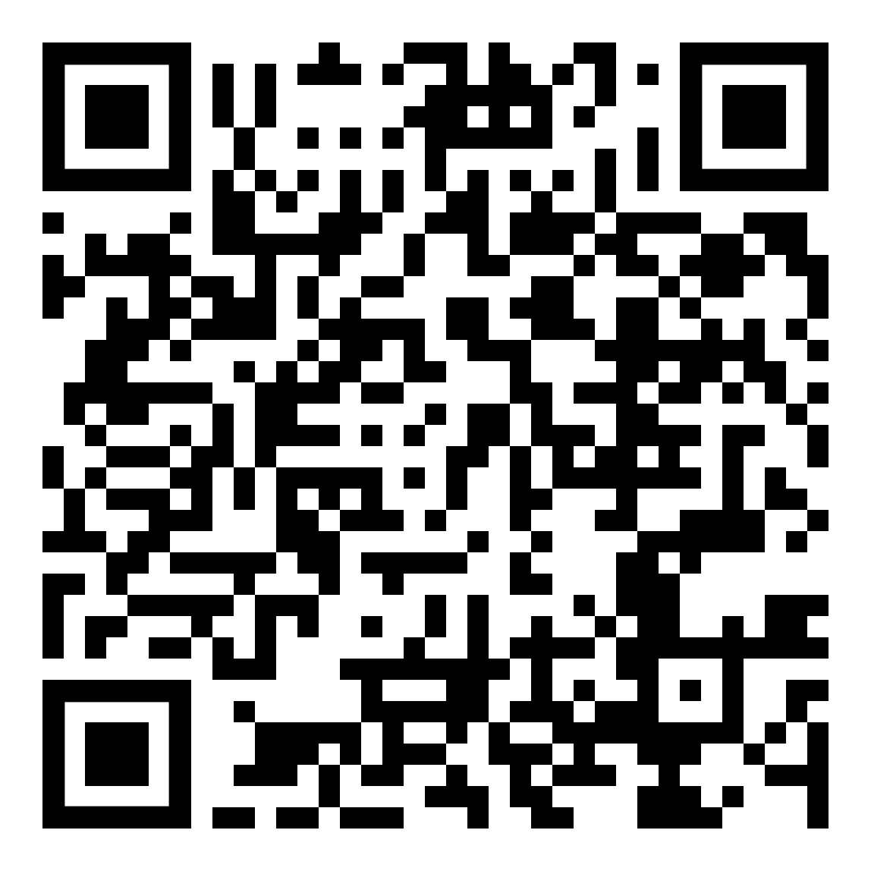
Questions? Follow up: ssauber@leantechniques.com
Slides up at scottsauber.com
scottsauber

Slide 36
Thanks!
Slides up at scottsauber.com
scottsauber

