Slide 1

Motor Insurance & Fraud Detection Platform
ClaimSure AI
From claim registration to settlement, with AI-assisted fraud risk scoring and a GenAI policy assistant.
D
Deepak
B
Balakrishna
G
Gowthami
V
Vardhan

Slide 2
Problem Statement & Objectives
The problem
1
2
  Manual claim handling is slow
  Fraudulent claims are hard to spot early
  Customers get little visibility on status
Digital claims
Fraud scoring
Register and track claims online
Flag Low, Medium and High risk claims
3
4
Role-based work
GenAI help
Customer, officer, surveyor, admin
Answer policy and coverage questions

Slide 3
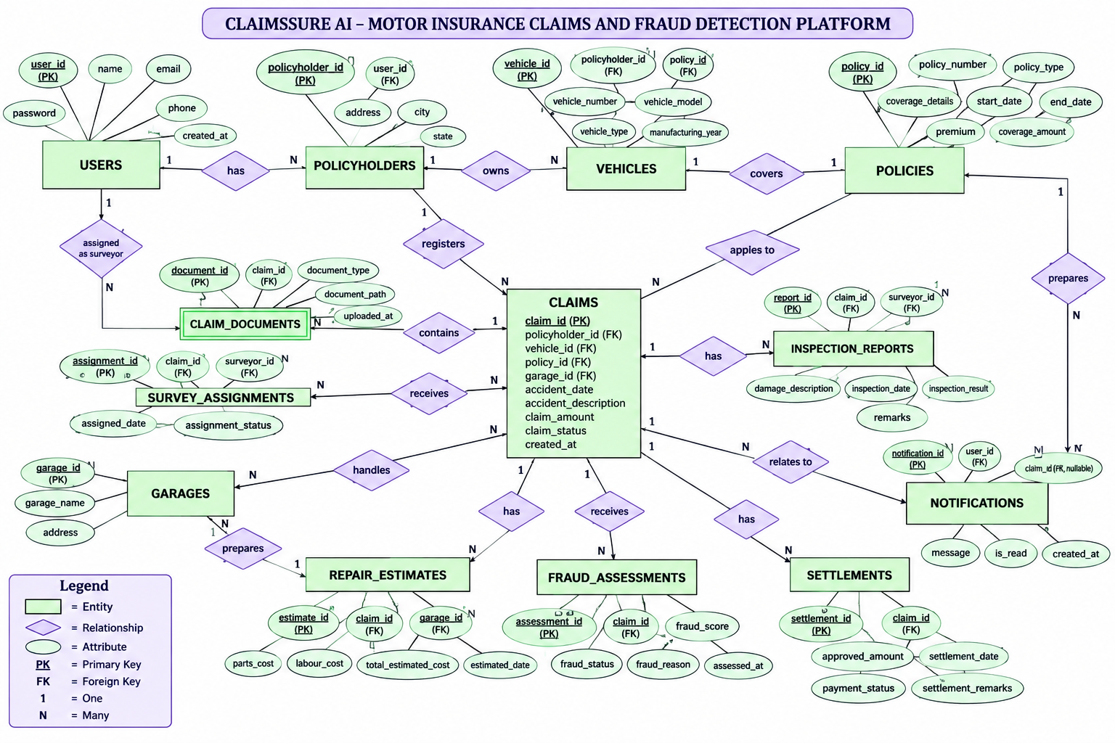

Slide 4
Database Design
13
tables in MySQL
7
sample claims seeded
4
user roles
Claims sit at the centre of the ER model, linked to policyholders, vehicles, policies, garages, surveys, fraud checks and settlements.
Claim lifecycle
Registered
→
Under Review
→
Survey Assigned
→
Approved
→
Settled
A claim can also be Rejected by the Claims Officer.

Slide 5
SQL Features & Data Integrity
7
Views
7
Stored procedures
Customer, claim, vehicle, fraud, repair, surveyor and settlement details
Fetch claims, update status, claim history, total claim amount
5
Triggers
11
Joins & subqueries
Block duplicate active claims, bad amounts and out-of-range fraud scores
Combine customer, vehicle, claim and fraud data in one result

Slide 6
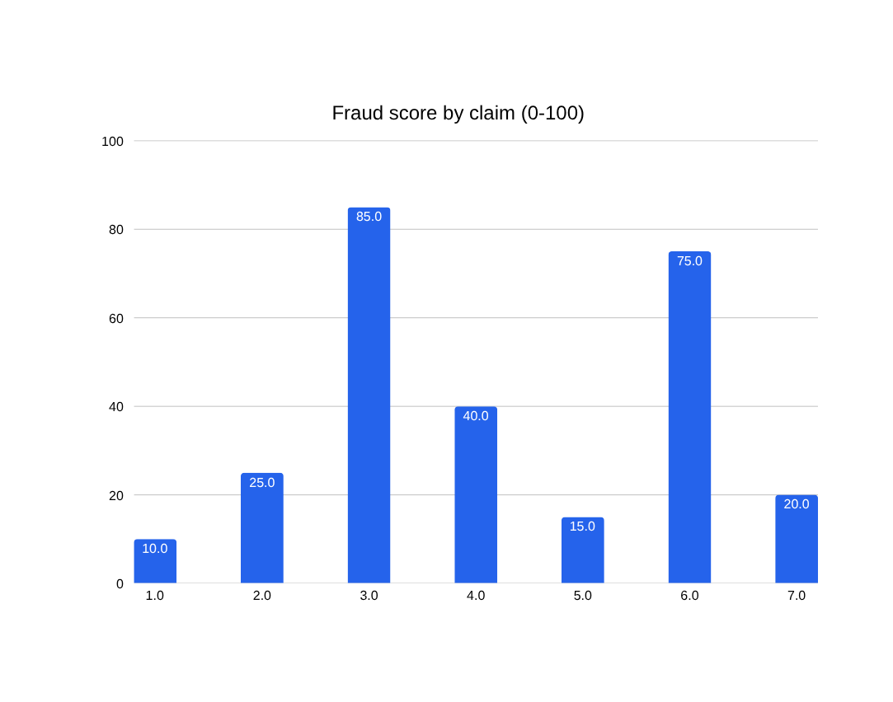
Backend & AI Layer
API
FastAPI + MySQL
Python backend connected to claimssure_ai
ML
Fraud detection
Isolation Forest (scikit-learn) on claim data
AI
GenAI assistant
Gemini answers coverage questions
Claims #3 and #6 are flagged High Risk (score 70+).

Slide 7
Role-Based Dashboards
P
C
S
A
Policyholder
Claims Officer
Surveyor
Admin
  Register a claim
  Ask the GenAI assistant
  Track claim status
  Review claims queue
  See AI fraud risk
  Approve or reject
  View assigned surveys
  Upload inspection report
  Submit estimates
  Users and claims totals
  Total claim value
  Garage network
One login page sends each user to their own dashboard

Slide 8
Conclusion & Next Steps
What we built
Next steps
  Full 13-table claims database
  Views, procedures and triggers
  Role-based web dashboards
  Connect the dashboards to the FastAPI backend
  Train Isolation Forest fraud scoring
  Link Gemini and hash passwords
Thank you

