Slide 1


IILM UNIVERSITY
Greater Noida
Google AI & Machine Learning
Virtual Internship
Internship Presentation — AICTE – EduSkills Virtual Internship Program
Student Name
Deepak Kumar
Enrollment Number
2410031218
Program & Semester
B.Tech CSE • Semester IV
Organization
Google for Developers / EduSkills
Academic Session
June – August 2026
10-Week
Program

Slide 2






PROGRAM SNAPSHOT
Internship Overview
Introduction
FOCUS AREAS
A 10-Week AICTE – EduSkills Virtual Internship Program delivered in partnership with Google for Developers, designed to build industry-relevant Artificial Intelligence and Machine Learning skills through structured, hands-on learning.
Machine Learning
TensorFlow
Purpose of the Internship
Neural Networks
To strengthen employability and confidence by combining structured learning with practical, project-based exposure to real-world AI/ML applications.
Object Detection
Internship Duration
10 Weeks • June – August 2026
Product Image Search
Google AI & Machine Learning Virtual Internship
2

Slide 3

STRUCTURED LEARNING PATH
Internship Curriculum
01
02
Program Neural Networks with TensorFlow
Get Started with Object Detection
Demystified machine learning from first principles
Learned the basics of object detection
Built convolutional neural networks (CNNs)
Integrated a pretrained object detector
Solved common computer-vision recognition tasks
Applied detection within a mobile app context
03
04
Go Further with Object Detection
Get Started with Product Image Search
Trained custom object-detection models
Built a product image search feature for mobile
Used TensorFlow Lite & Model Maker library
Detected objects in static & live camera feeds
Extended core object detection pathway skills
Built and called a product search backend
Google AI & Machine Learning Virtual Internship
3

Slide 4







KEY TAKEAWAYS
Learning Objectives
Understand Machine Learning Fundamentals
Learn Data Preparation & Feature Engineering
Train and Evaluate ML Models
Learn TensorFlow Basics
Understand Neural Networks
Learn Object Detection Techniques
Apply AI Concepts to Real-World Problems
Google AI & Machine Learning Virtual Internship
4

Slide 5





TOOLS & TECHNOLOGIES
AI & ML Technology Stack
Python
TensorFlow
TensorFlow Lite
Neural Networks
CNN
Computer Vision
Object Detection
ML Kit
Product Image Search
Google AI & Machine Learning Virtual Internship
5

Slide 6
STEP-BY-STEP PROGRESSION
Learning Methodology
Learn AI & ML Fundamentals
Build Neural Networks
Apply Object Detection
Implement Product Image Search
1
2
3
4
5
6
7
Understand TensorFlow
Train Models
Deploy Models
Google AI & Machine Learning Virtual Internship
6

Slide 7
END-TO-END PIPELINE
Development Workflow
1
2
3
4
Data Collection
Data Preparation
Feature Engineering
Model Training
5
6
7
8
Model Evaluation
Object Detection
Deployment
AI Application
Google AI & Machine Learning Virtual Internship
7

Slide 8



WHAT WAS GAINED
Skills & Learning Outcomes
Machine Learning Concepts
TensorFlow Development
Neural Networks
Computer Vision
Object Detection
Model Evaluation
AI Application Development
Overall Outcome
Strong foundation in Artificial Intelligence and Machine Learning.
Google AI & Machine Learning Virtual Internship
8

Slide 9
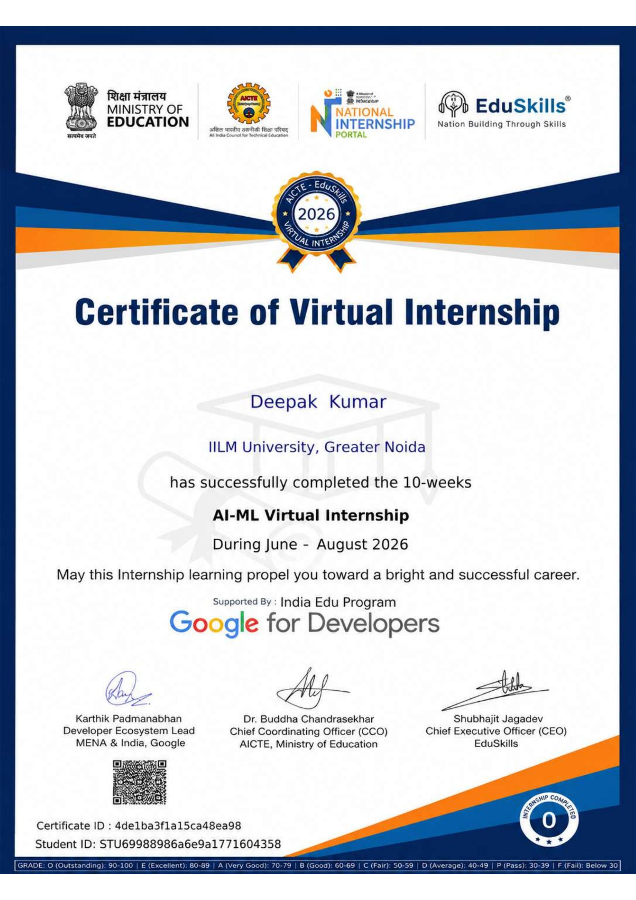
PROOF OF COMPLETION
Internship Certificate
CERTIFICATE DETAILS
Certificate Title
Certificate of Virtual Internship
Awarded To
Deepak Kumar
Institute
IILM University, Greater Noida
Program
AI-ML Virtual Internship (10 Weeks)
Duration
June – August 2026
Certificate ID
4de1ba3f1a15ca48ea98
Student ID
STU69988986a6e9a1771604358
Supported By
Google for Developers
Issued Under
AICTE, Ministry of Education – EduSkills
Google AI & Machine Learning Virtual Internship
9

Slide 10


WRAPPING UP
Conclusion
Successfully completed the Google AI & ML Internship
Gained practical exposure to AI technologies
Learned TensorFlow and Neural Networks
Understood Object Detection and Product Image Search
Built a strong foundation for future AI/ML projects
THANK YOU
Google AI & Machine Learning Virtual Internship
10

