Slide 1

B.N.M. Institute of Technology
An Autonomous Institution under VTU, Approved by AICTE, Accredited as Grade A Institution by NAAC.
All Eligible UG branches – CSE, ECE, EEE, ISE & Mech.Engg. Accredited by till 30.06.2025
Post box no. 7087, 27th cross, 12th Main, Banashankari 2nd Stage, Bengaluru- 560070, INDIA
Ph: 91-80- 26711780/81/82 Email: principal@bnmit.in, www.bnmit.org
Internship (21ECE149) Seminar
ON-SCREEN KEYBOARD USING CVZONE
 | Deepak Aditya Y
 | 1BG21EC029
Under the guidance of
Dr Keerti Kulkarni
Associate Professor
Dept. of ECE, BNMIT

Slide 2
CONTENTS
INTRODUCTION
OBJECTIVE AND SCOPE
FUNDAMENTALS OF PYTHON PROGRAMMING AND RASPBERRY PI
FUNDAMENTALS OF VERILOG
HACKATHON
INTERNSHIP PROJECT
RESULTS
CONCLUSION
REFLECTION NOTES
REFERENCES

Slide 3
INTRODUCTION
ON-SCREEN KEYBOARD WITH COMPUTER VISION:
Creation of an on-screen keyboard using computer vision techniques.
Enables operation through hand gestures and hand tracking from OpenCV.
TEXT INPUT WITHOUT PHYSICAL KEYBOARD:
Users can input text without needing a physical keyboard.
Virtual keyboard offers an alternative input method.
UTILIZING OPENCV:
Provided code leverages the OpenCV library for computer vision tasks.
Hand tracking techniques are used to detect user's hand movements.
VIRTUAL KEYBOARD LAYOUT:
Interface comprises virtual buttons representing letters, symbols, and space bar.
Buttons organized in rows with characters grouped logically.
GESTURE-DRIVEN TYPING:
User's hand proximity to a button triggers a gesture detection mechanism.
Gestures, such as finger movements, are recognized using OpenCV's hand tracking.
SIMULATING PHYSICAL KEYBOARD INPUT:
pynput.keyboard module is utilized to simulate typing on a physical keyboard.
Corresponding character is "typed" when a gesture is recognized.
CUSTOMIZATION POTENTIAL:
Users can extend the code for layout customization, gesture variations, and additional functionalities.

Slide 4
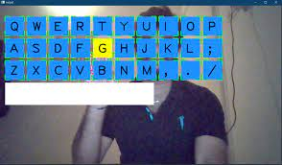
OBJECTIVE AND SCOPE
Objective:
The primary objective of this presentation is to provide an insightful overview of our internship and hackathon program, highlighting the milestones, achievements, and transformative experiences that participants underwent. This presentation aims to showcase the technical proficiency, collaborative ethos, and innovative mindset that defined our journey.
Scope:
This presentation encapsulates the key achievements of our program, spanning Python programming , Raspberry Pi hardware integration, and the development of an on-screen keyboard using computer vision. It outlines the chapters that detail our progress, challenges, and reflections, offering a comprehensive glimpse into the holistic growth experienced by participants. The scope of this presentation extends to our journey's outcomes, including technical accomplishments, personal development, and the community of innovators we've become.

Slide 5

FUNDAMENTALS OF PYTHON PROGRAMMING AND RASPBERRY PI
PYTHON:
1. Syntax and Readability
2. Data Types and Variables
3. Control Structures
4. Functions and Modules
5. Data Manipulation
6. Object-Oriented Programming (OOP)
7. Exception Handling

Slide 6

FUNDAMENTALS OF PYTHON PROGRAMMING AND RASPBERRY PI
RASPBERRY PI:
1. single-board computer with an ARM-based processor, GPIO pins, and multiple connectivity options
2. GPIO Interfacing
3. Linux Operating System
4. Hardware Control
5. Sensor Integration
6. Networking and IoT
7. Exception Handling

Slide 7
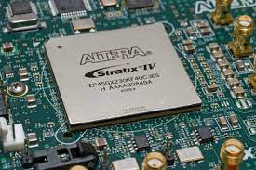
FUNDAMENTALS OF VERILOG
Hardware description language used to design digital circuits and systems.
Verilog designs are structured as modules, which encapsulate logical components.
Verilog supports different data types like wire, reg, integer, and real.
Combinational logic is described using assignments like AND, OR, NOT, and XOR gates.
Sequential logic elements like flip-flops and latches are used to describe memory elements.
Verilog allows both structural and behavioral modeling.
Testbenches are used to simulate and verify Verilog designs. They provide input vectors and expected outputs to verify the functionality of the design.
Verilog supports modeling of timing delays using concepts like #delay and parameterized delays.

Slide 8
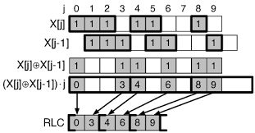
HACKATHON
The Run-Length Encoding (RLE) Hackathon was a captivating journey into the world of data compression, where participants harnessed their programming prowess to explore and implement an age-old technique with modern applications. This hackathon, centered around the concept of reducing data size by encoding consecutive repeated characters, showcased the convergence of algorithmic thinking, coding skills, and creativity.
OBJECTIVE:
The objective of the hackathon was to introduce participants to the concept of data compression using the Run-Length Encoding technique. Participants were tasked with implementing RLE algorithms that efficiently encode and decode data, effectively reducing its size while preserving its essential information.
SCOPE:
The hackathon began with an in-depth understanding of the RLE algorithm's principles. Participants delved into the algorithm's core mechanics, identifying patterns of consecutive repeated characters and devising methods to encode them succinctly. As the hackathon unfolded, participants were encouraged to explore variations of the algorithm, optimize performance, and even consider scenarios where RLE might be most effective.

Slide 9
KEY HIGHLIGHTS:
Algorithmic Exploration:
Participants embarked on an exploration of algorithmic concepts, identifying patterns, and devising efficient techniques to encode and decode data. They navigated the intricacies of data traversal and pattern recognition.
Coding Agility:
Hackathon participants translated their algorithmic insights into working code. The hackathon encouraged participants to apply programming concepts, libraries, and language features to bring the RLE algorithm to life.
Performance Optimization:
Beyond basic implementation, participants delved into performance optimization. They fine-tuned their code to achieve optimal compression ratios and decoding speed, showcasing their ability to balance trade-offs between space and time complexity.
Real-World Applications:
The hackathon facilitated discussions on real-world applications of RLE. Participants explored scenarios where data compression is crucial, such as image and video compression, storage optimization, and transmission efficiency.
Collaborative Learning:
The hackathon nurtured a spirit of collaboration, with participants sharing insights, strategies, and solutions. Peer reviews and discussions enriched the learning experience, fostering an environment of shared growth.

Slide 10
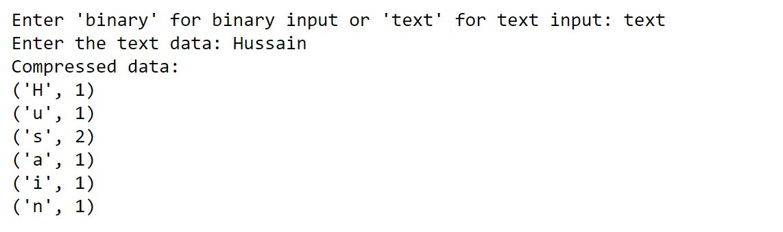
OUTCOME:
Participants emerged from the hackathon with a comprehensive understanding of Run-Length Encoding and its applications. They gained hands-on experience in implementing efficient compression algorithms, translating theoretical knowledge into practical solutions. The hackathon not only showcased their coding abilities but also their analytical thinking and creative problem-solving skills.
CONCLUSION:
The Run-Length Encoding Hackathon transcended data compression—it was a journey of discovery, innovation, and skill refinement. By mastering this classic technique, participants unlocked the potential to optimize data storage, transmission, and processing in diverse domains. This hackathon experience stood as a testament to the timeless significance of algorithms and their capacity to shape the digital landscape.

Slide 11
HACKATHON
Let's use the example string "AAABBCCCCDDEEF" to demonstrate the RLE algorithm:
Initialize compressedString = "".
Start with the first character "A":
Count consecutive occurrences: "A" (count = 3).
Append "3A" to compressedString.
Move to the next character "B":
Count consecutive occurrences: "B" (count = 2).
Append "2B" to compressedString.
Move to the next character "C":
Count consecutive occurrences: "C" (count = 4).
Append "4C" to compressedString.
Move to the next character "D":
Count consecutive occurrences: "D" (count = 2).
Append "2D" to compressedString.
Move to the next character "E":
Count consecutive occurrences: "E" (count = 2).
Append "2E" to compressedString.
Move to the next character "F":
Count consecutive occurrences: "F" (count = 1).
Append "1F" to compressedString.
Final compressedString: "3A2B4C2D2E1F".

Slide 12
INTERNSHIP PROJECT
The project "On-Screen Keyboard using CV Zone" was an innovative exploration into the realm of human-computer interaction, where computer vision technology merged with creative design to reimagine text input methods. This project showcased the power of Python programming, computer vision, and user-centered design in developing an intuitive and accessible virtual keyboard.
Objective: The primary objective of this project was to create a virtual keyboard that responds to hand gestures captured through a webcam. By utilizing the CV Zone library in Python, the project aimed to provide an alternative and more inclusive input method for users with mobility challenges and explore a novel way of interacting with computers.
Scope:
The project encompassed a multifaceted scope, including:
Hand Tracking: Accurate detection and tracking of hand movements through computer vision technology.
Gesture Recognition: Mapping hand gestures to specific letters, characters, or actions on the virtual keyboard.
User Interface: Designing an intuitive and user-friendly graphical interface for the virtual keyboard display.
Real-Time Responsiveness: Ensuring the virtual keyboard responds promptly and accurately to the user's hand gestures.
Accessibility: Creating an inclusive input method for individuals with limited physical mobility.

Slide 13
Key Highlights:
Computer Vision Exploration:
Participants delved into the intricacies of computer vision, learning how to detect and track hands in real-time using the CV Zone library.
Gesture Mapping:
The project challenged participants to devise algorithms that map hand gestures to appropriate characters on the virtual keyboard layout.
Graphical User Interface (GUI):
Participants designed an engaging and user-friendly GUI that displayed the virtual keyboard and provided visual feedback for recognized gestures.
Real-Time Interaction:
The project required participants to optimize algorithms and performance to ensure that the virtual keyboard responded seamlessly to the user's hand movements.
Inclusivity Considerations:
The project highlighted the significance of accessibility, inspiring participants to create a virtual keyboard that accommodated diverse user needs.

Slide 14
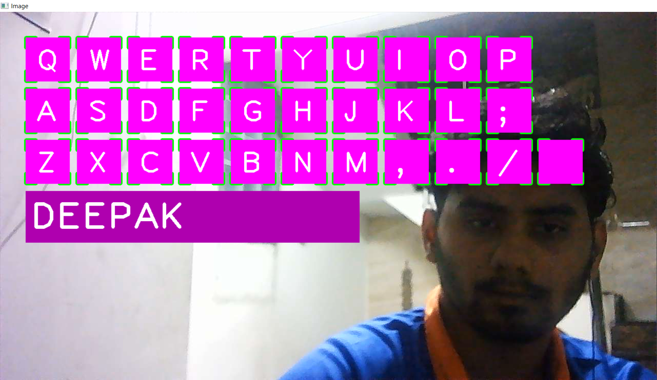
RESULTS
The project culminated in a functional on-screen keyboard that demonstrated the potential of computer vision technology to redefine human-computer interaction. The virtual keyboard responded accurately to hand gestures, providing an intuitive alternative to traditional keyboard input.
The on-screen keyboard project showcased the potential of technology to bridge gaps and enhance accessibility. It emphasized the role of innovation in transforming user interfaces and making technology more inclusive for individuals with diverse needs. The project left participants inspired to further explore the intersection of computer vision, human-computer interaction, and accessibility.

Slide 15
Conclusion
The "On-Screen Keyboard using CV Zone" project epitomized innovation at the crossroads of technology and accessibility. By harnessing the capabilities of Python and computer vision, participants created a tangible solution that has the potential to empower individuals with mobility challenges and inspire future advancements in the field of human-computer interaction.

Slide 16
REFLECTION NOTES
Technical Proficiency and Skill Mastery
Collaborative Learning and Peer Engagement
Problem-Solving Mindset
The Art of Innovation
Accessible Technology and Impact
Lifelong Learning
A Community of Innovators
Gratitude and Future Endeavors

Slide 17
REFERENCES
[1] Murtaza Hassan, Designer/ Educator/ Researcher, GitHub.
[2] Engineering Kanti
[3] https://youtu.be/jzXZVFqEE2I
[4] M. Basheri and L. Burd "Collaborative Software Design using Multi-touch Tables" 42nd ASEE/IEEE Front. Educ. Conf. pp. 5-6 December 2012.
[5] S. Design Durham E-Theses Multi-Touch Table for Enhancing Collaboration during Software Design 2013.
[6]. P. D. Varcholik J. J. Laviola and C. E. Hughes "Establishing a baseline for text entry for a multi-touch virtual keyboard" J. Hum. Comput. Stud. vol. 70 no. 10 pp. 657-672 2012.
[7]. D. Choi H. Cho and J. Cheong "Toward Designing a New Virtual Keyboard When All Finger Movements Are Known" Ext. Abstr. ACM CHI'15 Conf. Hum. Factors Comput. Syst. vol. 2 pp. 1663-1668 2015.
[8]. L. Findlater and J. Wobbrock "Personalized Input: Improving Ten-Finger Touchscreen Typing through Automatic Adaptation" Proc. 2012 ACM Annu. Conf. Hum. Factors Comput. Syst. - CHI '12 pp. 815-824 2012.

Slide 18
[9]. D. Gelormini and B. Bishop OPTIMIZING THE ANDROID VIRTUAL KEYBOARD: A STUDY OF USER EXPERIENCE Derek Gelormini Benjamin Bishop Department of Computing Sciences University of Scranton 2004.
[10] S. Ghosh S. Sarcar M. Kumar S. Debasis I. I. T. Kharagpur and W. Bengal Effective Virtual Keyboard Design with Size and Space Adaptation pp. 262-267 April 2010.
[11]. N. P. Oo EFFECTIVE MYANMAR KEY LAYOUT DESIGN ANALYZING FOR ANDROID SOFT KEYBOARD vol. 4 no. 01 pp. 276-284 2012.
[12]. A. I. Pritom H. Mahmud S. Ahmed K. Hasan and M. Khan TYPEHEX Keyboard: A virtual keyboard for faster typing in Smartphone pp. 522-526.
[13]. J. Edelmann P. Mock A. Schilling P. Gerjets W. Rosenstiel and W. Strasser "Towards the keyboard of Oz: Learning soft-keyboard models from raw optical sensor data" Proc. 2012 ACM SIGCHI Interact. Tabletops Surfaces ITS'12 pp. 163-172 2012.
[14]. D. Buschek O. Schoenleben and A. Oulasvirta "Improving Accuracy in Back-of-Device Multitouch Typing: A Clustering-based Approach to Keyboard Updating" Proc. 19th Int. Conf. Intell. user interfaces pp. 57-66 2014.
[15]. J. H. Kim L. Aulck O. Thamsuwan M. C. Bartha and P. W. Johnson The Effects of Virtual Keyboard Key Sizes on Typing Productivity and Physical Exposures pp. 887-891 2013.
[16]. S. Sarcar S. Ghosh P. Kumar and S. Debasis Virtual Keyboard Design: State of the Arts and Research Issues pp. 289-299 April 2010.

Slide 19
Thank You!

