Slide 1
System Design Review
Auto MoM System
Guide Name:
Mrs. B. Bhagyashree
Team Details:
Ch. Krishna Chaitanya | 22071A66E2
D. Deepak | 22071A66E7
K. Reshwanth | 22071A66G3
L. Manikumar | 22071A66G4
Notes:
封面标题特殊字体为百度简综艺.可以自行下载使用或改为微软雅黑.

Slide 2
1
PART ONE
Abstract

Slide 3
Problem: Manual Minutes of Meeting (MoM) are time-consuming, error-prone, and disconnect conversations from actionable documentation.
Solution (AutoMoM): An AI-driven end-to-end system that records, transcribes, summarizes, classifies action items, and formats professional MoMs automatically.
Core pipeline: Real-time/recorded speech recognition (e.g., Whisper), NLP/LLM summarization (e.g., GPT-4) and action-item / decision extraction.
Integrations: OAuth-based connectors to fetch recordings from Zoom, Google Meet (can extend to Teams, Webex).
Outputs: Structured MoM documents (plain text, Markdown, PDF, DOCX), export, archive, or email/share to participants.
Security & privacy: OAuth for account access, encrypted storage/transfer, configurable retention and access controls

Slide 4
2
PART TWO
Literature Review Summary

Slide 5
Trend: Summarization has shifted from classical methods to advanced neural models, with Large Language Models (LLMs) delivering substantially better coherence and fluency.
Modern LLM approaches (3 categories):
Prompt engineering — crafting inputs to steer LLM outputs without changing model weights.
Fine-tuning — adapting model weights on task-specific data for improved performance.
Knowledge distillation — training smaller/specialized models to mimic a larger LLM’s behavior.
Primary outstanding challenge: Multi-speaker ASR — especially overlapped speech — remains the hardest problem; separate diarization + transcription pipelines suffer from error propagation.
Cutting-edge solution (2025): Move to an integrated, diarization-aware framework where LLMs ingest speaker signals and audio features together, producing accurate, time-aligned transcriptions and reducing cascading errors.
Implication: Integrated approaches promise more reliable speaker attribution, cleaner transcripts in noisy/overlapped settings, and better downstream summarization/action-item extraction.

Slide 6
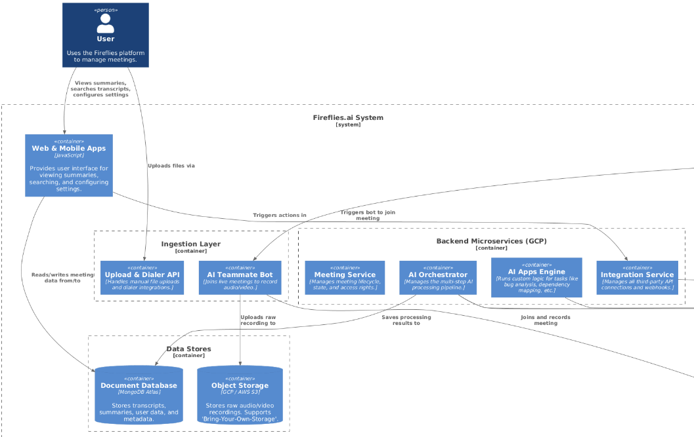
FireFlies.ai

Slide 7
Advantages:
Strong post-meeting automation for organizing and processing meeting content.
High-quality AI summaries that are concise and accurate.
Effective action-item detection that identifies tasks and responsibilities clearly.
Extensive integrations (e.g., Slack, CRM platforms, project management tools).
Disadvantages:
Speaker identification issues: Struggles with accurate multi-speaker labeling in fast or overlapping conversations.
Accent sensitivity: Transcription accuracy decreases noticeably with strong or diverse accents.
Bot intrusiveness: Some users feel the meeting bot joining calls is disruptive or uncomfortable.
Limited free plan: Key features are restricted, requiring higher-priced tiers to access full functionality.

Slide 8
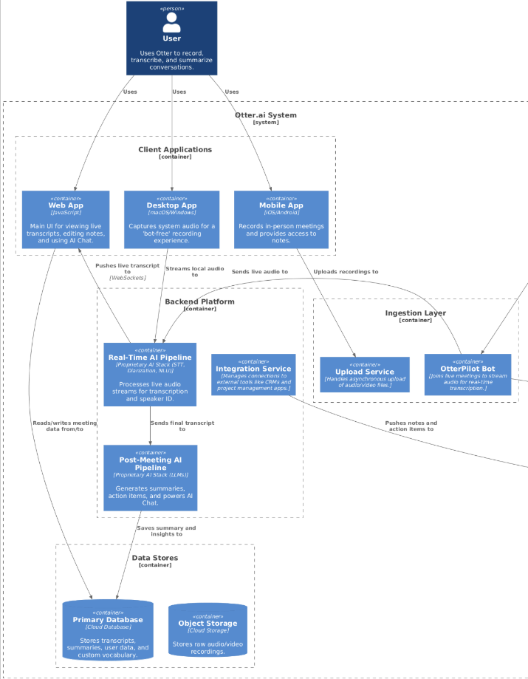
Otter.ai

Slide 9
Advantages:
Real-time transcription: Provides accurate live captions and allows in-meeting review.
Highly user-friendly interface: Clean, intuitive design makes it easy to adopt.
AI Chat feature: Allows users to ask questions and interact with meeting content.
Strong free plan: More generous compared to many competitors.
Disadvantages:
Inconsistent speaker identification: Often mislabels speakers, leading to confusing transcripts that need manual edits.
Reduced accuracy in noise: Transcription quality drops noticeably in noisy or overlapping speech environments.
Limited language support: Far fewer supported languages compared to competitors.

Slide 10
3
PART THREE
System Architecture

Slide 11
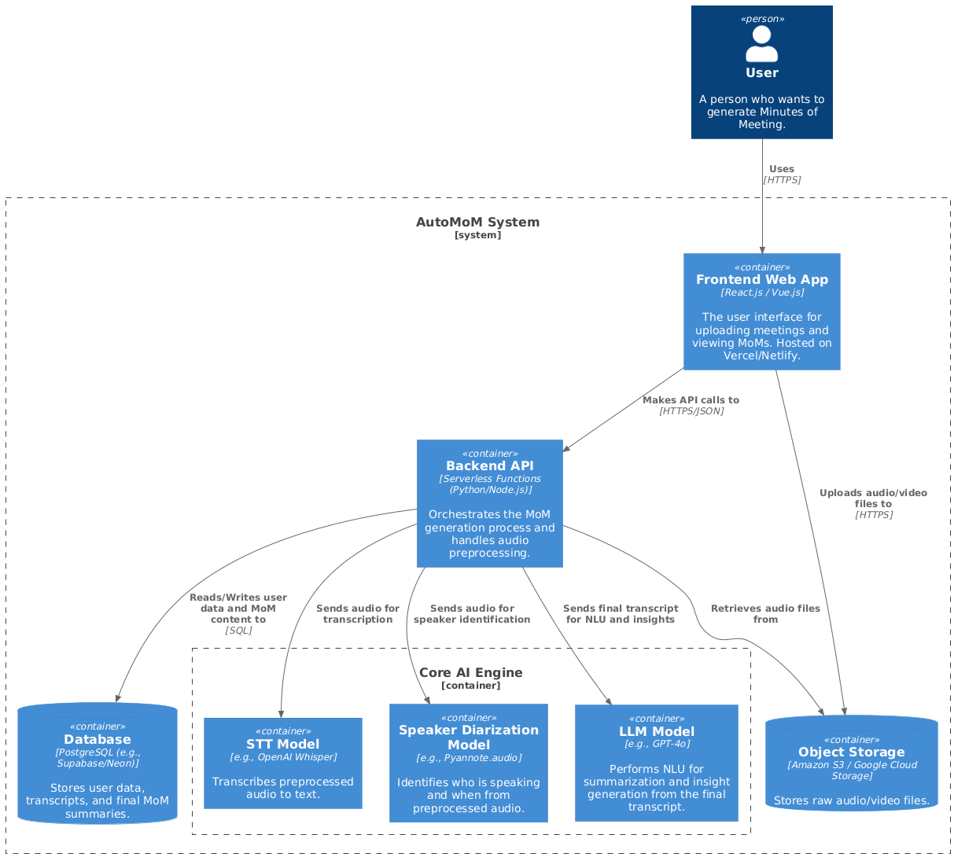

Slide 12
Architectural Adaptations
Parallel AI Processing:
  The system now processes transcription (STT Model) and speaker diarization (Speaker Diarization Model) at the same time, rather than one after the other.
  The Backend API orchestrates this by sending the preprocessed audio to both models simultaneously.
  This parallelization significantly reduces the total processing time, delivering the final minutes to the user much faster.
User-Provided Context for Enhanced Accuracy:
  A new feature has been added to the Frontend Web App allowing users to input a manual "gist" or key context (like topics, attendee names, or jargon) when uploading a meeting.
  This context is passed from the frontend to the Backend API.
  The backend then uses this information to "prime" the AI models
  It is sent to the STT Model to improve the accuracy of transcribing specific or uncommon terms.

Slide 13
System Requiremnets
Functional Requirements
User must be able to upload audio/video files.
User must be able to submit optional text context (a "gist") with the upload.
The STT model must use the user's "gist" to improve accuracy on specific terms.
The LLM must use the "gist" to generate a more relevant summary and extract action items.
The user must be able to view the final summary and transcript.
Non-Functional Requirements
Performance: The system must have low processing latency, achieved through parallel AI tasks.
Accuracy: Transcription and speaker identification must be highly accurate, enhanced by user-provided context.
Relevance: Generated summaries must be context-aware and relevant to the user's "gist".
Scalability: The architecture must scale to handle multiple, concurrent user uploads.
Modularity: The Core AI Engine components (STT, Diarization, LLM) must be decoupled for independent updates.

Slide 14
Modules
1. Frontend Web App (The User Interface)
Component: Frontend Web App
Technology: React.js / Vue.js
Function:
This is the primary module the user interacts with. Its job is to:
Provide a clean interface for file uploads.
Capture the user-provided "context gist" (jargon, names, topics) to improve accuracy.
Display the final, processed Minutes of Meeting, including the summary, transcript, and action items.
2. Backend API (The Orchestration Layer)
Component: Backend API
Technology: Serverless Functions (Python/Node.js)
Function:
This is the "brain" of the operation that manages the entire workflow. Its key responsibilities are:
Receiving requests from the Frontend.
Handling audio preprocessing to prepare the file for analysis.
Orchestrating the Core AI Engine by sending tasks to the different models.
Executing the parallel processing of transcription and diarization.
Performing the final "merge step" to combine the text transcript with the speaker timeline.

Slide 15
Modules
3. Core AI Engine (The Analysis Module):
Component: Core AI Engine
Technology: Containerized AI Models
Function: This module contains the three specialized AI models that perform the heavy lifting:
STT Model (e.g., OpenAI Whisper): The transcription service. It listens to the audio and converts the spoken words into written text.
Speaker Diarization Model (e.g., Pyannote.audio): The speaker identification service. It answers the question "Who spoke, and when?" by segmenting the audio by speaker.
LLM Model (e.g., GPT-4o): The "Natural Language Understanding" service. It reads the final, merged transcript and generates the high-level summary and extracts key action items.
4. Data Storage Layer (The Memory):
Component: Database & Object Storage
Technology: PostgreSQL & S3/Google Cloud Storage
Function: This layer is responsible for all data persistence. It's split into two parts for efficiency:
Object Storage: This is a cost-effective "filing cabinet" that stores the large, raw audio/video files.
Database: This is a structured database that stores all the processed, valuable data, such as user information, the final transcripts, and the generated MoM summaries.

Slide 16
4
PART FOUR
UML Diagrams

Slide 17
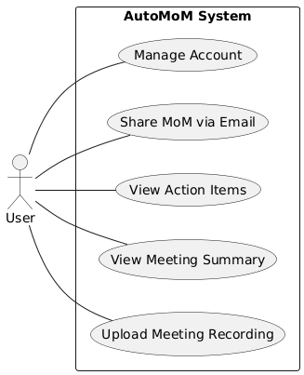
Usecase Diagram

Slide 18
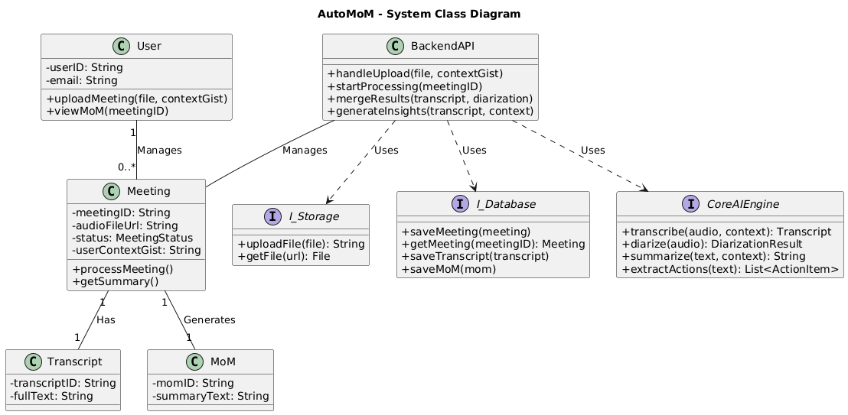
Class Diagram

Slide 19
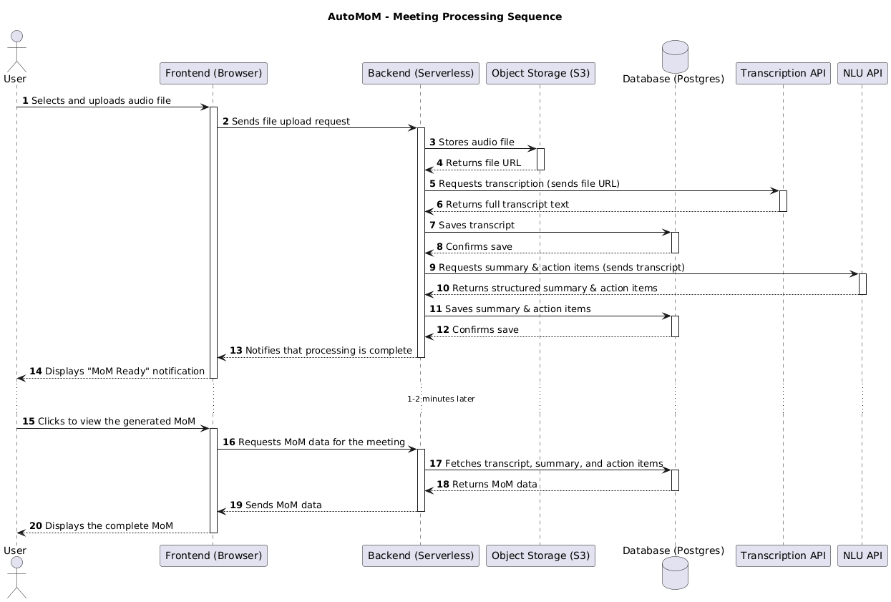
Sequence Diagram

Slide 20
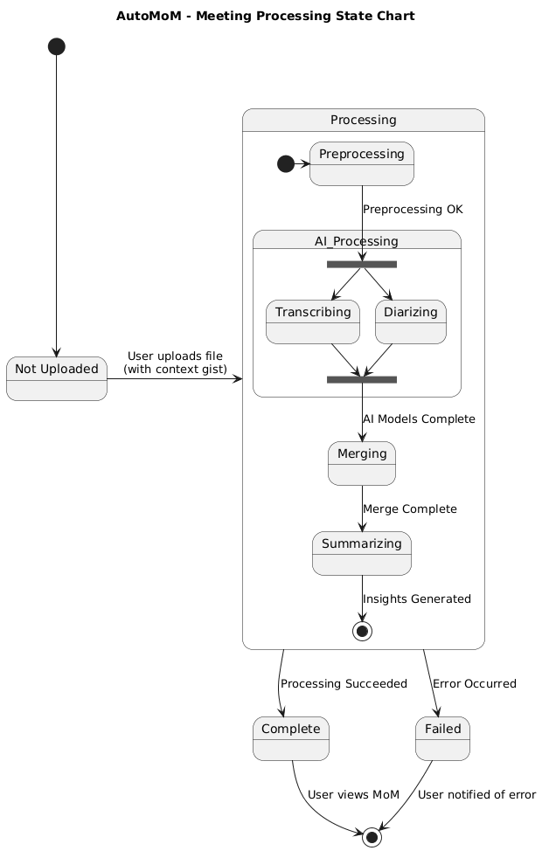
State Chart Diagram

Slide 21
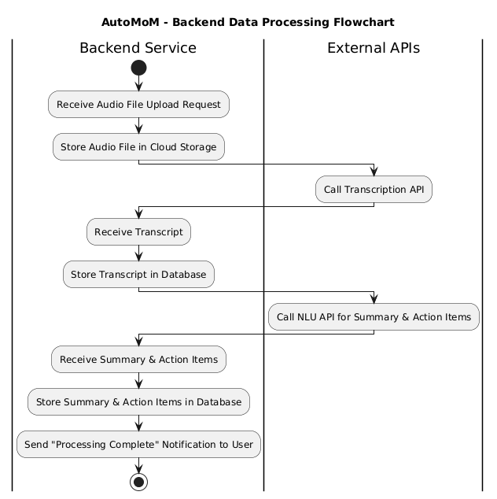
Activity Diagram

Slide 22
THANKS

