Slide 1
VIDEO SUMMARIZATION IMPLEMENTATION
----- MALLAMPATI DEEPAK
Guided BY
Mr.Aamandeep
Mr.Manish
Ms.Gireesha

Slide 2
ABOUT THE PROJECT
Video summarization is to generate a short summary of the content of a longer video document by selecting and presenting the most informative or interesting materials for potential users. ... By watching the summary, users can make quick decisions on the usefulness of the video.
My role in the project is to develop a web application to use the machine learning code in the background when a user gives the video, that video is given to the machine learning using flask, and then the output is displayed on the web page.

Slide 3
BACKGROUND RESEARCH
The aim of video summarization is to speed up browsing of a large collection of video data, and achieve efficient access and representation of the video content. By watching the summary, users can make quick decisions on the usefulness of the video.

Slide 4
FLASK
Flask is a web framework. This means flask provides you
with tools, libraries and technologies that allow you to build
a web application. This web application can be some web
pages, a blog, a wiki or go as big as a web-based calendar
application or a commercial website.

Slide 5
Technology Stack
Flask
HTML
CSS
JAVASCRIPT
PYTHON
JINJA2

Slide 6
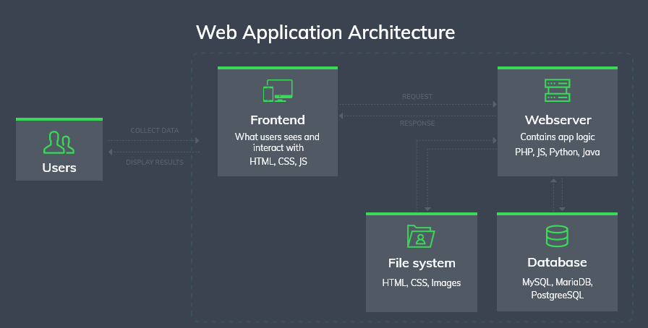
Architecture

Slide 7
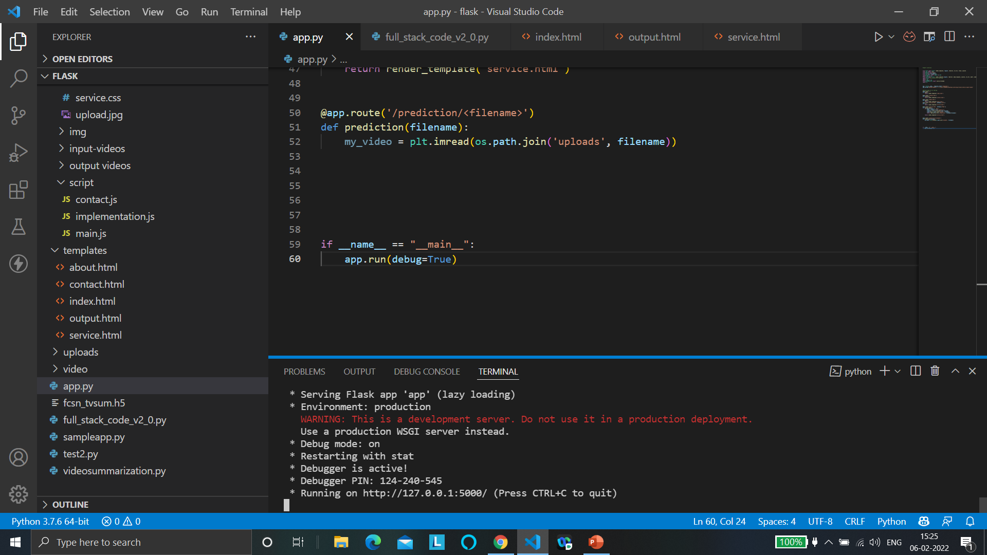
IMPLEMENTATION

Slide 8
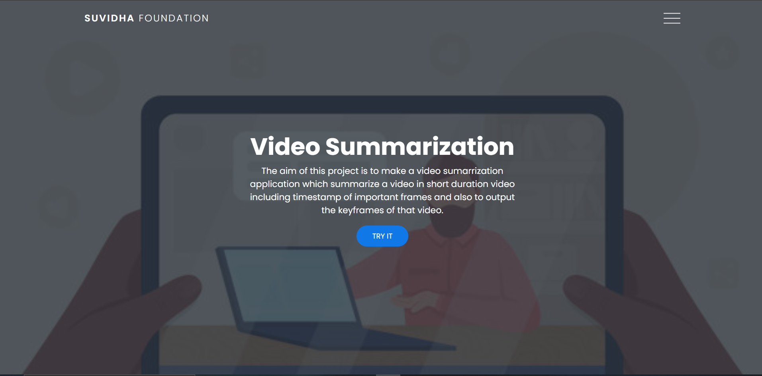

Slide 9
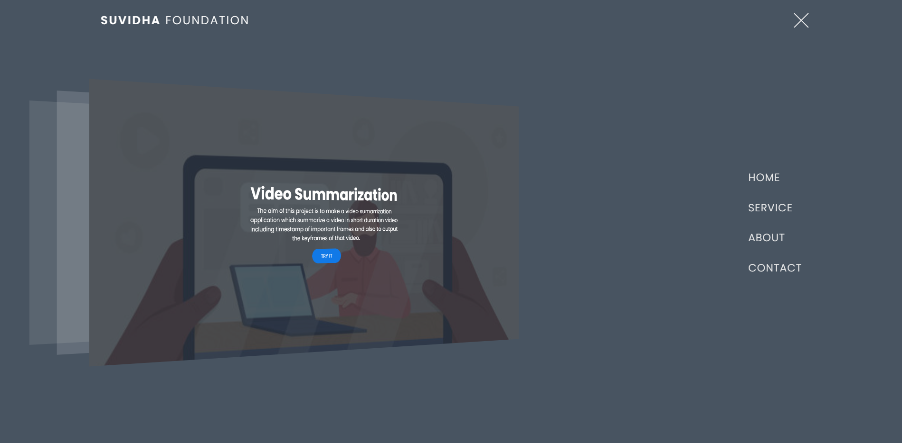

Slide 10
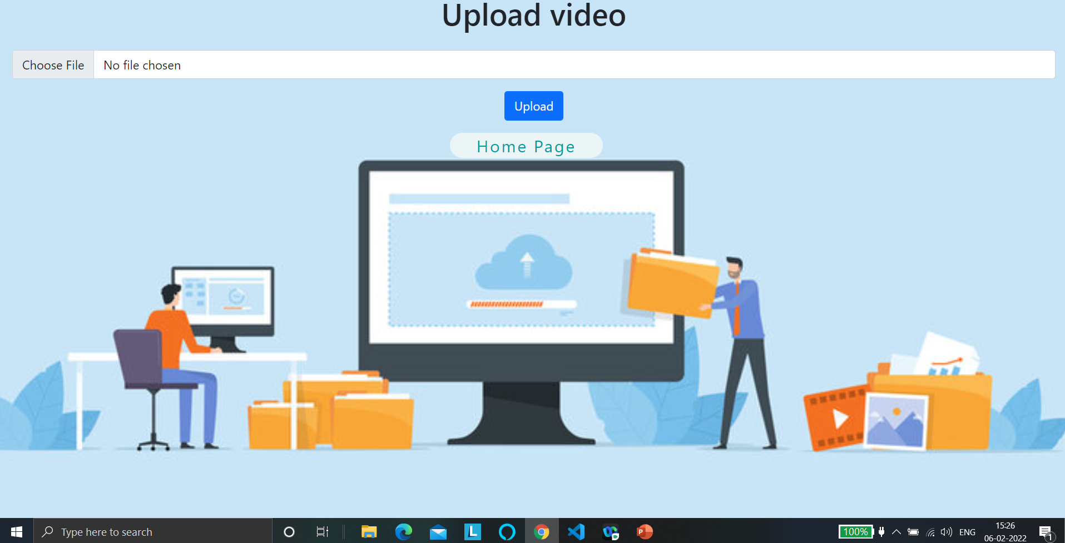

Slide 11
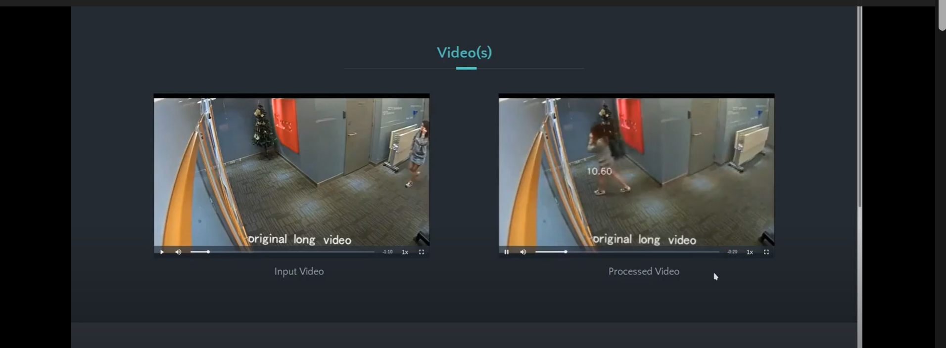

Slide 12
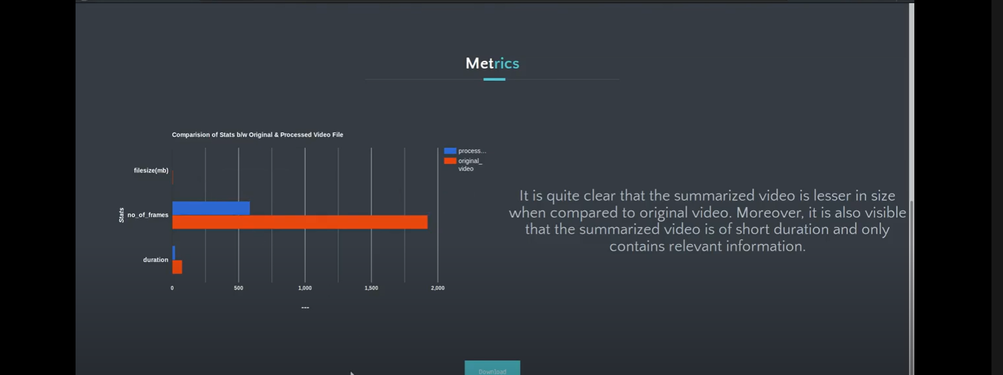

Slide 13


Slide 14
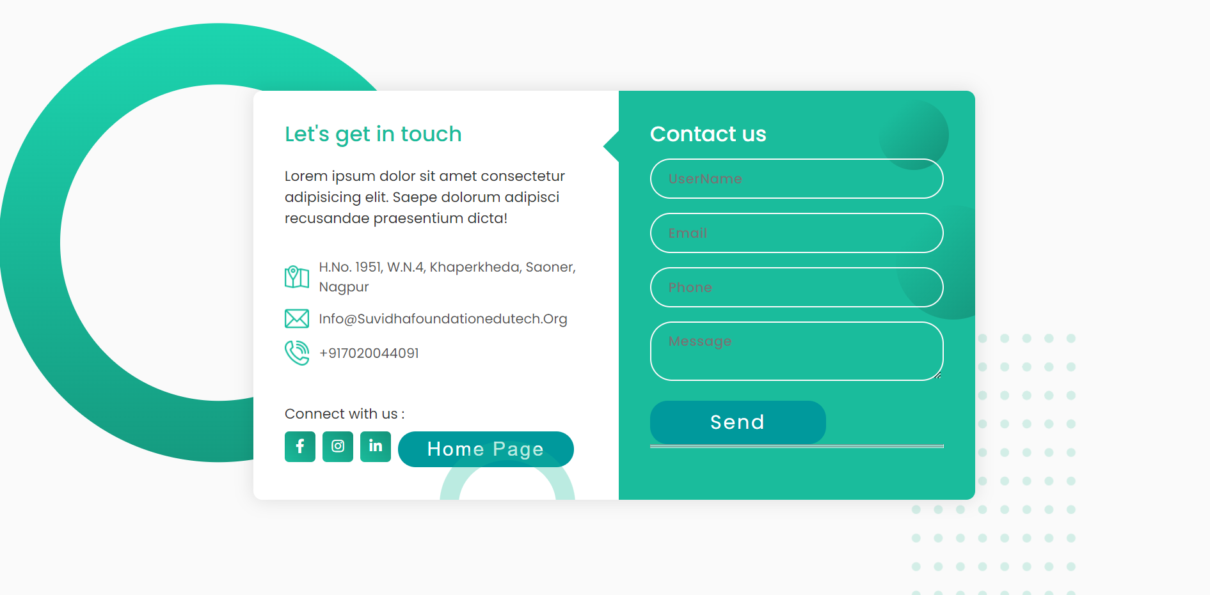

Slide 15
References
https://flask.palletsprojects.com/en/1.1.x/patterns/fileuploads/
https://roytuts.com/upload-and-display-image-using-python-flask/
https://towardsdatascience.com/building-a-web-application-to-deploy-machine-learning-models-e224269c1331

