Slide 1

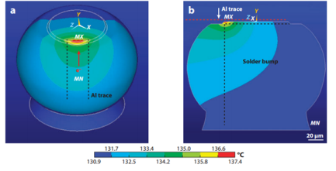
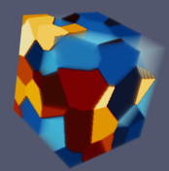
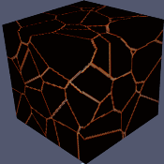

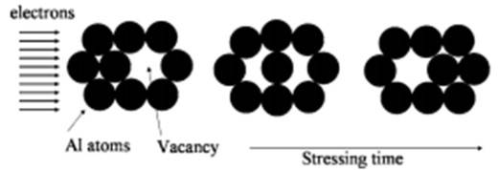
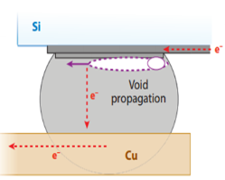
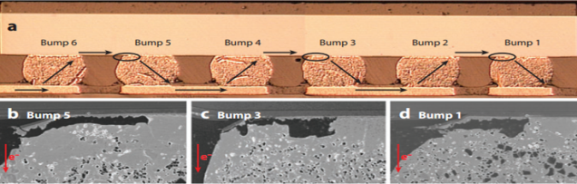
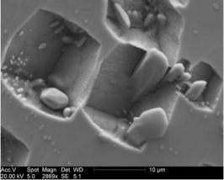
3D modelling of void formation due to electromigration in Pb-free Sn solders.
Deepak Karunakaran, Materials Science & Engineering, Complex Materials Research Group, Arizona State University
Objective: Physics based microstructure evolution modeling of void formation due to electromigration in lead free solders.
Task 1: Develop a model of void formation that takes into account Grain boundary diffusion and grain boundary diffusion coefficients.
Electromigration(EM) has been the most persistent reliability issue in interconnects of microelectronic devices
Using Kinetic Monte-Carlo Potts Model and simple physics based modelling techniques we propose a model for EM damage in lead free solders.
A 3D model of electro-migration void features is created in a purely stochastic mesoscale structure representing lead-free tin solder through microstructural evolution and diffusion of vacancies.
Simulated temperature distribution over an entire solder bump
The model is verified through comparing the features in the virtual microstructure to results from previous experimental studies
Motivation:
Increased miniaturization of semiconductor devices causes higher temperature in the metal interconnects, typically resulting in EM failures
Mass transportation of atoms driven by the momentum exchange between a high density of moving charge carriers and diffusing atoms resulting in the accumulation of vacancies on the cathode end of the interconnection.
Unknown characteristics such as formation of Kirkendall voids in Pb free Tin solders that are replacing Pb based solders in microelectronic industry due to environmental concerns.
Preferential clustering was observed at the cathode end in the 3D model. The vacancies tended to diffuse toward the cathode end, forming large clusters .
Task 2: Systematic calibration of the model to tune the parameters to obtain results in reasonable length and time scale.
Task 3: Investigate of effect of grain-parameters on void morphology
Different microstructures ideally show different void formation behavior. The idea is to reconstruct 3D alloy microstructures having different grain size, grain orientation and other grain parameters.
After microstructural evolution, morphology of voids in lead free solders having different grain parameters can be studied.
The ”parameters” that favor reduction in electromigration damage can be determined. These conditions can be used in practical solder design to minimize electromigration damage and improve solder life.
The reconstructions can be used for subsequent physics-based numerical analysis to study mechanical performance of alloys with different microstructures.
Goal: To observe robust void formation after setting realistic physical parameters such as Temperature, Current Density and Diffusion Coefficients that are scaled for the model.
Cross section of solder joint showing pancake type void formation at upper interface due to EM
Crystallographically faceted voids (CFV) in the microstructure of lead-free solder joints.
SEM cross-sections showing void formation.

