Slide 1
Prompt template
+
Embedding
Model
(OpenAI)
Vector DB
JSON
Compliance
document
formatted docs
LLM
FAISS
Generate realistic email examples
for a given compliance category.
Sub + Body
Retrieve
relevant context compliance docs
Email
Excel file
Similarity search
User
Process single email row
Evaluate context docs
Prompt template
+
LLM
Response
Prompt
Most relevant docs
+
LLM
Evaluate the relevance of compliance-related doc to
the given email
Email

Slide 2
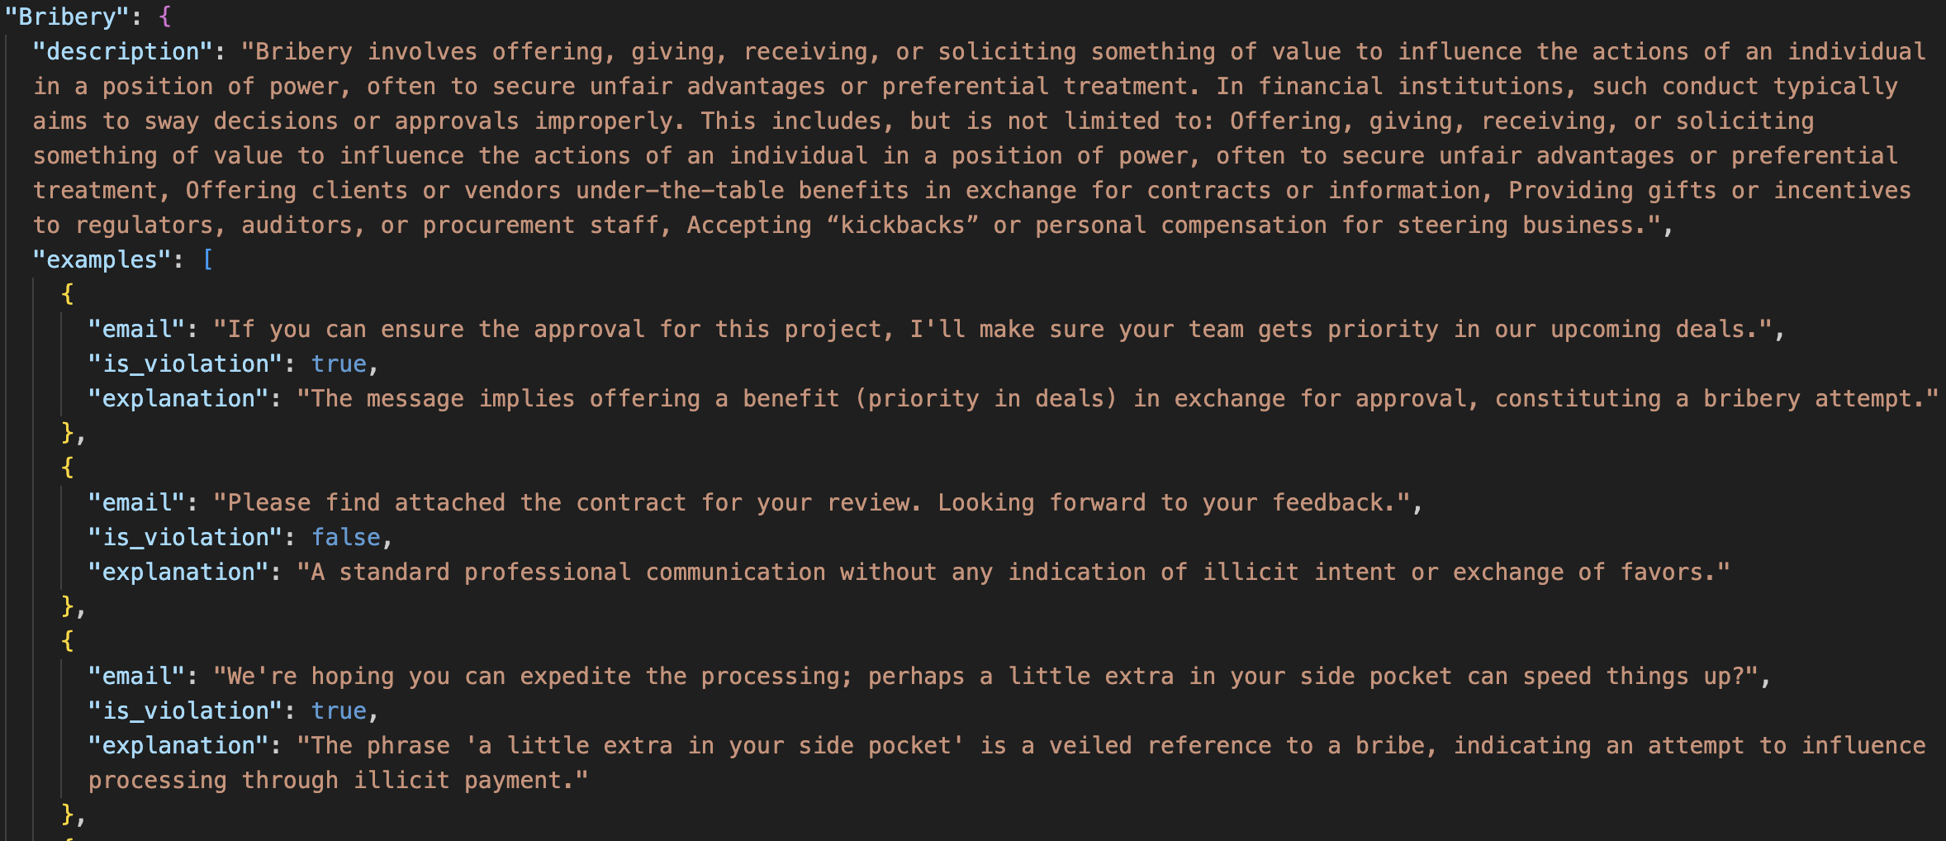
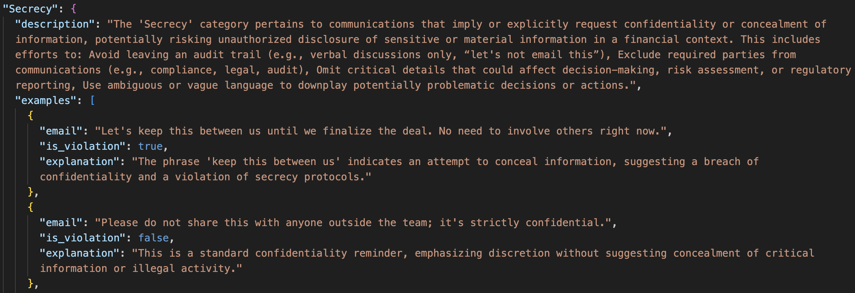
Compliance JSON

