Slide 1
Phpmyadmin
create a Database [database=youtube]
create a table [table=register]
create 7 columns
(1)id
(2)username
(3)password
(4)gender
(5)email
(6)phoneCode
(7)phone

Slide 2
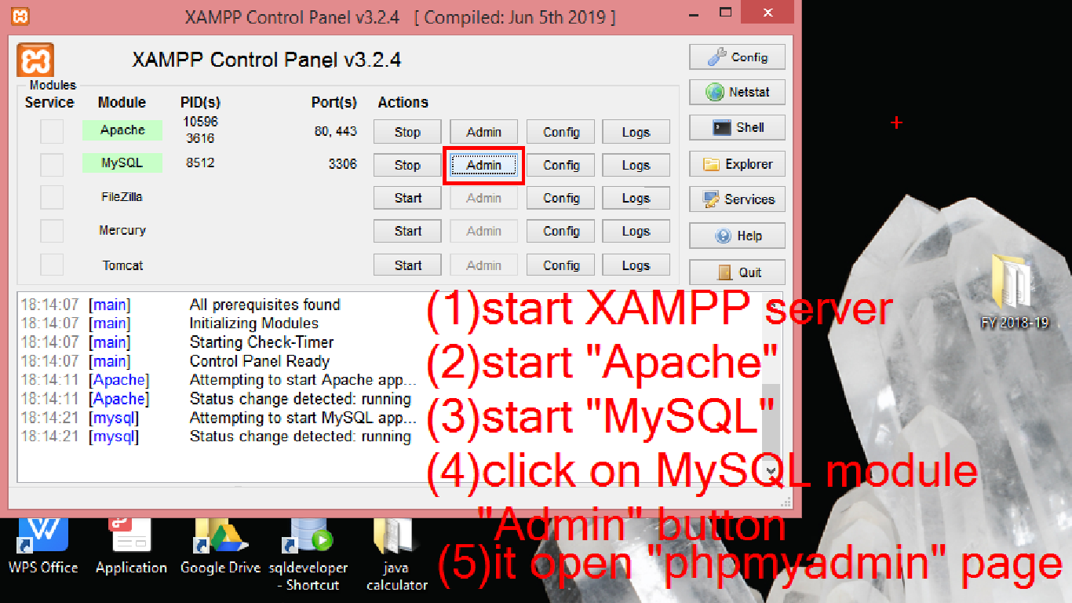

Slide 3
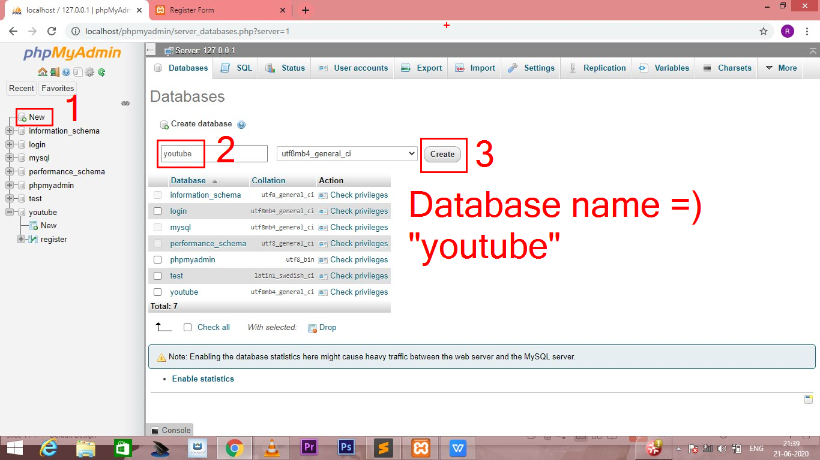

Slide 4
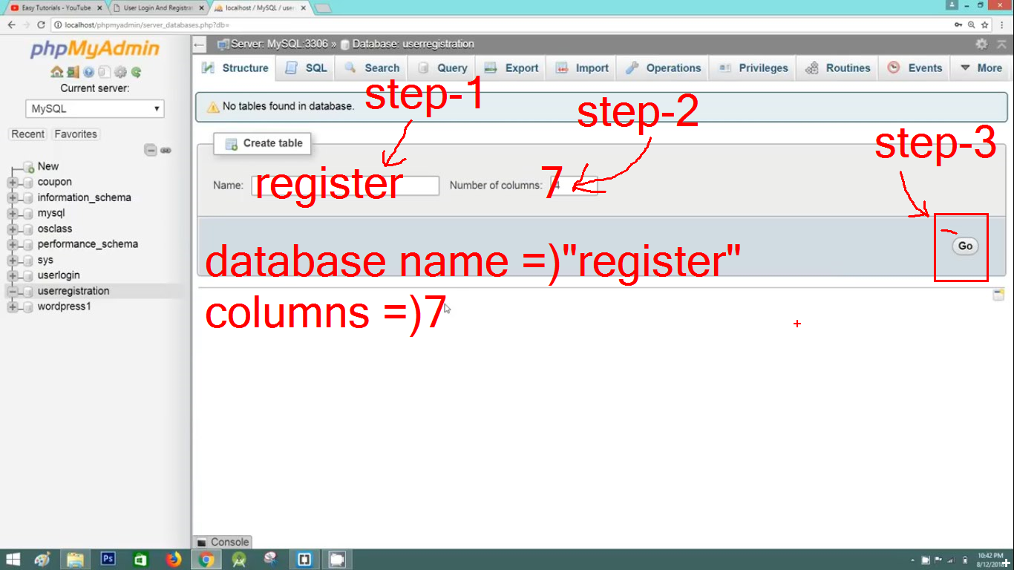

Slide 5
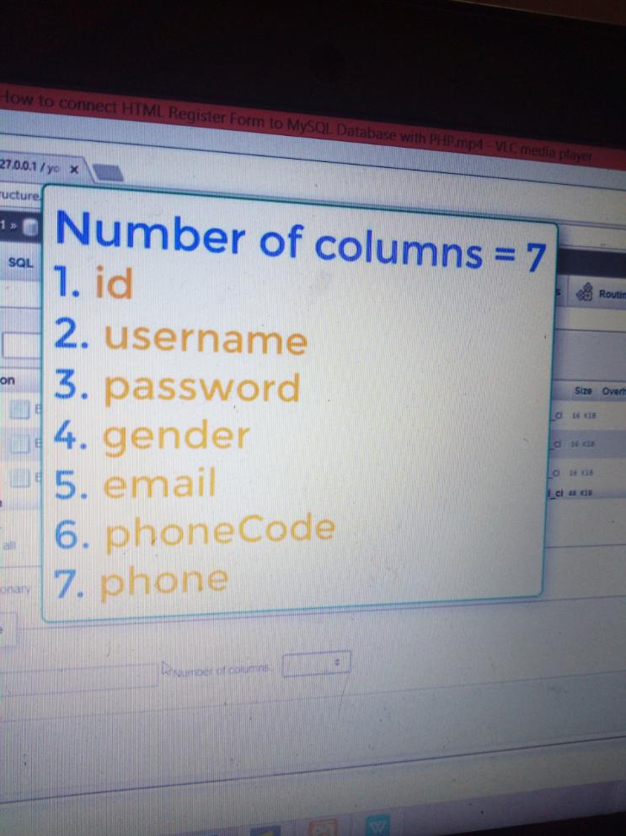
column name on your table

Slide 6
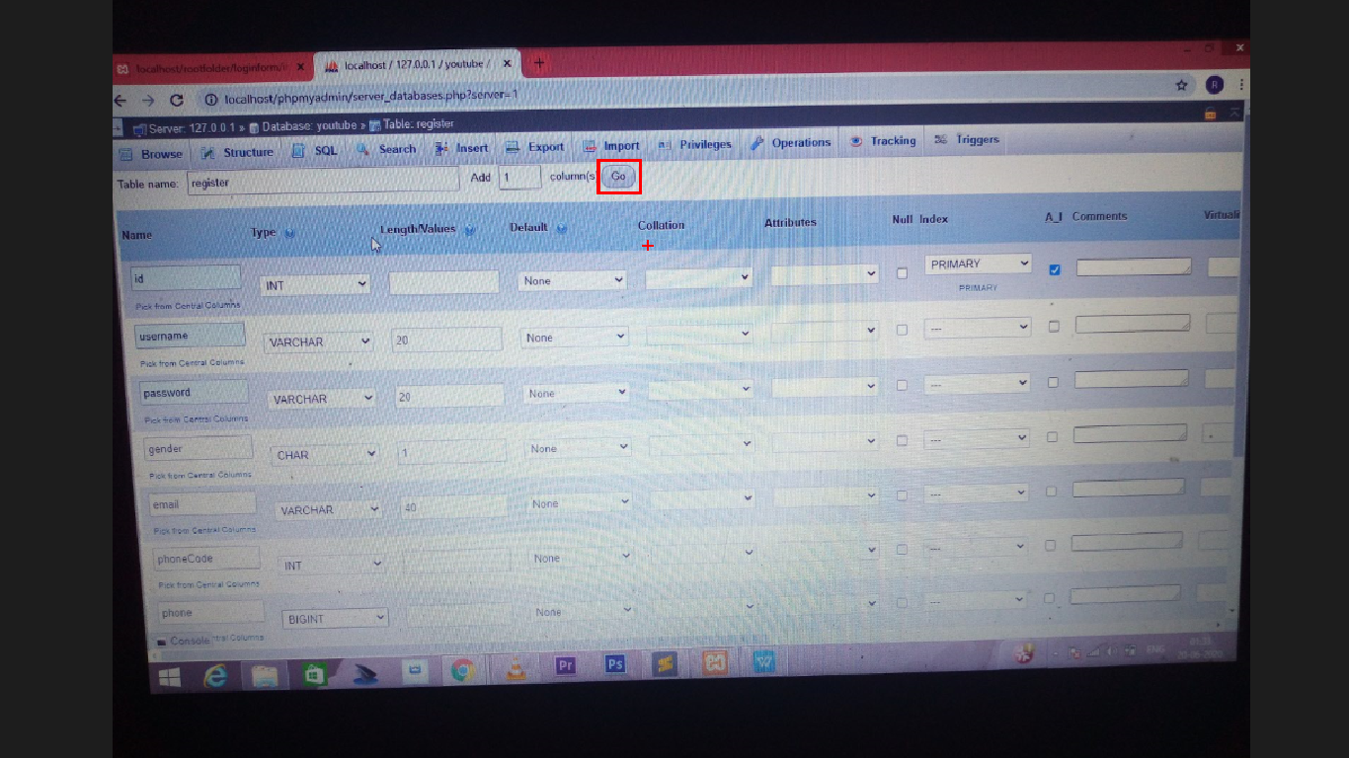
table data

