Slide 1


SATWA 2026
TITLE : Engineering Resilience - Designing for Uncertainty
TITLE PAGE
Problem Statement Title – SmartGIG : A Freelancing Platform for Modern Workforce Management
Team Name – TECH PANTHOMS
College Name – BANNARI AMMAN INSTITUTE OF TECHNOLOGY
College Address – Bhavani State Highway, Alathukombai Post, Sathyamangalam, Erode District, Tamil Nadu, 638401
@SATWA 2026 - Template

Slide 2
SATWA 2026
TITLE : Engineering Resilience - Designing for Uncertainty
PROBLEM STATEMENT
The Freelancing Ecosystem Has Structural Trust Gaps
The global freelance economy is growing rapidly but current platforms still struggle with:
Financial disputes take weeks to resolve, causing income instability.
Fake profiles and multi-account fraud reduce platform integrity.
Skill claims are rarely verified before hiring.
Reputation systems rely on single ratings that are easy to manipulate.
Clients face uncertainty when hiring unknown talent.
Freelancers face burnout due to hidden workload expectations.
@SATWA 2026 - Template

Slide 3
SATWA 2026
TITLE : Engineering Resilience - Designing for Uncertainty
ABSTRACT
SmartGIG is a resilient freelance marketplace designed to reduce systemic risk in digital work ecosystems. Traditional platforms rely heavily on reactive moderation and single-dimensional reputation systems, leading to disputes, fraud, burnout, and financial instability. SmartGIG introduces adaptive risk-mitigation mechanisms including escrow-backed milestone payments, 48-hour dispute resolution, device fingerprinting for ban-evasion detection, proof-of-work hiring trials, and multi-dimensional reputation scoring. By combining transparent workload tracking with secure communication infrastructure, the platform enhances trust, accountability, and fairness. SmartGIG redefines freelancing as a protected, measurable, and growth-oriented digital collaboration environment.
@SATWA 2026 - Template

Slide 4
SATWA 2026
TITLE : Engineering Resilience - Designing for Uncertainty
PROPOSED SOLUTION
SmartGIG is a human-centric, risk-mitigated freelance platform designed to reduce fraud, disputes, burnout, and hiring uncertainty through structured safeguards. Unlike traditional platforms that focus primarily on transaction facilitation, SmartGIG integrates structured financial protection (escrow with rapid dispute resolution), workload transparency controls to prevent freelancer exploitation, proof-of-work hiring mechanisms to validate skills before long-term engagement, and multi-dimensional trust scoring that evaluates reliability beyond simple star ratings.
It integrates:
Client-posted jobs (like Upwork)
Freelancer-posted opportunities (like Fiverr)
Adaptive security and transparency mechanisms
@SATWA 2026 - Template

Slide 5
SATWA 2026
TITLE : Engineering Resilience - Designing for Uncertainty
Technical & Structural Implementation
Financial Resilience
Escrow-based milestone payments
Automated release on approval
48-hour structured dispute resolution
Risk Mitigation Layer
Device fingerprinting (ban evasion detection)
Multi-layer violation tracking (transparent strike system)
Behavioral monitoring for fraud detection
Communication Infrastructure
Real-time messaging
Secure audio/video calls (WebRTC-based)
NDA support & milestone documentation
Trust & Transparency
Multi-dimensional reputation (delivery, communication, fairness)
Visible freelancer workload capacity
Proof-of-work hiring via paid trial tasks
@SATWA 2026 - Template

Slide 6
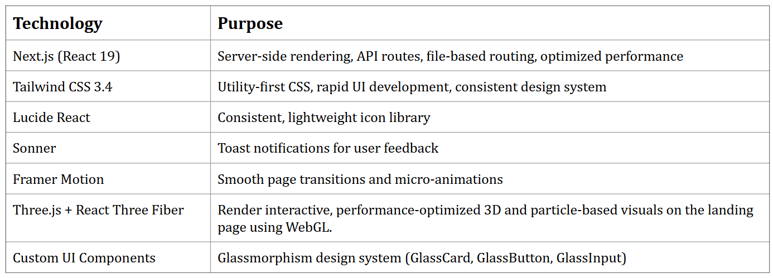
SATWA 2026
TITLE : Engineering Resilience - Designing for Uncertainty
TECHNICAL APPROACH
Frontend Technologies
@SATWA 2026 - Template

Slide 7
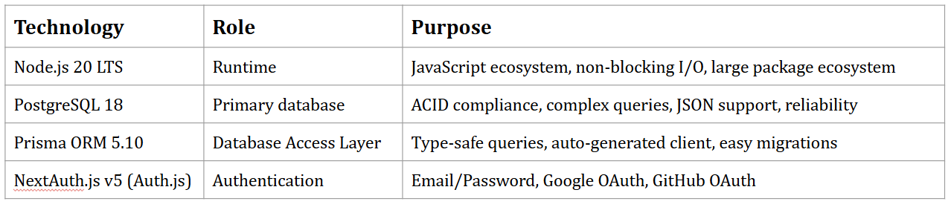
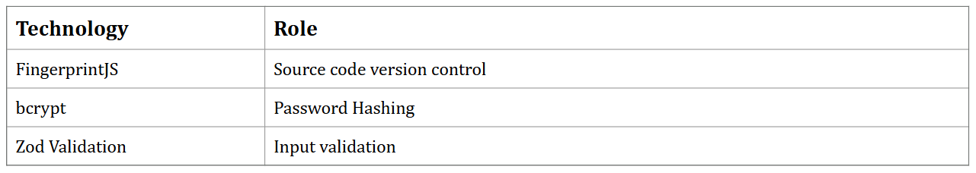
SATWA 2026
TITLE : Engineering Resilience - Designing for Uncertainty
Backend Technologies
Security Components
@SATWA 2026 - Template

Slide 8
SATWA 2026
TITLE : Engineering Resilience - Designing for Uncertainty
SOCIAL IMPACT AND BENEFITS
Social Benefits
Builds trust between freelancers and clients
Promotes fair evaluation and transparent communication
Protects individuals from exploitation and hidden penalties
Economic Benefits
Lower platform fee (10%) increases freelancer earnings
Faster dispute resolution reduces financial uncertainty
Proof-of-work hiring reduces costly hiring mistakes
Transparent strike system prevents unfair permanent bans
Digital & Community Resilience
Multi-layer fraud detection improves platform safety
Transparent workload system prevents oversubscription
Reputation analytics encourage long-term sustainable careers
@SATWA 2026 - Template

Slide 9
SATWA 2026
TITLE : Engineering Resilience - Designing for Uncertainty
CONCLUSION
SmartGIG is a technically feasible and scalable solution built using proven modern web technologies and secure system design principles. By integrating escrow protection, device fingerprinting, multi-dimensional reputation scoring, and transparent workload visibility, the platform directly addresses the trust, fraud, and communication gaps present in traditional freelancing marketplaces. While challenges such as market competition, dispute handling efficiency, fraud prevention at scale, and infrastructure scalability exist, these risks are mitigated through structured dispute workflows, behavioral risk detection, and cloud-ready modular architecture. Moving forward, the platform can launch through a controlled pilot phase, continuously optimize performance and security, and expand toward building a resilient, transparent, and community-centered freelancing ecosystem.
@SATWA 2026 - Template

