Slide 1

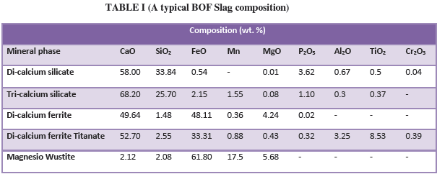
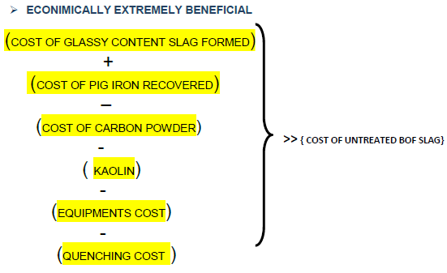
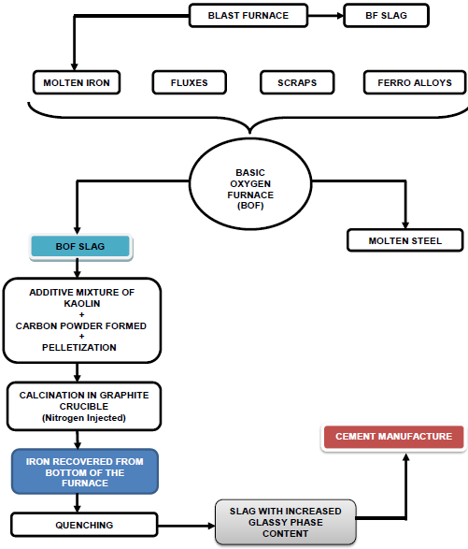
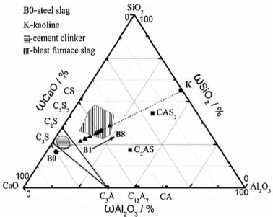
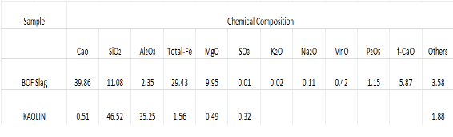
INCREASING THE GLASSY PHASE CONTENT OF BOF SLAG
Vishakha Singh , Mansi
NIT Jamshedpur
ABSTRACT
Quenching:
BOF slag is the main by-product from primary steelmaking. The cementitious nature of silicates in the BOF slag suggests that it is possible to use it in cement making application. The problems with BOF slag is that it has much higher basicity than blast furnace slag as it contains free lime and has poor volumetric stability. However, more pressing issue is the strong crystallization ability of the high basicity BOF slag leaves the glassy formation of the slag a challenge. Even under rapid cooling condition, the major phase is di-calcium silicate (C2S) and the glass phase is hardly formed. In this poster we will discuss ways to increase glassy phase content in the BOF slag, along with what is BOF slag, the different ways of recycling, problems faced in using crude BOF slag, recovery of beneficial minerals and heat treatment processes and overall benefits.
Problems faced in Cement Manufacturing:
BOF slag has much higher basicity than blast furnace slag as it contains free lime and has poor volumetric stability. In addition BOF Slag contains 10 -35% iron oxides, which considerably lowers its reactivity. Therefore, BOF Slag has received limited attention in cement manufacturing and concrete mixtures. Also dumping of BOF Slag leads to huge waste of iron due to high iron oxide percentage
This now quenched by pouring into water immediately. The extent of glassy phase formed in the residue now increases to more than 95% and can be used as an active supplementary cementitious material. The glassy phase Si-O-M⁺ (M= Ca, Mg, Na, K) in the residues were generated.
Equipments:
Graphite Crucible Furnace
Quenching Chamber
Nitrogen pumping equipment
OVERALL PROCESS BENEFITS
Process Route Throughout
Additive Mixture plus Pelletization:
KAOLIN (a chemical mixture of more than 45% SiO2 and about 35% Al2O3 along with small amounts of other compounds) is added to the slag mixture to bring BOF Slag closer to BF Slag in the CaO – SiO2 – Al2O3 ternary phase diagram.
Fig I: CaO – SiO2 – Al2O3 ternary phase diagram
STATEMENT OF RESEARCH QUESTION
BOF slag is the main by-product from primary steelmaking. Disposal of huge amount of BOF slag and its effective utilization is the main concern for the steel industry. The cementitious nature of silicates in the BOF slag suggests that it is possible to use it in cement making application. The glassy phases present in the solidified BOF slag has more hydration potential compared with the crystalline phases. However, the strong crystallization ability of the high basicity BOF slag leaves he glassy formation of the slag a challenge. Even under rapid cooling condition, the major phase is di-calcium silicate (C2S) and the glass phase is hardly formed. So, we are searching a method to increase glassy content in the BOF slag.
KAOLIN also acts as an efficient regulator to modify the viscosity and
melting Temperature of the residue melt.
Depending on BOF slag, KAOLIN added keeping R of the mixture between 1 and 1.30 which is close to BF slag.
Therefore the benefit of BOF slag treatment for outweighs the direct sale of BOF slag.
ENVIRONMENTALLY VIABLE ALTERNATIVE
SIMPLE AND EFFICIENT PROCESS- PRACTICALLY VIABLE
CONCLUSION
As the basicity decreases due to the iron recovery, the glass phase content increases. Also, the residues obtained are much more reactive and therefore could be used as a supplementary cementitious material. The overall benefits of the process for outweighs that of direct selling of BOF Slag for dumping process.
METHODOLOGY
Topic of concern: BOF slag
It basically consists of three major phases, namely, dicalcium silicate(2CaO.SiO2), dicalcium ferrite (2CaO·Fe203) and magnesio-wustite [(Fe,Mg.Mn)O]. At higher basicities, tricalcium silicate (3CaO.SiO2) and lime (CaO).
Why the need for glassy phase content?
BOF Slag is a by-product of steel industry and is essentially oxidizing in nature. BOF Slag accounts for 15 – 20% of the total final volume of crude steel.
BOF Slag can be used for soil remediation, waste water treatment, CO2 capture etc. but it has not been extensively used for this purposes.
BOF slag can be easily used in construction purposes, especially in cement manufacturing.
Table II: Chemical Composition of Kaolin
Calcination:
Mixture is pressed into pellets under required pressure.
The total mass of the pellets are taken in the graphite crucible and calcine in an atmospheric furnace in which Nitrogen is continuously purged. The temperature of the furnace is kept around 1500⁰ C (above the melting point). Where it should be maintain for one hour.
Iron Recovery:
Iron recovery ensures two main purposes
1. Decrease the basicity, thus increasing the glass content. 2. Soluble iron in form of pig iron is recovered.
ACKNOWLEDGMENTS
We would like to acknowledge the help and guidance provided to us by our respected professors. We are also thankful to our seniors and friends for their constant support during the making and completion of this poster.

