Slide 1
Drashti
A Network monitoring Tool
Project for IX Sem MCA
Submitted To : Prof. Jugendra Dongre
Submitted By : Deepak JOSHI
IC-2K16-14

Slide 2
Introduction
Monitoring an active communications network in order to diagnose problems and gather statistics for administration and fine tuning.
Includes operation needed to run network services smoothly.

Slide 3
Goal
Monitor Every Device on the Network and show Complete Information in Real Time.
Fault Monitoring of essential resources.
Send important alerts to admin via email.

Slide 4
Importance of Network monitoring
Fault Network Devices can be detected through early detection.
Server Downtime can be reported immediately.
Detailed Statistics on a single Platform

Slide 5
Features
Monitoring the essentials
Listing Entire Infrastructure
Keep Track of outages
Helps to Fix Issue
Provide real time Information
Visualization
Helps to Manage Growing Network

Slide 6
Requirements
Hardware Requirement
Dual Core Processor
1 GB Primary Memory
16 GB Secondary Memory
Software Requirements
-Operating System ( Linux or UNIX based)
- Web Browser for Client
- Required Frameworks

Slide 7
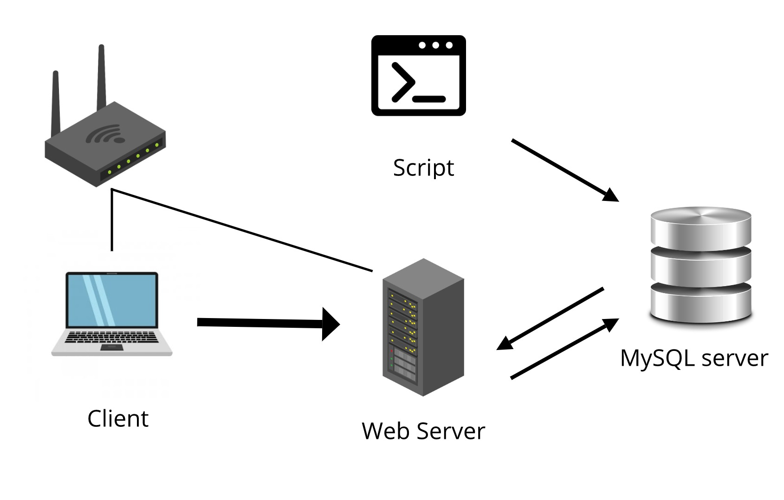
Design

Slide 8
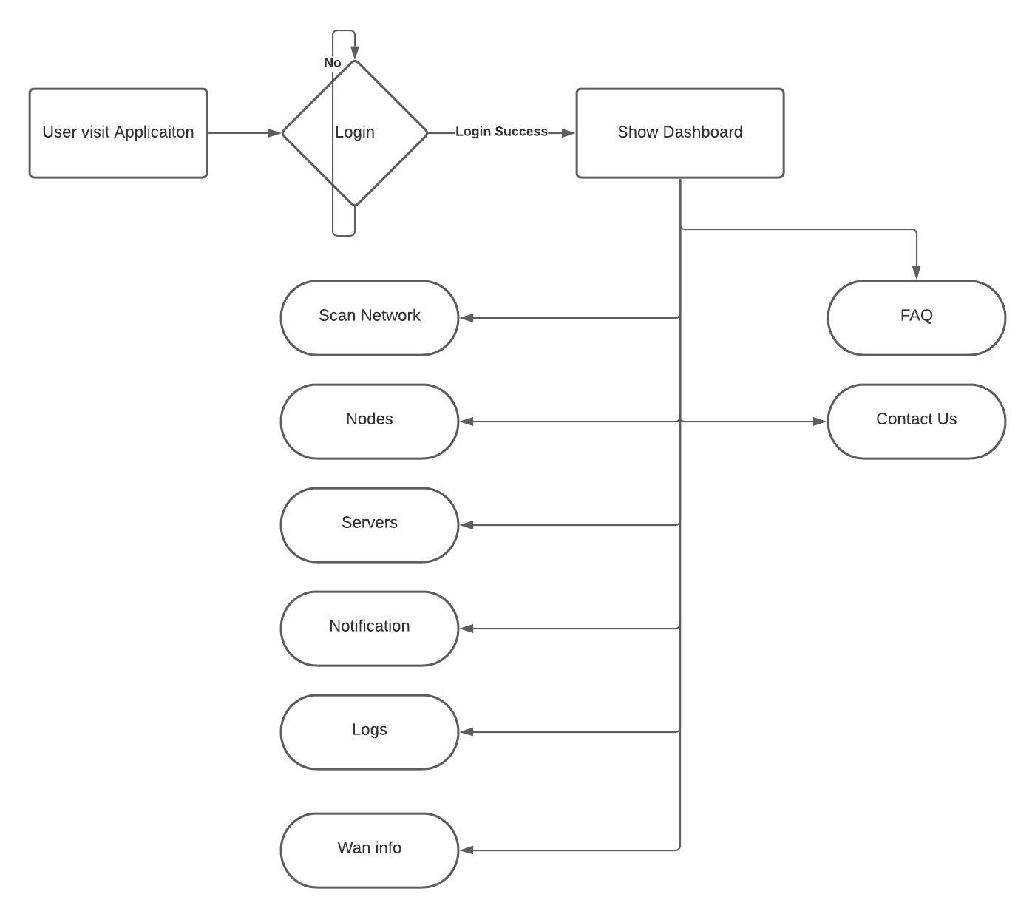
User Workflow

Slide 9
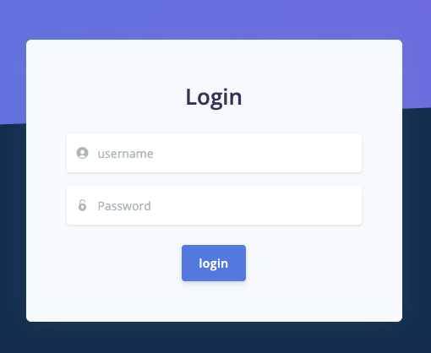
Demo
Login

Slide 10
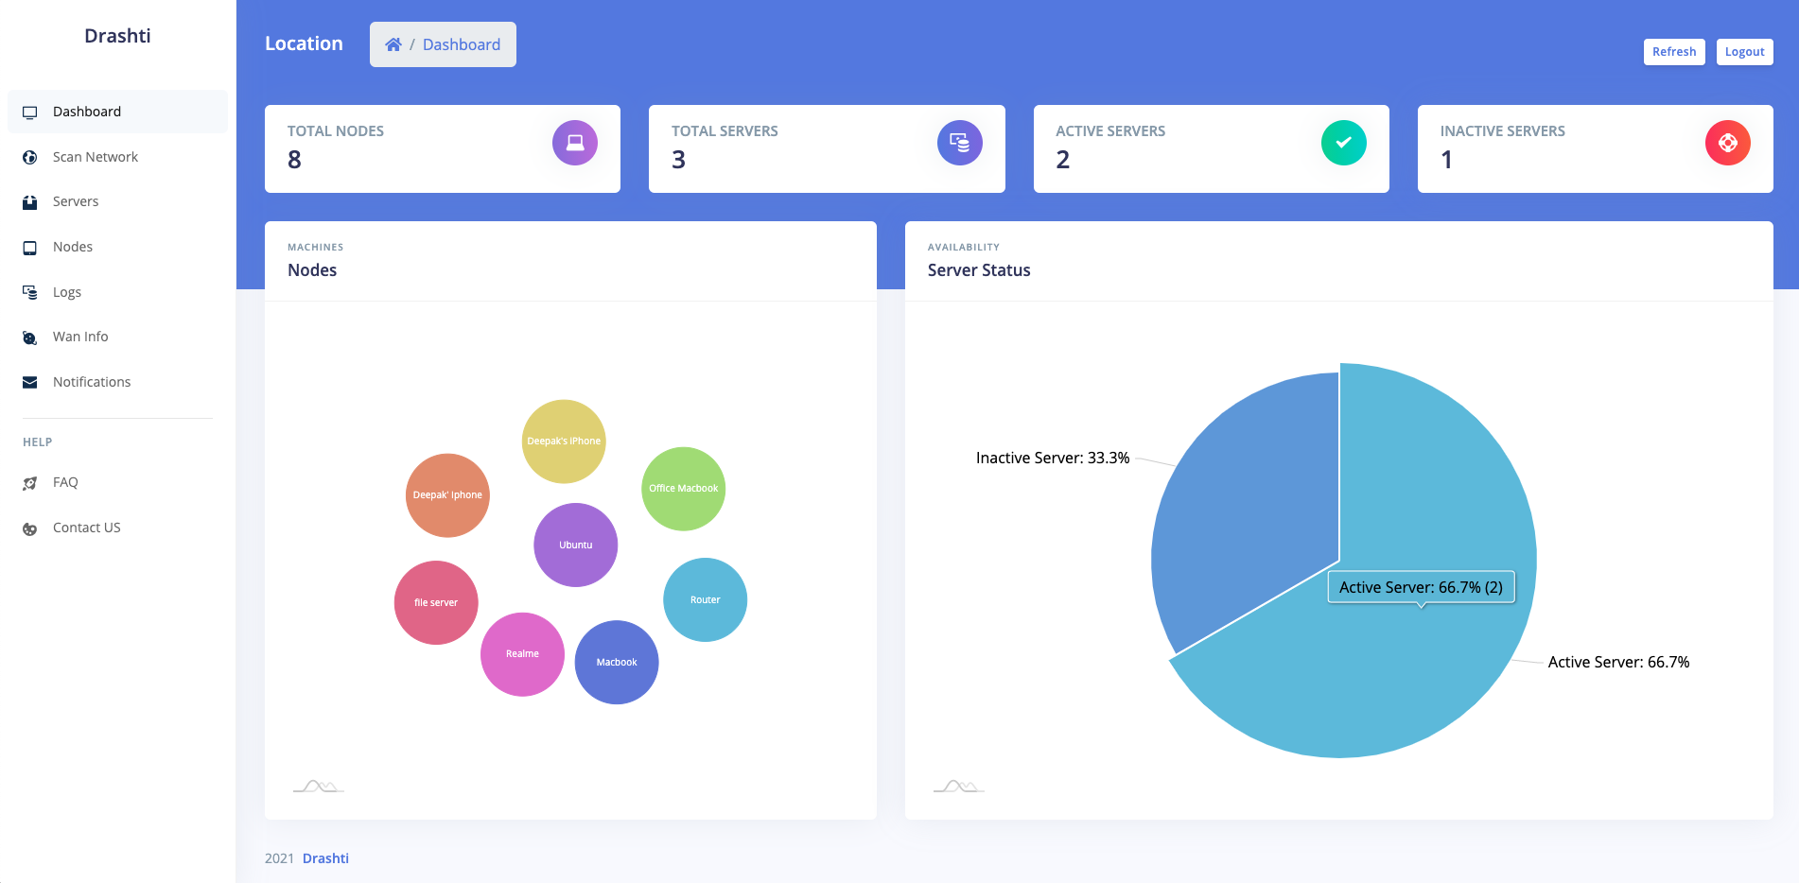
Dashboard

Slide 11
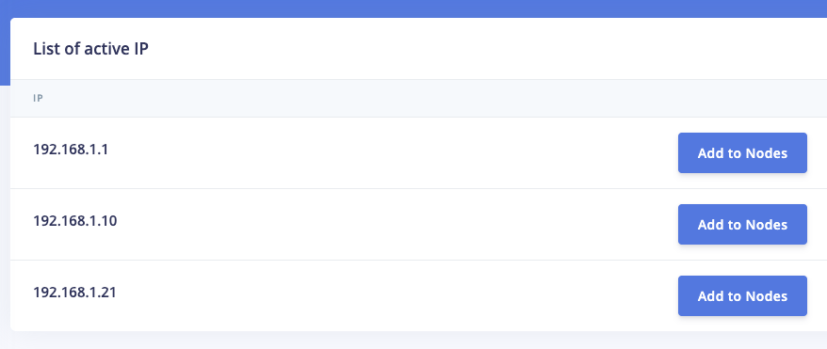
Scan Network

Slide 12
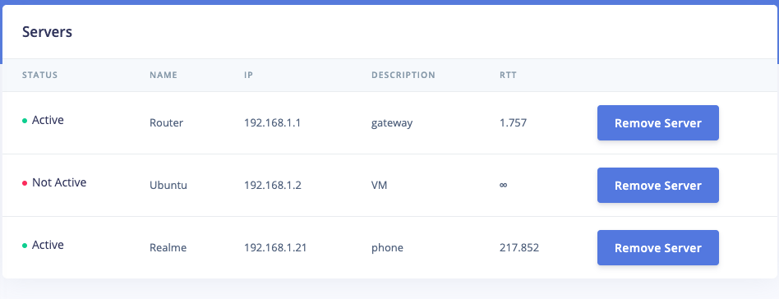
Servers

Slide 13
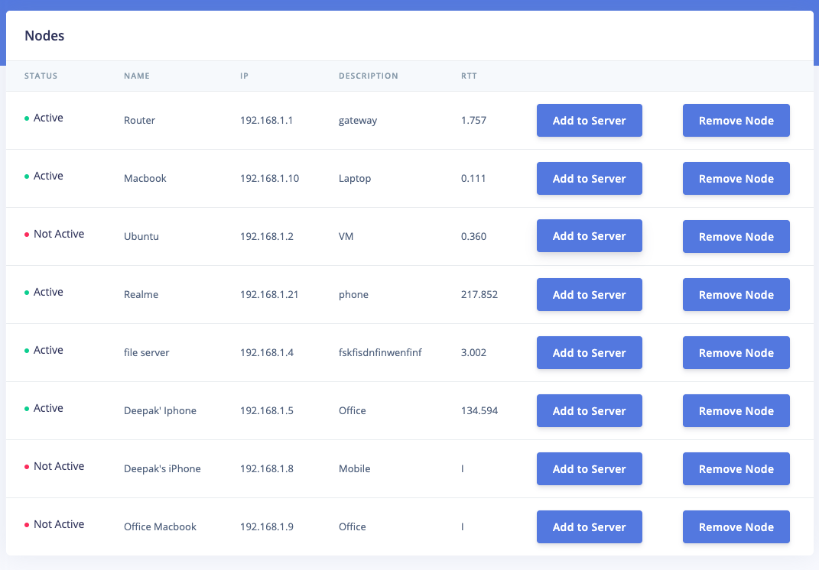
Nodes

Slide 14
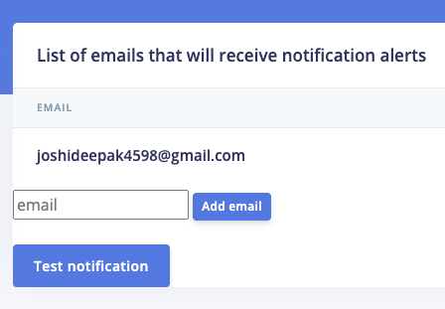
Notification

Slide 15
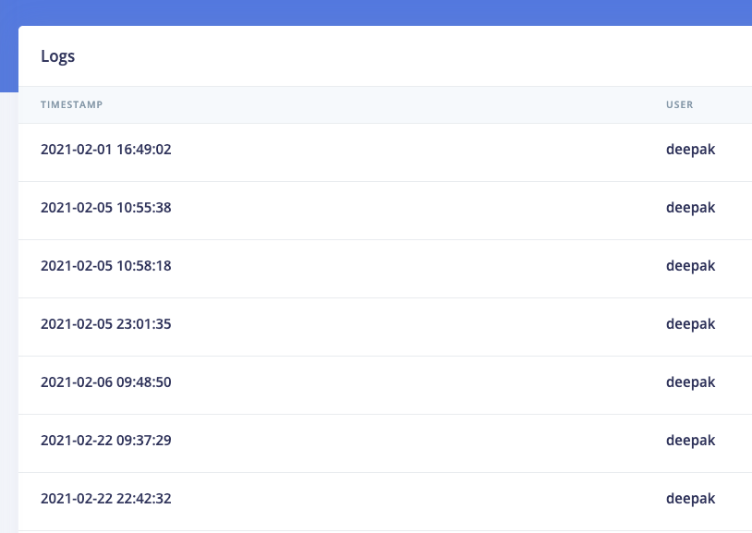
Logs

Slide 16
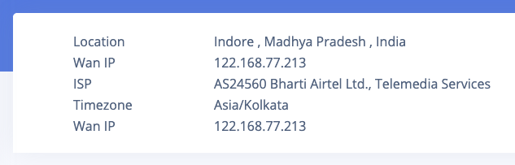
WAN info

Slide 17
Conclusion
Monitoring is the only way to find out whether the network in functioning according to plan.
This application provide all the information of devices.
The outcome is wide range of useful data.
These data can be used to provide statistical report.
Ultimately helps to make network more efficient for use.

