Slide 2
General Categories of Weaknesses (aspects)
Activity flow
Infrequent variant (%2)
Self loop
Loop with specific length (4)
Missing the frequent activities (Important act, threshold)
Performance
Average case duration (Threshold)
Average activity duration
Average performance spectrum (a,b)
Number of cases in a queue for a activity

Slide 3
Table of incidents at the case level
Detected Weakness Row | Case ID | Weakness Type (AF/PA) Activity-flow/performance aspect | Weakness ID (ID from the defined weakness) (1-9 for user define) (1-10 for automatic) | Weakness Origin (User/Auto) | Weakness Time (timestamp of happening) | Weakness information | Weakness Measurement
1 | Case10 | FA | 1 | User | 110/02/2020 12:20 | Unwanted activity “a” | Happened in the case
2 | Case 18 | Pa | 5 | Auto | 110/02/2020 12:20 | Long duration of the case | 20% longer than average case duration
3
4

Slide 4
Table of incidents at the Process Level
Detected Weakness Row | Weakness Type (AF/PA) Activity-flow/performance aspect | Weakness ID (ID from the defined weakness) (1-9 for user define) (1-10 for automatic) | Weakness Origin (User/Auto) | Weakness Time (timestamp of happening) | Weakness information | Weakness Measurement
1 | FA | 1 | User | 110/02/2020 12:20 | Unwanted activity “a” | Happened in the case
2
3
4

Slide 5
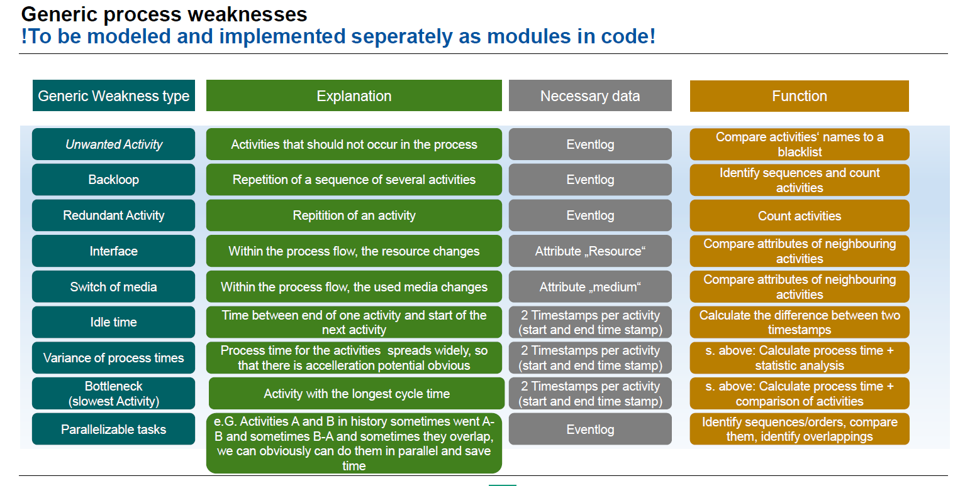

Slide 6
High level view
Weakness from rules(1-9)
Event Log
Merged data for representation
Weakness from automatic detection

