Slide 1

Joint Master Thesis - Modelling of production expertise to extend the data-driven analysis of process models
Supervisor:
Prof.Dr.ir. Wil van der Aalst
Advisors:
Mahsa Pourbafrani MSc
Marco Schopen MSc

Slide 2
Declarative process mining
http://ceur-ws.org/Vol-1021/paper_8.pdf ->Declarative Process Mining with the Declare Component of ProM
https://www.researchgate.net/publication/225792142_Declarative_workflows_Balancing_between_flexibility_and_support -> Declarative workflows: Balancing between flexibility and support
https://ieeexplore.ieee.org/stamp/stamp.jsp?tp=&arnumber=5949297 ->User-Guided Discovery of Declarative Process Models
https://link.springer.com/chapter/10.1007/978-3-642-32885-5_6 -> Aligning Event Logs and Declarative Process Models for Conformance Checking
https://link.springer.com/chapter/10.1007/978-3-540-85758-7_24 -> Efficient Compliance Checking Using BPMN-Q and Temporal Logic, page 326

Slide 3
Summary of the papers read
There is something called as the DECLARE templates that characterise the language and highlight different features which are worth being specified in a process model.
The templates are classified according to four groups: existence, relation, negative relation and choice.
Prom uses the Declare Maps Miner plugin to generate from scratch a set of Declare constraints representing the actual behaviour of a process as recorded in an event log.
The Declare Replayer and the Declare Diagnoser (Declare Checker package) can be used to check the conformance of the actual behaviour of a process as recorded in an event log with respect to a reference Declare model.
There is another approach to specify the constraints which is BPMN-Q. It is used to query business process models by matching a process graph to a query graph.

Slide 4
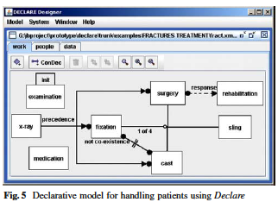
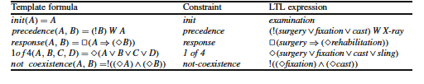
Declare

Slide 5
Possible implementation
Get all the constraints and convert it into Declare models or keep them in LTL representation as it gives more clarity on possible constraints.
Then we can choose to modify the existing PROM implementation or implement from the scratch the algorithm.
For simple constraints like A must not be followed by B, we can use the follows graph which is generated before the discovery of the model we can use the check there to raise a violation.

Slide 6

Code status
Explored the mining algorithms and their visualizations.
Also checked for performance analysis available in PM4PY.

Slide 7
Github

