Slide 1
Joint Master Thesis - Modelling of production expertise to extend the data-driven analysis of process models
Supervisor:
Prof.Dr.ir. Wil van der Aalst
Advisors:
Mahsa Pourbafrani MSc
Marco Schopen MSc

Slide 2
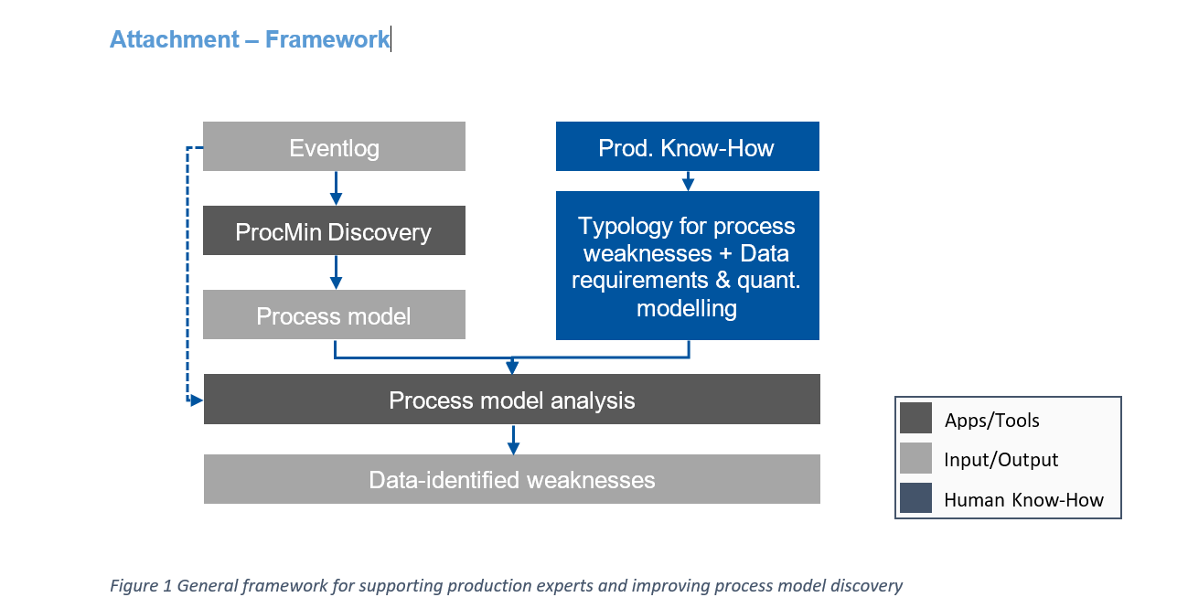
Problem understanding
Input : Event log, activity-flows/sequence of forbidden events from production line experts
Process:
1. Convert activity flow to process model(expert-negative-model) if it’s an event log and also keep it as sequence of events and convert it to event log notation.
2. Convert the given event log into process model(current- model)
3. Compare the 2 models to check if the current-model is satisfying the expert-negative-model and if yes note down the results as weakness.
4. Do a performance analysis on the current model and identify the outliers and report them as weakness as-well.
Output:
Discovered process model from the event log(current- model) + discovered process model from expert knowledge(expert-negative-model) + weakness identified in the discovered current-model.

Slide 3
Challenges / questions to be answered:
1. Can the activity flow be converted to a model/should the activity flow be kept as sequence of activities just like in an event log.
2. How can we compare 2 models / should the conformance checking of event log of experts be used to check on the current-model.
3. Can we include performance conditions from the experts and include them while reporting the performance analysis of the current model.
Possible solution: Apart from the forbidden sequence from the production experts we can collect the metrics separately so that we can compare with the current model’s performance.
Possible solution: Use the production sequence of events as input to conformance checking algorithms in pm4py:
We can use Footprints from pm4py to identify the sequence, parallel, start_activities, activities restrictions. This is for identifying the immediate activity anomalies.
We can also use the results from Alignments in pm4py to check if forbidden sequence of events fits in the given model.

Slide 4

Thank you for attention ☺
Deepak Sateesh (391813)

