Slide 1

Joint Master Thesis - Modelling of production expertise to extend the data-driven analysis of process models
Supervisor:
Prof.Dr.ir. Wil van der Aalst
Advisors:
Mahsa Pourbafrani MSc
Marco Schopen MSc

Slide 2
Implementation
Obtained petrinet from the dfg.
Challenge: Unable to find a function to visualize the petrinet by highlighting the edges violating it.
Possible solution: write our own visualization function.
Implemented duplicate search at trace level/cycle detection.
Created a framework wherein each function is called step by step via main function.

Slide 3
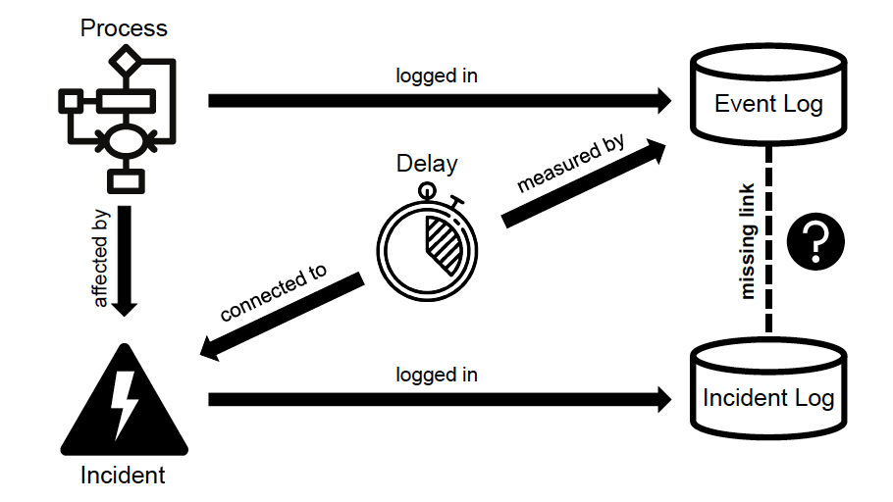
Paper for Estimating the Impact of Incidents on Process Delay

Slide 4

Further implementation
Try to set a parameter which says if that transition is violated and after the discovery try to color the violated constraints.
Based on this model try perform the analysis and see if further constraints are violated.
Use these to build a visualizer.

Slide 5

Thank you☺

