Slide 1

Joint Master Thesis - Modelling of production expertise to extend the data-driven analysis of process models
Supervisor:
Prof.Dr.ir. Wil van der Aalst
Advisors:
Mahsa Pourbafrani MSc
Marco Schopen MSc

Slide 2
Interactive process mining
https://www.win.tue.nl/~hverbeek/wp-content/papercite-data/pdf/dixit18.pdf ->Fast Incremental Conformance Analysis for Interactive Process Discovery
http://www.padsweb.rwth-aachen.de/wvdaalst/publications/p1004.pdf ->ProDiGy : Human-in-the-loop Process Discovery

Slide 3
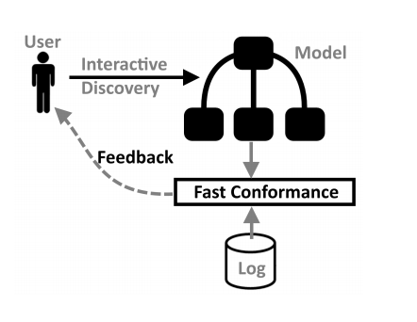
Summary of the papers read
Interactively choose the alternates based on conformance score and help to create the model.
Implementation in ProM.

Slide 4
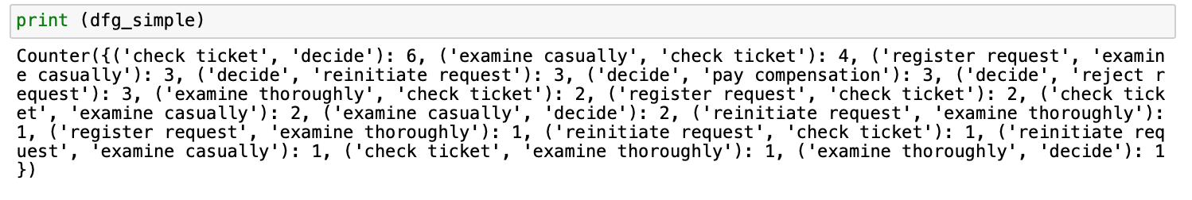
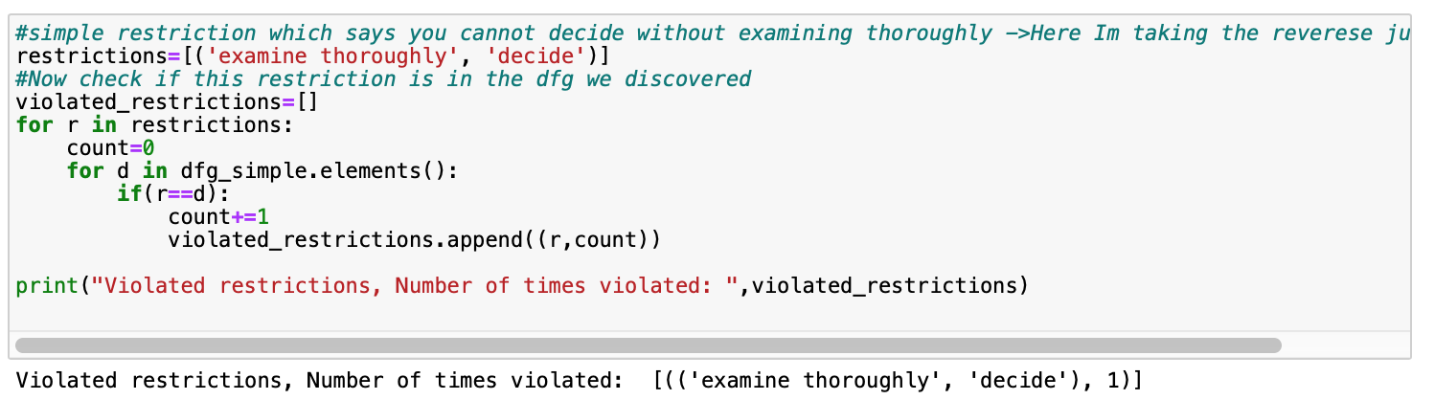
Implementation till now..
From the above DFG we make one of the transition as a restriction and write an algorithm to detect the violated
constraints as seen below ..

Slide 5

Further implementation
Use the DFG obtained and try to get the Petrinet using inductive miner algorithm.
Also try to set a parameter which says if that transition is violated and acter the discovery try to color the violated constraints.
Based on this model try perform the analysis and see if further constraints are violated.

Slide 6

Thank you☺

Slide 7
Github

